Slide 1
Project Presentation of CO-OP Project at Industry (Module-2) (22CS421)
On
Short-Term Stock Prediction Using News Sentiment Analysis Pari Gupta (2210990640)
Palkit Dhiman (2210990633)
Nikhil Guleria (2210990610)
Raghav Thakur (2210990701)
Supervised By
Dr. Gifty Gupta
Department of Computer Science and Engineering,
Chitkara University, Punjab

Slide 2
Introduction
Stock market prediction is complex and volatile
Traditional models rely on historical prices
External factors like news sentiment affect markets
Deep learning improves time-series forecasting
Goal: combine sentiment analysis with stock prediction

Slide 3
Objective
Combine technical indicators with news sentiment
Develop an LSTM-based prediction model
Improve short-term stock prediction accuracy
Compare hybrid model with baseline LSTM

Slide 4
Literature Review
Traditional ML models: regression, SVM, decision trees
LSTM performs well for sequential financial data
Sentiment analysis captures investor psychology
Hybrid approaches improve prediction accuracy
Need better integration of financial and textual data

Slide 5
Methodology
Data collection from Yahoo Finance and news sources
Preprocessing of stock and textual data
Sentiment analysis on financial headlines
Feature integration of technical + sentiment data
Training using LSTM deep learning model

Slide 6
Hybrid Deep Learning Model for Stock Price Prediction — Workflow
STOCK DATA PIPELINE
NEWS DATA PIPELINE
Data
Collection
Historical Stock Data
Financial News Data
Yahoo Finance (OHLCV)
Headlines & timestamps
▼
▼
Data Cleaning
Text Preprocessing
Normalize, handle missing
Tokenize, remove stop words
▼
▼
Technical Indicators
Sentiment Analysis
MA, RSI, MACD
NLP: +1 / 0 / −1 | Daily score
▼
Unified Feature Set
OHLCV + Technical Indicators + Sentiment Score
▼
LSTM Model
Train/Test
Input → LSTM Layers → Dense Output
Adam / MSE
▼
Stock Price Prediction
Direction (Up/Down) or Future Price
▼
Performance Evaluation
Accuracy · Precision · Recall · F1-score
Stock Pipeline
News Pipeline
LSTM Model
Evaluation

Slide 7
Data Preprocessing &Features
Technical indicators used: MA, RSI, MACD
News headlines cleaned and tokenized
Sentiment scores assigned as positive/neutral/negative
Daily sentiment scores aggregated
Combined structured and unstructured features

Slide 8
LSTM Model Architecture
Input layer with integrated features
LSTM layers learn temporal dependencies
Dense output layer for prediction
Adam optimizer used for training
Evaluation using Accuracy, Precision, Recall, F1-score

Slide 9
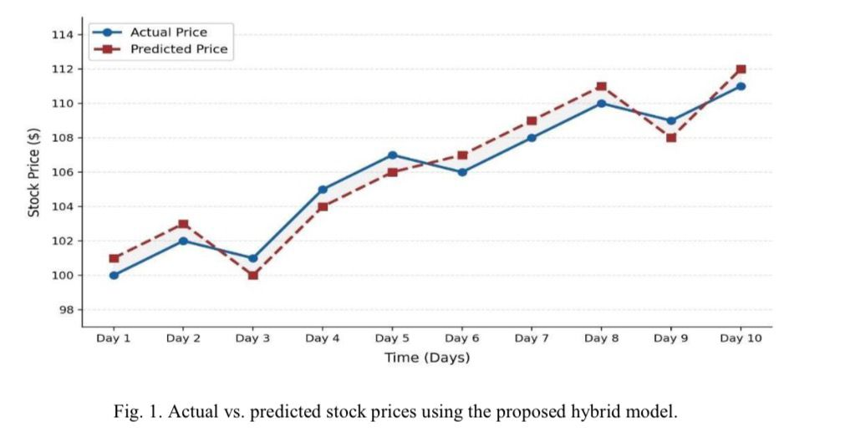
Results & Discussion
Hybrid model accuracy: 90%
Baseline LSTM accuracy: 84%
Sentiment features improved prediction quality
Model better captured market trends
More stable and consistent predictions observed

Slide 10
Limitations
Dependent on quality of financial news
Difficulty handling sarcasm and financial jargon
Focused mainly on short-term prediction
No real-time data integration
High computational requirements and overfitting risk

Slide 11
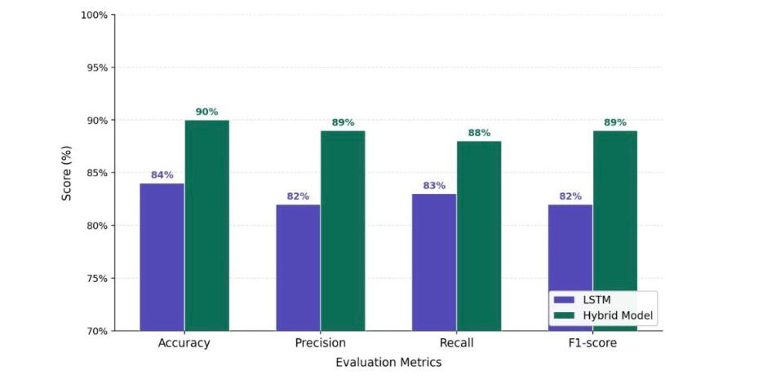
Conclusion
Hybrid model improves stock prediction performance
Combining sentiment and financial data is effective
LSTM captures temporal market behavior
Future work: transformers and real-time systems
Useful for smarter financial decision-making

Slide 12
Thank You

