Slide 1
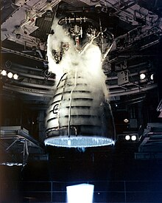
SPACECRAFT TURBOFAN ENGINE
Project on NASA’s CMPASS Dataset for RUL

Slide 2
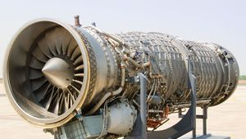
To move an airplane through the air, thrust is generated by some kind of propulsion system. Most modern airliners use turbofan engines because of their high thrust and good fuel efficiency.
A turbofan engine is the most modern variation of the basic gas turbine engine. As with other gas turbines, there is a core engine, whose parts and operation are discussed on a separate page. In the turbofan engine, the core engine is surrounded by a fan in the front and an additional turbine at the rear. The fan and fan turbine are composed of many blades, like the core compressor and core turbine, and are connected to an additional shaft. All of this additional turbomachinery is colored green on the schematic. As with the core compressor and turbine, some of the fan blades turn with the shaft and some blades remain stationary. The fan shaft passes through the core shaft for mechanical reasons. This type of arrangement is called a two spool engine

Slide 3
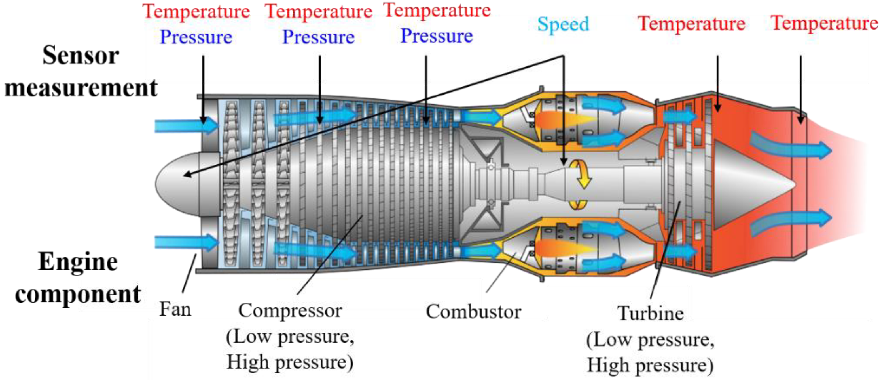

Slide 4
WORKING
The incoming air is captured by the engine inlet. Some of the incoming air passes through the fan and continues on into the core compressor and then the burner, where it is mixed with fuel and combustion occurs. The hot exhaust passes through the core and fan turbines and then out the nozzle, as in a basic turbojet. The rest of the incoming air passes through the fan and bypasses, or goes around the engine, just like the air through a propeller. The air that goes through the fan has a velocity that is slightly increased from free stream. So a turbofan gets some of its thrust from the core and some of its thrust from the fan. The ratio of the air that goes around the engine to the air that goes through the core is called the bypass ratio.

Slide 5
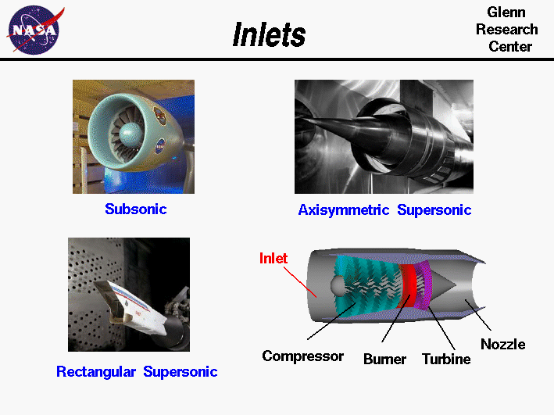

Slide 6
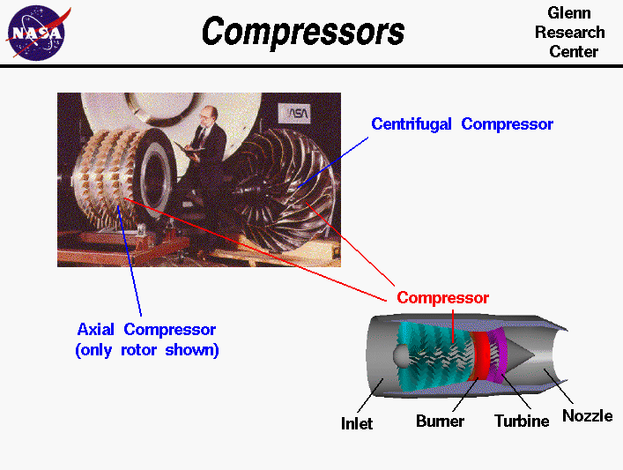
As shown in the above figure, there are two main types of compressors: axial and centrifugal. In the picture, the compressor on the left is called an axial compressor because the flow through the compressor travels parallel to the axis of rotation. The compressor on the right is called a centrifugal compressor because the flow through this compressor is turned perpendicular to the axis of rotation. Centrifugal compressors, which were used in the first jet engines, are still used on small turbojets and turboshaft engines and as pumps on rocket engines. Modern large turbojet and turbofan engines usually use axial compressors.

Slide 7
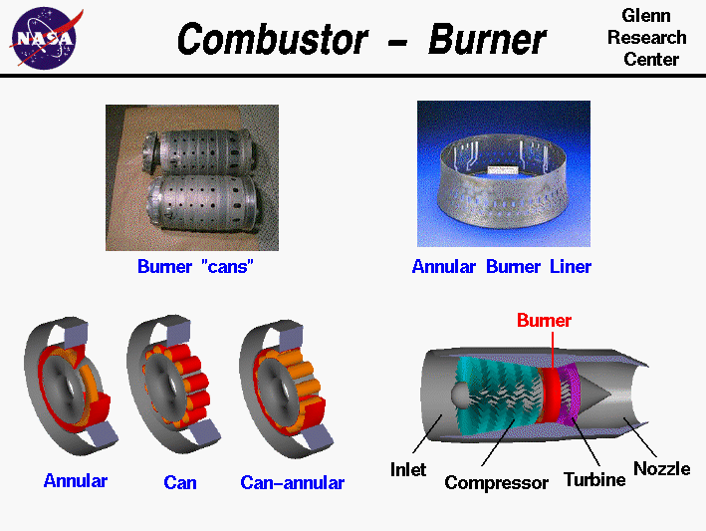
All turbine engines have a combustor, or burner, in which the fuel is combined with high pressure air and burned. The resulting high temperature exhaust gas is used to turn the power turbine and produce thrust when passed through a nozzle
Burners are made from materials that can withstand the high temperatures of combustion. A burner usually has an outer casing, shown in red, and an inner liner, shown in orange. The liner is often perforated to enhance mixing of the fuel and air, as shown in the photo at the upper right.

Slide 8
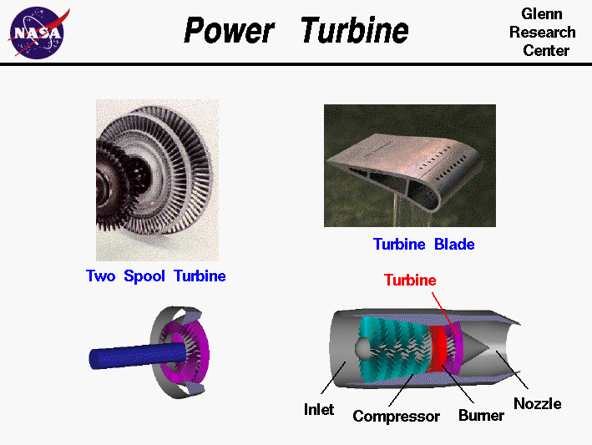

Slide 9
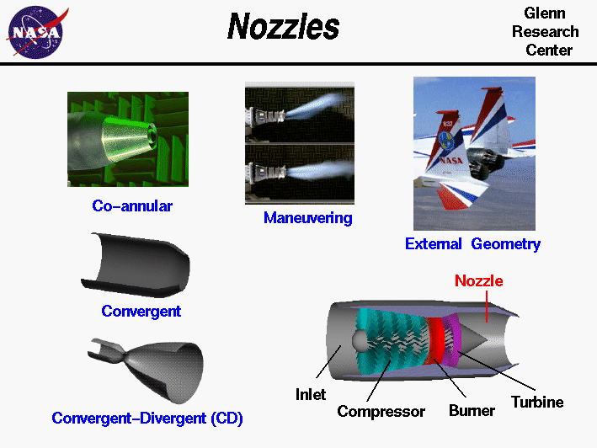
A nozzle is a relatively simple device, just a specially shaped tube through which hot gases flow
also use nozzles to accelerate hot exhaust to produce thrust

Slide 10
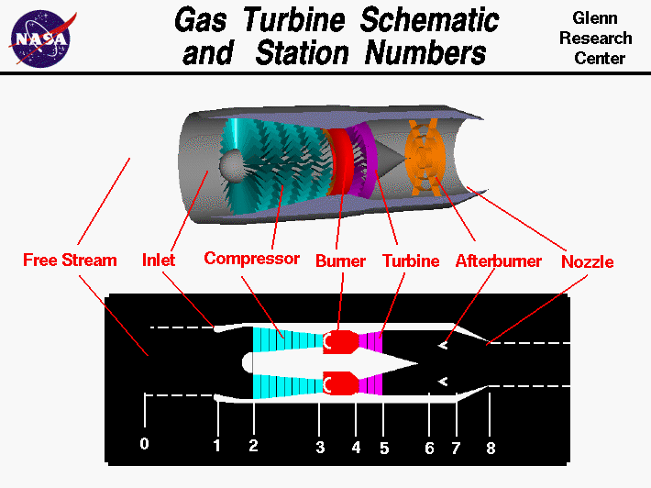

Slide 11
Remaining Useful Life (RUL) is used to provide an early indication of failures that required performing maintenance and/or replacement of the system in advance. Accurate RUL prediction offers cost-effective operation for decision-makers in the industry. The availability of data using intelligence sensors leverages the power of data-driven methods for RUL estimation.
RUL
Remaining Useful Life (RUL) is used to ensure the safety and reliability of the aircraft equipment. It is used to decide whether to perform maintenance or not and how many spare parts should be ordered such as the overall maintenance cost is reduced [1]. If the lifetime of the aircraft equipment cannot be known with certainty, it is recommended to keep monitoring the life and state of operating equipment. Hence, monitoring of the equipment gives the required information on the current working age and state by measuring certain variables that may affect its operation work

Slide 12
SHELL LIFE OF EQUIPMENTS
Air Data Computers | 24 Months
Altimeters | 12 Months
Computers | 24 Months
Control Panels | 24 Months
EFIS Displays | 12 Months (applies to any unit with CRT)
Gyro | 12 Months (any unit w/ gears, bearings, etc)
Indicators | 12 Months (units w/ meter movements)
Radios | 24 Months
Radio Altimeters | 24 Months
Sensors (analog) | 12-18 Months
Sensors (digital) | 24 Months
Servo | 12 Months (any unit w/ gears, bearings, etc)
Transponders | 24 Months

Slide 13
Top Aircraft Maintenance Tools
Speed Handle
Torque Wrench. ...
Vibration Meter. ...
Safety Wire Pliers. ...
Metal Working Tools.
Read More:

Slide 14
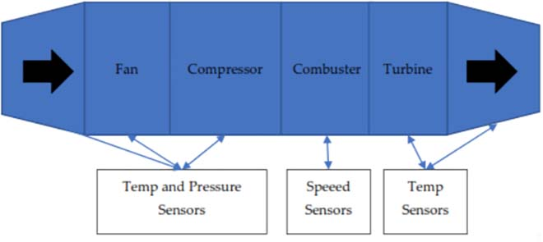
SENSOR DESIGN OF NASA ‘S SPACECRAFT
Journal Ref : https://ieeexplore.ieee.org/document/9815246

Slide 15


SENSOR DESIGN OF NASA ‘S SPACECRAFT
Flow sensors
Pressure sensors
Temperature sensors
Altimeters
Altimeter
Airspeed indicators
Oxygen sensors
Gyroscopes
Attitude heading and reference systems (AHRSes)
(AHRSes)
Read More: https://www.electronicsforu.com/market-verticals/sensors-strength-aviation-aerospace

Slide 16
Tachometers
Tachometers indicate engine rpm. Tachometer probes are used in turbine engines. These sense the changes in magnetic field flux density, as rotating gear wheels move at the same speed as compressor shafts travelling through the probes’ magnetic field. Resulting voltage signals are directly proportional to engine speed.
Other aircraft instruments include aneroid barometers, direction indicators, artificial horizons, attitude indicators, laser sensors, sound sensors, IR and RF sensors, among others.

Slide 17
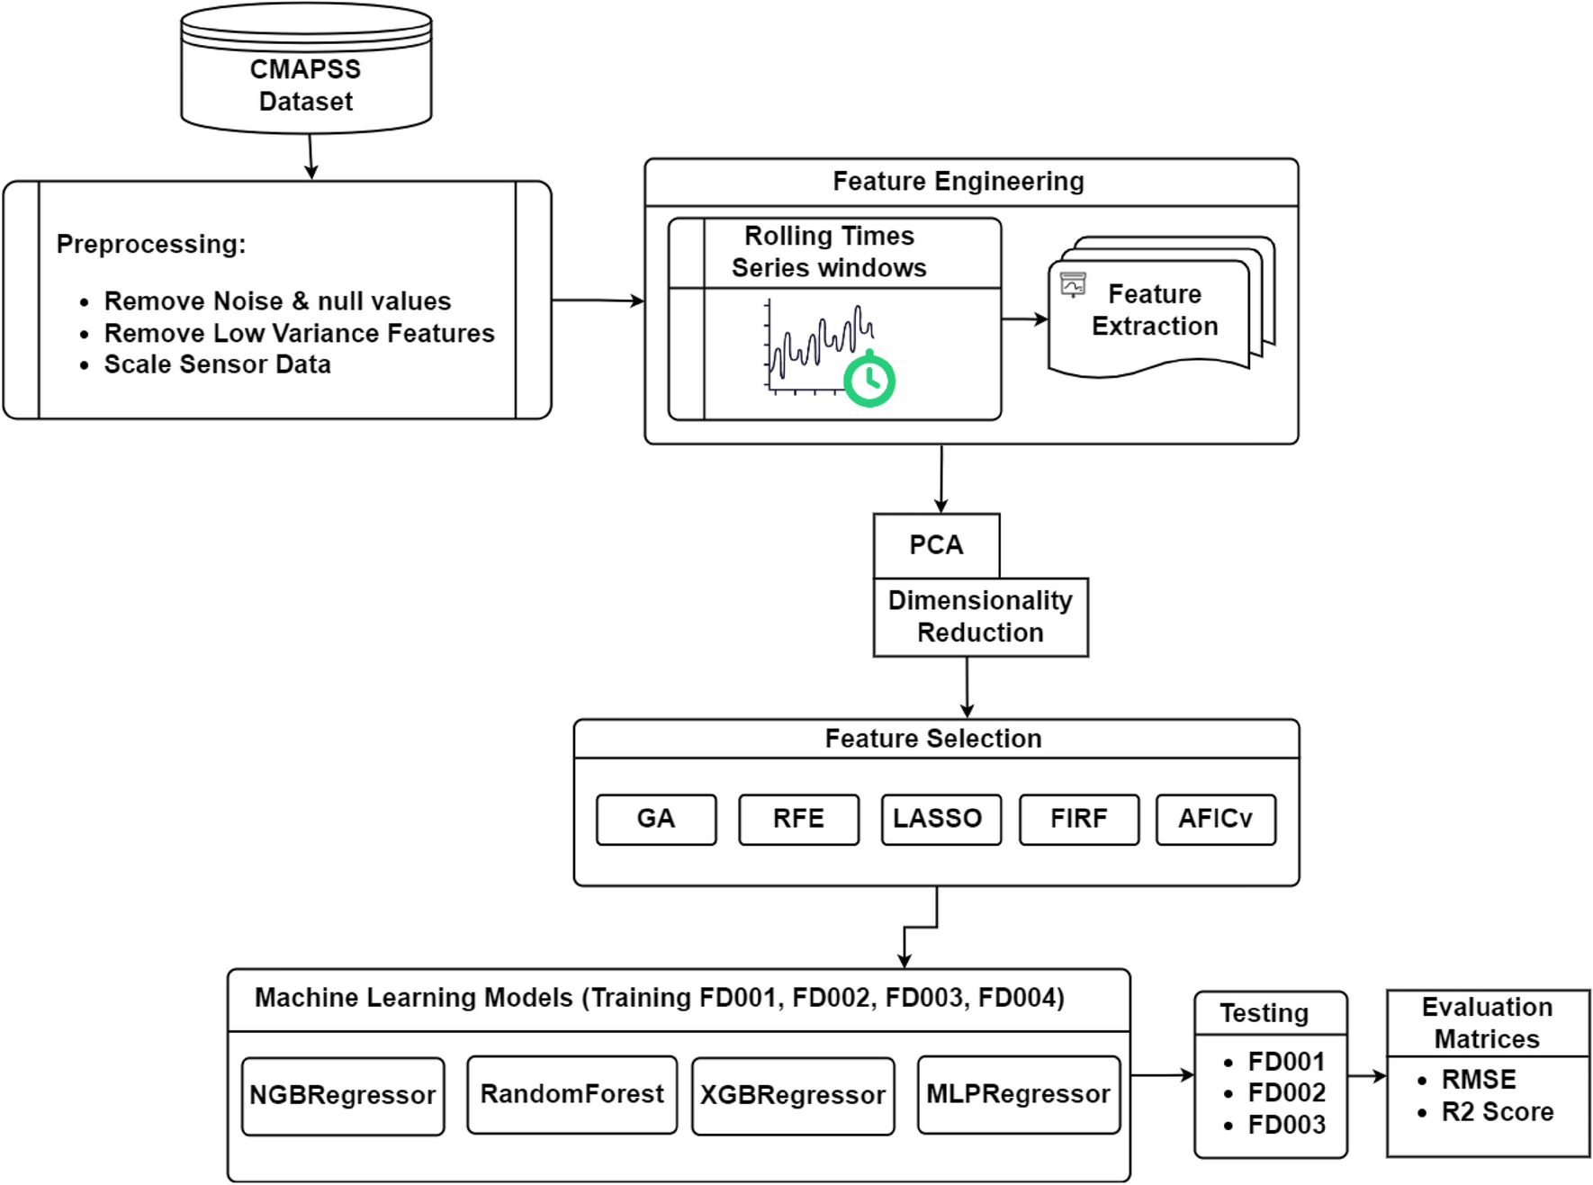


Select K Best + Correlartion Matrix

Slide 18
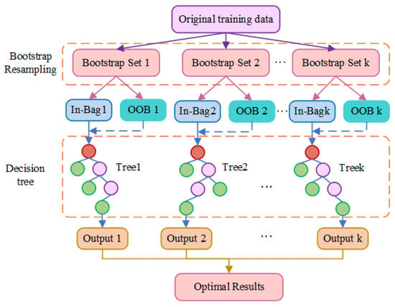
Figure 1. Random forest feature extraction model.

Slide 19
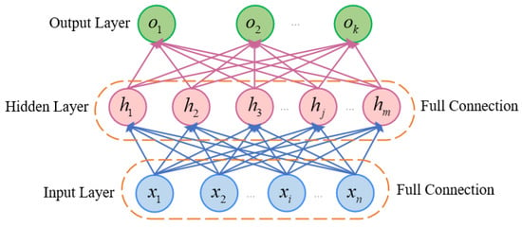
Figure 2. MLP structure diagram.

