Slide 1
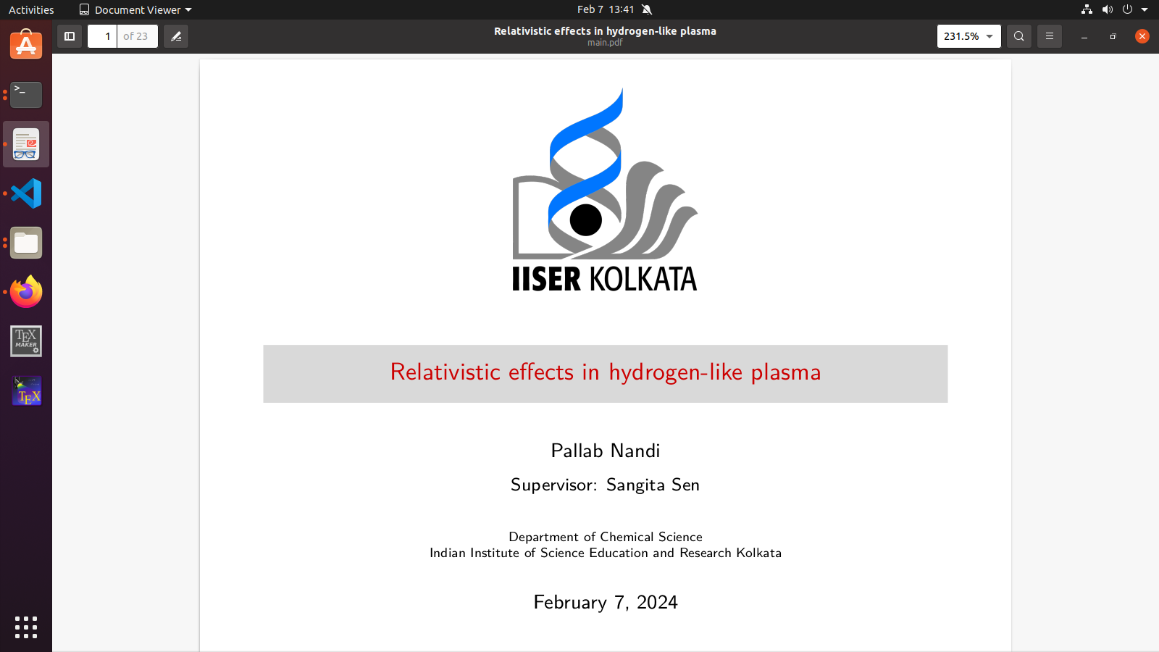

Slide 2
Objective
1
Study the Combined effects of relativity and plasma screening on the pattern of splittings of ns_{½},np_{½} ,and np_{3/2} of H-like atoms
2
Compare different screening potential models of plasma.
3
Effect of plasma screening on various relativistic corrections.

Slide 3


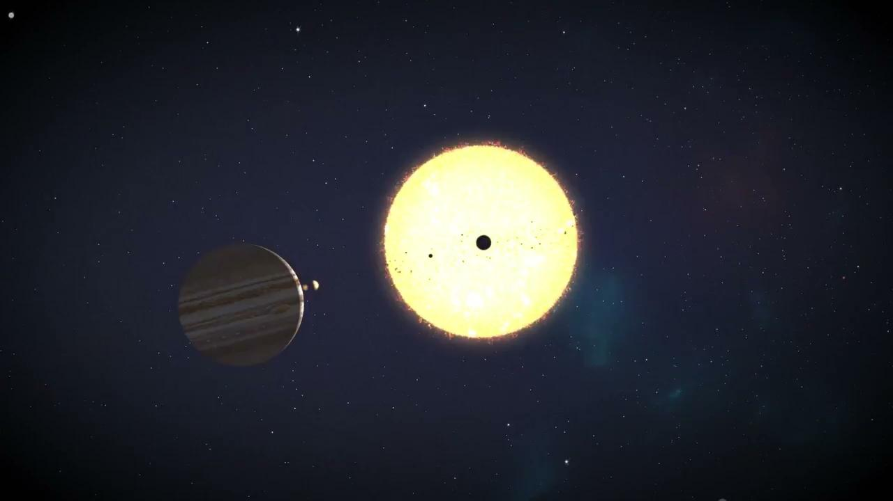
Introduction
What is Plasma ?
Plasma is one of the four fundamental states of matter.
Plasma is formed when a gas is heated to extremely high temperatures,causing its atoms to lose electrons and become positively charged ions.
The term "hydrogen-like plasma" is used to describe a type of plasma in which the behavior of ions is similar to that of hydrogen atoms.

Slide 4
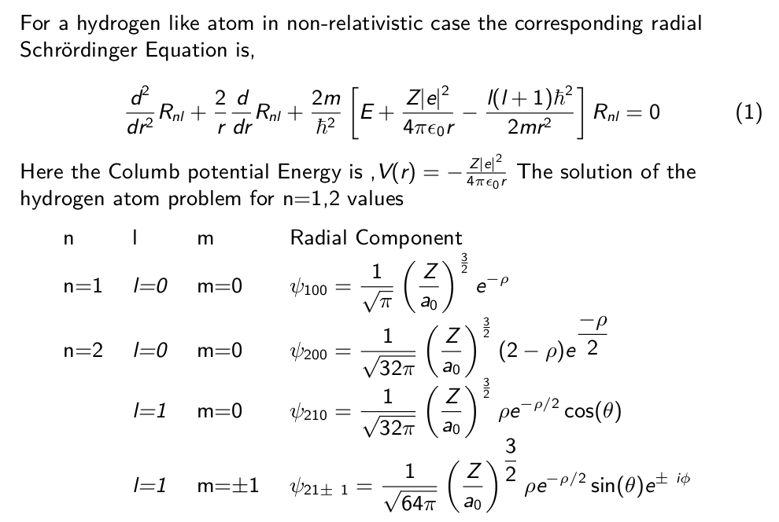

Slide 5
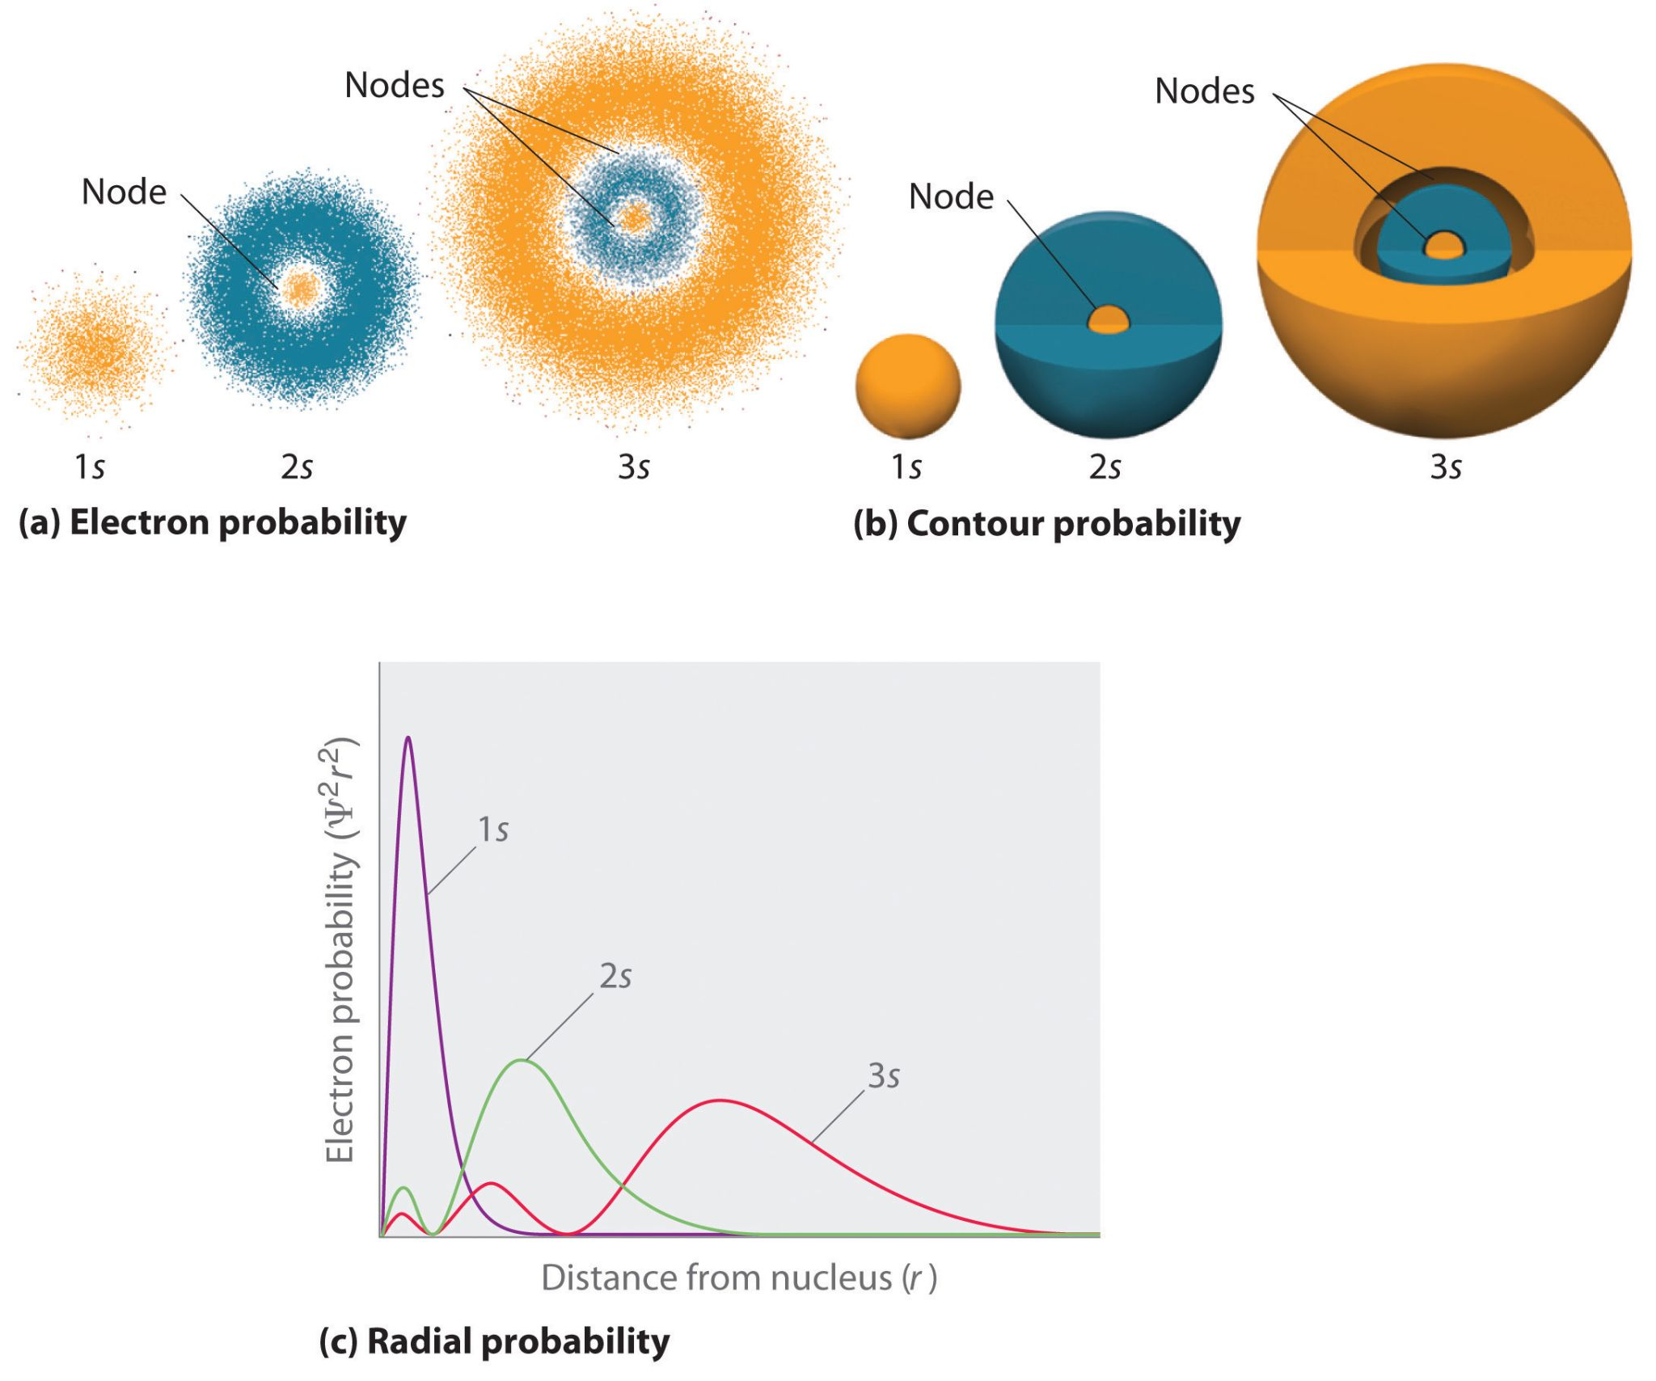
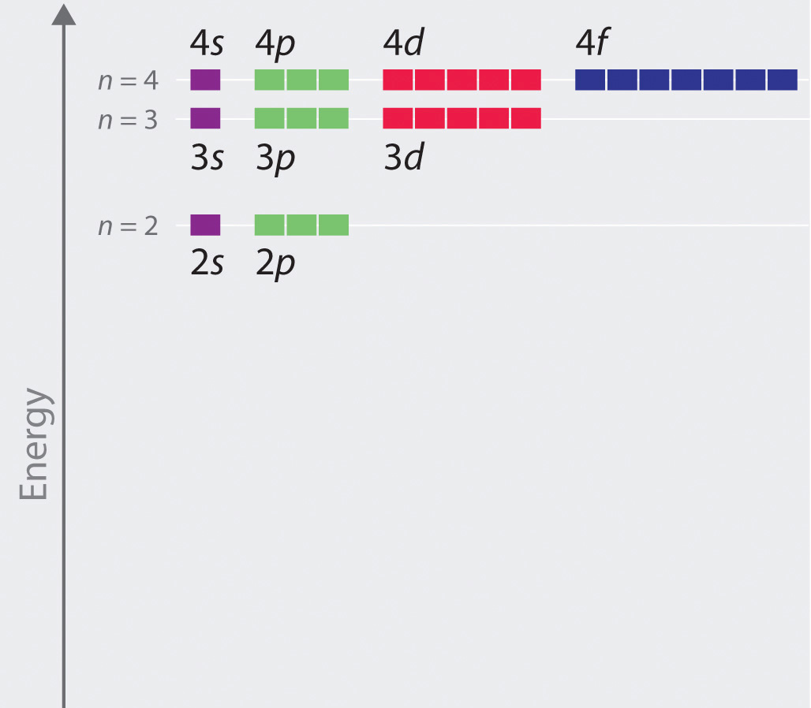
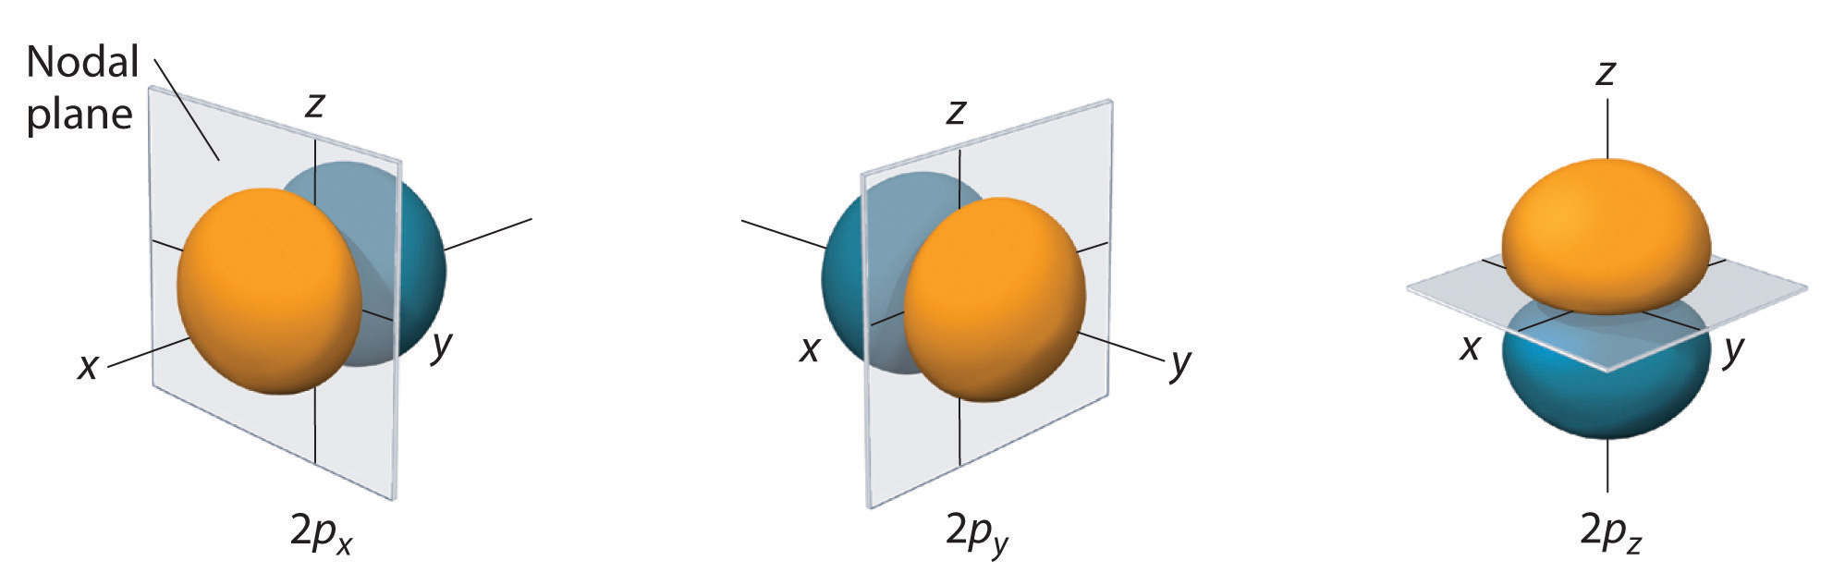
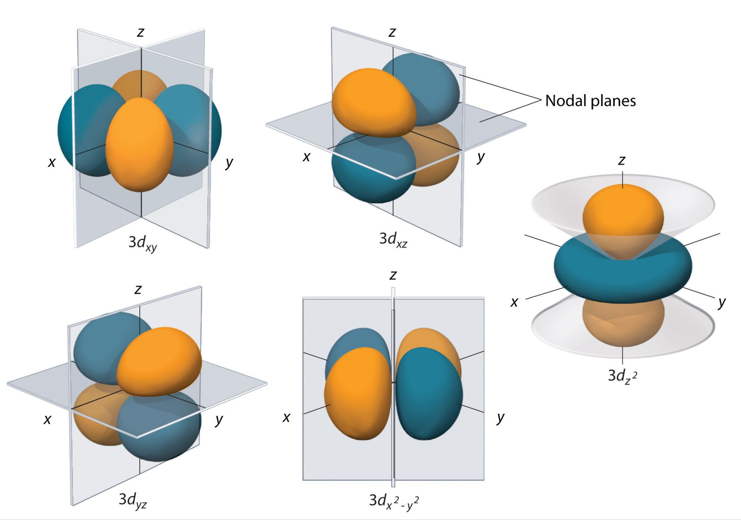
Orbital Energy Level Diagram for the Hydrogen Atom

Slide 6
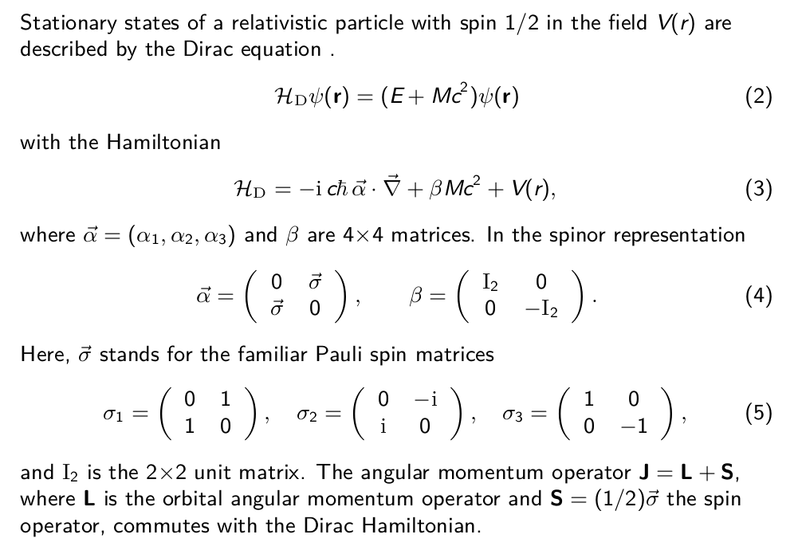

Slide 7

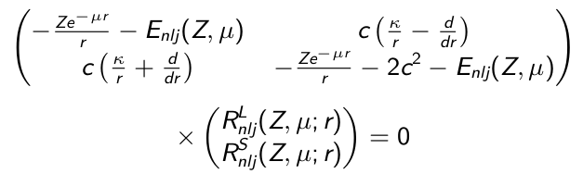
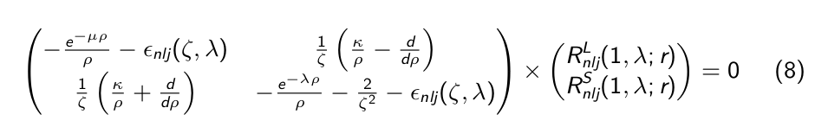
Plasma confinement is mimicked by two different kind of screened potentials
In presence of potential 1 and 2, Dirac Equation for H atom is solved as coupled differential equation
κ = ±(j + ½ ) for l = j ± ½ Dirac angular momentum quantum number
R^{L}_{njl} (Z, µ; r) and R ^{S}_{nlj} (Z, µ; r) are the radial parts of the large and small components of the wave function,
E _{nlj} (Z, µ) is the energy relative to c ² (the rest energy of the electron),
This coupled differential equation (8) is solved by the power series method using spline interpolation technique in radial grid using inhouse numerov Dirac solver program[1]
[1]Shamik Chanda, Sangita Sen: Numerov Dirac radial equation solver program (Inhouse) 2023
[2]S. Bhattacharyya, A. N. Sil, S. Fritzsche, and P. K. Mukherjee, Effect of Strongly Coupled Plasma on the Spectra of Hydrogenlike Carbon, Aluminium and Argon, The European Physical Journal D 46, 1 (2007).

Slide 8
 |  |  |  | Present Data |  |  |  |  |  |  |  | Analytical data
Atomic Number | 1S_(1/2) | 2S_(1/2) | 3S_(1/2) | 4S_(1/2) | 5S_(1/2) | 6S_(1/2) | 2P_(3/2) |  | 1S_(1/2) | 2S_(1/2) | 3S_(1/2) | 4S_(1/2) | 5S_(1/2) | 6S_(1/2) | 2P_(3/2)
Z=6 | -18.0086349982670 | -4.502698566 | -2.000959399 | -1.125438441 | -0.720234830 | -0.500139888 | -4.500539299 |  | -18.00863499816 | -4.502698566 | -2.000959399 | -1.125438441 | -0.7202348295 | -0.5001398879 | -4.500539299
Z=8 | -32.027311252912 | -8.008535495 | -3.558589883 | -2.001386592 | -1.280742627 | -0.889331258 | -8.001704770 |  | -32.02731125257 | -8.008535495 | -3.558589883 | -2.001386592 | -1.280742627 | -0.8893312575 | -8.00170477
Z=10 | -50.066742017 | -12.520859663 | -5.562970357 | -3.128388069 | -2.001814471 | -1.389969689 | -12.504163034 |  | -50.06674202 | -12.52085966 | -5.562970357 | -3.128388069 | -2.001814471 | -1.389969689 | -12.50416303
Z=12 | -72.138559272 | -18.043308099 | -8.015392548 | -4.507032699 | -2.883766084 | -2.002243175 | -18.008634998 |  | -72.13855927 | -18.0433081 | -8.015392548 | -4.507032699 | -2.883766084 | -2.002243175 | -18.008635
Z=14 | -98.257056246 | -24.580351127 | -10.917443292 | -6.138044753 | -3.926985032 | -2.726382433 | -24.516002948 |  | -98.25705624 | -24.58035113 | -10.91744329 | -6.138044753 | -3.926985032 | -2.726382433 | -24.51600295
Z=60 | -1,895.682340924 | -480.056587772 | -210.575254259 | -117.292591987 | -74.551457304 | -51.513153918 | -455.524906314 |  | -1895.68234 | -480.0565874 | -210.5752541 | -117.2925919 | -74.55145727 | -51.5131539 | -455.5249062
Z=80 | -3,532.192093162 | -904.847783519 | -392.083686819 | -216.424745346 | -136.695270982 | -94.024607320 | -817.807495210 |  | -3532.192088 | -904.8477819 | -392.0836863 | -216.4247451 | -136.6952709 | -94.02460724 | -817.807495

Slide 9
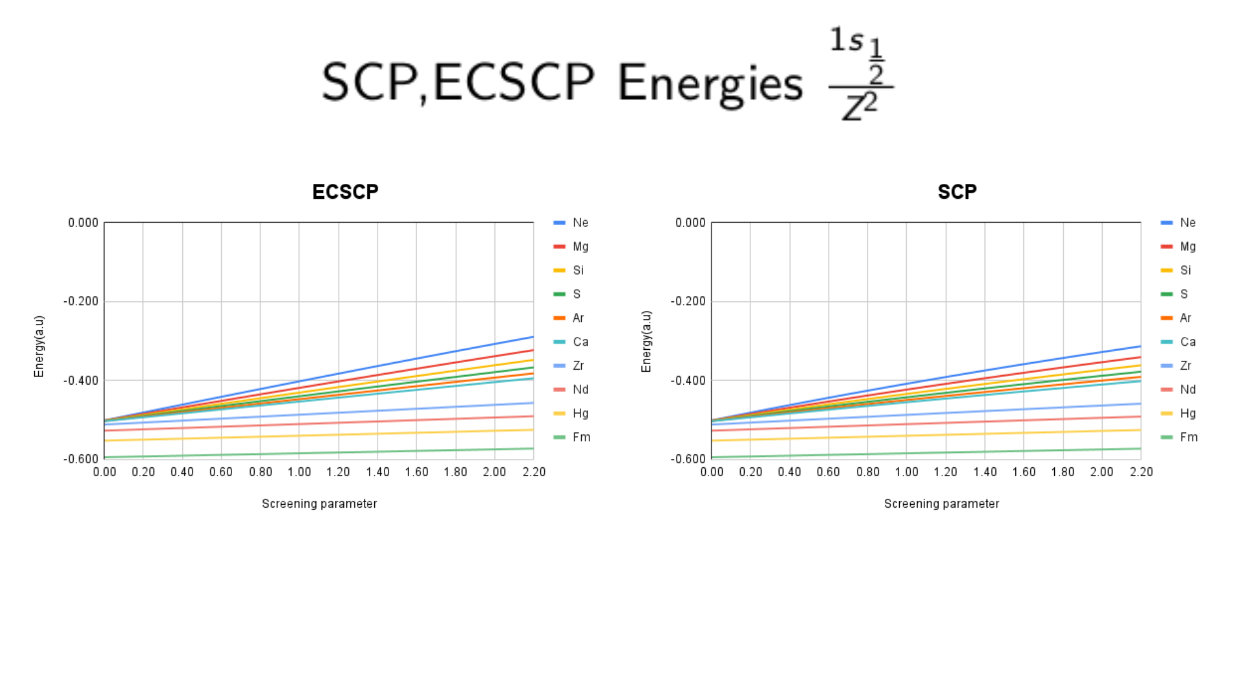
Effect of screening is less in heavier atoms
Ground state Energies of SCP & ECSCP are Similar

Slide 10
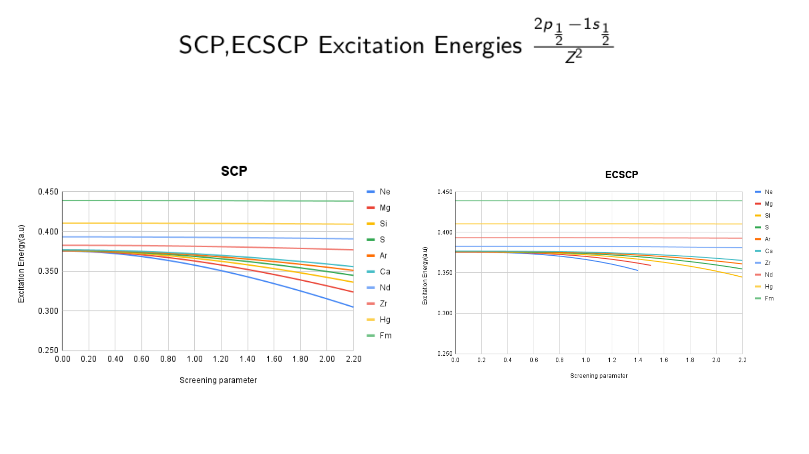

Slide 11
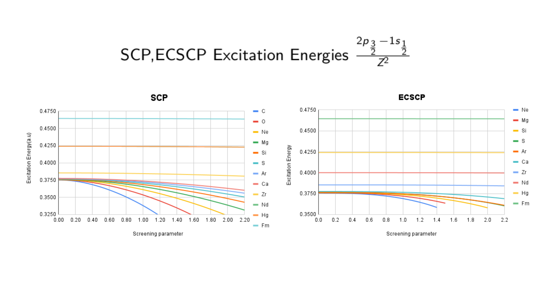
SCP Excitation energy showing larger effective screening compared to ECSCP

Slide 12
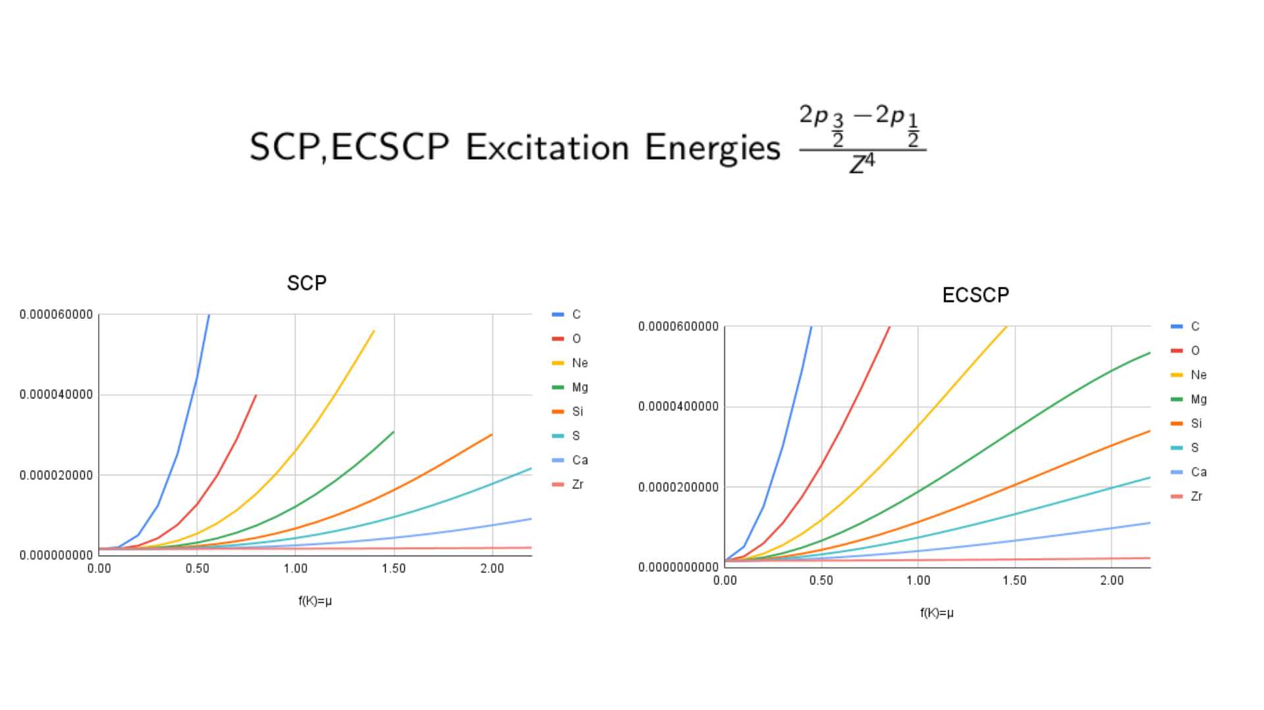
Spin orbital splitting is remarkable in SCP &ECSCP

Slide 13

Findings
Effect of screening is less in heavier atoms.
Current result under plasma environments definitely possible to use similar experiments with ultra-high resolution.
Effect of plasma screening on the various relativistic corrections.
Spin orbit splitting is remarkable SCP and ECSCP

Slide 14

Future Outlook
[1]M. A. L. Marques, M. J. T. Oliveira, and T. Burnus, Libxc: A Library of Exchange and Correlation Functionals for Density Functional Theory, Computer Physics Communications 183, 2272 (2012).
1.Current work can be extended to the many electron systems. Through a self-consistent manner to evaluate electronic structure for several xc functionals, an interface to libxc[1] has been planned.
2.To solve the time dependent Schrodinger Equation for one and many electron atoms to know the dynamics of the systems in plasma.

Slide 15

Acknowledgement
Supervisor
Dr. Sangita Sen & my labmates .
RPC Members
Dr. Susmita Sen
Dr. Mousumi Das

Slide 16
References
[1]S. Chanda, A. Kantholi, S. Sen, Relativistic effects in hydrogen-like plasma, To be submitted. (2024)
[1]S. Bhattacharyya, A. N. Sil, S. Fritzsche, and P. K. Mukherjee, Effect of Strongly Coupled Plasma on the Spectra of Hydrogenlike Carbon, Aluminium and Argon, The European Physical Journal D 46, 1 (2007).
[2]S. K. Chaudhuri, P. K. Mukherjee, and B. Fricke, Atomic Structure under External Confinement: Effect of Plasma on the Spin Orbit Splitting, Relativistic Mass Correction and Darwin Term for Hydrogen-like Ions, The European Physical Journal D 71, (2017).

Slide 17
Objective
To study the effect of confinement in the electronic structure of atomic systems.
To study the effect of several plasma environment to the energies and transition energies of hydrogen-like systems. We choose hydrogen-like systems as exact analytical solution for free system is known and relevant for astronomical phenomenon.

Slide 18
Methodology
Dirac Equation for H atom can be written as coupled differential equation
κ = ±(j + ½ ) for l = j ± ½ Dirac angular momentum quantum number
R^{L}_{njl} (Z, µ; r) and R ^{S}_{nlj} (Z, µ; r) are the radial parts of the large and small components of the wave function,
E _{nlj} (Z, µ) is the energy relative to c ² (the rest energy of the electron),

Slide 19
This coupled differential equation (8) is solved by the power series method using spline interpolation technique in radial grid using inhouse numerov Dirac solver Program[1]
[1]S. Bhattacharyya, A. N. Sil, S. Fritzsche, and P. K. Mukherjee, Effect of Strongly Coupled Plasma on the Spectra of Hydrogenlike Carbon, Aluminium and Argon, The European Physical Journal D 46, 1 (2007).

Slide 20
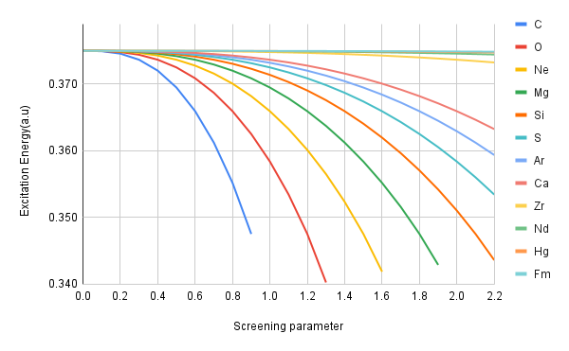

Slide 21
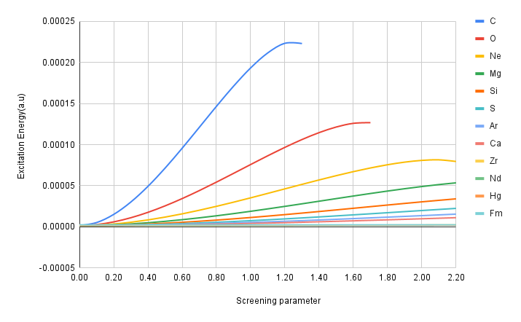
SCP {2P_(3/2)-2P_(1/2)}/z^4 scaling

Slide 22
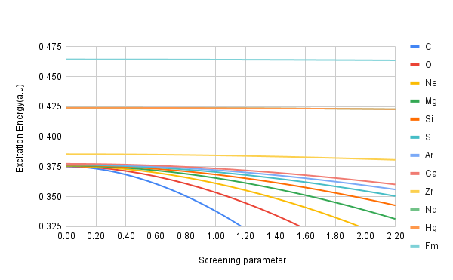
2p(3/2)-1s(1/2)/z^2 scaling graph against screening parameter

Slide 23
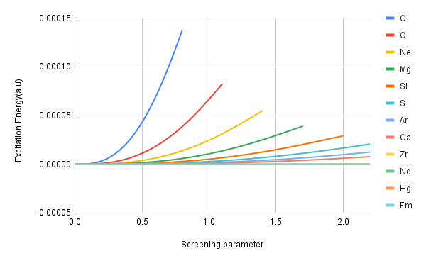
2p_(3/2)-2p_(½)/Z^4 scaling against screening parameter

Slide 24
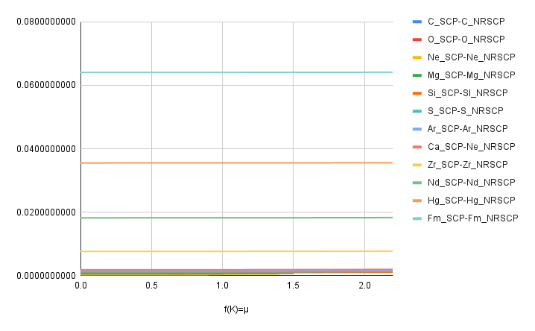
The difference plot of SCP with Non-relativistic SCP for 2p_(1/2) to 1s_(½) transition

Slide 25
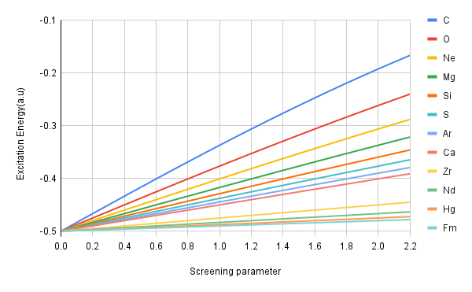
Non-relativistic Excitation ECSCP 1S_{1/2} / Z²

Slide 26
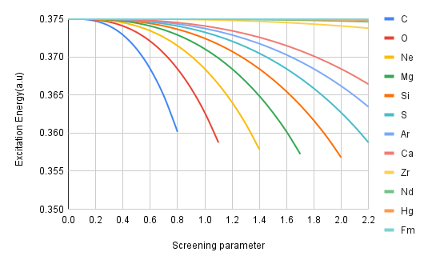
Excitation Energy in Non-relativistic ECSCP

Slide 27
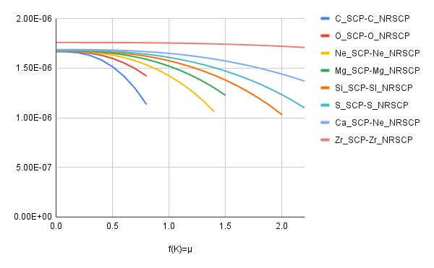
The difference plot of SCP with Non-relativistic SCP for 2p_(3/2) to 2p_(½) transition

Slide 28
Study the Combined effects of relativity and plasma screening on the pattern of splittings of ns_{½},np_{½} ,and np_{3/2} of H-like atoms
Effect of confinement in the electronic structure of atomic systems.
Effect of plasma screening on various relativistic corrections.
Effect of several plasma environment to the energies and transition energies of hydrogen-like systems.

