Slide 1


Hardware implementation of AI algorithms for high-speed AI platforms

Slide 2
Synopsys
Moving AI based process execution from generic hardware system to application specific dedicated hardware systems for high-speed low power more energy efficient architecture.
Dedicated memory architecture for each AI algorithm-based ALU platforms for better performance. (Distributed and dedicated memory)
Application of In-memory computing (IMC) for optimization (According to need)
Optimize and design On-chip NPUs (Neural Processing Unit→ Currently slow and power hungry) to run low-power, localized inferencing directly on personal devices
Design and optimize Large and complex ALU applications on hardware→
Metrix Multiplications
Circular and Linear convolution
first order second order equations etc.

Slide 3
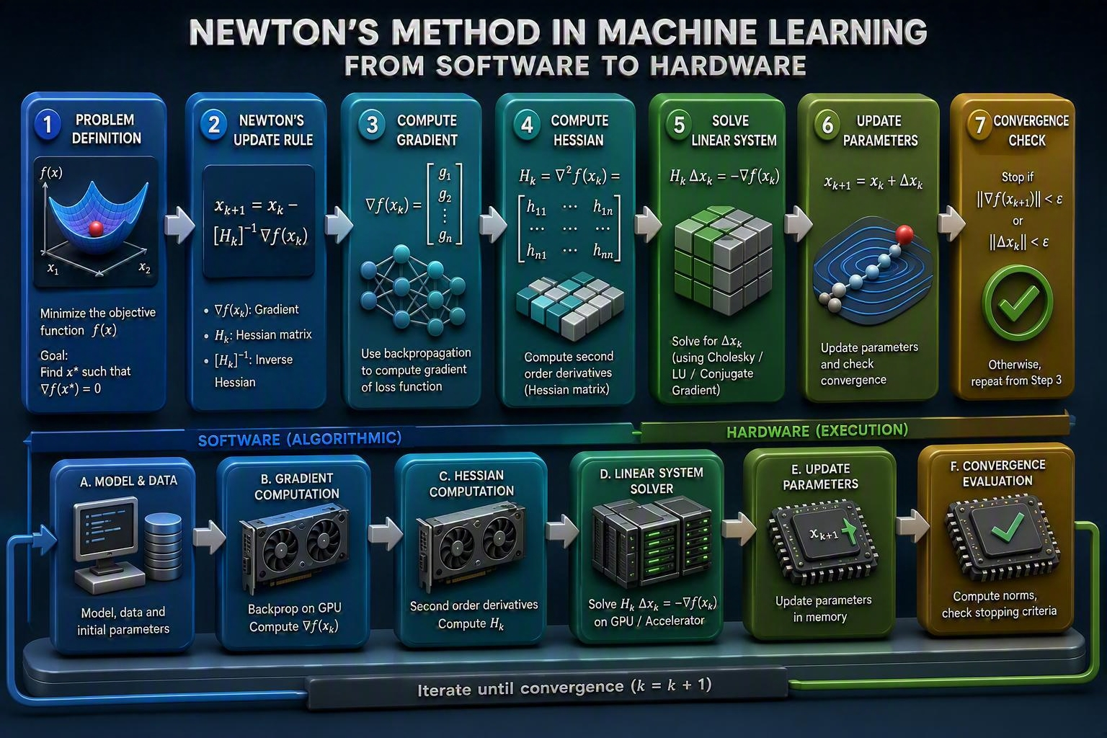
Application scenario on current architecture
In current scenario step 2 3 & 4 are completely dependent on software which is executed with a generic hardware(Not speed and power efficient)
Step 5 is partially on hardware.
Our target →
Gradually move the 2nd 3rd and 4th stage on hardware for high-speed application.
5th stage also needs more application specific hardware.

Slide 4
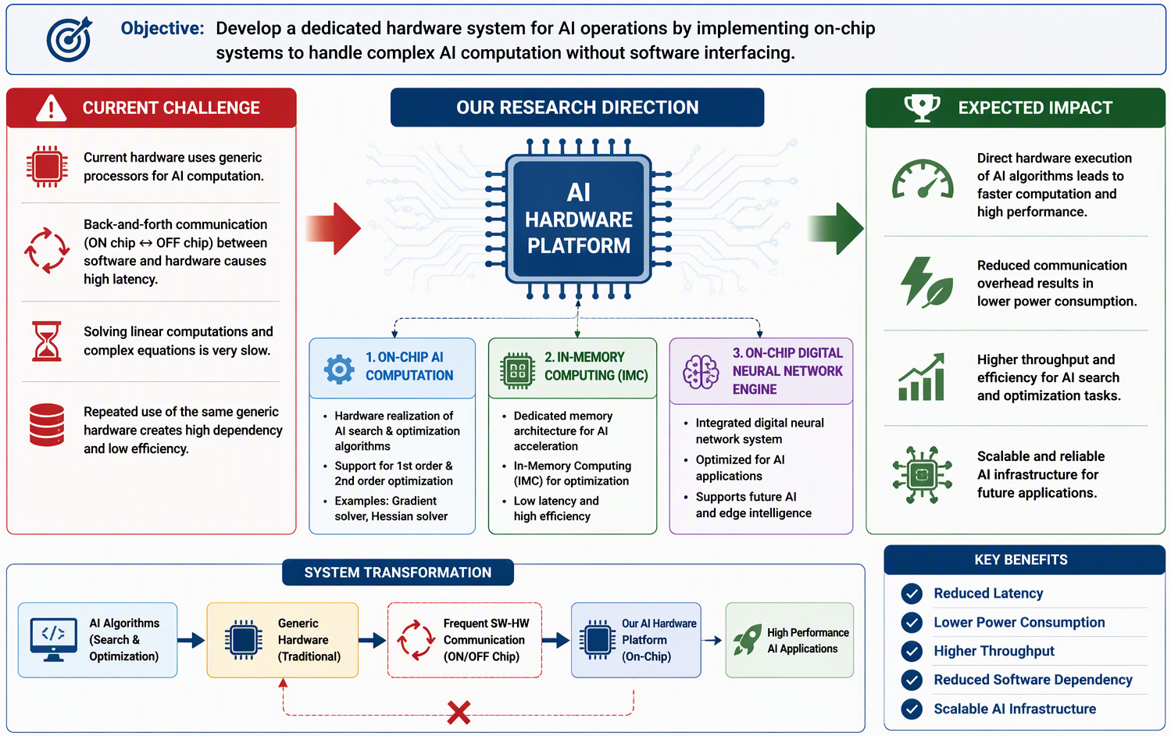
Research

Slide 5
Research
Introduce a highly effective hardwire system dedicated for AI operations by implementing dedicated on chip systems to handle complex AI computation without softwire interfacing.
Incorporate dedicated Memory architecture for the developed hardware/ Application of In-memory computing (IMC) for optimization
On chip digital neural network system to support AI application (TBD)
Reduce Software dependency and increase hardware dependency of a system for better reliability and faster response.
Currently hardwires are solving linear computation by using generic hardware which needs back and forth communication in between software and Hardware (ON chip and OFF chip communication) which is finally solving a complex equation. This process is Very Slow and creating high dependency/repeated use of same generic hardware. | Goal→ Develop a hardwire system to solve 1st order 2nd order equations coming out of various AI search and optimization algorithms. Direct realization of AI algorithms on hardwire will give a huge leap in current AI infrastructure. Example→ Hardware computation capability of Optimization Algorithms, Gradient and Hessian function solver, etc.

Slide 6
Literature survey (TBD…)
AI algorithms to be targeted→
Linear Programming and Optimization Algorithms
AI Algorithms Based on Neural Networks
AI Algorithms for Computer Vision
AI Search Algorithms
Reference→
https://www.geeksforgeeks.org/artificial-intelligence/ai-algorithms/
https://www.geeksforgeeks.org/deep-learning/second-order-optimization-methods/#example-1-newtons-method
https://www.geeksforgeeks.org/machine-learning/newtons-method-in-machine-learning/#newtons-method-for-optimization

Slide 7
Initial study and Final framework
TBD…..

