Slide 1
Introduction to Python
by
RAGE Uday Kiran

Slide 2

Hai!
I am Guido Van Rossum
Creator Python

Slide 3
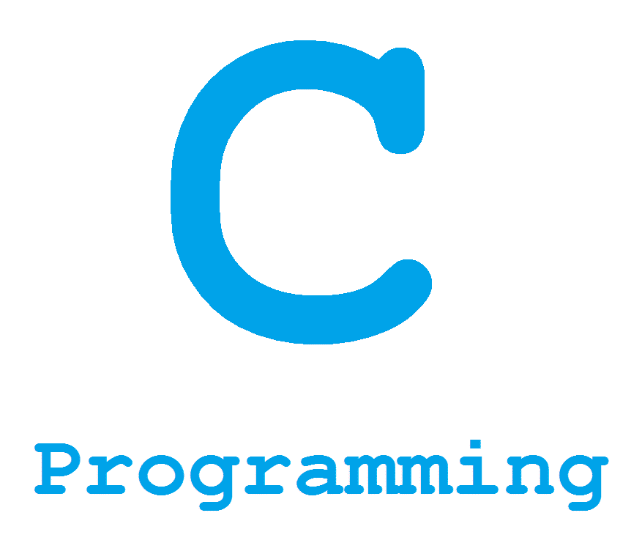

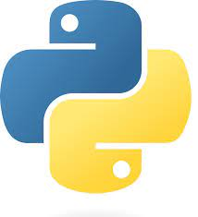
#include <stdio.h>
int main(void)
{
printf(“Hello World!!\n”);
}
Python is famous for its simplicity
Class HelloWorld{
public static void main(Srting args[]){
System.out.println(“Hello World!!”);
}
}
print(“Hello World!!”)

Slide 4
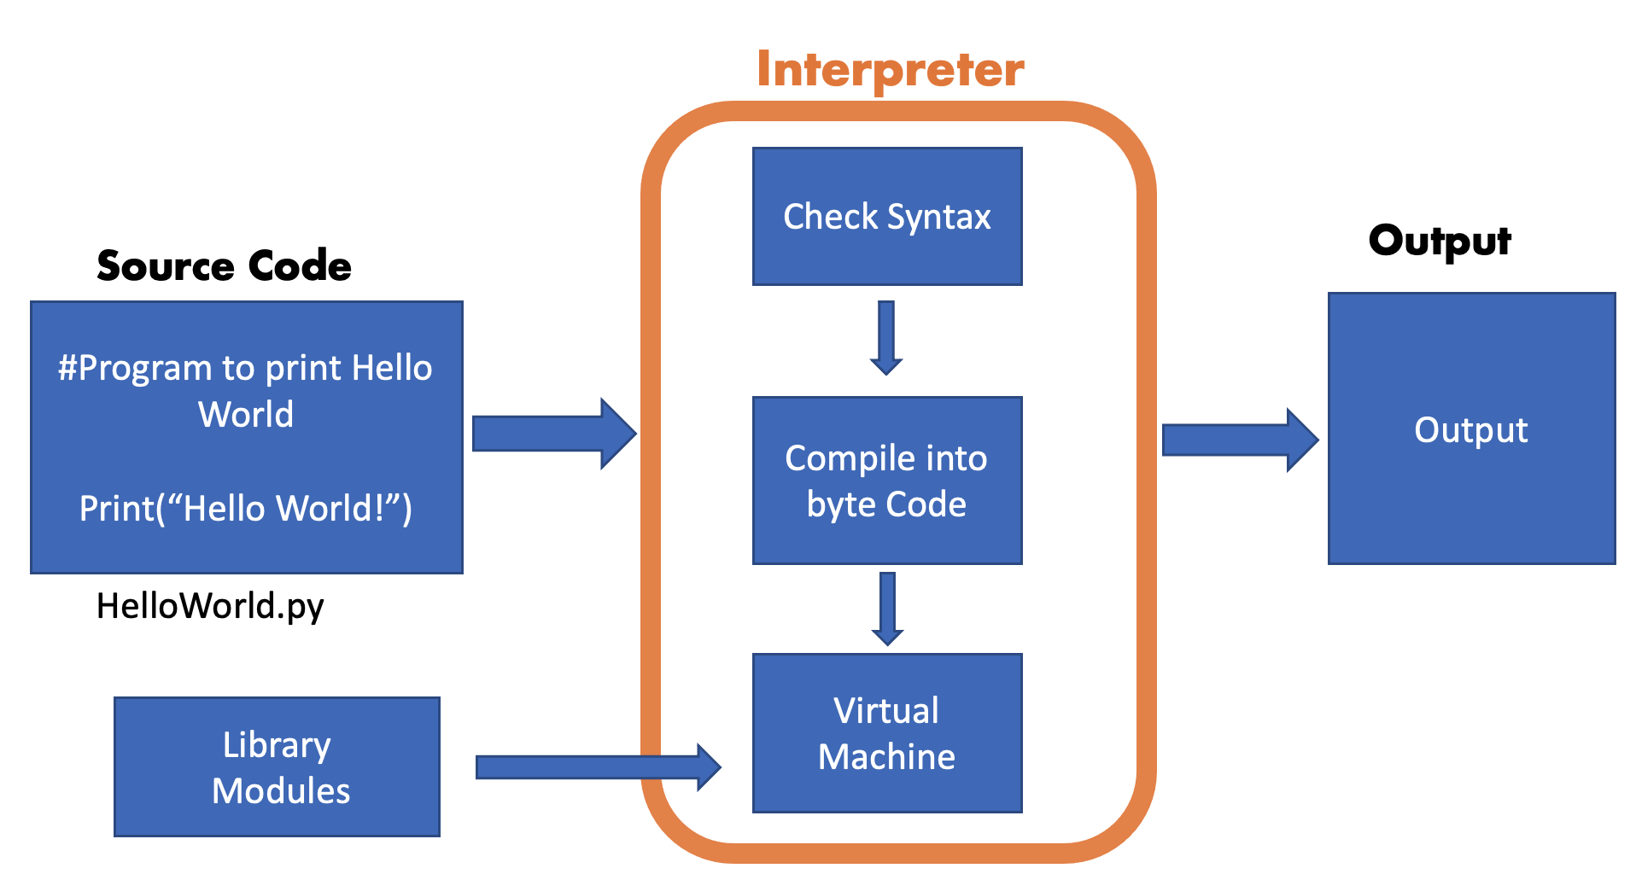
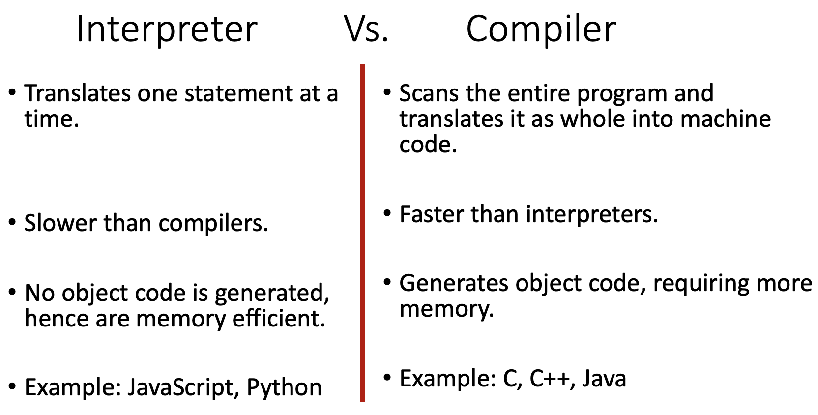
Python uses interpreter not compiler

Slide 5

myfile.py
# Sample Program
a = 10
b = 5
print(“Total Sum: ”, a+b)
A Python program can be executed using
python fileName.py
Output:
Total Sum: 15

Slide 6
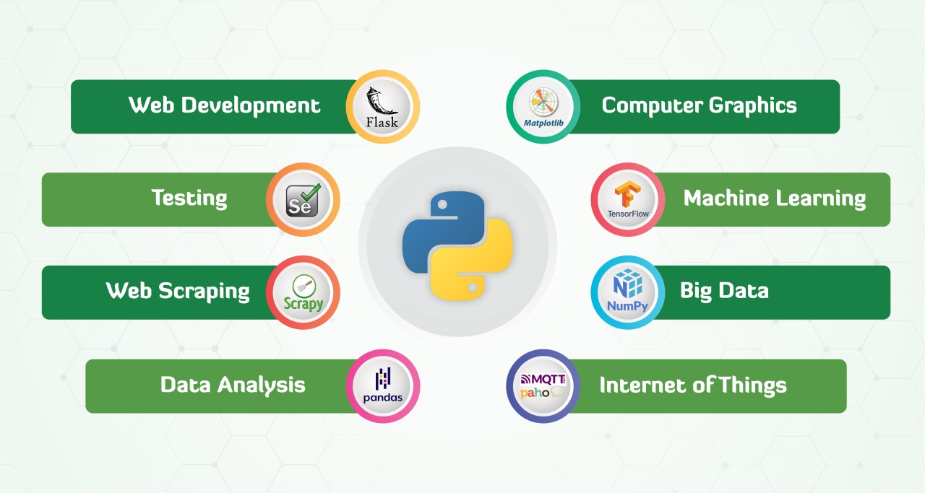
Python has many applications

Slide 7
All of you please
learn Python

Slide 8
All of you must
learn Python

Slide 9
I will take leave now.
Your professor will handle the rest.
Bye

Slide 10
Outline
Indentation
Variables and Casting
Conditions and Loops
Functions and
Arguments

Slide 11

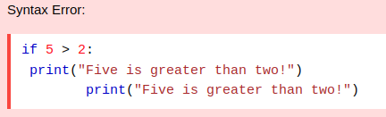
Indentation
Vertical arrangement of code.
Python uses indentation to indicate a block of code
starting of the block
Example With Proper Syntax
Block1:
line1
line2
…
Block2:
Block21:
line1
line2
…
Block22:
…
…
All lines in a block must start at same column
ending of the block
nested block

Slide 12
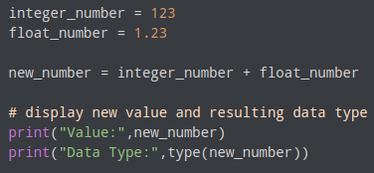

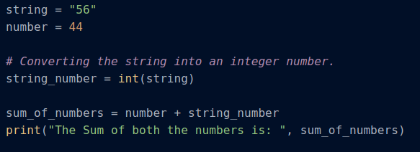
Variables and Casting
Implicit casting
Variables are created by assigning a value.
No need to declare the type of the variable
Variables conversions/casting can be done implicitly or explicitly
Explicit casting
Number
Number
to
String
to
Number
String
implicit casting
explicit casting

Slide 13
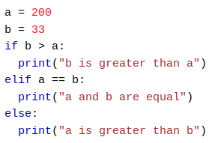
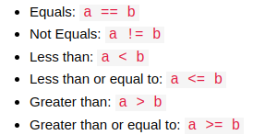
Conditions and Loops
Python supports the usual logical conditions from mathematics

Slide 14

Conditions and Loops
A for loop is used for iterating over a sequence(that is either a list, tuple, a dictionary, a set, or a string) .Works more like an iterator.
break Statement : With the break statement we can stop the loop before it has looped through all the items.
Output : apple
banana

Slide 15
Functions
A function is a block of code which only runs when it is called. You can pass data, known as parameters, into a function.
A function is defined using the def keyword.
Call a function using its name and arguments in parenthesis.
Example :
def my_function():
print("Hello from function")
my_function()
declarating a function
calling a function

Slide 16

Arguments
Information can be passed into function as arguments.
We can add as many arguments as we want
Arguments are separated with a comma
We can set default value to an argument
default value
def my_function(fname=“RAGE”, lname)
print(fname + ” “ + lname)
my_function(“Uday Kiran”) RAGE Uday Kiran
my_function(“Musashi”, “Ito”) Musashi Ito
Output

Slide 17
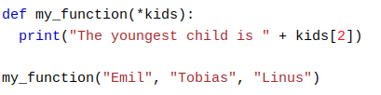


Arguments
Arbitrary Arguments
Arbitrary Arguments - If you don’t know how many arguments that will be passed into your function. (add a * before the parameter name in the function definition.)
Keyword Arguments - You can also send arguments with the key=value syntax. This way the order of the arguments does not matter.
Arbitrary keyword Arguments - add two asterik ** before the parameter name in the function definition. This way the function will receive a dictionary of arguments, and can access the items accordingly.
Keyword Arguments
Arbitrary Keyword Arguments

Slide 18
The END

