Slide 1
Advanced Topics in SQL (Spatiotemporal queries)
By
RAGE Uday Kiran

Slide 2
Outline
Projections
Types of geometric objects
Creating a table to store Geometric objects
Quering the geometric objects

Slide 3
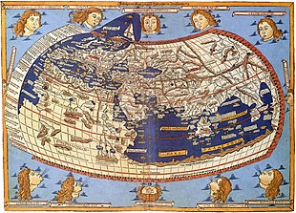
Projections
In cartography, a map projection is a way to flatten a globe's surface into a plane in order to make a map.
A medieval depiction of the Ecumene (1482, Johannes Schnitzer, engraver), constructed after the coordinates in Ptolemy's Geography and using his second map projection
https://en.wikipedia.org/wiki/Map_projection

Slide 4
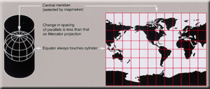
Popular projections
Cylindrical projection
Assume earth is kept in a cylinder and light is passed from the earth
Advantages:
places at equator will be represented currectly
Disadvantages:
Places at the poles will get distorted

Slide 5
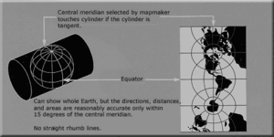
Popular projections
Cylindrical projection with poles

Slide 6
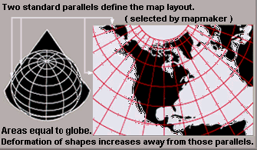
Popular projections
Conic projection
Place the cone at the poles of the earth
Advabtages:
Poles will be represented properly
Disadvantages:
Places away from the poles get distorted

Slide 7
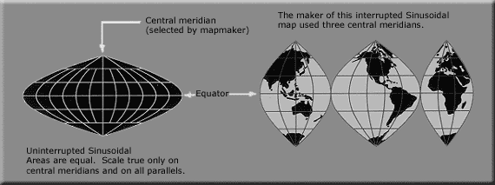
Pseudocylindrical Projections
Cylindrical, conic, or plane projections implicitly assume that earth is sphere
However, Earth's actual shape is closer to an oblate ellipsoid.

Slide 8
Web Mercator projection
Web Mercator, Google Web Mercator, Spherical Mercator, WGS 84 Web Mercator[1] or WGS 84/Pseudo-Mercator is a variant of the Mercator projection and is the de facto standard for Web mapping applications.
It rose to prominence when Google Maps adopted it in 2005.
It is used by virtually all major online map providers, including Google Maps, Mapbox Bing Maps, OpenStreetMap, Mapquest, Esri, and many others.
Its official EPSG identifier is EPSG:3857, although others have been used historically.
Right now the version we use is EPSG:4326

Slide 9
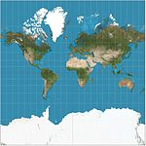
More information on projections
Google uses mercator projection
Visit: https://en.wikipedia.org/wiki/List_of_map_projections

Slide 10
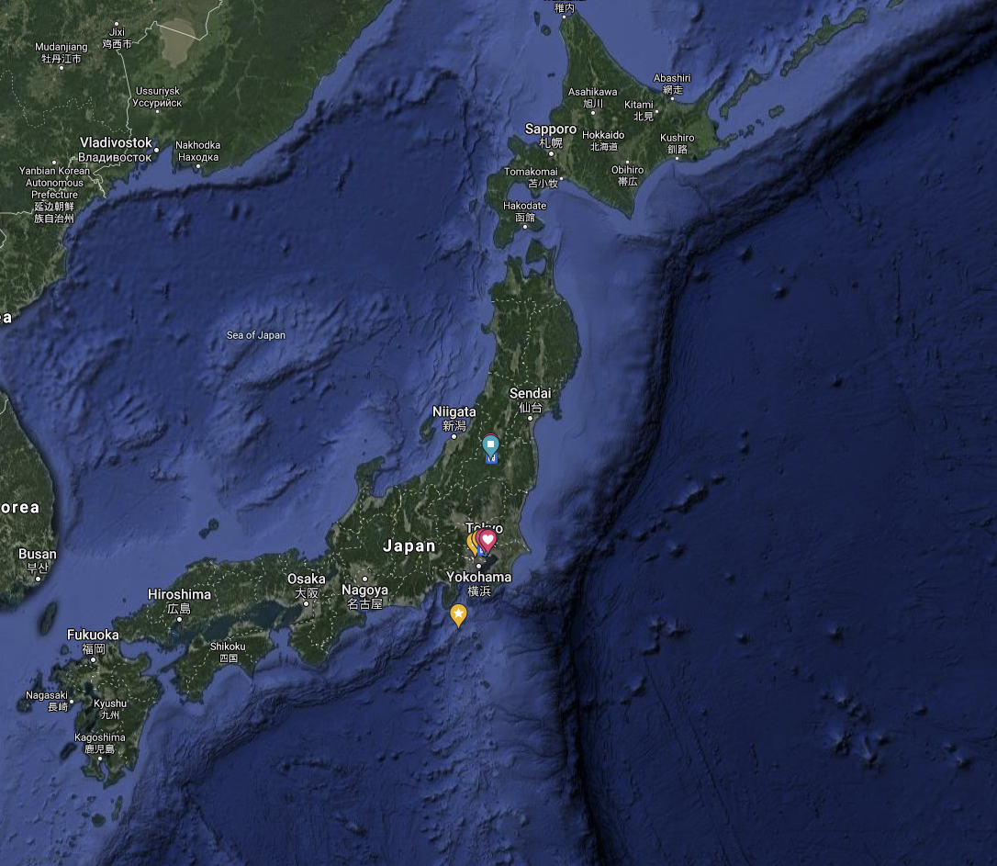
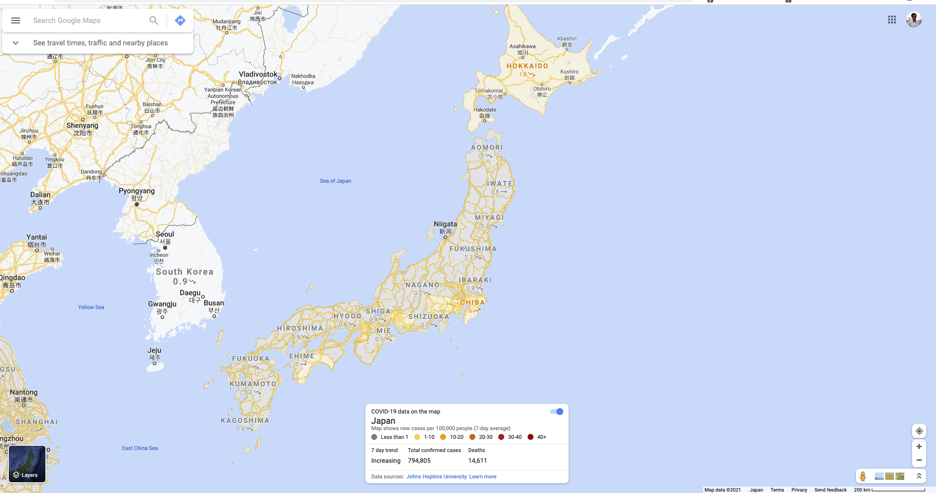
Geometric Shapes
Raster format
Image format
JPG, PNG
contain X and Y coordinates and values
Vector format
Point
Line
Polygon

Slide 11
Raster Data
X | Y | Band 1 | Band 2 | … |  |  |  |  | Band n
0 | 0 | 10 | 20 |  |  |  |  |  | 90
0 | 100 | 20 | 0 |  |  |  |  |  | 0
can be stored as a Point

Slide 12
Vector data
Object | Band 1 | Band 2 | … |  |  |  | Band n
Point(0 0) | 10 | 20 |  |  |  |  | 90
Line(0 0, 1 1) | 20 | 0 |  |  |  |  | 0
POLYGON((0 0, 1 0, 1 1, 0 1, 0 0))

Slide 13
SQL for Spatial Objects

Slide 14
Create a spatial extension
After you create a database
Install the spatial extension using PostGIS
CREATE EXTENSION postgis;
You will encounter problems if you do not execute above statement

Slide 15
CREATE TABLE
CREATE TABLE geometries (name varchar, location point);
Try to avoid using this format as GIS softwares do not recognize it
CREATE TABLE geometries (name varchar, geom geometry);
To store vector data
CREATE TABLE geometries (name varchar, geom geography(POINT,4326));
use point,line,polygon
Projection system

Slide 16
INSERT DATA
nonspatial attributes
spatial attributes
INSERT INTO tableName (attributes) VALUES (values, 'SRID=4326;POINT(x y)');
projection
object type and value
INSERT INTO geometries (name, geom) VALUES ('Town', 'SRID=4326;POINT(-110 30)');

Slide 17
SELECT
Select geom from geometries
Will print the geometry in non-human readable format
SELECT ST_AsTEXT(geom) from geometries
Will print the geometry in human readable format

Slide 18
Casting ::
Casting – refers to changing the spatial objects from one form to another
SELECT 'POINT(0 0)'::geometry;
SELECT 'SRID=4326;POINT(0 0)'::geometry;

Slide 19
Calculate distance between the points
ST_Distance()
float ST_Distance(geometry g1, geometry g2);
float ST_Distance(geography geog1, geography geog2, boolean use_spheroid=true);
For geometry types returns the minimum 2D Cartesian (planar) distance between two geometries, in projected units (spatial ref units).
For geography types defaults to return the minimum geodesic distance between two geographies in meters, compute on the spheroid determined by the SRID. If use_spheroid is false, a faster spherical calculation is used.

Slide 20
Calculate distance between the points
SELECT attributes, ST_Distance(table1.geometricAttribute::geography,table2.geometricAttribute::geography) AS distance FROM table 1, table 2
CREATE TABLE geometries (name varchar, geom geography(POINT,4326));
SELECT a.name, b.name,
ST_Distance(a.geom::geography,b.geom::geography)
FROM geometries a, geometries b WHERE a.name != b.name

