Slide 1
Database Connectivity
by
RAGE Uday Kiran

Slide 2
Outline
Two-tier architecture
Installation of ODBC Driver
Simple approach to use ODBC
Professional approach to use ODBC

Slide 3
Client-Server Connectivity
Client
Server:
hostname/ipaddress
port
parameters:
host address
port
username
password
database
Database management system
username
password
Database

Slide 4
Two-Tier architecture using PSQL
PSQL-Client
Server:
hostname/ipaddress
port
parameters:
host address -h
port -p
username -u
password -P
database -D
Database management system
username
password
Database
Example:
psql –h localhost –u studentID –p 3701 –D airpollution

Slide 5
Two-Tier architecture using Drivers
Object Database Connectivity
(ODBC)
Driver
java/python
Server:
hostname/ipaddress
port
parameters:
host address -h
port -p
username -u
password -P
database -D
Database management system
username
password
Database

Slide 6
Install the ODBC driver
Install postgres database driver using pip
pip install psycopg2
pip install psycopyg2-binary (in certain cases)

Slide 7
Simple Approach to Establish Connection
conn = psycopg2.connect(
host="localhost",
database=“databaseName",
user=“studentID",
password=“pwd")

Slide 8
Simple Approach to Establish Connection
conn = psycopg2.connect(
host="localhost",
database=“databaseName",
user=“studentID",
password=“pwd")
cur = conn.cursor()

Slide 9
Simple Approach to Establish Connection: Execute the statement (insert/update)
conn = psycopg2.connect(
host="localhost",
database=“databaseName",
user=“studentID",
password=“pwd")
cur = conn.cursor()
cur.execute(“insert into sensors values (1,’asd’,’loc’,’address’)”)

Slide 10
Simple Approach to Establish Connection: Execute the statement (select)
conn = psycopg2.connect(
host="localhost",
database=“databaseName",
user=“studentID",
password=“pwd")
cur = conn.cursor()
rows = cur.execute(“select name, location from sensors”)
for row in rows:
print(row[0] + “\t” + row[1])

Slide 11
Simple Approach to Establish Connection 4: Commit
conn = psycopg2.connect(
host="localhost",
database=“databaseName",
user=“studentID",
password=“pwd")
cur = conn.cursor()
cur.execute(“insert into sensors values (1,’asd’,’loc’,’address’)”)
conn.commit()
If you do not commit, then data will not appear in the database.

Slide 12
Simple Approach to Establish Connection 5: Close the Connection
conn = psycopg2.connect(
host="localhost",
database=“databaseName",
user=“studentID",
password=“pwd")
cur = conn.cursor()
cur.execute(“insert into sensors values (1,’asd’,’loc’,’address’)”)
conn.commit()
cur.close()

Slide 13
Professional approach: Step 1
Creation of database.ini file
[postgresql]
host = 163.143.165.136
port = 5432
database = studentID
user = studentID
password = PWD

Slide 14
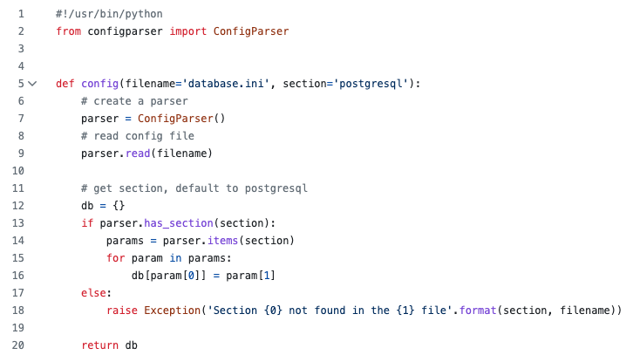
Professional approach: Step 2
Creation of config.py file

Slide 15
Professional approach: Step 3
Use the config.py file in your code
from config import config
try:
params = config()
conn = psycopg2.connect(**params)
cur = conn.cursor()
…
cur.execute(query)
conn.commit()
cur.close()
except (Exception, psycopg2.DatabaseError) as error:
print(error)
finally:
if conn is not None:
# close database connection
conn.close()
print('Database connection closed.')

