Slide 1
SELECT COMMAND
by
RAGE Uday Kiran

Slide 2
Outline
SELECT
SELECT-WHERE
SELECT-GROUP BY
SELECT with functions
SELECT-AS

Slide 3
SELECT
The SELECT statement is used to select data from a database.
The data returned is stored in a result table, called the result set.
Syntax
SELECT column1, column2, ... FROM table_name
WHERE
GROUP BY
Select
Data
Result set
Mandatory
Not mandatory

Slide 4

SELECT
The SELECT statement is used to select data from a database.
The data returned is stored in a result table, called the result set.
Syntax
SELECT column1, column2, ... FROM table_name1, table_name2,…
Select
Data
Result set

Slide 5


Need students names and gender
name and gender
Controlling Redundancy
(class-1 slide)
provide
Extract/filter
Table: students_info
SID | Name | Gender | Address
1 | Sato | Female | Tokyo
2 | Suzuki | Male | Chiba
3 | Takahashi | Male | Fukushima
4 | Tanaka | Male | Aizu
…
generate
Need students names and address
name and address
provide
Extract/filter
SELECT name,gender FROM students_info
SELECT name,address FROM students_info

Slide 6
Different Types of SELECT Commands
SELECT * from tableName
prints the entire data in a table
SELECT DISTINCT columnNames from tableName
Output unique rows in a table
SELECT * from tableName ORDER BY columnName asc/desc
Output the rows in ascending/descending order of columns
SELECT * from tableName LIMIT k
Outputs only first k rows in the result set

Slide 7
Examples
Table: students_info
Table: students_info
SID | Name | Gender | Address
1 | Sato | Female | Tokyo
2 | Suzuki | Male | Chiba
3 | Takahashi | Male | Fukushima
4 | Tanaka | Male | Aizu
…
SID | Name | Gender
1 | Sato | Female
2 | Suzuki | Male
3 | Takahashi | Male
4 | Tanaka | Male
…
Need students names and gender
answer in the slide note
Notes:
SELECT name, gender from students_info

Slide 8
Examples
Table: students_info
Table: students_info
SID | Name | Gender | Address
1 | Sato | Female | Tokyo
2 | Suzuki | Male | Chiba
3 | Takahashi | Male | Fukushima
4 | Tanaka | Male | Aizu
…
SID | Name | Gender | Address
1 | Sato | Female | Tokyo
2 | Suzuki | Male | Chiba
3 | Takahashi | Male | Fukushima
4 | Tanaka | Male | Aizu
…
Need the entire data in the table
answer in the slide note
Notes:
SELECT * from students_info

Slide 9
Examples
Table: students_info
SID | Name | Gender | Address
1 | Sato | Female | Tokyo
2 | Suzuki | Male | Chiba
3 | Takahashi | Male | Fukushima
4 | Tanaka | Male | Aizu
…
Table: students_info
Gender
Female
Male
Print the distinct genders in the table
answer in the slide note
Notes:
SELECT distinct(gender) from students_info

Slide 10
Examples
Table: students_info
Table: students_info
SID | Name | Gender | Address
1 | Sato | Female | Tokyo
2 | Suzuki | Male | Chiba
3 | Takahashi | Male | Fukushima
4 | Tanaka | Male | Aizu
…
SID | Name | Gender | Address
4 | Tanaka | Male | Aizu
3 | Takahashi | Male | Fukushima
2 | Suzuki | Male | Chiba
1 | Sato | Female | Tokyo
…
Print the student details in descending order of SID
answer in the slide note
Notes:
SELECT * from students_info ORDER BY sid DESC

Slide 11
Examples
Table: students_info
SID | Name | Gender | Address
1 | Sato | Female | Tokyo
2 | Suzuki | Male | Chiba
3 | Takahashi | Male | Fukushima
4 | Tanaka | Male | Aizu
…
Table: students_info
SID | Name | Gender | Address
1 | Sato | Female | Tokyo
2 | Suzuki | Male | Chiba
Print the first two rows in the table
answer in the slide note
Notes:
SELECT * from students_info LIMIT 2

Slide 12
SELECT - WHERE

Slide 13
SELECT - WHERE
SID | Name | Gender | Address
1 | Sato | Female | Tokyo
2 | Suzuki | Male | Chiba
3 | Takahashi | Male | Fukushima
4 | Tanaka | Male | Aizu
…
SELECT command works on the entire table
WHERE clause makes the command to work on particular rows
Example: SELECT * from students_info
WHERE gender=“Male”
Syntax:
SELECT column1, column2, ... FROM table_name1
WHERE

Slide 14
Operatus in SQL
Arthimatic operators
Comparison operators
Logical operator

Slide 15
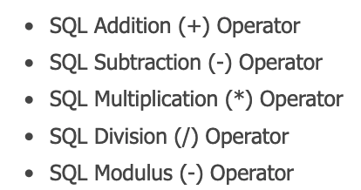
Arithematic Operators
arithmetic operators are useful to perform mathematical operations
Syntax
SELECT arithmeticOperators
FROM tableName
Mandatory
Non-mandatory
SID | Name | Gender | Address
1 | Sato | Female | Tokyo
2 | Suzuki | Male | Chiba
3 | Takahashi | Male | Fukushima
4 | Tanaka | Male | Aizu
…
SID
2
4
6
8
…
SELECT 12/4
SELECT SID*2
FROM students_info

Slide 16
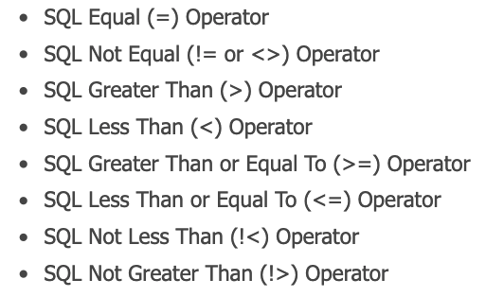
Comparision operators
Print all the students whose sid is more than 2
Comparision operators
SELECT * from students_info
WHERE sid>2
answer in the slide note
Notes:
SELECT * from STUDENTS_INFO
WHERE sid>2

Slide 17
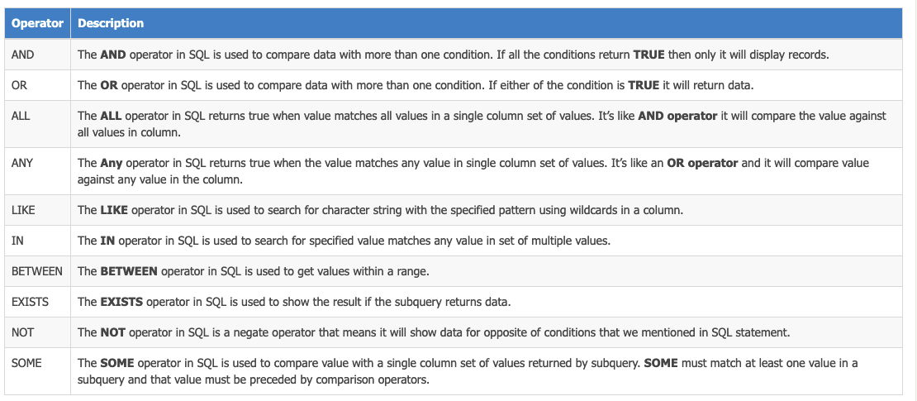
Logical Operators
logical operators are useful to perform some conditional and comparison checks in SQL statements.

Slide 18
CONDITIONAL AND COMPARISON
Conditional operations:
PURPOSE: establish condition between the columns
AND
OR
NOT
Comparison operators:
Purpose: check the values in a column
in
between
etc.

Slide 19
SYNTAX of SELECT
SID | Name | Gender | Height (cm) | Address
1 | Sato | Female | 140 | Tokyo
2 | Suzuki | Male | 150 | Chiba
3 | Takahashi | Male | 130 | Fukushima
4 | Tanaka | Male | 160 | Aizu
…
SELECT columns, arthematicOperators
FROM tableName
WHERE column_1 comparisonOperator value
conditionalOperator
column_2 comparisonOperator value
conditionalOperator
…
conditionalOperator
column_n comparisonOperator value
Print the name, gender, height in meters for students whose gender is “male” or height >=140 and height<=150
answer in the slide note
Notes:
SELECT name, gender, height/100
FROM students_info
WHERE
gender=“Male” OR height >=140 OR height <= 150

Slide 20
SELECT - Group by

Slide 21
Group by
The GROUP BY statement groups rows based on the values in a column
The GROUP BY statement is often used with aggregate functions
COUNT()
MAX()
MIN()
SUM()
AVG()
array_agg()
Numerical columns
String (supported may be by PostGres)
This command is ur Bread and Butter. Used to create datasets

Slide 22
SELECT-GROUP BY syntax
SELECT columnName, arthematicOperators
FROM tableName
group by columnName

Slide 23
Examples
Find the average height of students with respect to gender
SID | Name | Gender | Height (cm) | Address
1 | Sato | Female | 140 | Tokyo
2 | Suzuki | Male | 150 | Chiba
3 | Takahashi | Male | 130 | Fukushima
4 | Tanaka | Male | 160 | Aizu
…
answer in the slide note
Notes:
SELECT gender, avg(height) FROM students_info
GROUP BY gender

Slide 24
SELECT command

Slide 25
Generic SELECT command
SELECT columns, arthematicOperators
FROM tableName
WHERE column_1 comparisonOperator value
conditionalOperator
column_2 comparisonOperator value
conditionalOperator
…
conditionalOperator
column_n comparisonOperator value
GROUP BY column(s)

Slide 26
Good URLs to learn/practise SQL
https://www.w3schools.com/sql/default.asp
https://www.tutlane.com/tutorial/sql-server/sql-logical-operators

Slide 27
END

