Slide 1
Introduction to SQL
By
Rage Uday Kiran

Slide 2
Overview
Basic disk operations
Metadata and data
SQL for Metadata
SQL for data

Slide 3


Basic disk operations

Slide 4


Basic Operations on the Disk
Read-Write operations
Read (r)
Write (w)
Read a file
Write a file
Update a file

Slide 5
Need for Structured Query Language
Files can be written using programs
Files can be read programs
Limitations:
Everyone are not good at coding
Difficult to incorporate constraints
E.g., Age must be in numbers; joining date must be in dd-yy-yyyy format

Slide 6
Need for Structured Query Language
Solution:
Structured query language (SQL) for processing data
SQL to be as close to human language as possible
Foundation for SQL is Relational Algebra (discussed in next class)

Slide 7
Metadata and Data

Slide 8
Meta-data and Data
Data: Observable fact that can be recordable
Mr. Smith, 50 years old, male, America
Meta-data is the data that describes other data
Name, age, sex, country
Name is a string
Age is a real number
Sex is a string
Country is a string
Age cannot be more than 120 years

Slide 9

Meta-data and Data
CID | cName | cIntro
1 | Java | Programing language
2 | Database | Data analystics
…
Help me in classifying Metadata and data?

Slide 10
Visualization of MetaData and Data
Query
Error
If Query is correct, then
start processing
else
generate error
MetaData
Data
response/output

Slide 11
SQL for Metadata
(Create, Alter, Drop)

Slide 12

Handling Metadata using Schema
Data Abstraction is the key factor for Schema
supression of data organization details and storage, and highlighting the essential features to understand the data (Class 1)
Data
1 | Sato | Female | Tokyo
2 | Suzuki | Male | Chiba
3 | Takahashi | Male | Fukushima
4 | Tanaka | Male | Aizu
…
Representation
SID | Name | Gender | Address
Schema
Understanding SCHEMA is crucial for SQL

Slide 13

Basic Operations on Schema/Tables
Alter
Drop
create table <tableName>
Create
add
delete
Operator
alter table <tableName>
drop table <tableName>

Slide 14
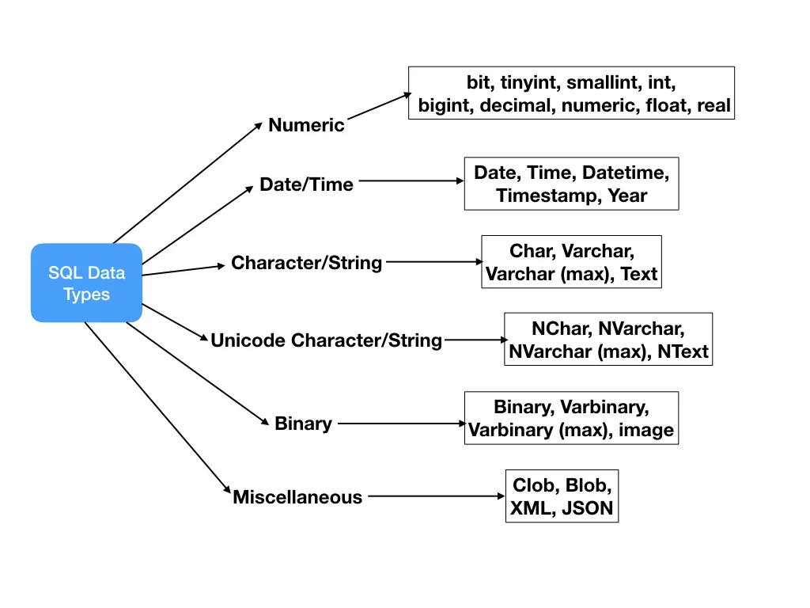
Basic attribute types
Frequently used
Varchar
Integer
Float
Date
Blob

Slide 15
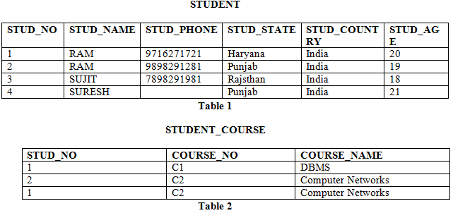
Constraints
primary key
foreign key
not null
attribute value cannot be empty
unique key
Each value of an attribute must be unique
primary key – foreign key
A primary key is used to ensure data in the specific column is unique. It is a column cannot have NULL values.
A foreign key is a column or group of columns in a relational database table that provides a link between data in two tables.
<discussed in further chapters>

Slide 16
SQL operations on Schema
create table <tableName>
Operator
add
delete
constraints
alter table <tableName>
join
join
drop table <tableName>
create table STUDENTS(sid integer primary key, name varchar not null, height float, address varchar)
alter table STUDENTS add column country varchar
alter table STUDENTS delete column country
drop table STUDENTS

Slide 17
Write an SQL QUERY to Create the below table
Table name: Students_Info
SID | Name | Gender | Address
1 | Sato | Female | Tokyo
2 | Suzuki | Male | Chiba
3 | Takahashi | Male | Fukushima
4 | Tanaka | Male | Aizu
…

Slide 18
Write an SQL Query to add additional two columns
Table name: Students_Info
SID | Name | Gender | Address | Age | DoB
1 | Sato | Female | Tokyo
2 | Suzuki | Male | Chiba
3 | Takahashi | Male | Fukushima
4 | Tanaka | Male | Aizu
…
DoB: Date of Birth

Slide 19
Write an SQL Query to delete Age column
Table name: Students_Info
SID | Name | Gender | Address | Age | DoB
1 | Sato | Female | Tokyo
2 | Suzuki | Male | Chiba
3 | Takahashi | Male | Fukushima
4 | Tanaka | Male | Aizu
…

Slide 20
Write an SQL Query to delete entire table
Table name: Students_Info
SID | Name | Gender | Address | DoB
1 | Sato | Female | Tokyo
2 | Suzuki | Male | Chiba
3 | Takahashi | Male | Fukushima
4 | Tanaka | Male | Aizu
…

Slide 21
SQL for Data
(Select, Insert, Update, and Delete)

Slide 22

Basic Operations on Data
Insert: Insert the data into a table
Update: Update the value(s) of a column(s) in a table
Delete: Delete tuples from a table
Select: Output the data from the tables
INSERT
UPDATE
DELETE
SELECT

Slide 23
INSERT INTO
The INSERT INTO statement is used to insert new records in a table.
SYNTAX
INSERT INTO table_name (column1, column2, column3, ...) VALUES (value1, value2, value3, ...);
INSERT INTO table_name VALUES (value1, value2, value3, ...);

Slide 24
Example: SQL query
Write an SQL query to create a table with
Name: students_info
Attributes: SID integer cannot be empty
NAME varchar cannot be empty
GENDER varchar
ADDRESS varchar
Table name: students_info
SID | NAME | GENDER | ADDRESS
answer is in notes
Notes:
CREATE TABLE students_info(SID integer not null, name varchar not null, gender varchar, address varchar)

Slide 25
Example: Insert first row into the table
Write an SQL query to insert the following details:
SID:1
NAME: Sato
GENDER: Female
ADDRESS: Tokyo
Table name: students_info
SID | NAME | GENDER | ADDRESS
1 | Sato | Female | Tokyo
answer is in notes
Notes:
INSERT INTO students_info
values (1,”Sato”,”Female”,”Tokyo”);

Slide 26
Example: Insert second row into the table
Write an SQL query to insert the following details:
ADDRESS: Chiba
GENDER:Male
NAME:Suzuki
SID:2
Table name: Students_Info
SID | Name | Gender | Address
1 | Sato | Female | Tokyo
2 | Suzuki | Male | Chiba
answer is in notes
Notes:
INSERT INTO students_info(Address,gender,name,sid)
VALUES (“Chiba”,”Male”, ”Suzuki”,2)

Slide 27
Example
Table name: Students_Info
SID | Name | Gender | Address
1 | Sato | Female | Tokyo
2 | Suzuki | Male | Chiba
3 | Takahashi |  | Fukushima
Write an SQL query to insert the following details:
SID:3
NAME: Takahashi
Address:Fukushima
answer is in notes
Notes:
INSERT INTO students_info
VALUES (3,”TAKAHASHI”,null, ”Fukushima”)
Note: NULL is not a string. Do not put it in quotations
--------------------
INSERT INTO students_info (SID,NAME,ADDRESS)
VALUES (3,”Takahashi”,”Fukushima”)

Slide 28
UPDATE
The UPDATE statement is used to modify the existing records in a table.
UPDATE table_name SET column1 = value1, column2 = value2, ...
WHERE condition;
Mandatory
Not mandatory
If where clause is missing that all rows gets updated
One of the most cautious commands to execute

Slide 29
Example
Write SQL query to update gender for Takahashi to Male
Table name: Students_Info
SID | Name | Gender | Address
1 | Sato | Female | Tokyo
2 | Suzuki | Male | Chiba
3 | Takahashi |  | Fukushima
Table name: Students_Info
SID | Name | Gender | Address
1 | Sato | Female | Tokyo
2 | Suzuki | Male | Chiba
3 | Takahashi | Male | Fukushima
answer is in notes
Notes:
UPDATE students_info
SET Gender=“Male”
WHERE Name=“Takahashi”

Slide 30
DELETE
The DELETE statement is used to delete existing records in a table.
Syntax:
DELETE FROM table_name
WHERE condition;
Mandatory
Not mandatory
If where clause is missing that all rows gets updated

Slide 31
Example
Write SQL query to delete the third row
Table name: Students_Info
SID | Name | Gender | Address
1 | Sato | Female | Tokyo
2 | Suzuki | Male | Chiba
3 | Takahashi | Male | Fukushima
Table name: Students_Info
SID | Name | Gender | Address
1 | Sato | Female | Tokyo
2 | Suzuki | Male | Chiba
answer is in notes
Notes:
delete from students_info where sid=3

