Slide 1
Object Oriented Programming
by
RAGE Uday Kiran

Slide 2
Outline
Lambda
Regular expressions
Object Oriented Programming
Class
Objects
Polymorphism
Encapsulation
Inheritance
Data Abstraction
Abstract classes and
Interfaces

Slide 3
Outline
Lambda
Regular expressions
Object Oriented Programming
Class
Objects
Polymorphism
Encapsulation
Inheritance
Data Abstraction
Abstract classes and
Interfaces

Slide 4
Lambda functions
A lambda function is a small anonymous function.
A lambda function can take any number of arguments but only have one expression.
Syntax:
lambda arguments : expression
Name of the lambda function
task to perform
z = lambda p : p + 5 print(z(2))
input variable
Explanation
z = lambda p : p + 5 print(z(2))
output is 7
Calling the lambda function

Slide 5
Power of Lambda
Lambda is used as an anonymous function inside another function.
declaring a function with a return Lambda value
def multiply(n): return lambda a : a * n
def multiply(n): return lambda a : a * n
doubler = multiply(2)
Explanation
doubler = multiply(2)
assign n =2
print(doubler(20))
print(doubler(20))
call the lambda with a =20
output is 40

Slide 6
Outline
Lambda
Regular expressions
Object Oriented Programming
Class
Objects
Polymorphism
Encapsulation
Inheritance
Data Abstraction
Abstract classes and
Interfaces

Slide 7
Regular Expressions (RegEx)
Regular Expression is a sequence of characters that forms a search pattern.
import the regular expression module
import re
text = "The rain in Spain”
x = re.search("^The.*Spain", text)
if x:
print("YES! We have a match!")
else:
print("No match")
import re
text = "The rain in Spain”
x = re.search("^The.*Spain", text)
if x:
print("YES! We have a match!")
else:
print("No match")
define a string
Explanation
call a function to perform a task
calling search function in re
specifying
search string
specifying
where to search

Slide 8
Functions of Regular Expressions
The re module offers a set of functions that allows us to search a string for a match:
Function | Description
findall | Returns a list containing all matches
search | Returns a Match object if there is a match anywhere in the string
split | Returns a list where the string has been split at each match
sub | Replaces one or many matches with a string

Slide 9
Metacharacters
Metacharacters are characters with a special meaning
Character | Description | Example
[] | A set of characters | "[a-m]"
\ | Signals a special sequence (can also be used to escape special characters) | "\d"
. | Any character (except newline character) | "he..o"
^ | Starts with | "^hello"
$ | Ends with | "planet$"
* | Zero or more occurrences | "he.*o"
+ | One or more occurrences | "he.+o"
? | Zero or one occurrences | "he.?o"
{} | Exactly the specified number of occurrences | "he.{2}o"
| | Either or | "falls|stays"
() | Capture and group
[a-z]
[A-Z]
[0-9]
[a-zA-Z]
[a-zA-Z0-9]
[a-zA-Z]*
very important
multiLingualText=“I am ラゲ ウダイキラン”
Japanese = re.sub(“[a-zA-z]*”, ””,multiLingualText)
# Remove all English letters from the text
small or capital letters
Zero to multiple occurrences
from the string
Replace with an empty string

Slide 10
Sets
A set is a list of characters inside a pair of square brackets [] with a special meaning
[a-z]
[A-Z]
[0-9]
[a-zA-Z]
[a-zA-Z0-9]
[a-zA-Z]*
Set | Description
[arn] | Returns a match where one of the specified characters (a, r, or n) is present
[a-n] | Returns a match for any lower case character, alphabetically between a and n
[^arn] | Returns a match for any character EXCEPT a, r, and n
[0123] | Returns a match where any of the specified digits (0, 1, 2, or 3) are present
[0-9] | Returns a match for any digit between 0 and 9
[0-5][0-9] | Returns a match for any two-digit numbers from 00 and 59
[a-zA-Z] | Returns a match for any character alphabetically between a and z, lower case OR upper case
[+] | In sets, +, *, ., |, (), $,{} has no special meaning, so [+] means: return a match for any + character in the string
multiLingualText=“I am ラゲ ウダイキラン”
Japanese = re.sub(“[a-zA-z]*”, ””,multiLingualText)
# Remove all English letters from the text
small or capital letters
Zero to multiple occurrences
from the string
Replace with an empty string

Slide 11
Outline
Lambda
Regular expressions
Object Oriented Programming
Class
Objects
Polymorphism
Encapsulation
Inheritance
Data Abstraction
Abstract classes and
Interfaces

Slide 12
Object Oriented Programing (OOPs)
An object-oriented paradigm is to design the program using classes and objects.
Unlike Java, Python does not strictly follow OOPs
Python programming language supports different programming approaches
Functional programming,
Modular programming, and
OOPs

Slide 13
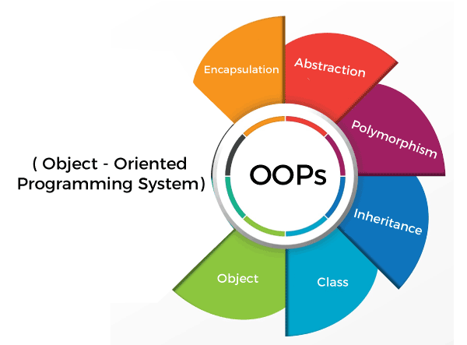
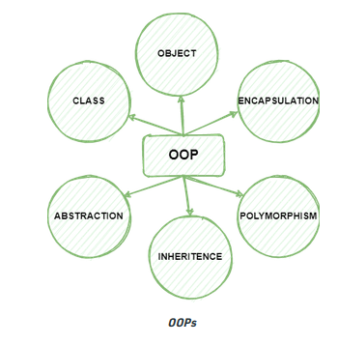
Python OOPs Concepts
Main concepts of Object-Oriented Programming(OOPs)
Classes
Objects
Polymorphism
Encapsulation
Inheritance
Data Abstraction

Slide 14
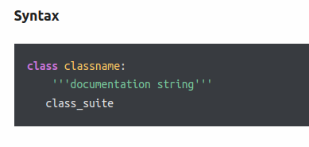
Classes
Use the keyword "class" to define a Class.
__init__(parameters) is the constructor of a class.
__init__() is the default constructor
Documentation string (optional):
Represents a description of the class.
class_suite:
the class suite contains code.
That is attributes and methods.

Slide 15
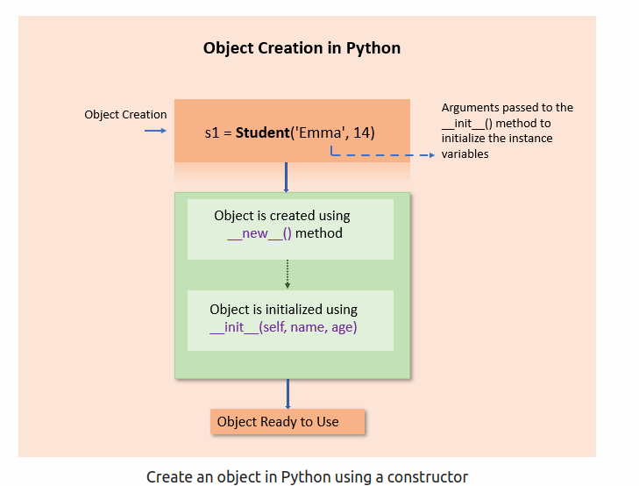
Objects
An object is created by simply calling the class
Note: Memory will be consumed only after creating objects.
object1 = className()

Slide 16
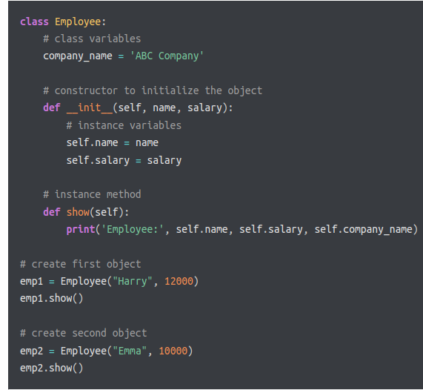
OOP Example: Creating Class and Object in Python
Parameters/arguments
constructor
Instance Variables
Instance Method
Object of Class Employee

Slide 17
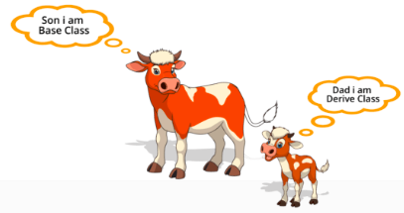
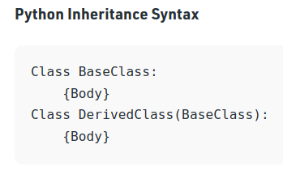
Inheritance
Inheritance is the capability of one class to derive or inherit the properties from another class.
Types of classes:
Parent Class(Super / Base class)
Child Class(Subclass/ Derived class)

Slide 18
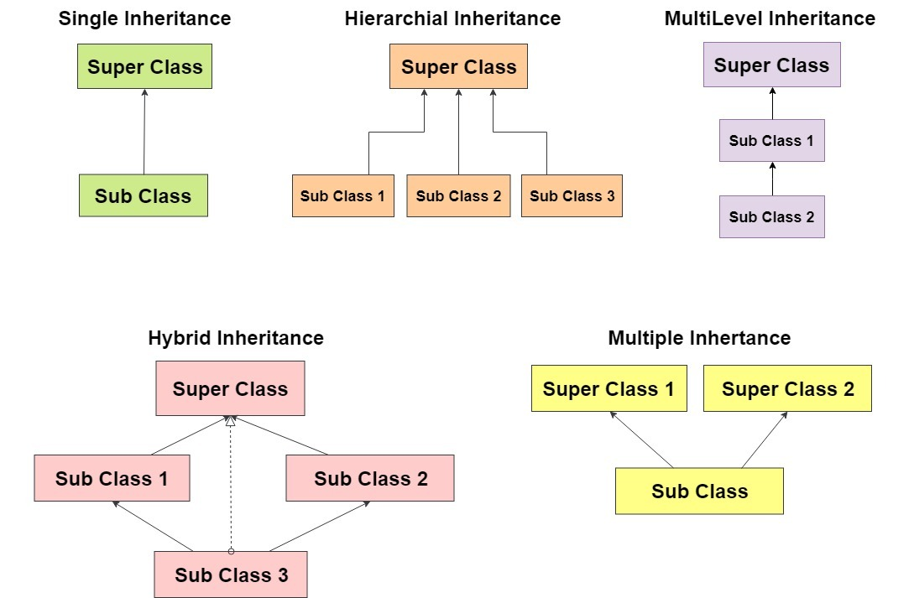
Types of Inheritance

Slide 19
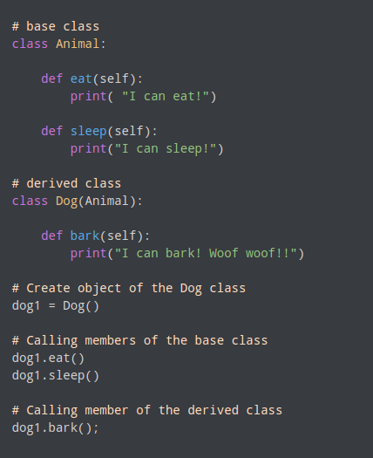

Example
Output :

Slide 20
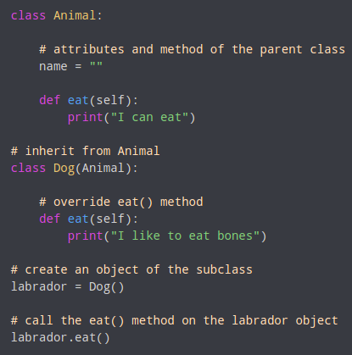

Method Overriding
If the parent and child classes have same method, then child class overrides the parent method.
Base Class
Method(x)
output
Derived Class
Method(x)
NOTE : If we need to access the superclass method from the subclass, we use the "super()" method.

Slide 21
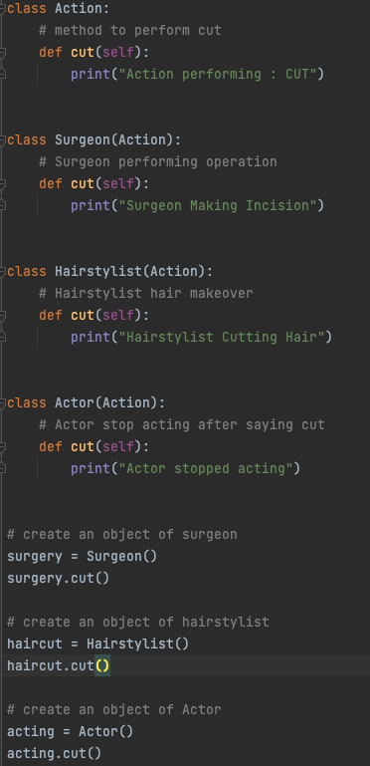
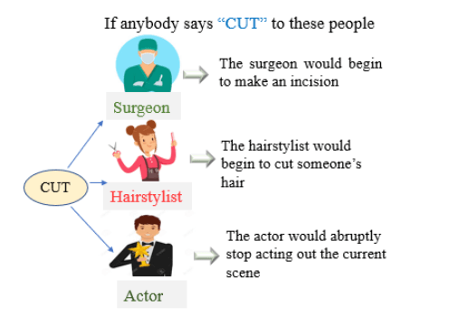

Polymorphism
Polymorphism is the ability of an object to take many forms.
Polymorphism allows us to perform the same action in many different ways.
Output

Slide 22
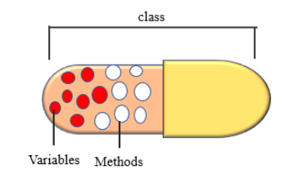
Encapsulation
Encapsulation is a method of wrapping data and functions into a single entity.
Encapsulation provides security by hiding the data from the outside world.
Public Access Modifier –
The public member is accessible from inside or outside the class.
For example : age
Private Access Modifier –
The private member is accessible only inside class.
Define a private member by prefixing the member name with two underscores.
For example : __age
Protected Access Modifier –
The protected member is accessible from inside the class and its sub-class.
Define a protected member by prefixing the member name with an underscore.
For example : _age

Slide 23
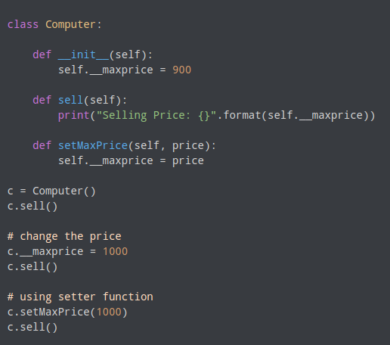

Example
Output:
Notice that you cannot change the __maxprice
Notice that you can only change the __maxprice using
the inbuilt function provided by the class.

Slide 24
Abstract Classes
Abstract classes are the blueprint of other classes, a prototype.
It is used to hide the internal functionality and structure of the classes from the users.
Abstract methods doesn't have any implementation, it only contains set of variables and methods that needs to be created in its child class.

Slide 25
How to implement abstract class in Python?
We cannot create an abstract class in Python like we do in JAVA.
Python provides a module that allows us to define abstract classes.
The module we can use to create an abstract class by importing abc module
from abc import ABC
class <Abstract_Class_Name>(ABC):
# body of the class
import
mention
from abc import ABC
class DemoAbstractClass(ABC):
# body of the class

Slide 26
Abstract Method
To define abstract method we use @abstractmethod decorator of the abc module.
from abc import ABC, abstractmethod
class DemoAbstractClass(ABC):
@abstractmethod
def DemoAbstractMethod(self, other parameter):
pass

Slide 27
Abstract Class Example:
Abstract.py
Circle.py
main.py
from abc import ABC, abstractmethod class Shape(ABC): def __init__(self, shape_name): self.shape_name = shape_name @abstractmethod def draw(self): pass
from Shape import Shape class Circle(Shape): def __init__(self): super().__init__("circle") def draw(self): print("Drawing a Circle")
from Circle import Circle #create a circle object circle = Circle() circle.draw()
What is the output of ”main file"?

Slide 28
Interfaces
Interface is a collection of methods that should be provided by implementing class.
Interface is a way of writing an organized code and to achieve abstraction.
The package zope.interface provides an implementation of "object interfaces" for python.
import zope.interface
class MyInterface(zope.interface.Interface):
x = zope.interface.Attribute("foo")
def method1(self, x):
pass
def method2(self):
pass
class IMyInterface(zope.interface.Interface): # methods and attributes

Slide 29
Implementing Interface:
Interfaces are implemented using implementer decorator on class.
import zope.interface
class MyInterface(zope.interface.Interface):
x = zope.interface.Attribute("foo")
def method1(self, x):
pass
def method2(self):
pass
@zope.interface.implementer(MyInterface)
class MyClass:
def method1(self, x):
return x**2
def method2(self):
return "foo"
@zope.interface.implementer(*interfaces) class Class_name: # methods

Slide 30
Some Advanced Topics on Interface. Read for yourself, if interested.

Slide 31
Built-in methods in interface:
implementedBy(class): returns a true or false value that is True if the class implements the interface and False otherwise.
providedBy(object): return a boolean value that is True if the object provides the interface and False otherwise.
providedBy(class): always return False since the class does not offer the interface but instead implements it.
list(zope.interface.implementedBy(class)): produce a list of interfaces that class has implemented.
list(zope.interface.providedBy(object)): produce a list of interfaces that an object has provided.
list(zope.interface.providedBy(class)): always produce an empty list since the class does not supply the interface but does implement it.

Slide 32
Declaring interface:
Implementing interface:
Output:
@zope.interface.implementer(Interface) class Class_name: def method1(self, x): return x**2 def method2(self): return "I am a zope.interface attribute" obj = Class_name() # ask an interface whether it is implemented by a class: print(Interface.implementedBy(Class_name)) # Class_name does not provide Interface but implements it: print(Interface.providedBy(Class_name)) # ask whether an interface is provided by an object: print(Interface.providedBy(obj)) # ask what interfaces are implemented by a class: print(list(zope.interface.implementedBy(Class_name))) # ask what interfaces are provided by an object: print(list(zope.interface.providedBy(obj))) # class does not provide interface print(list(zope.interface.providedBy(Class_name)))
import zope.interface
class Interface(zope.interface.Interface): x = zope.interface.Attribute("I am a zope.interface attribute") def method1(self, x): pass def method2(self): pass
True False True
[<InterfaceClass __main__.Interface>] [<InterfaceClass __main__.Interface>] []

Slide 33
Inheritence in Interface:
Interfaces can extend other interfaces by listing other interfaces as base interfaces.
Several functions are:
Extends(interface): returns a boolean value, whether one interface extends another
IsOrExtends(interface): returns a boolean value, whetherinterfaces are same or one extends another
IsEqualOrExtendedBy(interface): return a boolean value, whether interfaces are same or one is extended by another.

Slide 34
Declaring interfaces:
Implementing interface:
Output:
import zope.interface
class BaseI(zope.interface.Interface):
def m1(self, x):
pass
def m2(self):
pass
class DerivedI(BaseI):
def m3(self, x, y):
pass
@zope.interface.implementer(DerivedI)
class cls:
def m1(self, z):
return z**3
def m2(self):
return 'foo'
def m3(self, x, y):
return x ^ y
# Get base interfaces
print(DerivedI.__bases__)
# Ask whether baseI extends DerivedI
print(BaseI.extends(DerivedI))
# Ask whether baseI is equal to or is extended by DerivedI
print(BaseI.isEqualOrExtendedBy(DerivedI))
# Ask whether baseI is equal to or extends DerivedI
print(BaseI.isOrExtends(DerivedI))
# Ask whether DerivedI is equal to or extends BaseI
print(DerivedI.isOrExtends(DerivedI))
False True False True

Slide 35
The END

