Slide 1

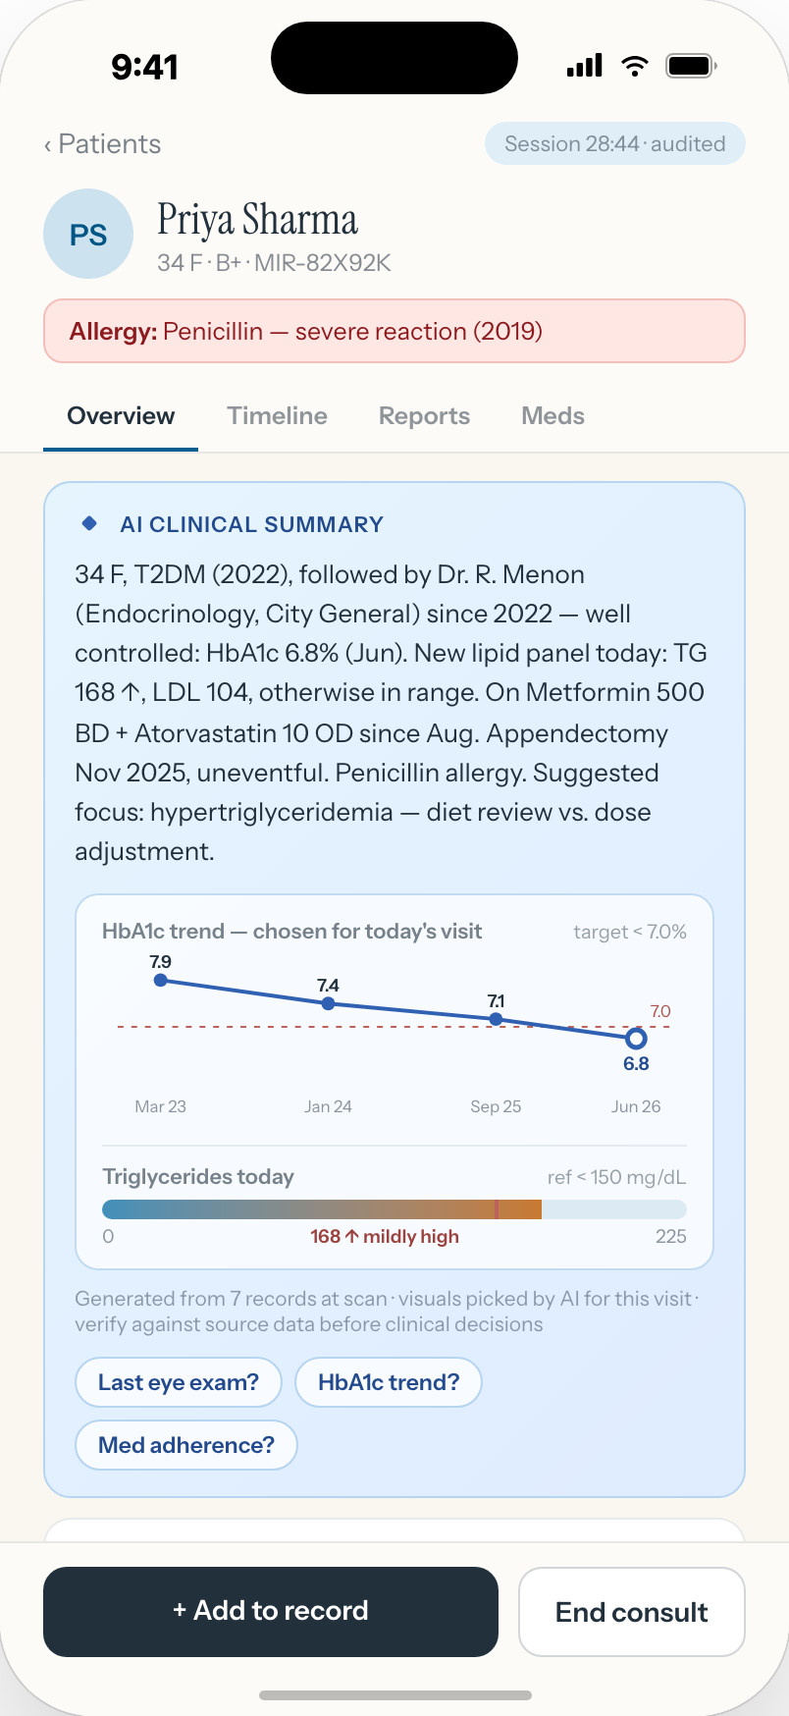
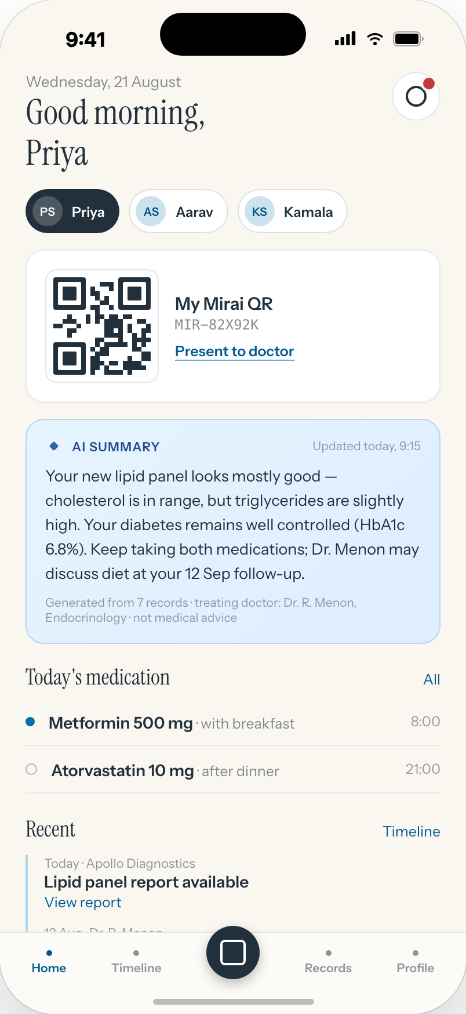
Mirai
The chart is ready before the patient sits down.
One patient · one identity · one QR · complete history · controlled access
A patient-centric health record with clinical AI, built on top of the hospital systems you already run.
Briefing for the clinical investor panel · September 2026
Notes:
Open with the promise, not the product. The panel are clinicians: the sentence they will remember is "the chart is ready before the patient sits down." Everything that follows is evidence for that sentence.

Slide 2




THE OPD, TODAY
Ravi, 62. Stented in February. Diabetic since 2019. He is your 3:40 patient.
Angiogram report
Other hospital · paper
Prescription
WhatsApp photo
He arrives with a carry bag: an angiogram report from another hospital, two WhatsApp photos of prescriptions, a discharge summary from February, and last week’s HbA1c from a lab you do not use.
His cardiologist changed the beta-blocker dose on the 20th. Nobody told you. The file says nothing.
You have eight minutes. The first four go to reading.
Discharge summary
February · scanned PDF
HbA1c
Outside lab · SMS link
Beta-blocker change
Cardiology OPD · not in your file
Find the papers
Read them
Reconcile what changed
Examine & decide
Write
Time that is not medicine
Time that is medicine
2
Notes:
Do not rush this slide. Let them recognise the patient. Ask: how many of your 3:40 patients arrive like this? The point is not that doctors are slow. It is that the record is scattered, unsummarised and silent about what another department changed.

Slide 3


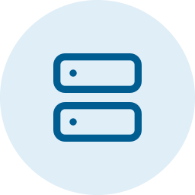




FRUSTRATIONS
The slowest part of the consult is reading.
Scattered
Unsummarised
Old systems
Siloed
Paper, PDFs, WhatsApp photos, other hospitals’ letterheads. Every report in its own format, none of them in one place.
You read the whole file to find the three numbers that matter today. Nothing tells you what changed since the last visit.
The HIS was built for billing and admissions, not for clinicians. A lab trend is a dozen clicks; the discharge summary is a scan.
A co-managed patient sees two specialists who never see each other’s notes, until something goes wrong.
Paid for three ways
Time
Money
Attention
Fewer patients per OPD session.
Investigations repeated because the report is in a bag at home.
Decisions made on an incomplete file.
3
Notes:
Four frustrations, one root cause: the record exists but cannot be read quickly. Name the cost explicitly. Time is throughput. Money is repeat investigations and length of consult. Attention is the one they care about most: a decision made without the full file.

Slide 4



WHY IT IS STILL UNSOLVED
Every previous answer meant starting over.
Time
Money
Effort
Replacing the HIS means years of migration. Clinicians carry the disruption while the vendor carries the invoice.
Rip-and-replace costs crores, plus a change freeze. Most hospitals have just finished the last one.
EMRs asked doctors to type more. Every minute typing is a minute not consulting, so the data never got entered.
Doctor app · Patient app
The insight
the reading layer
The records already exist. Every lab, discharge and prescription is finalised somewhere in your building. The problem is not creating data. It is reading it, in one place, in seconds.
Mirai
identity · consent · AI brief · audit
Your HIS · LIS · PACS
stay the system of record
Nothing is replaced. Mirai sits on top.
4
Notes:
This is the reframe. They have been sold "digital transformation" before and it meant replacing systems. Mirai does not. The hospital systems stay the system of record. Mirai is a reading layer that receives finalised results, the same way a lab sends a result today.

Slide 5
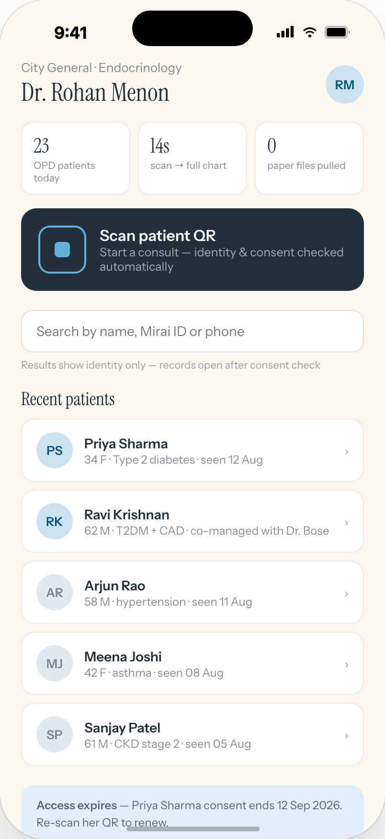



WHAT YOU ACTUALLY WANT
Scan. Fourteen seconds. The chart has been read for you.
You look at the patient, not the file.
The brief is one paragraph, written for your specialty, with the three numbers that matter today.
You already know what cardiology changed last week.
Every department’s finalised records, one timeline. No surprises in the bag.
The allergy is the first line. Every time.
And the warning fires at the moment of prescribing, not at the pharmacy.
23
14 s
0
OPD patients today
scan → full chart
paper files pulled
The doctor home screen, as designed. These are the targets the pilot will measure.
Notes:
Paint the outcome. The three feelings are: calm (you are present with the patient), certainty (nothing from another department is missing), safety (allergy first, warning at prescribing). The tiles are the doctor home screen: they are the targets we designed to, and what the pilot will measure.

Slide 6
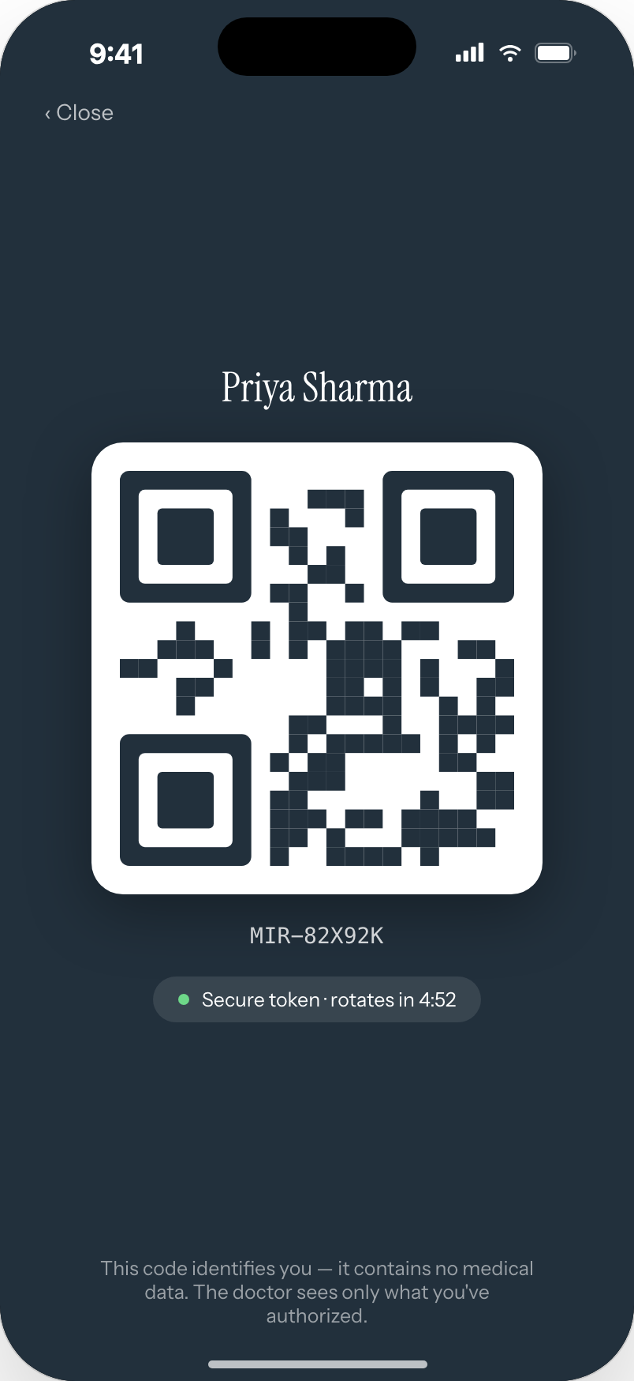
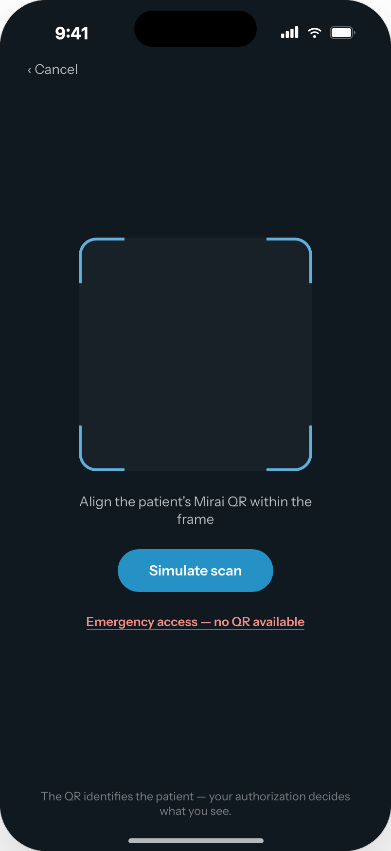
MIRAI IN ONE LINE
One patient. One identity. One QR.
The patient carries the record
Identifies. Never authorises.
Scan starts the consult
A phone number and an OTP. Family profiles on one account. Reports arrive on the phone the day they are finalised.
An opaque token that carries no medical data and rotates every five minutes. What the doctor sees is decided by authorisation and consent.
Identity resolved, consent checked, session logged. The doctor’s own hospital records are there before a single patient enrols.
6
Notes:
Three screens, one principle: the QR identifies the patient; authentication and authorisation decide what the doctor can see. This is why the QR is safe to print on a card for patients without phones. Note the last caption: the hospital already holds the records it created, so its doctors get value on day one.

Slide 7
THE DOCTOR’S VIEW
The whole history, read for your specialty, at the moment of scan.
1
Allergy first. Always.
The red strip sits above the tabs. It cannot be scrolled away.
2
A brief, not a file.
Seven records became one paragraph: control, what is new today, current medication, past surgery, a suggested focus. Written for an endocrinologist.
3
The chart chooses its own visual.
HbA1c against target, triglycerides against reference. Picked for this visit, rendered live. A cardiologist would get an EF trend instead.
4
Verify against source.
Every brief states where it came from. The original report is one tap away. The AI never writes to the record.
7
Notes:
Walk the screen top to bottom. Priya Sharma, 34, type 2 diabetes. Point out that the brief ends with a suggested focus, not a diagnosis. Point 4 is the one to slow down on: the source line, the original PDF one tap away, and the fact that nothing generated ever enters the record.

Slide 8
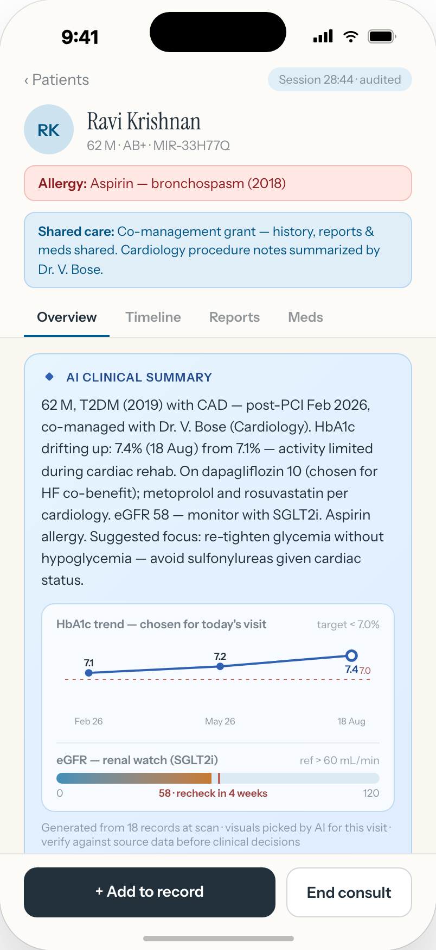
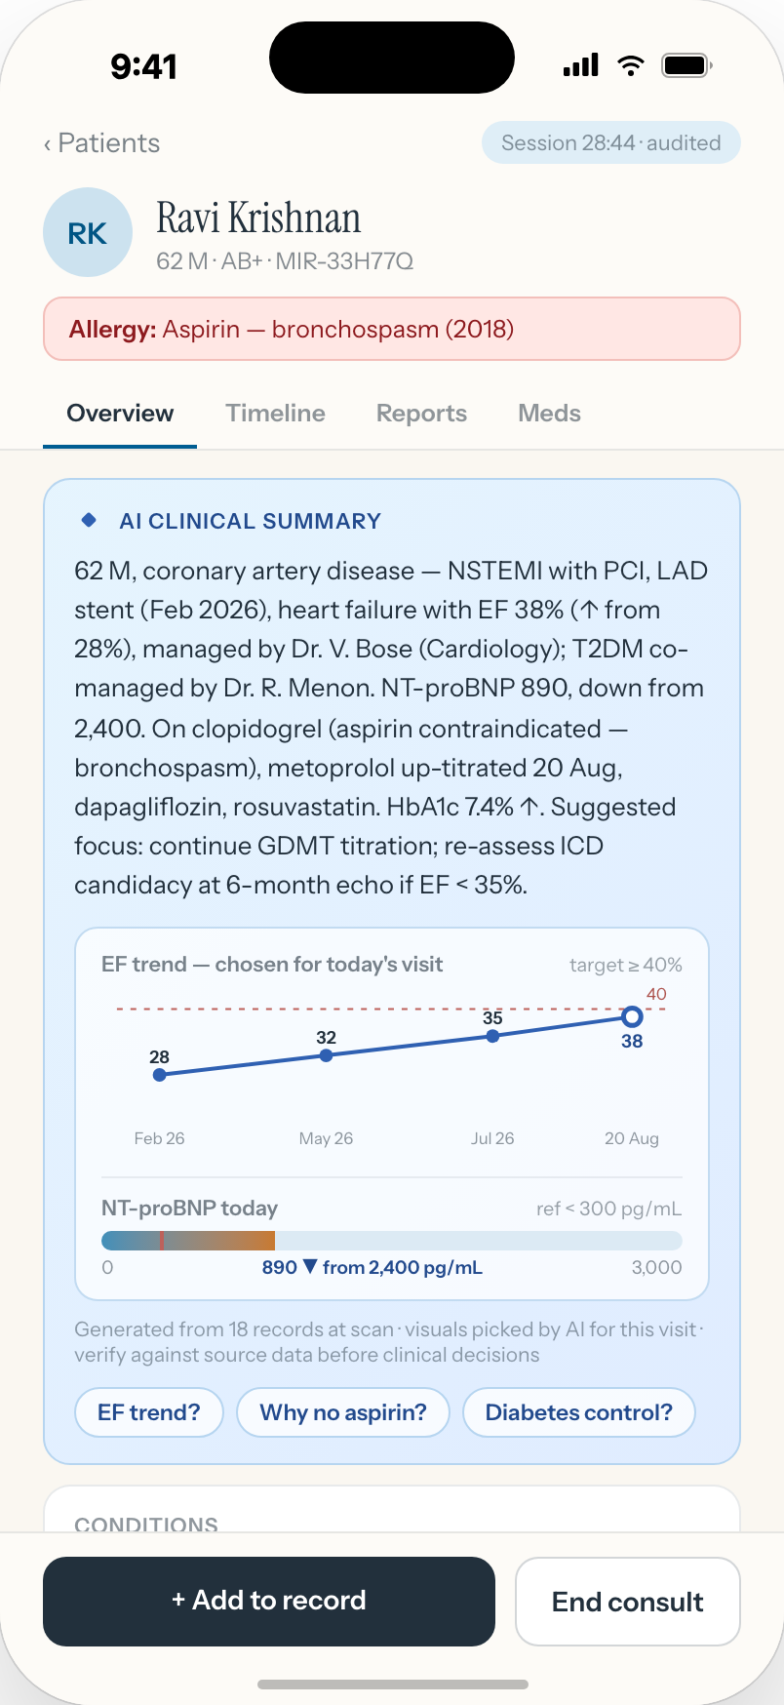



ACROSS DEPARTMENTS
Same patient. Two specialists. Each gets the brief written for them.
Endocrinology · Dr. Menon
Cardiology · Dr. Bose
Ravi Krishnan, 62
NSTEMI with PCI in February. Heart failure, EF 38%. Type 2 diabetes. Aspirin allergy. Co-managed.
One record, two briefs
The endocrinologist gets the HbA1c trend and an eGFR watch for the SGLT2 inhibitor. The cardiologist gets the EF trend and NT-proBNP. Same eighteen records.
Consent scope is visible
The shared-care banner at the top of the chart says exactly what the co-management grant covers.
Both see what either adds
A prescription written in one OPD is on the other’s timeline before the patient reaches the corridor.
8
Notes:
This is the slide for a hospital with departments. The same patient opened by two doctors produces two different briefs, each with the visuals that specialty needs. Neither doctor had to ask the other what changed. Emphasise: the beta-blocker up-titration from the opening story is on the endocrinologist’s screen.

Slide 9
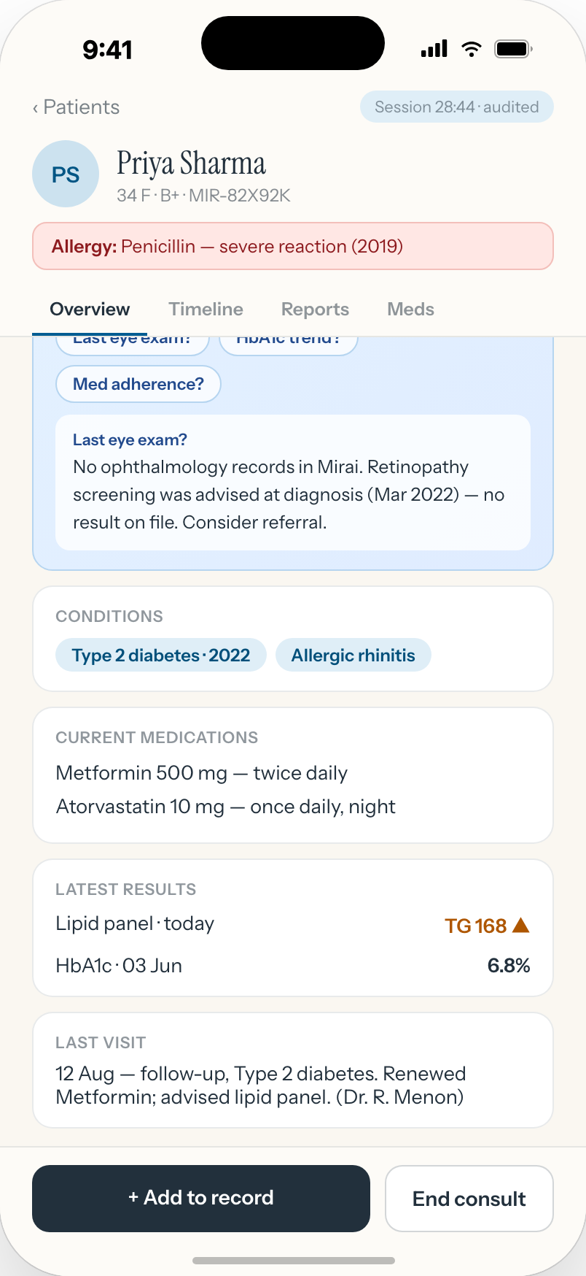
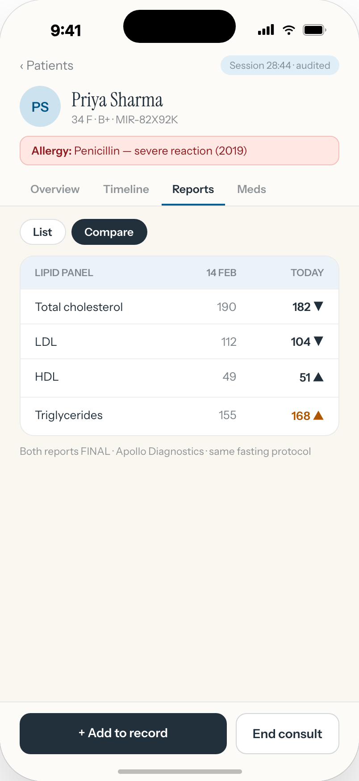
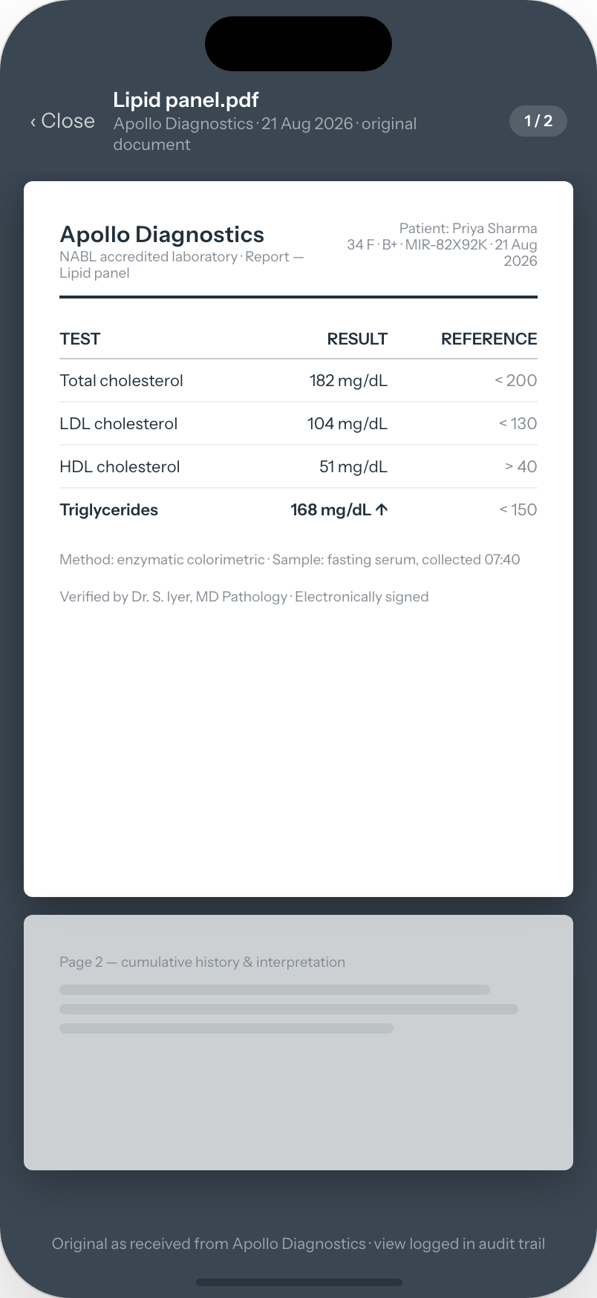
WHEN YOU HAVE A QUESTION
Ask the record. Compare the reports. Open the original.
“Last eye exam?”
Two lipid panels, side by side
The original, as received
Answers come only from the record. No ophthalmology record on file, so it says so, and suggests the referral. It does not guess.
Same lab, same fasting protocol, both final. Triglycerides 155 to 168. The comparison a registrar would spend ten minutes assembling.
Letterhead, reference ranges, pathologist’s signature. Because a summary is only as trustworthy as the source it points to. The view is logged.
9
Notes:
Three ways a clinician interrogates a record. The first answer is the important one: when there is no record, the system says there is no record. That behaviour, refusing rather than inventing, is what makes the AI usable in a clinic.

Slide 10
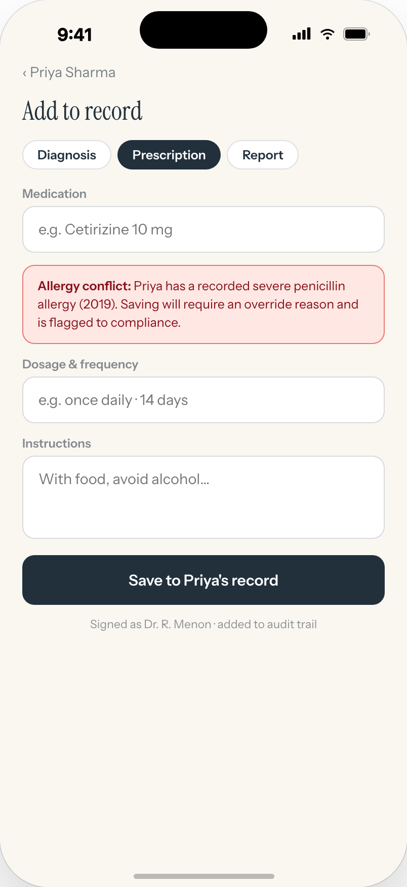
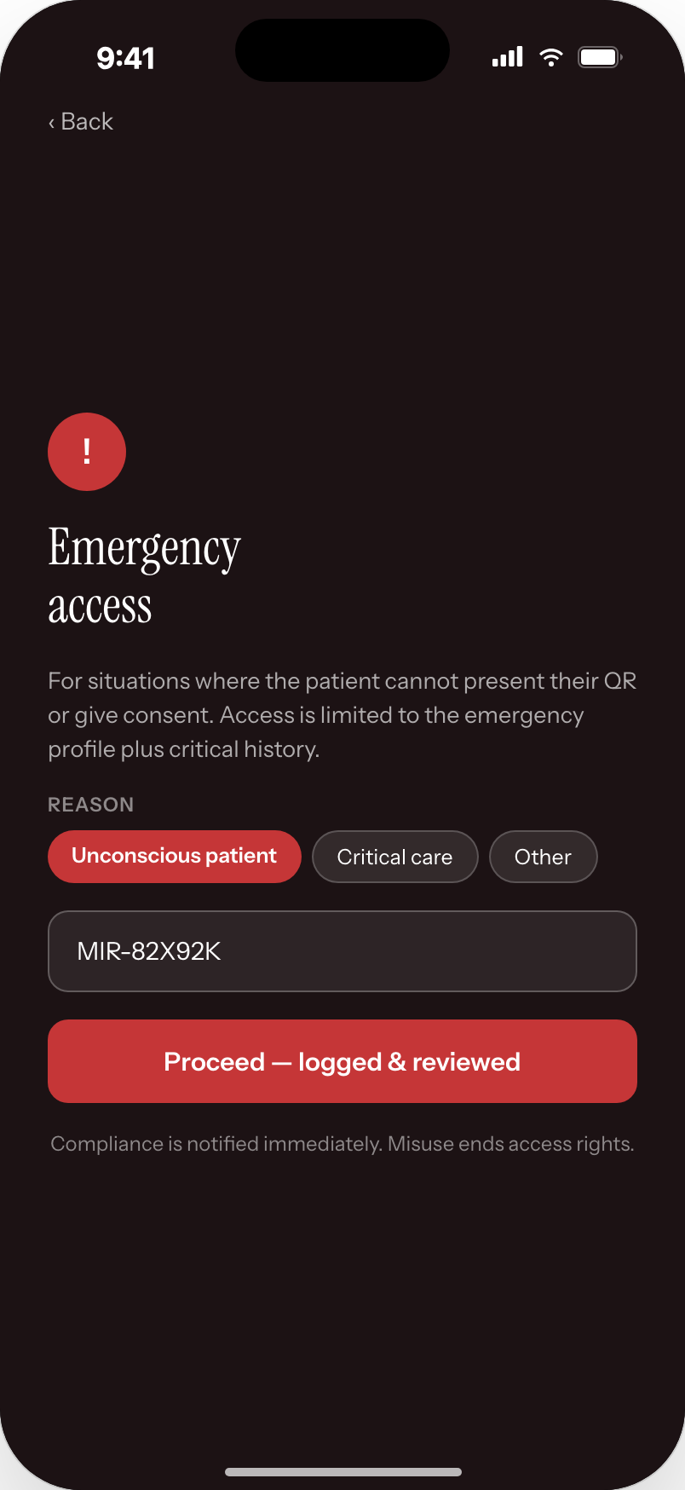




GUARDRAILS
Built to be trusted by the doctor who signs.
Allergy conflict at the moment of prescribing
Amoxicillin for a patient with a recorded penicillin reaction: the warning appears before you save. Override needs a reason and is flagged to compliance.
Break-glass for the unconscious patient
No QR, no consent: emergency access with a mandatory reason, limited to the emergency profile and critical history. Compliance and the patient are notified immediately.
Every view, write and scan is audited
Append-only and hash-chained. The session pill on the chart says “audited” because it is.
The AI never writes to the record
It reads. You decide. Nothing enters the chart without the clinician’s signature.
10
Notes:
Senior clinicians will ask about safety before they ask about features. Show the allergy warning firing on the prescribing screen. Show that emergency access exists, is constrained, and is reviewed. Then the two sentences that matter: everything is audited, and the AI never writes to the record.

Slide 11
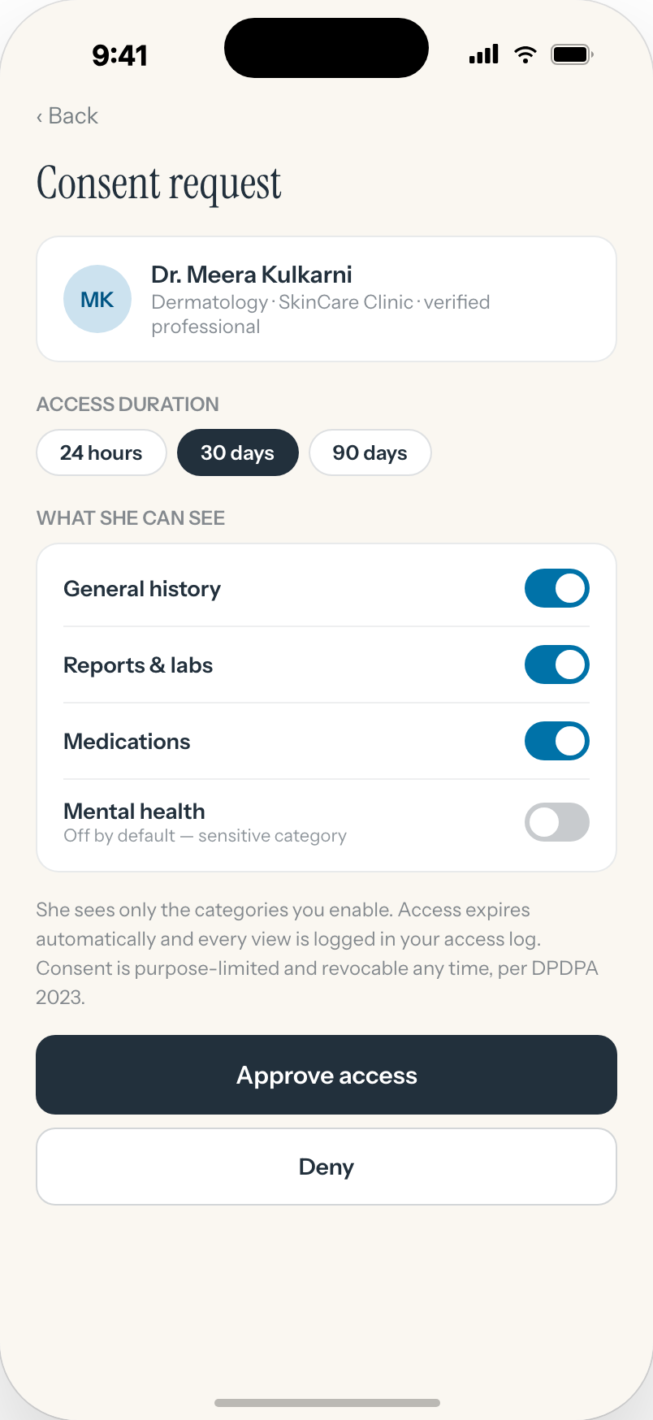
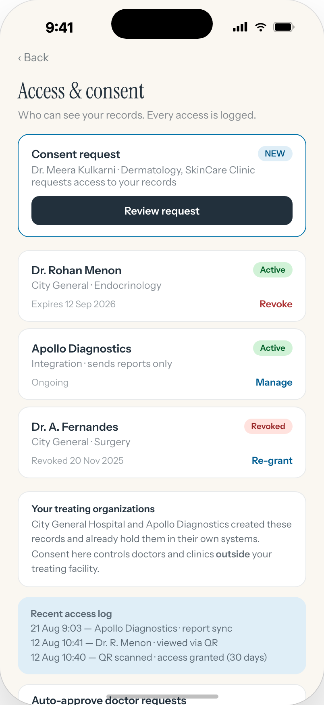
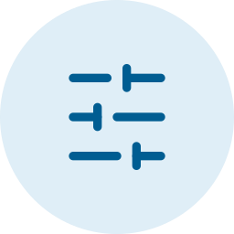



THE PATIENT’S SIDE
The patient decides who sees what, and for how long.
Categories, not all-or-nothing
General history, reports, medications, each a switch. Mental health is off by default.
Time-bound by default
24 hours, 30 days or 90 days. Expiry is automatic. Revocation takes effect on the next read.
Verified doctors get in instantly
Auto-approve is on by default: the patient is notified and can revoke with one tap. The hospital keeps the records it created; consent governs outside doctors.
DPDPA 2023 rights, inside the app
Download my data. Request correction or erasure. Nominate someone to act for me. Contact the grievance officer.
11
Notes:
Consent is a first-class object in Mirai: scoped by grantee, category, duration and purpose, and evaluated on every read. That is the Digital Personal Data Protection Act posture expressed as product behaviour rather than as a policy document. The "treating organisations" card matters to a hospital: your own records stay yours.

Slide 12
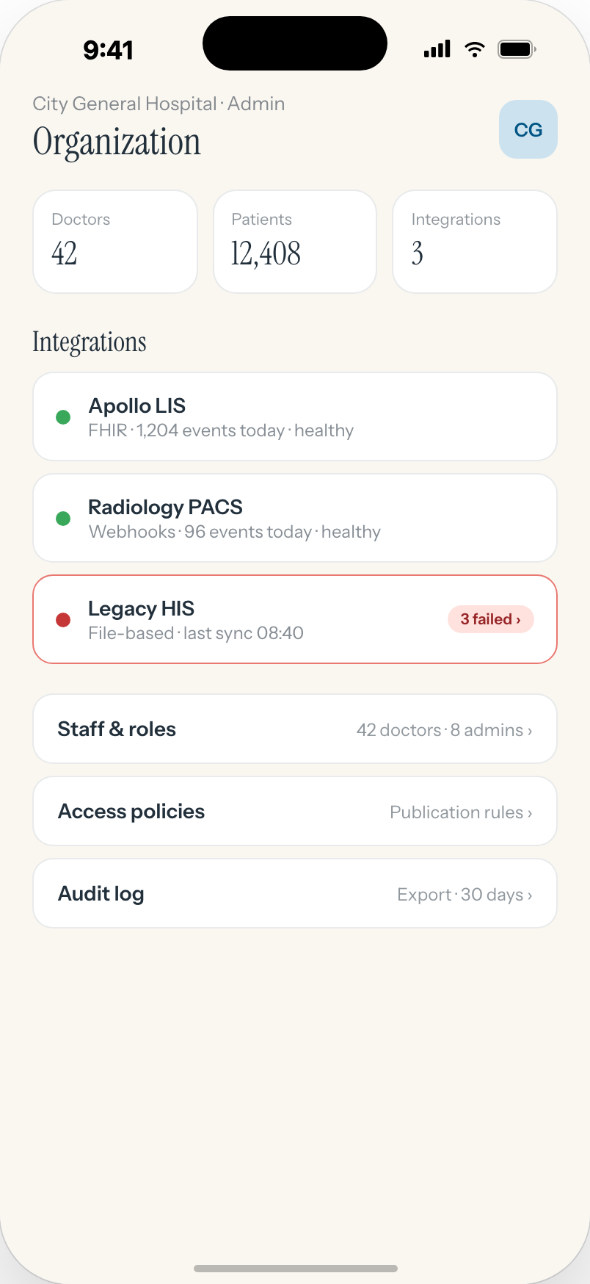
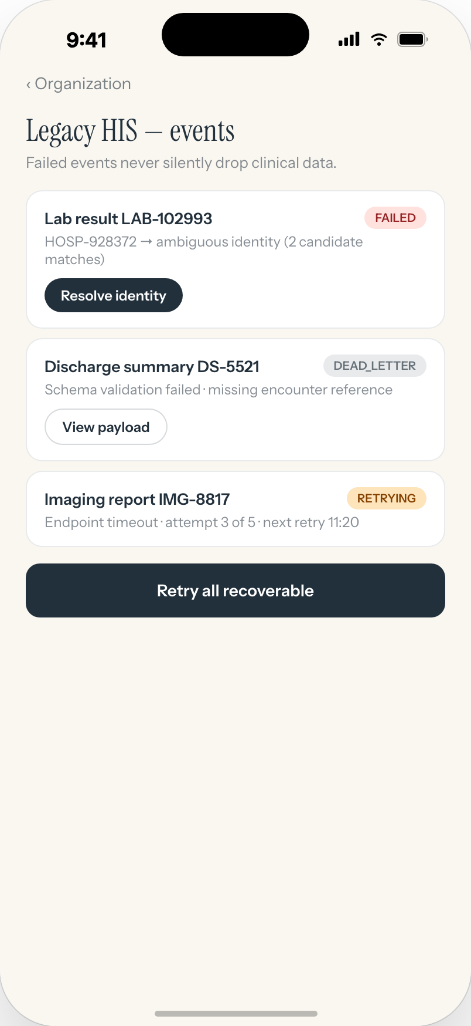




FOR THE HOSPITAL
Your systems stay. Finalised reports flow. Nothing is lost silently.
No replacement
HIS, LIS and PACS remain the system of record. Mirai receives finalised results through FHIR, HL7 v2, webhooks, or a file drop for legacy systems.
Identity resolved, never guessed
An ambiguous match goes to a human queue. A report is never attached to the wrong patient.
Fail loudly
A failed event sits in a visible queue with its reason and a retry. Clinical data is never dropped.
Provisioned in minutes
Tenant setup is automated. A sandbox connector proves your feed before go-live. Your identity provider handles doctor sign-in.
12
Notes:
For the person on the panel who runs the hospital. Three integrations on the admin screen: a modern LIS over FHIR, PACS over webhooks, and a legacy HIS over files. The error queue is the honest part: it shows failures instead of hiding them.

Slide 13

WHAT YOU MAY BE THINKING · 1 OF 2
The objections we would raise ourselves.
THE BELIEF
WHAT IS ACTUALLY TRUE
“An AI summary will hallucinate, and a patient will be harmed.”
The brief is generated only from the records you are authorised to see. Every number, date and drug name is checked against the source before it is shown; unsupported claims are dropped. It carries citations and the instruction to verify. It never writes to the record. Clinician-reviewed test sets gate every model change.
“This means replacing our HIS. We have been through that.”
Nothing is replaced. Your HIS stays the system of record. Mirai receives finalised reports through an integration layer, the way a lab sends a result today. If Mirai were switched off tomorrow, your records would be exactly where they are now.
“Our patients will not adopt an app.”
Sign-in is a phone number and an OTP, in English, Hindi and Marathi. A family shares one account. A printed QR works for patients without phones. And your own doctors benefit on day one: the hospital’s records are there before a single patient enrols.
13
Notes:
Say the objections out loud before they do. The first one is the one that decides the room: the answer is grounding, claim-level verification, refusal over invention, citations, and the rule that the AI never writes to the record.

Slide 14
WHAT YOU MAY BE THINKING · 2 OF 2
And the ones the board will raise.
THE BELIEF
WHAT IS ACTUALLY TRUE
“Patient data will leave the country, or train someone’s model.”
Data residency is pinned to India; backups and replicas stay in region. Contracts require zero retention and no training on tenant data. For a no-egress posture, the model runs inside the hospital’s own cell on open-weight models. Embeddings are treated as PHI.
“Sharing records outside the hospital is a legal exposure.”
Consent is a first-class object: scoped by category, duration and purpose, evaluated on every read, revocable instantly. Every access sits in an append-only, tamper-evident log the patient can also see. This is the DPDPA 2023 posture written into the product.
“Doctors will not change how they work. And who is liable?”
The only new gesture is a scan. Notes can be dictated. Nothing enters the record without the doctor’s signature, and every override is flagged. Clinical responsibility stays exactly where it is today: with the clinician, now holding a complete file.
14
Notes:
Residency, contracts and the self-hosted option cover the data-sovereignty question. The liability answer is deliberately simple: nothing changes about who is responsible; what changes is that the responsible clinician now has the complete file.

Slide 15







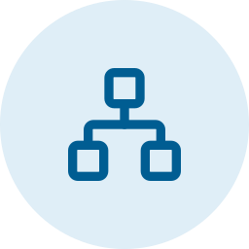

SECURITY AND COMPLIANCE
Security is the foundation, not a feature.
AES-256 at rest
TLS 1.3 in transit
Tamper-evident audit
Per-tenant keys. One leaked key exposes one tenant only.
Certificate pinning and root detection in the clinical apps.
Append-only, hash-chained, anchored daily. Exportable per hospital.
Data stays in India
RPO ≤ 5 min · RTO ≤ 1 h
QR token, not data
Residency pinned per tenant. Backups and replicas never cross regions.
Multi-zone by default. Restore drills. QR and emergency card serve from cache if the core degrades.
Opaque, bound to the scanning session, rotates every five minutes, rate-limited, anti-replay.
Your identity provider
ABHA and FHIR aligned
No standing access to PHI
Doctors sign in through hospital SSO with MFA enforced. Professional-registry (HPR) verification ready.
ABDM federation for patient identity. FHIR R4-aligned data model with provenance on every record.
Admin access is just-in-time and audited. Static and dynamic analysis in CI; independent penetration tests.
Design targets
p95 under 500 ms
under 1 s
p95 under 2.5 s
QR to patient
Patient 360° load
AI brief at scan
15
Notes:
Do not read the grid. Let it sit and answer questions from it. The three targets at the bottom are engineering service-level objectives from the architecture, and the pilot will report against them.

Slide 16




WHY NOW
Possible now. Not possible five years ago.
ABDM and ABHA exist
DPDPA 2023 is law
AI can be grounded and checked
A phone in every pocket
A national health identity is already in the patient’s hands. Mirai links to it instead of inventing another number.
Consent, purpose limitation and data rights are now statutory. A product built on them is the compliant path, not the risky one.
Language models can read a whole file and write a specialty-specific brief, and each claim can be verified against the source before it is shown.
No smart card, no kiosk, no new hardware in the OPD. The patient’s phone presents the QR; the doctor’s phone scans it.
The pieces were assembled by others. Mirai is the layer that puts them in front of a clinician in fourteen seconds.
16
Notes:
Timing answers "why has nobody done this". The identity layer, the legal framework, the model capability and the device are all recent. Mirai is the composition.

Slide 17





BUSINESS MODEL
Whoever gains clinician time pays. The patient never pays for their own record.
Eight ways Mirai earns, grouped by who pays. Four are live in year one, two need a dedicated tier, two wait for consent tooling and legal review.
Hospitals and clinic chains
Diagnostics and imaging networks
Patients
Government and hospital networks
Insurers, TPAs and partner apps
1 · Subscription by tier
2 · Metered AI briefs
5 · Threshold-gated enterprise
3 · Per finalised report
4 · Free record, optional family plan
6 · Dedicated cell licence
7 · Consented data access
8 · API platform
Live in year one
Live in year one
Free; plan later
Year two
Year three, after legal review
17
Notes:
One principle: the party that gains clinician time pays. Hospitals and labs are the payers; the patient holds the consent and never pays for the record. The numbering on the cards is used on the following slides.

Slide 18
MODEL 1 · HOSPITAL SUBSCRIPTION BY TIER
The floor: a platform fee that follows the isolation tier already in the architecture.
 | Pooled | Siloed | Dedicated
Who | Clinics, polyclinics, small labs | Hospitals | Hospital networks, government, national platforms
Isolation | Shared tables, row-level security | Schema per tenant on shared clusters | Own cluster, pinned region, optional customer-held keys
Included | Doctor and patient apps, QR, consent, audit, one feed | Everything in Pooled, plus multiple feeds, admin console, SSO | Everything in Siloed, plus custom SLOs, in-cell AI models, dedicated support
Price components | Platform fee + seats | Platform fee + seats + per-feed fee | Annual licence + implementation + support
Contract | Monthly, self-serve | Annual, department or hospital-wide | Multi-year, procurement
Onboarding | Minutes, automated | Days: feeds proven in sandbox | Weeks: residency, keys, identity federation
THE TWO ADD-ONS
Seat per active clinician
Counted monthly on clinicians who opened a chart, not on the staff list. Department licences cap the bill for a large OPD and remove the incentive to under-register.
One-time fee per feed
LIS, HIS, PACS: each feed is mapped, proven on synthetic data in the sandbox, then switched on. The fee covers our integration hours, not the hospital vendor’s.
WHY THE HOSPITAL PAYS
Clinician minutes per consult, throughput per OPD session, fewer decisions on a partial file, and a consent and audit posture it would otherwise build itself.
Tiers map one-to-one to the isolation tiers in the platform design: same code, different isolation, different price.
18
Notes:
The tier table is the platform’s own isolation model priced. Pooled is self-serve and cheap because it is cheap to run. Dedicated is procurement-grade because residency, keys and identity federation are custom. Seats are counted on use, not on payroll, which is what a hospital will accept.

Slide 19



MODEL 2 · METERED AI BRIEFS
Usage above the quota is billed per brief. The model cost is a pass-through, not a margin trap.
WHO PAYS
UNIT
INCLUDED
METERING
Hospital, on the same invoice
One generated clinical brief
Monthly quota inside the tier
Per-tenant token metering, already in the control plane
HOW IT WORKS
Quota, then overage
WHY THEY PAY
The brief is the minute-saver; paying per brief ties cost to the minutes saved.
Quota inside the tier keeps most hospitals on a predictable bill.
Model choice stays the hospital’s: provider, region, or in-cell.
Each tier carries a monthly brief quota sized to its seat count. Briefs above the quota are billed per brief at a published rate; briefs re-opened from cache within the day are not counted twice.
Cost stack per brief
Authorise, retrieve the consented slice, generate, verify every number against the source, cite, log. Generation is the only line that scales with the model provider’s price.
NEEDS FROM THE PRODUCT
Metering and quota enforcement in the control plane (designed).
Cache keyed on patient, consented slice and model version (designed).
Pre-computation keeps the cost down
Where the hospital enables it, the brief is refreshed when a new result lands rather than at scan time, so the same brief serves several openings and the scan-time latency target holds.
RISKS AND HOW WE HOLD THEM
Provider price moves: pass-through with a published margin, provider switch is configuration.
Alert on runaway usage per tenant; hard cap optional.
In-cell models priced as infrastructure
For no-egress postures the open-weight model runs inside the hospital’s dedicated cell and is priced as a monthly infrastructure line, with no per-brief component.
19
Notes:
Per-brief pricing is honest because the brief is the unit of value. The pass-through structure means a cheaper model lowers the hospital’s bill, not only ours. Pre-computation on report.finalized is what makes the unit economics work.

Slide 20


MODEL 3 · DIAGNOSTICS AND IMAGING NETWORKS
Labs pay per finalised report that reaches the patient and the treating doctor.
WHO PAYS
UNIT
REPLACES
VOLUME BANDS
Lab or imaging chain, as a report-only tenant
One finalised report delivered
SMS links, PDF portals, courier copies
Price per report falls with monthly volume
HOW IT WORKS
Report-only tenant
WHY THEY PAY
Cheaper than running a patient portal and SMS gateway.
Referral stickiness: the report lands where the doctor already looks.
One integration covers many hospitals and all patients.
The lab connects its LIS or RIS as a feed; it never sees other tenants’ data and holds no doctor seats. The integration is the same sandbox-proven path a hospital uses.
Delivery is the product
When the LIS marks a report final, it is published to the patient’s phone under the lab’s publication rule and appears on the timeline of every doctor the patient has authorised. Amendments create a new version and say so.
NEEDS FROM THE PRODUCT
Report lifecycle and publication rules (designed).
Identity resolution with a human queue for ambiguous matches (designed).
Compliance handled once
The lab’s ABDM reporting obligations, consent capture, provenance and audit are carried by the platform rather than by a portal the lab maintains.
RISKS AND HOW WE HOLD THEM
Thin lab margins: volume bands and a bundle with the hospital tier.
A lab pushing preliminary results as final: lifecycle states enforced at ingest.
Two-sided pull
Every lab that joins makes each hospital’s history more complete; every hospital that joins puts the lab’s report in front of the treating doctor, which is what a referring lab wants.
20
Notes:
This is the cheapest tenant to onboard and the one that most improves the hospital product. The pricing unit is the report because that is what the lab already counts.

Slide 21


MODEL 4 · PATIENTS
The record is free, always. A family plan is retention, not the revenue line.
WHO PAYS
FREE FOREVER
OPTIONAL LATER
RULE
Nobody, for the core
Identity, QR, timeline, consent, emergency card
Family plan, monthly
Consent and access are never behind a paywall
HOW IT WORKS
Why free
WHY THEY PAY
Families managing parents and children want one place and a nominee.
Outside papers photographed once, visible to every treating doctor.
Explanations in plain language reduce calls to the clinic.
A record that patients pay for is a record fewer patients carry, and the hospital product depends on every patient presenting a QR. Consent density is the asset; charging for it would shrink it.
Family plan, when it comes
Dependants under a guardian’s sign-in with their own identity and QR, nominee workflows for the elderly, storage for photographed outside papers, plain-language report explanations, and long-run trend views.
NEEDS FROM THE PRODUCT
Guardian links and family profiles (designed).
Document upload with malware scan and provenance (designed).
What stays outside the plan
Anything that touches consent, revocation, the access log, the emergency card or the data-rights requests stays free, because those are the patient’s rights, not features.
RISKS AND HOW WE HOLD THEM
Low willingness to pay: treat as retention; never gate rights.
Data-rights requests route to the hospital’s grievance officer, not to a paid tier.
Where the value goes
A denser patient base raises the value of the hospital and lab tiers; the family plan is priced to cover its own storage and support, not to carry the company.
21
Notes:
Say this plainly: we do not monetise the patient’s consent. The family plan exists because families ask for it, and it is priced to cover itself.

Slide 22


MODELS 5 AND 6 · THE TWO CONTRACT SHAPES
How a pilot becomes a contract, and how a network becomes a licence.
5 · Threshold-gated enterprise
6 · Dedicated cell licence
Hospitals and clinic chains · the standard sales motion from year two
Hospital networks, state missions, national platforms · dedicated tier
Week 0
Flat pilot fee. Thresholds agreed with the clinical panel: scan-to-brief time, claim-level accuracy, consult minutes against a measured baseline.
Licence
Annual, per cell: own cluster, region pinned, customer-held keys optional, custom service levels, in-cell open-weight models for no-egress rules.
Week 12
Results reviewed against the thresholds. Enterprise contract unlocks only if they are met; otherwise the pilot ends cleanly with data exported.
Implementation
One-time: identity federation, ABHA linkage, professional-registry checks, feeds from each facility proven in sandbox.
Year 1 to 3
Annual subscription at the hospital’s tier, seats and feeds added department by department, brief quota grown with usage.
Support
Named support, restore drills, audit exports, quarterly review against the service levels.
Why it works: the hospital buys measured results, not promises; we price the pilot to lose nothing if the thresholds fail. Risk: a hospital that never sets thresholds; the panel sets them in week 0 or the pilot does not start.
Why it works: procurement buys residency, isolation and named accountability, which the dedicated tier is built for. Risk: long cycles and tender rules; pursued opportunistically, never as the plan of record for year one.
22
Notes:
Model 5 is the commercial engine: every enterprise contract is earned against thresholds the hospital’s own clinicians set. Model 6 is the same platform sold as a licence to bodies that must own their cell. Dedicated cells are a post-MVP tier; say so if asked.

Slide 23
MODELS 7 AND 8 · AFTER CONSENT TOOLING MATURES
Consented access for insurers and partners, priced per retrieval, patient-approved per purpose.
7 · Consented data access
8 · API platform
Insurers and TPAs · pre-authorisation and claims
Pharmacy, telemedicine, home care, wellness · partner applications
Unit: one consented retrieval of a defined record set for a stated purpose.
The patient approves each purpose on the phone; the grant is scoped by category and duration and expires on its own.
Every retrieval is in the append-only audit log the patient can read; the hospital sees the same log.
Revenue shared with the hospital that created the records, so the fiduciary is paid for its data, not bypassed.
Why they pay: days off a pre-authorisation, fewer document chases, less fraud.
Unit: monthly platform access plus per-call pricing on consented reads and signed writes.
FHIR-aligned records API, webhooks for events the patient has allowed the partner to receive.
Partners never see more than the patient granted; tenant isolation and rate limits apply per partner.
Certification tier for partners that write back, so a pharmacy dispensing record lands on the timeline with provenance.
Why they pay: one integration reaches every hospital and lab on the platform.
Gate: DPDPA legal review of purpose limitation, and the consent marketplace the design lists as a future capability.
Gate: the full interoperability surface is post-pilot in the architecture; pharmacy and insurance integrations are explicitly deferred from the MVP.
Neither model sells patient data. Both sell a consented, audited retrieval the patient can see and revoke. If the legal review says otherwise, they do not ship.
23
Notes:
These two are deliberately last. They depend on consent tooling that is a future capability in the design and on a legal review under the DPDPA. The revenue share with the hospital keeps the fiduciary aligned rather than bypassed.

Slide 24


PRICING ARCHITECTURE
How a bill is built. Structure now, numbers in the term sheet.
Hospital, per month
Lab or imaging chain, per month
Network or government, per year
Platform fee for the tier
Finalised reports delivered × report price, banded by volume
Annual cell licence
+ active clinician seats × seat price
+ one-time feed fee
+ one-time implementation
+ briefs above quota × brief price
No seats, no brief charges
+ named support and service-level review
+ one-time fee per feed connected
Discount when bundled with a hospital in the same network
Seats and briefs included up to a negotiated envelope
+ in-cell model line, dedicated tier only
Three rules. Seats are counted on use, never on payroll. Brief price is a pass-through of model cost plus a published margin. Nothing the patient does is ever on any bill.
24
Notes:
Structure only on the slide; rupee figures belong in the term sheet after the pilot baseline, because seat counts and brief volumes are what the pilot measures.

Slide 25
SIDE BY SIDE
Eight models, one page.
Model | Who pays | Unit | Product readiness | Time to revenue | Margin profile | Main risk
1 · Subscription by tier | Hospital | Tenant + seats | Designed: pooled and siloed in MVP | Pilot end | High, recurring | Seat under-counting
2 · Metered briefs | Hospital | Brief | Designed: metering in control plane | Pilot end | Pass-through + margin | Provider price moves
3 · Per report | Lab, imaging chain | Finalised report | Designed: report sync flow | Months | Medium, volume-banded | Thin lab margins
4 · Patient plan | Patient (optional) | Family plan | Partly designed: guardian links | Year 2 | Low; retention | Willingness to pay
5 · Threshold-gated | Hospital | Annual contract | Commercial motion | Week 12 of pilot | High, recurring | No thresholds set
6 · Cell licence | Network, government | Annual licence | Dedicated tier post-MVP | Year 2 | High, lumpy | Procurement cycles
7 · Consented access | Insurer, TPA | Retrieval | Future: consent marketplace | Year 3 | High per unit | Legal review
8 · API platform | Partner apps | Access + calls | Post-pilot interoperability | Year 3 | Medium | Partner write-back quality
Readiness colour: green is designed into the current architecture; amber is partly designed or a commercial motion; grey is a future capability.
25
Notes:
Use this page for questions. The readiness column is honest: models 1 to 3 rest on designed components; 4 to 6 on partly designed or commercial motions; 7 and 8 on future capabilities.

Slide 26



SEQUENCING AND UNIT ECONOMICS
Three steps from pilot to platform.
3
Year 3
WHAT DECIDES THE MARGIN
Platform
Cost per brief
2
Year 2
Expand
Consented access for insurers and TPAs (7). API access for pharmacy, telemedicine and home care (8). Only after legal review of the consent tooling.
Retrieval plus generation, pre-computed when results land, against price per brief.
1
Year 1
Land
Threshold-gated enterprise as the standard motion (5). Dedicated cells for hospital networks and state missions (6). Family plan if patients ask for it (4).
Hours per feed
Hospital subscription with metered briefs (1, 2). Labs per report (3). Pilot priced flat; the enterprise contract unlocks only against the week-12 thresholds (5).
Vendor-side integration hours against the one-time feed fee.
Seats per hospital
Active clinicians against the tier price; department licences cap the gaming.
Hospitals earn from investigations, so avoided repeat tests are not a shared-savings lever. Price on OPD throughput and clinician time.
Enterprise contracts unlock only against thresholds this panel agrees in week 0.
26
Notes:
Year 1 is the pilot converting to a subscription. Year 2 is repeatable enterprise sales gated by measured thresholds, plus dedicated cells for networks and government. Year 3 is the consent-driven platform, deliberately last. The margin question is the AI cost per brief; pre-computation on report.finalized keeps it down.

Slide 27


THE ROLLOUT NINETY DAYS
A 90-day pilot in two departments that share patients.
1
2
3
4
What we will report
Weeks 0 to 2
Weeks 2 to 6
Weeks 6 to 10
Weeks 10 to 12
Scan-to-chart time, against the 14 s target
Minutes per consult, before and after
Repeat investigations ordered
Consent approvals, revocations, emergency accesses
Brief accuracy, as rated by your clinicians
Provision and connect
Scan in two OPDs
Shared care
Measure and decide
Tenant provisioned. LIS connected for finalised reports through a sandbox feed. Doctor SSO live.
Endocrinology and Cardiology scan patients. Briefs generated at scan. Clinicians rate every brief.
Co-management grants across the two departments. Patients see reports and manage consent on their phones.
Results reviewed with this panel. Decision on hospital-wide rollout.
What we ask of you
Your clinical judgment
Two departments, ninety days
Investment
Senior clinicians review the golden sets that gate our AI.
A pilot in the OPDs that already co-manage patients.
To take Mirai from this pilot to every OPD in the hospital.
27
Notes:
Make the next step small and concrete. Two departments that already share patients, so the shared-care value shows in weeks. The ask has three parts and the first is not money: their clinical judgment shaping the test sets is what makes the AI safe in their hospital. State the investment figure verbally.

Slide 28
The chart is ready before the patient sits down.
Mirai · mirai.health
Interactive prototype, architecture and component design available for the panel’s review.
Notes:
Return to the opening sentence. Then stop talking and take questions. The phone on screen is the cardiologist’s view of Ravi, the patient from slide two.

