Slide 1
Identify Car
Wash Services
By :
……
……
……
……

Slide 2
TABLE OF CONTENTS
01
04
About Project
Sneak Peek
02
05
Project Description
Project Code
03
06
Tools
Extent Report

Slide 3
ABOUT PROJECT
SELENIUM JAVA
Explore the Innovative Implementations.
Implement Best practices such as creating Smoke and Regression suite.
Implement Maven on the created automation test scripts
Explore Jenkins to execute the test scripts on different platforms and against different browsers.
Integrate Jenkins with version controller (GIT) and scheduled builds to run automatically.

Slide 4
PROJECT DESCRIPTION
Open Website www.Justdial.com
1. Display 5 Car washing services name and phone numbers, near your location with highest rating (more than 4) on top & Customer Votes more than 20
2. Try to register for Free Listing, fill the form with any one input invalid (example: phone); Capture the error message & display
3. From Fitness, go to Gym and retrieve all sub-menu items and store in a List; Display the same

Slide 5
FIRST DESCRIPTION
1.Open Website www.Justdial.com
2. Display 5 Car washing services name and phone numbers, near your location with highest rating (more than 4) on top & Customer Votes more than 20

Slide 6
FIRST DESCRIPTION
SELENIUM JAVA
1. "www.justdial.com/" should open
2. Search Textbox should be selected
3. "Car washing services" should be read and written
4. "Mumbai" should be selected as default
5. Search Button should be clicked
6. "Car Wash Services At Home near me" button should be selected
7. Filter "Ratings" should be selected
8. Services should be selected where ratings are greater than four star
9. Votes should be greater than 20

Slide 7
SECOND DESCRIPTION
2. Try to register for Free Listing, fill the form with any one input invalid (example: phone);
Capture the error message & display

Slide 8
SECOND
DESCRIPTION
SELENIUM JAVA
1. User should navigate back to home page
2. User should be redirected to "Free Listing" page
3. User should be able to put values in all placeholders
4. If user gives incorrect values, then error message
should be displayed.

Slide 9
THIRD DESCRIPTION
3. From Fitness, go to Gym and retrieve all sub-menu items and store in a List; Display the same

Slide 10
THIRD
DESCRIPTION
SELENIUM JAVA
1. Hamburger menu should be clicked
2. User should scroll down for options
3. Fitness option should be clicked
4. Menu items should be displayed
5. Gym option should be clicked
6. Sub-menu items should be displayed
7. Sub-menu items should be send to excel

Slide 11









TOOLS
Selenium
Extent Report
Maven
MS Excel
Jenkins
Eclipse
TestNG
Git
Java

Slide 12
SNEAK PEEK

Slide 13
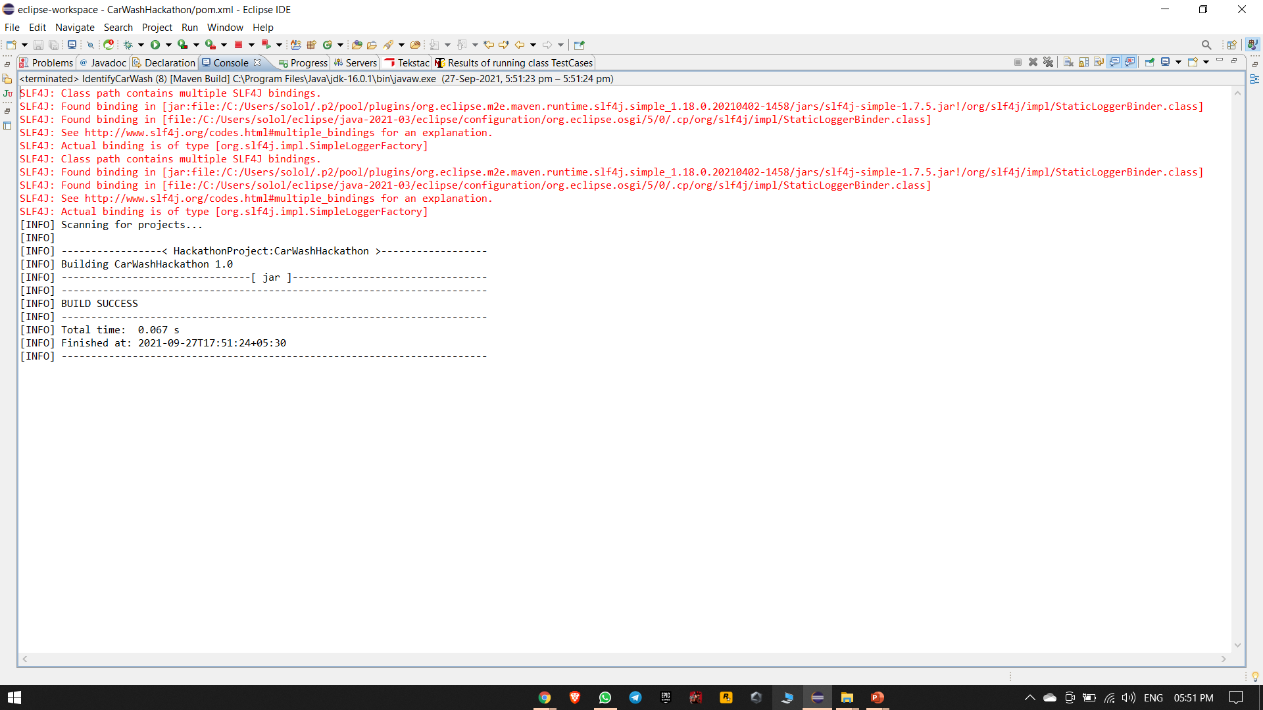
MAVEN IMPLEMENTATION
Console Output after Maven Implementation(BUILD SUCCESS)

Slide 14
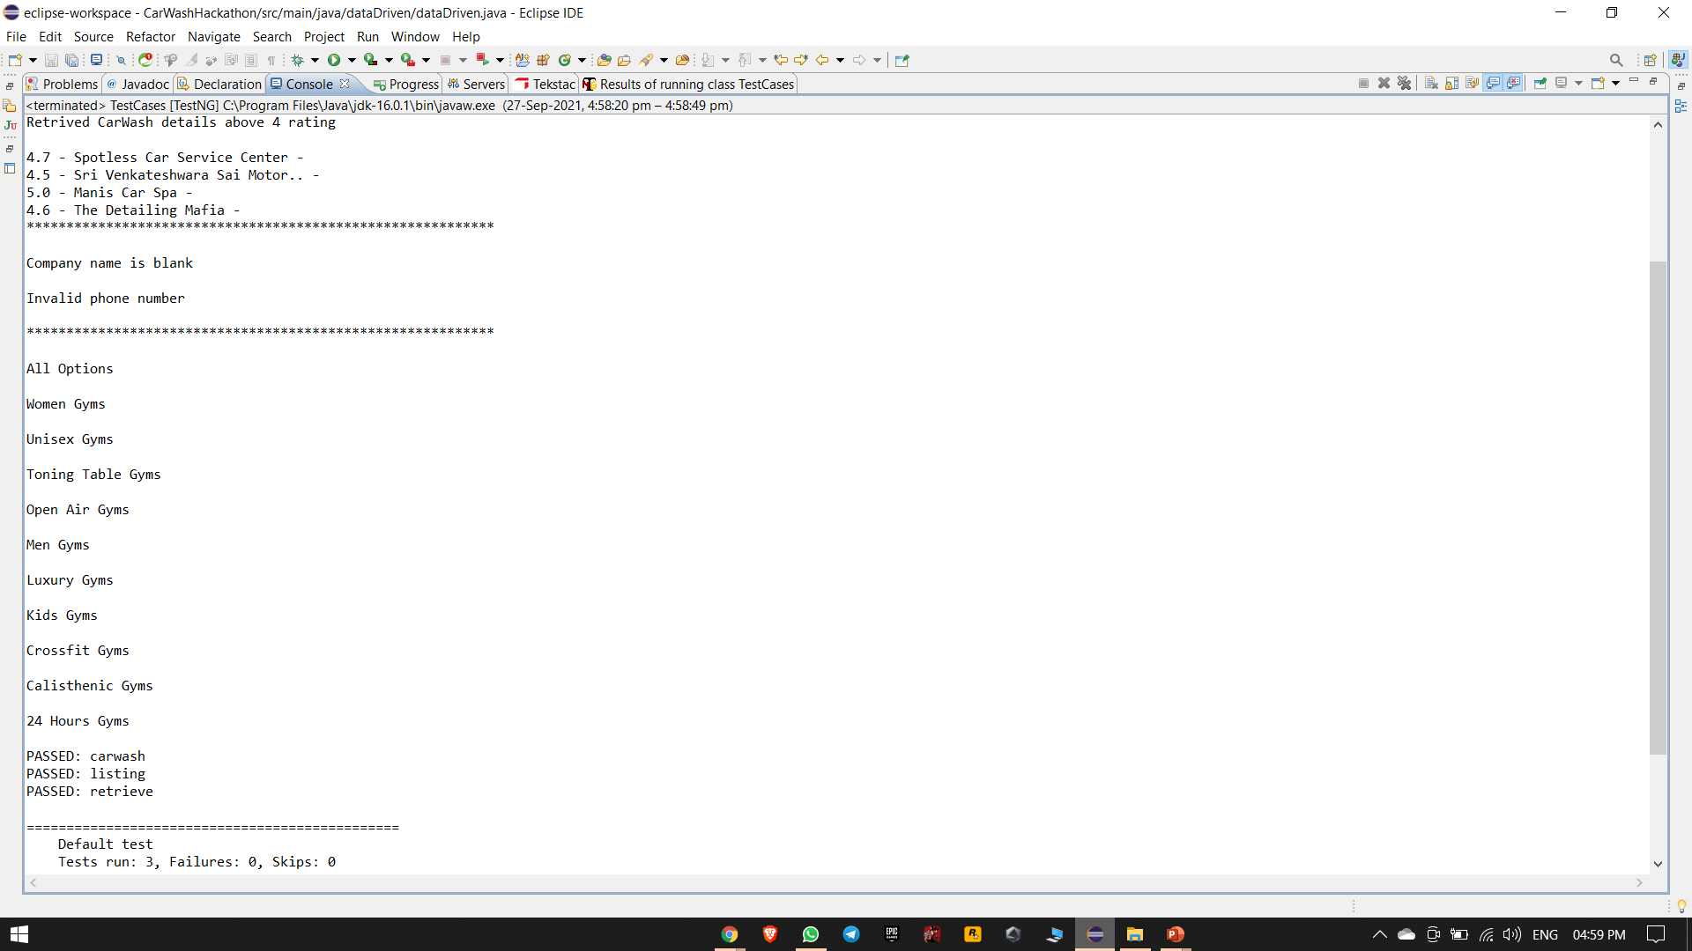
TESTNG IMPLEMENTATION

Slide 15
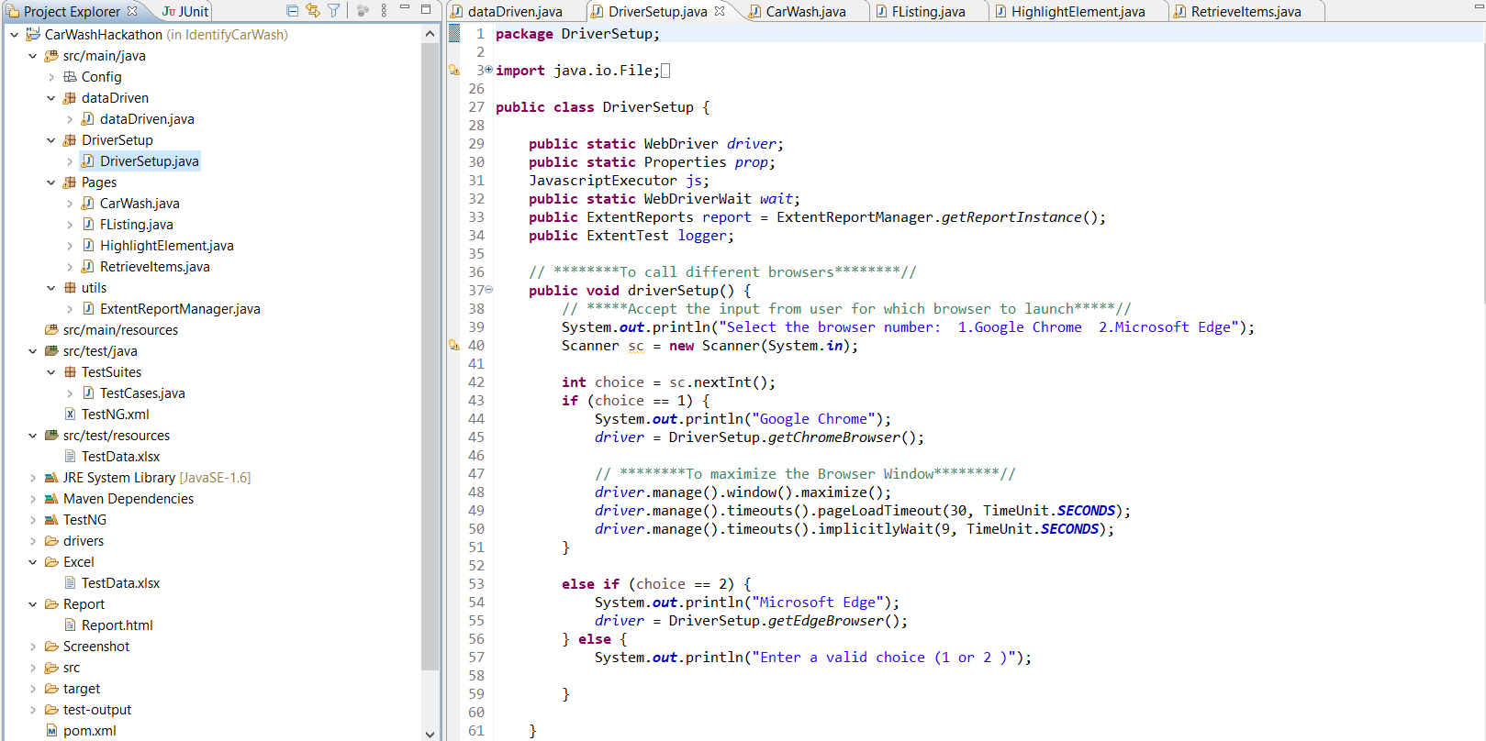
Project Structure

Slide 16
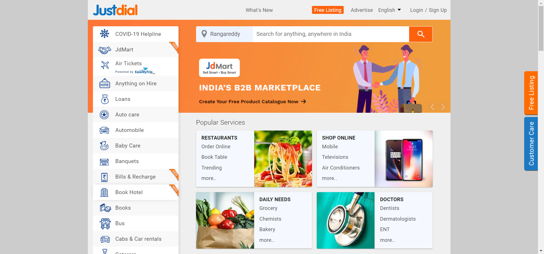
Test execution screenshot Homepage

Slide 17
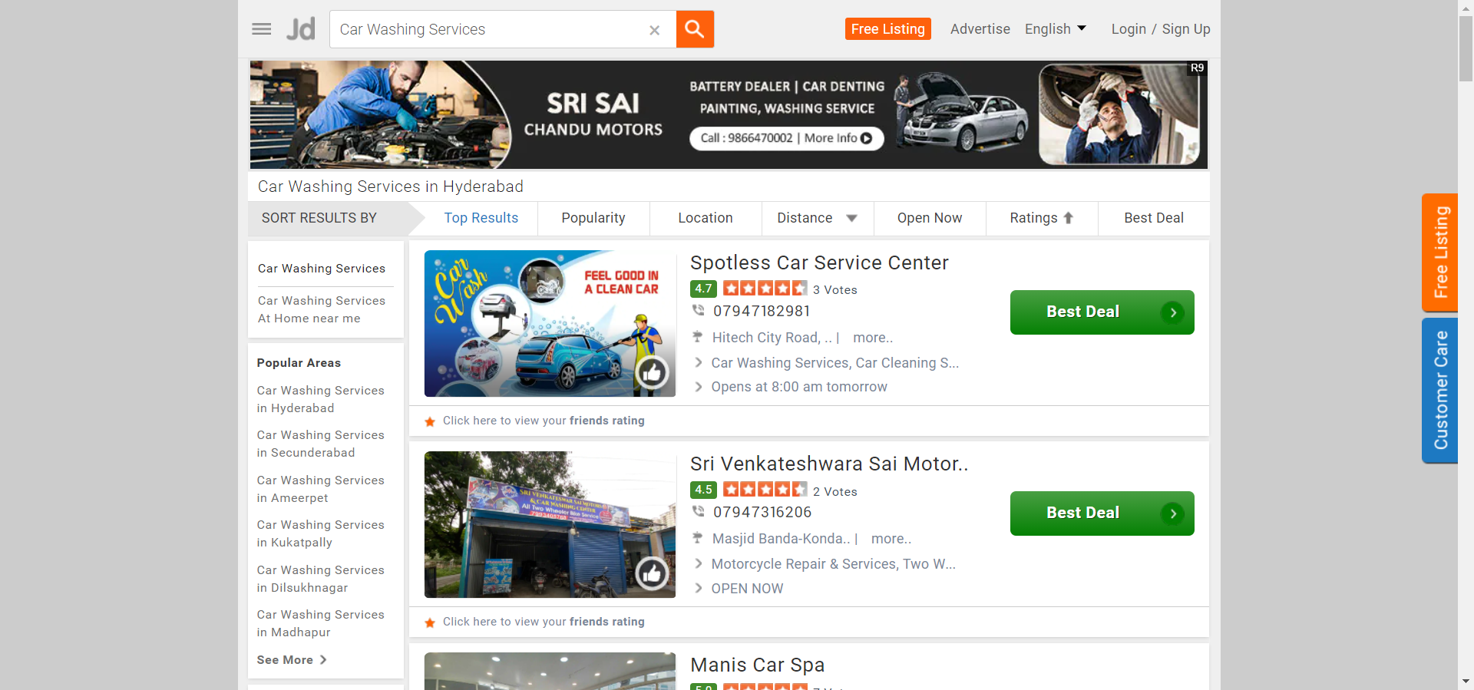
CarWash services:

Slide 18
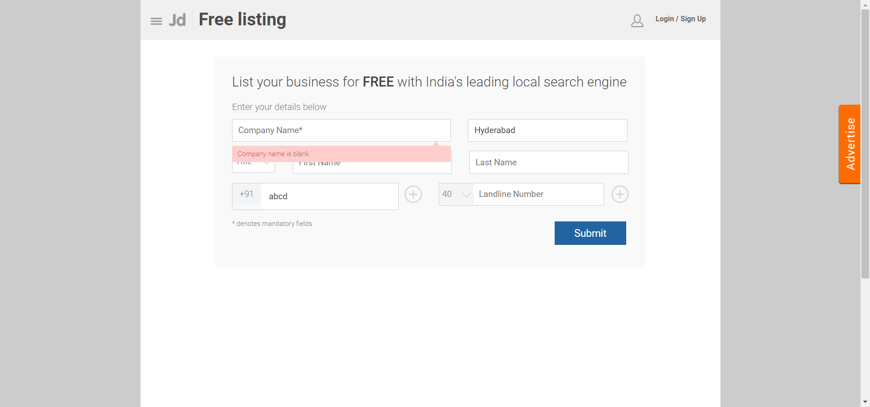
Freelisting:

Slide 19
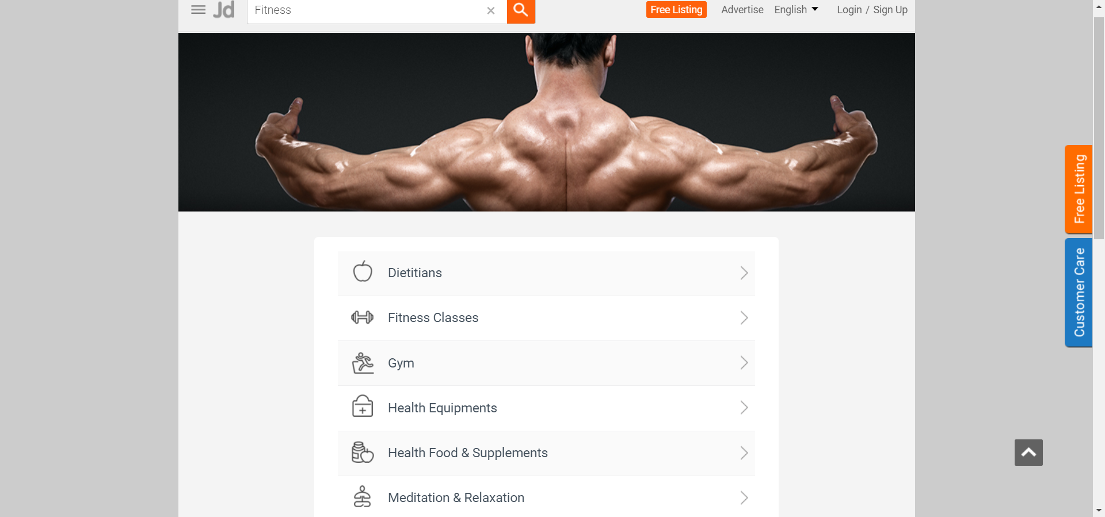
Retrieving Submenu

Slide 20
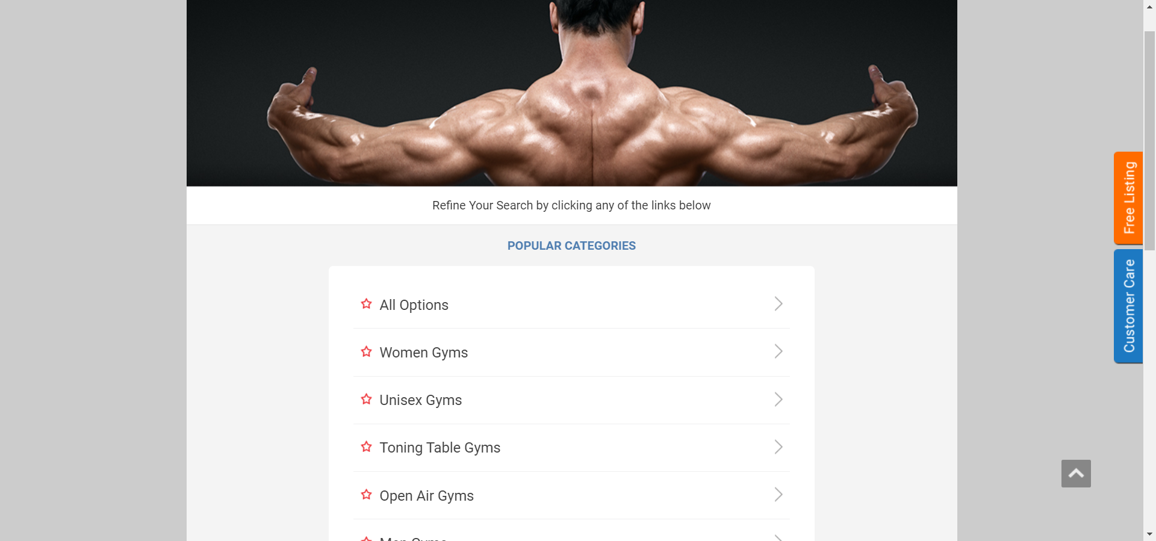
Retrieving gym details

Slide 21
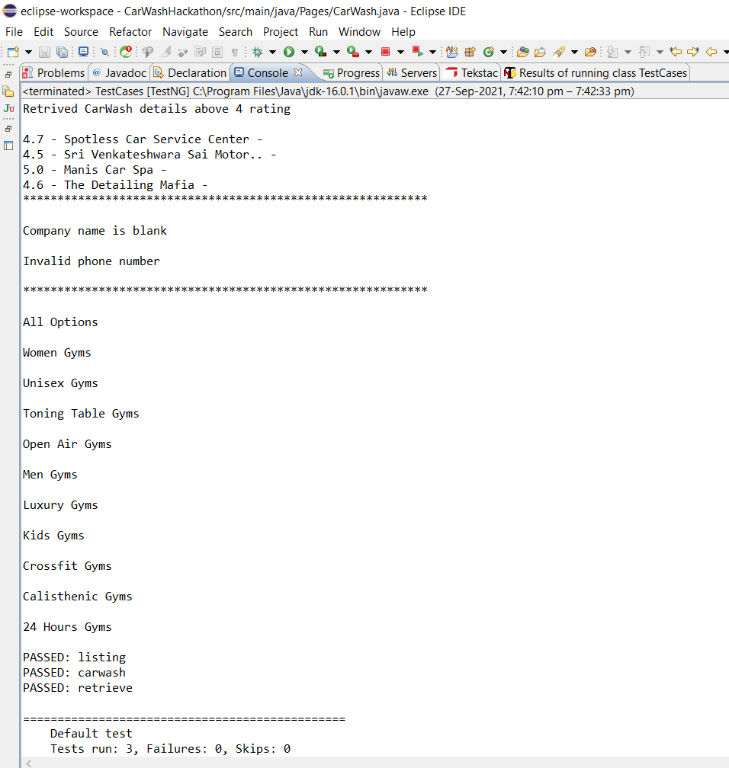
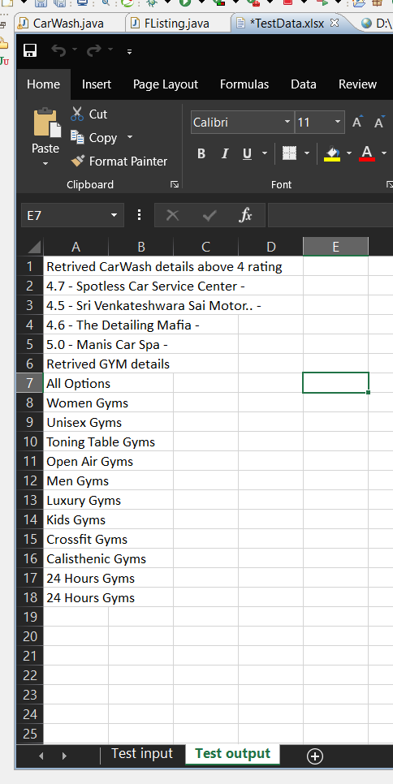
Final output

Slide 22
Thank
You!

