Slide 1
KeyHole - Social Media
Analytics Tool
Submitted by
Siddhant Nikumbh 33241
Pallavi Dadape 33242
Prajakta Lanje 33248

Slide 2
INTRODUCTION
Keyhole was launched in the year of 2013. It is a notable item and a web-based social networking investigation apparatus created by the Assetize endeavor working in the IT business. The organization has its primary concern of promoting as "Hashtag Analytics" (Tracks Hashtags on Twitter). Through a continuous dashboard that quantifies the social effects of patterns and influencers, clients can concentrate on executing, advancing, and announcing efforts as opposed to aggregating measurements, for example, client commitment. Keyhole.co gives continuous social discussion following for Twitter, Facebook, and Instagram. The motto of company is “We help customers make better decisions with social media data. We are proud to be the #1 company in the world for Hashtag Analytics."

Slide 3
OVERVIEW
KeyHole is an online portal that encourages you track and draw in individuals discussing your web based life handle.
KeyHole has more than 6 billion posts investigated over various sites, for example, Google, WHO, Spotify, Alibaba and substantially more.
KeyHole gives a solid, simple to utilize, and reasonable arrangement that permits you to both track and connect with online discussions pertinent to your business.

Slide 4
PURPOSE
The fundamental purpose for KeyHole is to screen the web-based social networking stages, basically Twitter to dissect the Hashtags and notices. They additionally give investigation to YouTube, Facebook and Instagram.
Notwithstanding online life measurements like notices and crowd reach, KeyHole additionally permits you to follow your web-based social networking makes reference to, explicit catchphrases, and so forth. They have accessible help for Specialists, Endeavors, Non-benefits and individual investigation.

Slide 5
FEATURES
Mentions Feed: Find what individuals state about your image and make a move continuously. Connect with conversations pertinent to your business with a single tick of the mouse.
Discuss Volume Chart: Distinguish abrupt changes in the conversation volume to secure your organization picture. Spot tricky issues before they heighten and augment the capability of positive exposure you're as of now getting.
Mention Analytics: Show signs of improvement comprehension of who is discussing your image on the web. Dissect buzz quality and amount to increase new bits of knowledge about your clients.
Influence Score: Pinpoint your industry influencers to settle on cognizant choices about who you ought to be working with.

Slide 6
Sentiment Analysis: On account of notice estimation (positive, negative, unbiased) you can show signs of improvement comprehension of client mentalities and spot hazardous territories which need quick consideration.
Alerts: Be the first to find changes in the volume of conversation around your image. Redo your alarms the manner in which you need - for instance, you can get email or in-application warnings of negative notices of your organization from web journals with in excess of 300,000 month to month visits.
Filtering: Slender down your outcomes to concentrate on what is generally significant for you. You can channel by notice source, notion, number of visits, and some more.
Data Exporting: Transform your information into computerized PDF reports, .xls records, and infographics. Procedure your notices accumulated with KeyHole so you can utilize them outside of the device.

Slide 7
HOW TO USE
Usually, to perform online networking examination, one needs to follow some fundamental advances. Given beneath are the a portion of the fundamental advances that are should have been followed for performing internet based life investigation.
Step 1 - To begin with, distinguish your web-based social networking rivalry and discover which stages they use. You should concentrate on the contenders that effectively utilize online networking promoting to develop their business.
Step 2 - After you've limited your rivals, the subsequent stage is to accumulate information. The procedure will be marginally unique relying upon which stages you target.

Slide 8
OFFERS SERVICES AND PRICES
Step 3 - After you've assembled the numbers, you additionally need to take a gander at how your rivals utilize every stage. What's more, take care of how they explicitly utilize this.
KeyHole.co has services for Account Analytics, Campaign and Keyword tracking (+ account analytics). All are paid services, by per month subscription basis, which is billed annually.
There is also a service for Enterprises, called as Enterprise Suite, for the organizations that work with influencers or use customer insights to make critical decisions. The subscription for Enterprise Suite is calculated as per the size of company.
Link to pricing options: https://keyhole.co/pricing

Slide 9
USING KeyHole
KeyHole is also available web-based application.
It is an online entrance and can be utilized online with a functioning web association. It offers free time for testing of 30 days by simply joining. Be that as it may, when the time for testing is more than one needs to pay the predefined sum to the organization to profit the top notch administrations. Account analytics cost $29/mo (minimum), Campaign and Keyword tracking (+ account analytics) costs $99/mo (minimum). The cost for both increases with the increase in number of accounts needed to track, for latter, it also depends on the number of posts/mo. Latter also provides Sentiment Analysis. Free Sign Up Link: https://keyhole.co/register/20 KeyHole Portal Link: https://keyhole.co/

Slide 10
CUSTOMERS
There are lot of companies that use KeyHole for social media analysis and social media management. Some of them are as listed below:
• Arizona State university
• John Hopkins University
• USTA
• McCANN
• soapbox

Slide 11
APPLICATIONS
The main applications of the tool are brand monitoring on the web, tracking a campaign or an event or influencers, perform market research, reputation protection or the opportunity to enter into a discussion with clients on the web.
It is also used for
application development,
monitoring & measuring hashtag performance,
imaging to interventional MRI (I-MRI)

Slide 12
ADVANTAGES
The reporting feature is robust and helps to reach interesting conclusions.
KeyHole is very user-friendly and does not need a lot of technical knowledge.
The customer service is awesome as they have an excellent support team to solve any technical issue.
Simplicity
Use of conventional phase encoding and Fourier transform reconstruction found on virtually all modern MR imagers

Slide 13
DISADVANTAGES
• Searches for crises of different brands as well as perception in social media.
• It is unable to detect spam posts.
• Unable to input individual posts to get statics on them.

Slide 14
REAL-TIME SCREENSHOTS

Slide 15
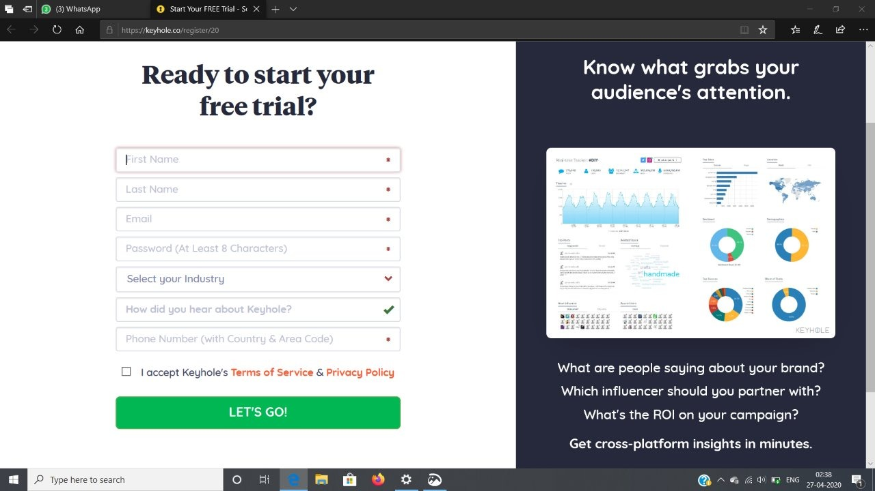

Slide 16
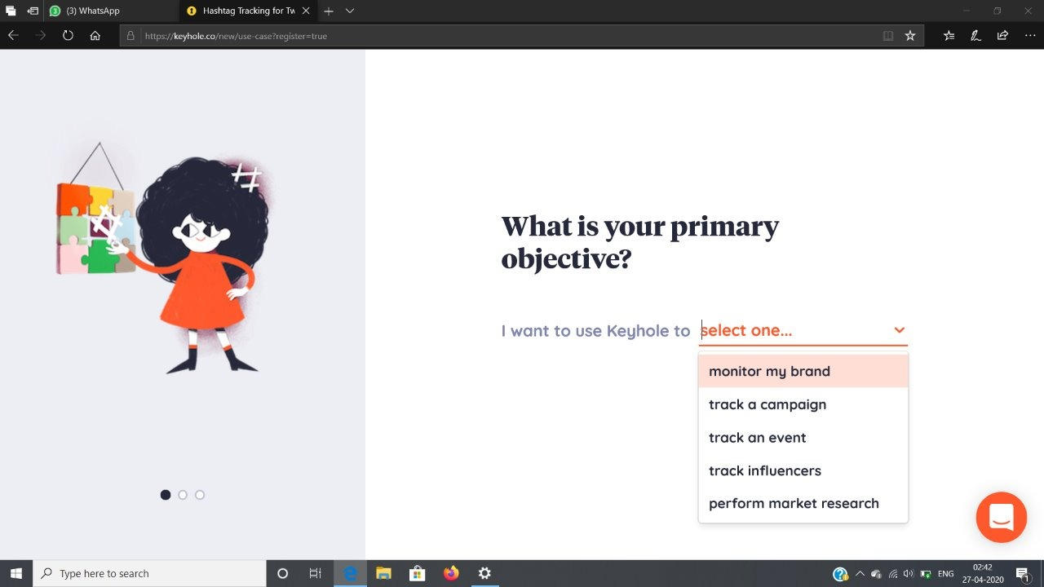

Slide 17
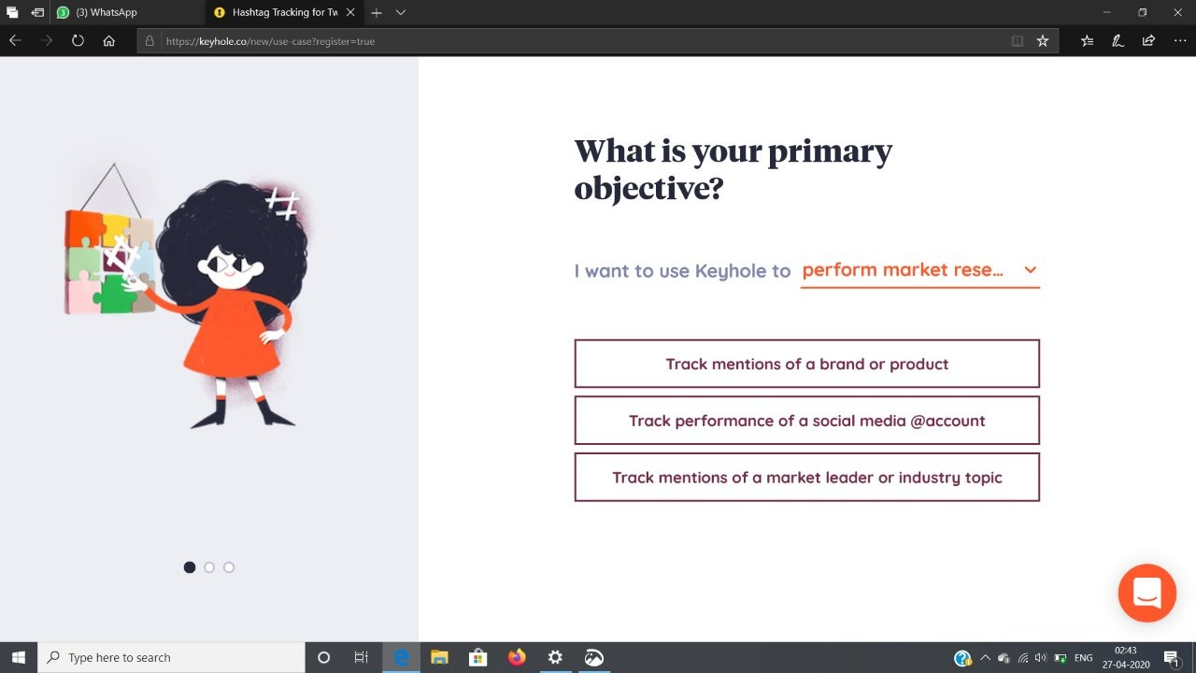

Slide 18
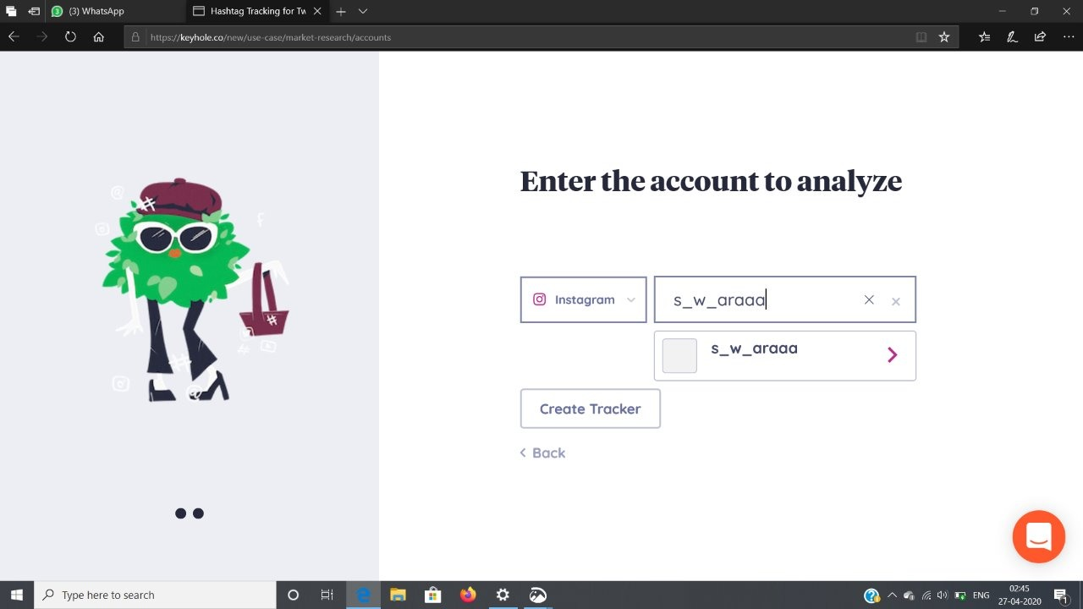

Slide 19
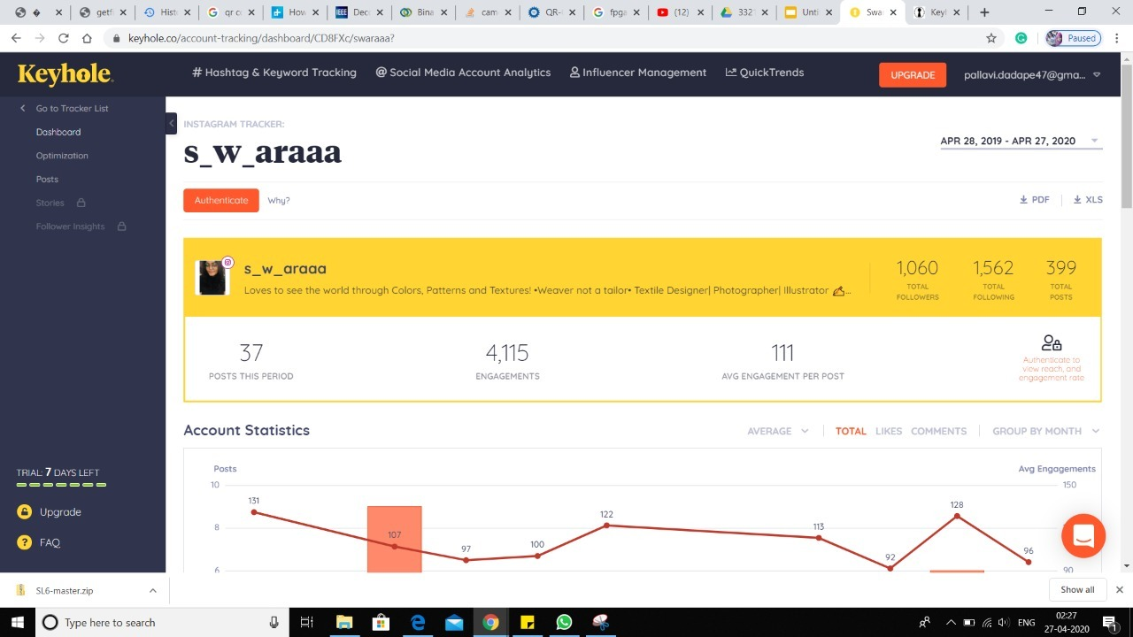

Slide 20
SAMPLE REPORT - AUDI

