Slide 1
MySQL Quiz

Slide 2
The wildcard in a WHERE clause is useful when?
An exact match is necessary in a SELECT statement.
An exact match is not possible in a SELECT statement.
An exact match is necessary in a CREATE statement.
An exact match is not possible in a CREATE statement.

Slide 3
A table that displays data redundancies yields ________ anomalies
Insertion
Deletion
Update
All of the above

Slide 4
If there is more than one key for relation schema in DBMS then each key in relation schema is classified as
Prime key
Super key
Candidate key
Primary key

Slide 5
A view is which of the following?
A virtual table that can be accessed via SQL commands
A virtual table that cannot be accessed via SQL commands
A base table that can be accessed via SQL commands
A base table that cannot be accessed via SQL commands

Slide 6
Which of the following are the five built-in functions provided by SQL?
COUNT, SUM, AVG, MAX, MIN
SUM, AVG, MIN, MAX, MULT
SUM, AVG, MULT, DIV, MIN
SUM, AVG, MIN, MAX, NAME

Slide 7
The HAVING clause does which of the following?
Acts like a WHERE clause but is used for groups rather than rows.
Acts like a WHERE clause but is used for rows rather than columns.
Acts like a WHERE clause but is used for columns rather than groups.
Acts EXACTLY like a WHERE clause.

Slide 8
Find the SQL statement below that is equal to the following: SELECT NAME FROM CUSTOMER WHERE STATE = 'VA';
SELECT NAME IN CUSTOMER WHERE STATE IN ('VA');
SELECT NAME IN CUSTOMER WHERE STATE = 'VA';
SELECT NAME IN CUSTOMER WHERE STATE = 'V';
SELECT NAME FROM CUSTOMER WHERE STATE IN ('VA');

Slide 9
Which join refers to join records from the write table that have no matching key in the left table are include in the result set:
Left outer join
Full outer join
Right outer join
Half outer join

Slide 10
A _____ is a property of the entire relation, rather than of the individual tuples in which each tuple is unique.
Rows
Key
Attribute
Fields

Slide 11
Which of the following statements creates a new table temp instructor that has the same schema as instructor.
create table temp_instructor;
Create table temp_instructor like instructor;
Create Table as temp_instructor;
Create table like temp_instructor;

Slide 12
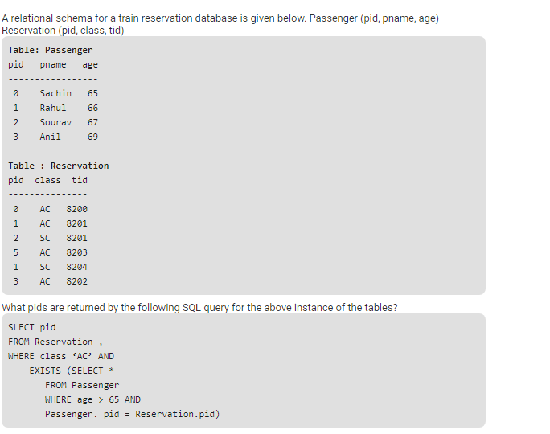
1,0
1,2
1,3
1,5

Slide 13
User() function return the current user name and
both a and b above
database name associated with the use
host name
password

Slide 14
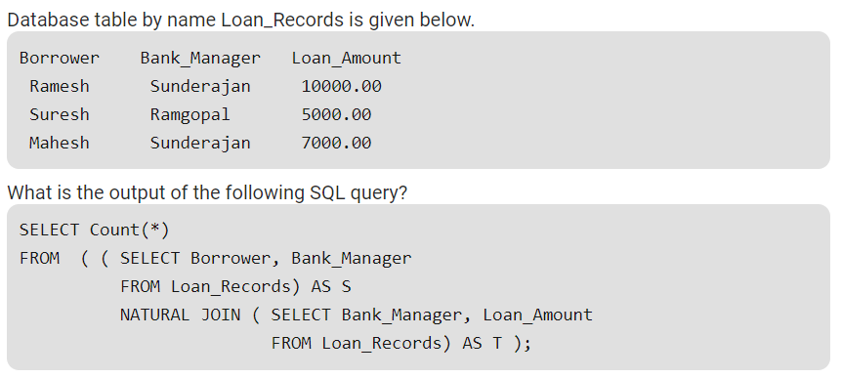
3
9
5
6

Slide 15
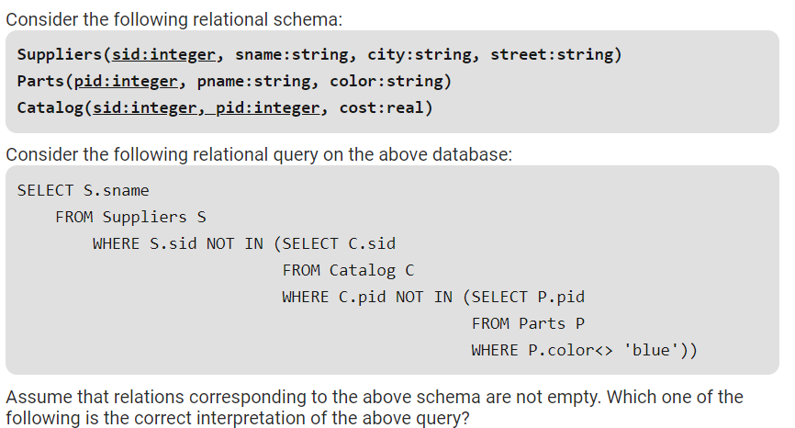
Find the names of all suppliers who have supplied a non-blue part.
Find the names of all suppliers who have not supplied a non-blue part.
Find the names of all suppliers who have supplied only blue parts.
Find the names of all suppliers who have not supplied only blue parts.
None

Slide 16
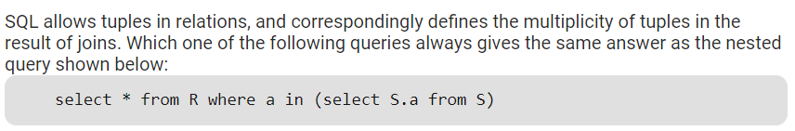
select R.* from R, S where R.a=S.a (D)
select distinct R.* from R,S where R.a=S.a
select R.* from R,(select distinct a from S) as S1 where R.a=S1.a
select R.* from R,S where R.a=S.a and is unique R

Slide 17
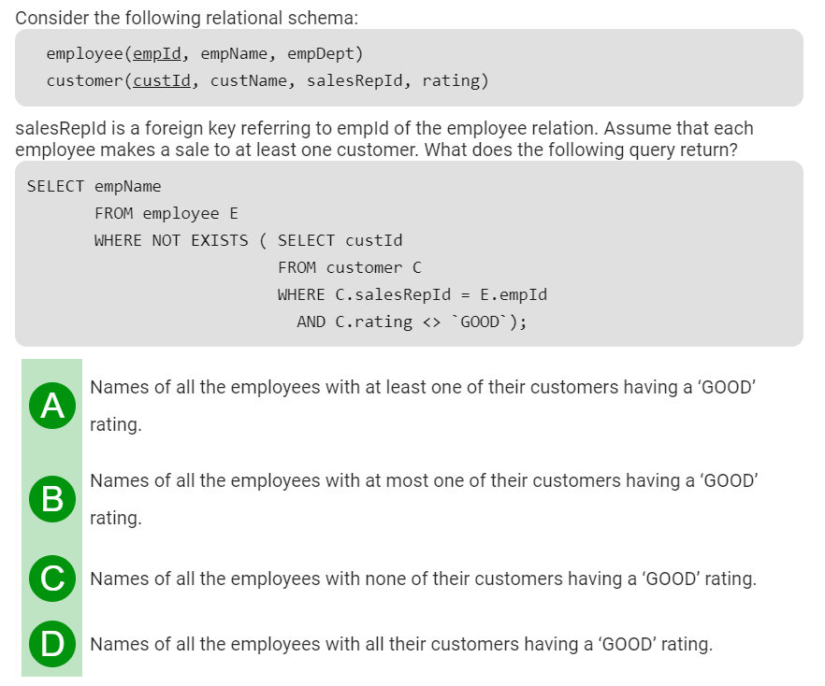

Slide 18
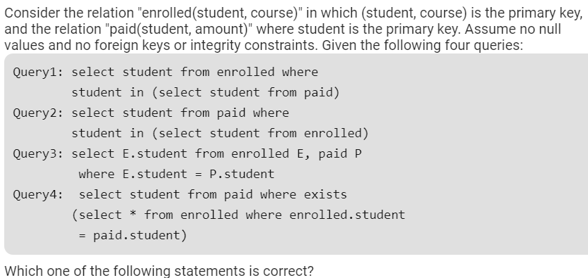
All queries return identical row sets for any database
Query2 and Query4 return identical row sets for all databases but there exist databases for which Query1 and Query2 return different row sets.
There exist databases for which Query3 returns strictly fewer rows than Query2
There exist databases for which Query4 will encounter an integrity violation at runtime.

Slide 19
The data type BLOB stands for:
Binary Large Object
Big List Object
Binary List Object
None of the above

Slide 20
The student marks should not be greater than 100. This is
Integrity constraint
Referential constraint
Over-defined constraint
Feasible constraint

Slide 21
Which of the following statements is NOT true for views in SQL?
Select statement used in the view definition cannot include ORDER BY clause.
A view drives its data from the base tables(s)
A view is updatable if it has been defined from a single relation
A view contains a copy of the data

Slide 22
_____ is process of extracting previously non known valid and actionable information from large data to make crucial business and strategic decisions.
Data Management
Database
Data Mining
Meta Data

Slide 23
Which of the following is true?
A relation in BCNF is always in 3NF.
A relation in 3NF is always in BCNF.
BCNF and 3NF are same.
A relation in BCNF is not in 3NF

Slide 24
Data Warehouse provides
Transaction Responsiveness
Demand and Supply Responsiveness
Storage, Functionality Responsiveness to queries
None of the above

Slide 25
What will be the output of this query UPDATE tab_name SET col1 = col1 + 1, col2 = col1;
col1 and col2 have different value
col1 and col2 have same value
col2 has original value of col1
None of the above

Slide 26
In which of the following is a single-entity instance of one type related to many entity instances of another type?
One-to-One Relationship
One-to-Many Relationship
Many-to-Many Relationship
Composite Relationship

Slide 27
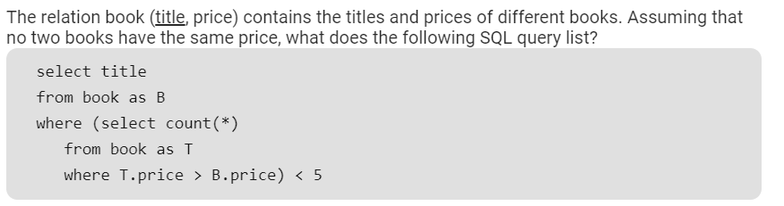
Titles of the four most expensive books
Title of the fifth most inexpensive book
Title of the fifth most expensive bookTitles of the five most expensive books
Titles of the five most expensive books

Slide 28
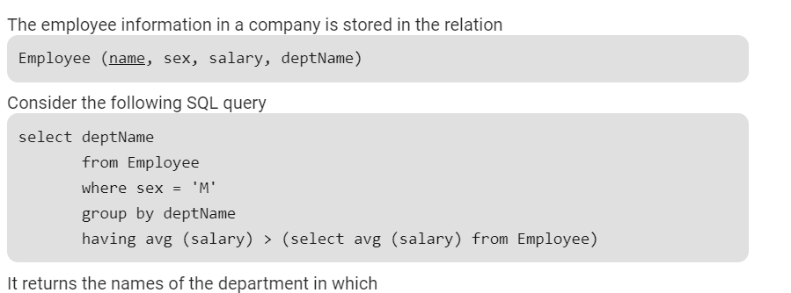
the average salary is more than the average salary in the company
the average salary of male employees is more than the average salary of all male employees in the company
the average salary of male employees is more than the average salary of employees in the same department
the average salary of male employees is more than the average salary in the company

Slide 29
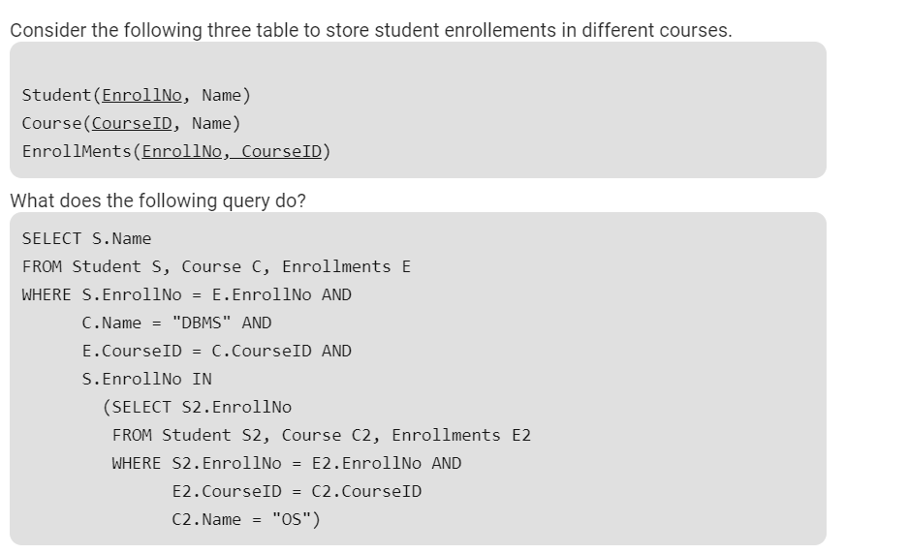
Name of all students who are either enrolled in "DBMS" or "OS" courses
Name of all students who are enrolled in "DBMS" and "OS“
Name of all students who are either enrolled in "DBMS" or "OS" or both.
None of the above

Slide 30
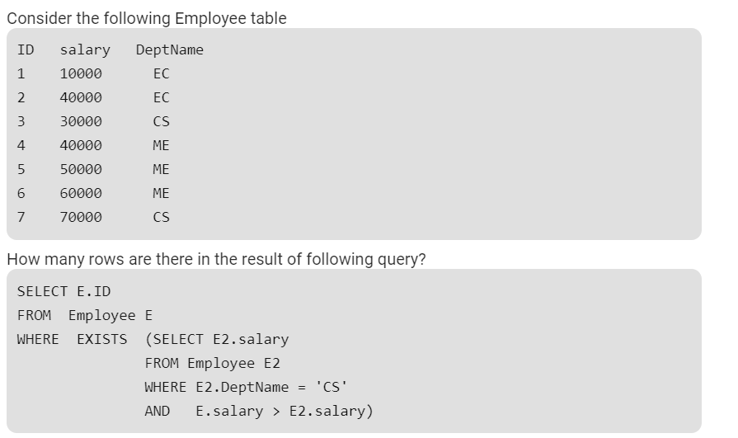
0
4
5
6

Slide 31
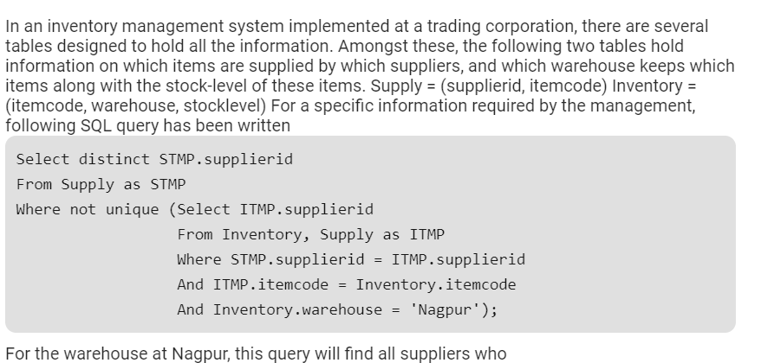
do not supply any item
supply exactly one item
supply one or more items
supply two or more items

