Slide 1
Predicting Credit Card Approval using Logistic Regression
Pallavi Aggarwal
MET CS 521

Slide 2
About the Database
Source: Credit Card Approval data from UCI Machine Learning Repository
Number of Attributes: 16
Number of Instances = 690

Slide 3
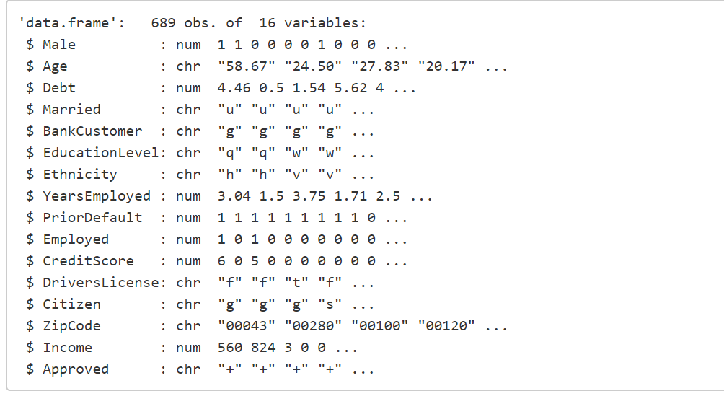
Names of the Attributes

Slide 4
Pre processing data steps
Handling the missing Values
Converting non numeric values into numeric
Drop Drivers License and Zip Code from the data as the correlation is low for these two attributes.
Split the data into test and train (20/80)
Scale the values to a uniform range (0-1)

Slide 5
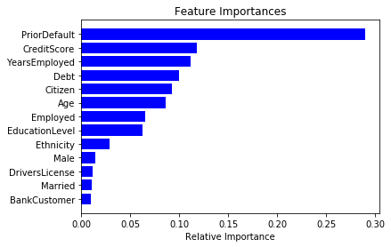
Feature Importance

Slide 6
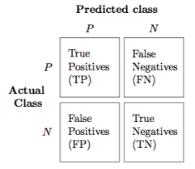

Confusion Matrix
Out of 138 test samples, 74 applications were predicted to be approved.
Out of which 66 were correctly predicted and 8 were predicted approved but were not approved.

Slide 7
Accuracy of the regression Model
The Model shows accuracy of the classifier as 87%.
This means that the model is working great in predicting the credit card approvals.

Slide 8
References
http://rstudio-pubs-static.s3.amazonaws.com/73039_9946de135c0a49daa7a0a9eda4a67a72.html
http://archive.ics.uci.edu/ml/datasets/credit+approval

