Slide 1

Summarization of Ted Talks
By Pallavi Aggarwal

Slide 2
Topic: Movie
How I accidentally changed the way movies get made
How I made an impossible film
How movies teach manhood
My journey into movies that matter
Spider-Man, The Lion King and life on the creative edge
The art of creating awe
The benefits of a bilingual brain
The magic ingredient that brings Pixar movies to life
The shared wonder of film
What it's like to be a woman in Hollywood

Slide 3
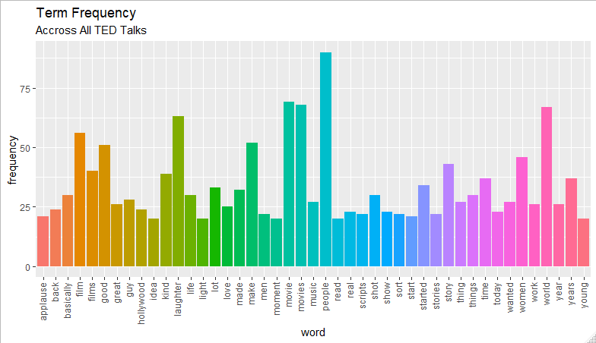
High Frequency Terms
(>20)

Slide 4
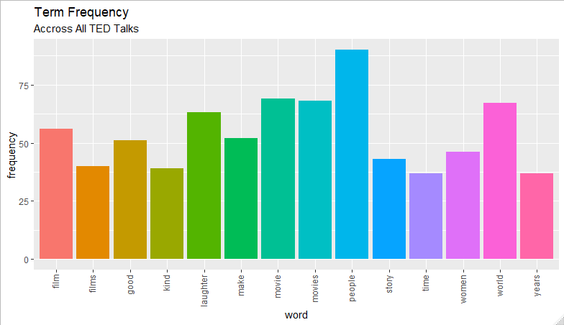
High Frequency Terms
(>30)

Slide 5

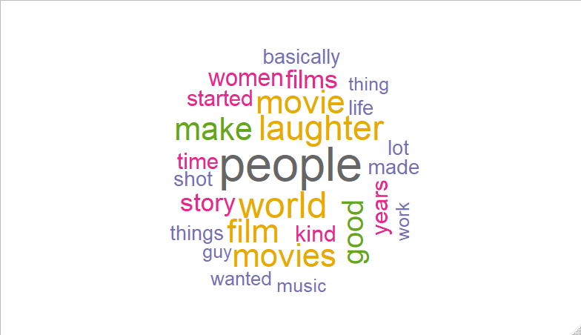
Word Cluster

Slide 6
Summary Example
"Forty years later was when the trend really caught on, with, interestingly, another movie that featured a metal guy and a furry guy rescuing a girl by dressing up as the enemy's guards. The monkeys are rather aggressive, as are the apple trees. I know from my own experience that Princess Leia did not provide the adequate context that I could have used in navigating the adult world that is co-ed. And we also have some terrific women who are writing new stories for our kids, and as three-dimensional and delightful as Hermione and Katniss are, these are still war movies. Alison Bechdel is a comic book artist, and back in the mid-'80s, she recorded this conversation she'd had with a friend about assessing the movies that they saw. So try to meet that bar.06:31 And do these women talk to each other at any point in the movie? (Applause) Thank you very much.06:50 Two women who exist and talk to each other about stuff. 07:07 In fact, this week I went to see a very high-quality movie, \"Argo.\" You've read about how the new economy is changing the roles of caregiver and wage earner. So our sons are going to have to find some way of adapting to this, some new relationship with each other, and I think we really have to show them, and model for them, how a real man is someone who trusts his sisters and respects them, and wants to be on their team, and stands up against the real bad guys, who are the men who want to abuse the women. "
>

Slide 7
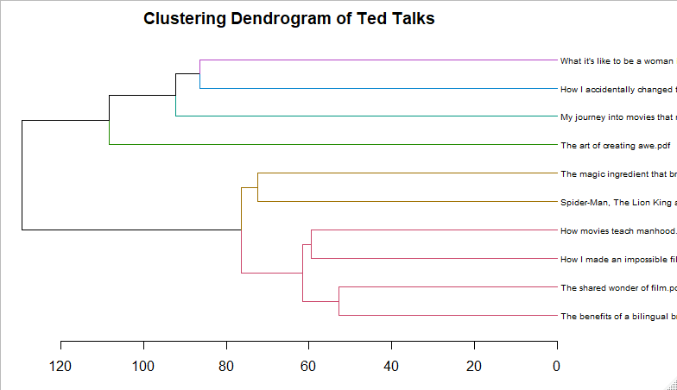
Hierarchical Clustering

