Slide 1
NCERT Multilingual Doubt-Solver
Architecture, Workflow, and Secure AI Integration
Submitted By : Gauri Kakad, Sharvari Bhujade, Pallavi Tayade
Institution : Shri Sant Gajana Maharaj College of Engineering, Shegaon

Slide 2
Project Overview
AI-powered doubt-solving system tailored for NCERT curriculum-based learning
Supports multilingual question answering, enabling students to ask doubts in their preferred language
Uses Firebase Authentication for secure anonymous user access and Firestore for real-time chat storage
Integrates Gemini AI to generate accurate, contextual responses aligned strictly with NCERT content

Slide 3
Frontend Initialization
Firebase SDK is initialized automatically when the page loads in the browser
Anonymous authentication allows users to access the system without login or personal data
A unique user ID is generated for each session to uniquely identify the student
This ID is used to securely link messages to the correct user in Firestore
Ensures privacy, session isolation, and consistent chat history management

Slide 4
Chat Message Flow
Student types a question in the chat interface and submits it using the “Send” button
The submitted message is securely stored in Cloud Firestore under the user’s unique ID
Firestore real-time listeners instantly update the chat interface
Previous and current chat messages are retrieved using the unique user ID for continuity

Slide 5
AI Integration Attempt
Frontend attempts to call the Gemini AI API directly from the browser
A system prompt is used to restrict responses strictly to NCERT-based content
The AI-generated response is post-processed to remove formatting and symbols
The cleaned response is then stored back into Cloud Firestore for display

Slide 6
Critical Issue Identified
Direct API calls from the browser expose sensitive API keys, creating a security risk
The Gemini API blocks such requests and returns a 403 Forbidden error
This restriction is a security enforcement implemented by the API provider
As a result, AI answer generation fails when attempted directly from the frontend

Slide 7
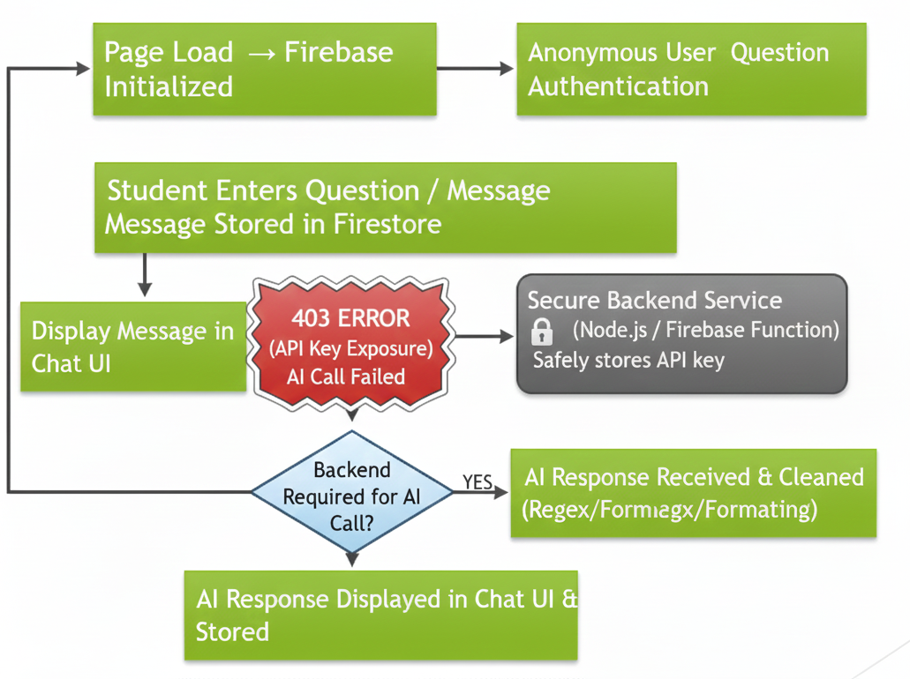
System Workflow – Flowchart
Page Load → Firebase Initialized
Anonymous User Authentication
Unique User ID Generated
Student Enters Question
Message Stored in Firestore
Attempt AI Call from Browser
403 Error (API Key Exposure)
Backend Required for AI Call
AI Response Returned & Stored

Slide 8
Intended Secure Architecture
Move all AI API calls from the frontend to a secure backend environment
Implement the backend using Node.js or Firebase Cloud Functions
Store and manage API keys securely on the server, preventing exposure
The frontend communicates with the backend using secure HTTPS requests

Slide 9
Technology Stack
Frontend: HTML, CSS, JavaScript for interactive chat-based user interface
Backend: Node.js / Firebase Cloud Functions for secure AI request handling
Database & Auth: Firebase Authentication and Cloud Firestore for real-time data storage
AI & APIs: Gemini AI API for NCERT-based multilingual answer generation

Slide 10
Team Contribution & Roles
Member 1: Designed and developed the frontend user interface, integrated the Firebase SDK, implemented anonymous authentication, and ensured smooth real-time chat rendering
Member 2: Designed and managed Cloud Firestore database structure, implemented message storage and retrieval logic, and maintained real-time synchronization of chat data
Member 3: Architected the complete system workflow, implemented secure backend integration for Gemini AI, handled API security constraints, and ensured scalability and performance

Slide 11
Conclusion
The system design is partially functional on the frontend, handling UI, authentication, and data storage
The system design is partially functional on the frontend, handling UI, authentication, and data storage
Security constraints require moving AI processing to a backend environment
The proposed architecture ensures secure, scalable, and maintainable system operation
This approach enables reliable multilingual, NCERT-aligned learning support for students

