Slide 1
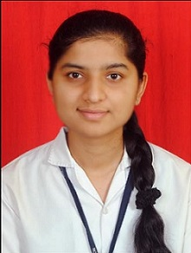
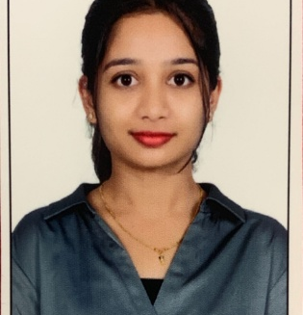


Pallavi Andhale
Analyst/Software Engineer
Bachelor of Engineering
Computer Science: 2017 -2021
Skills Java
Spring Boot
Spring MVC
MERN Stack
NodeJS
MongoDB
Database
SQL database –MySQL
No SQL database – MongoDB
Web Technologies
HTML5
CSS3
JavaScript
AddOns
Github
Postman
Additional Details
Patience
Willingness to learn
Team management
Pune
pallavi-ashok.andhale@capgemini.com
+918999968893
A4
Software Engineer who is Strong in design and integration with intuitive problem-solving skills. Passionate about implementing and launching new projects.
Ready to learn new technologies and implement them to further improve my knowledge.
Eager to work in a team of dedicated people and serve a key role in the enhancement and development of the project.
Has working knowledge on Angular and Java Microservice Development using Spring framework on an intermediate level.
https://github.com/pallavi1608
Online Hotel Management System :
Completed end to end case study of Online Hotel Management System along with JWT authentication, and Swagger . Material-UI and Angular used for user interface.
HTML CSS JAVASCRIPT for web developers at Coursera:
Completed this course with 98.6% and Designed responsive hotel management system using HTML5 CSS3 Bootstrap and JavaScript
Check out my work on GitHub & Video Profile

