Slide 1
FIN 7053: Algorithmic Trading
Long-Only Equity Strategy:
Mean Reversion & Momentum
Composite Signal
Universe:
S&P 500 Large-Cap · 60 Stocks
Period:
2015 – 2026
Signals:
5-Day Reversal (40%) + 12-1 Month Momentum (60%)
Execution:
Monthly Rebalance · Equal-Weight · Long-Only · 15 bps TC
Pallavi Sodani | Professor Mehmet Sağlam | Spring 2026

Slide 2
Strategy Overview
Market Inefficiency
Signal Construction
Execution Rules
Short-term overreaction (reversal) exploits investor herding & liquidity effects
Medium-term momentum captures persistent return patterns (Jegadeesh & Titman 1993)
Composite blend reduces single-signal drawdowns
Reversal: Negative 5-day cumulative return (Jegadeesh 1990)
Momentum: 12-1 month past returns (skip most recent month)
Composite: 40% Reversal + 60% Momentum, z-score normalized
Top decile (10%) = 6 stocks, equal-weighted
Monthly rebalance on last trading day
Positions set t+1 — no look-ahead bias
15 bps one-way transaction cost applied

Slide 3
Performance at a Glance (In-Sample Net)
817.6%
24.28%
0.950
-31.4%
1.275
Total Return
Ann. Return
Sharpe Ratio
Max Drawdown
Sortino
25.57%
1.85%
+8.34%
+6.25%
1.180
Ann. Volatility
Ann. TC Drag
Active Return
Jensen's Alpha
Beta
Annual Returns (Net):
2016
2017
2018
2019
2020
2021
2022
2023
2024
2025
2026
+37.43%
+41.78%
+2.07%
+12.43%
+27.01%
+6.27%
-1.38%
+36.10%
+55.74%
+22.71%
+18.53%
▲
▲
▲
▲
▲
▲
▼
▲
▲
▲
▲

Slide 4
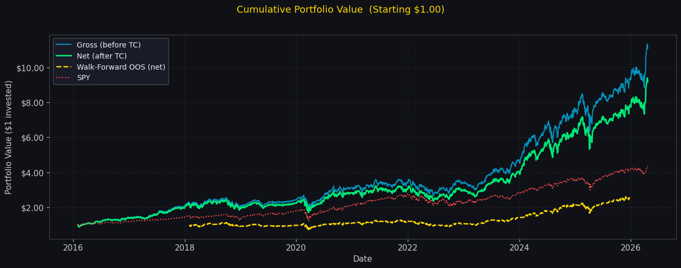
Cumulative Returns vs SPY Benchmark
Gross (Before TC)
Net (After 15 bps TC)
SPY Benchmark
Total: 1007.7%
Total: 817.6%
Ann. Return: 15.38%

Slide 5
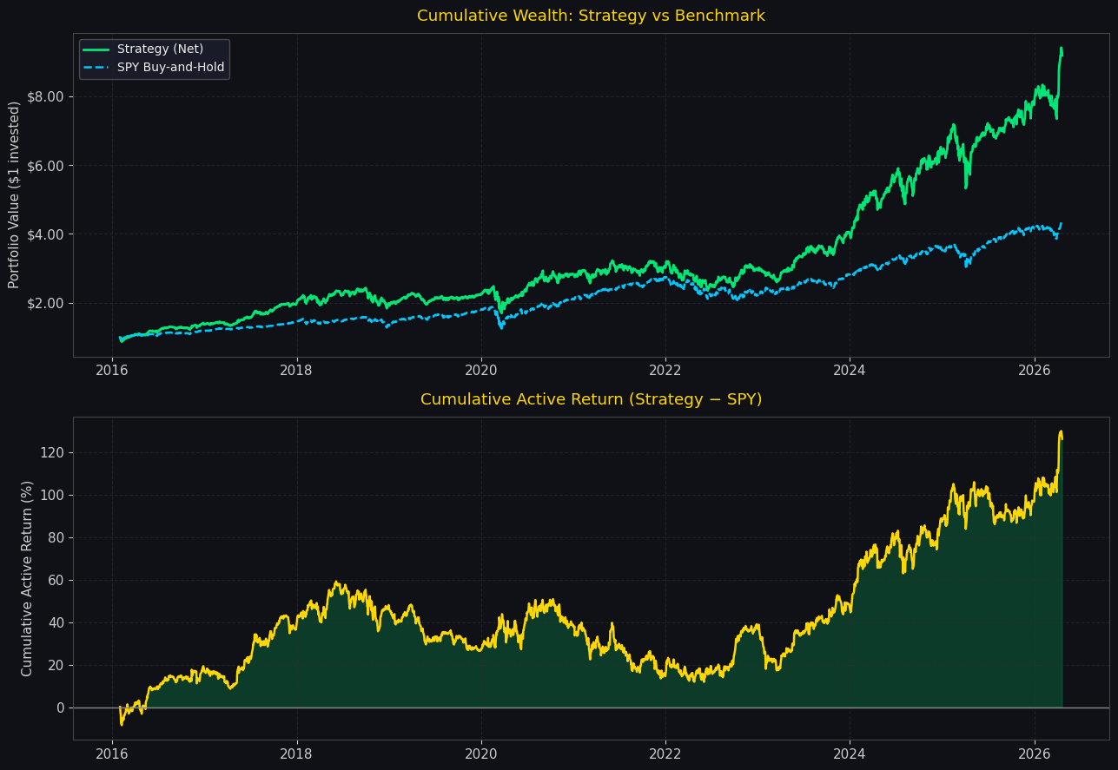
Benchmark Comparison vs SPY
CAPM Decomposition
Jensen's Alpha
+6.25%
Market Beta
1.180
R-Squared
0.679
Alpha p-value
0.0000 ✓
Info Ratio
0.562
Tracking Error
14.83% ann.
Strategy outperforms SPY by +8.34% ann.
Statistically significant alpha (p < 0.001)

Slide 6
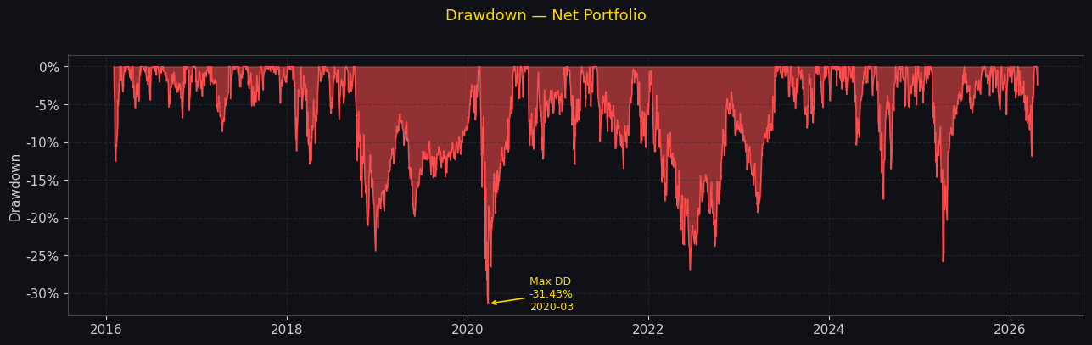
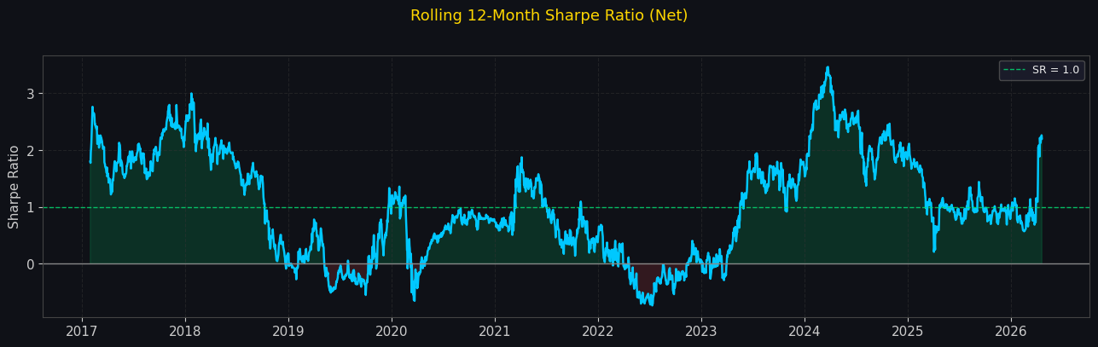
Drawdown Analysis & Rolling Sharpe Ratio
Maximum Drawdown Profile
Rolling 12-Month Sharpe Ratio

Slide 7
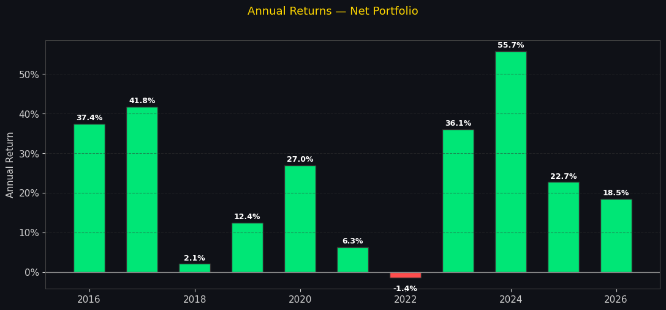
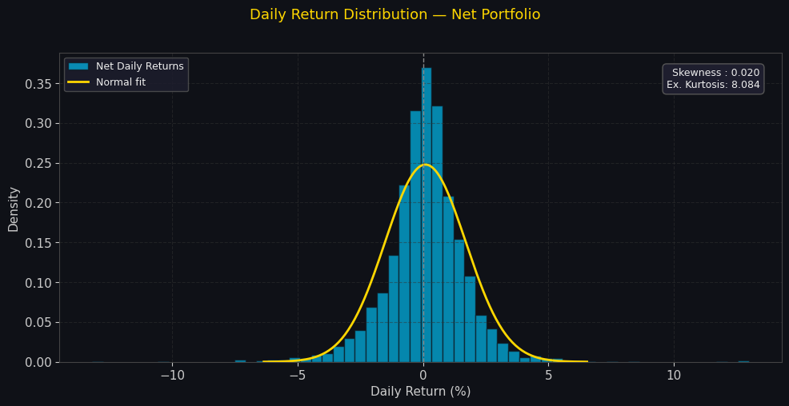
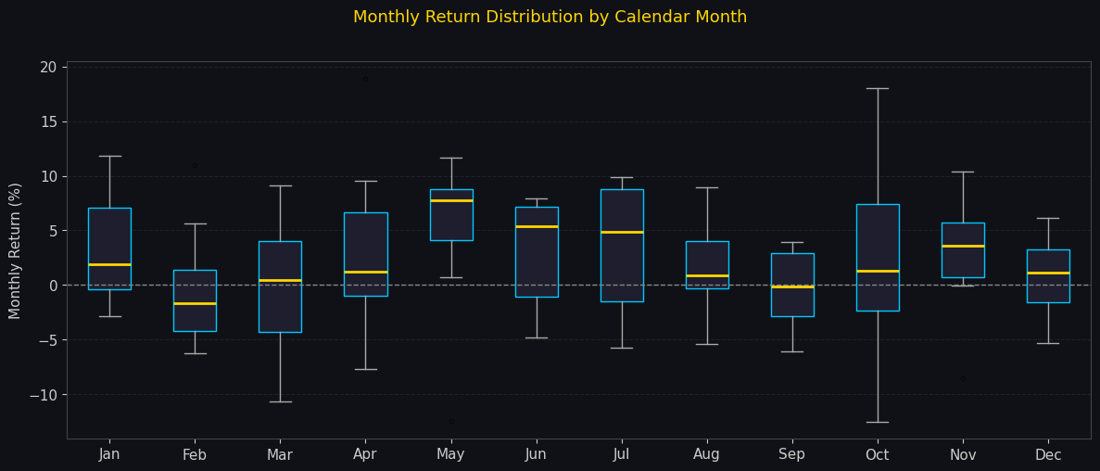
Annual Returns & Return Distribution

Slide 8
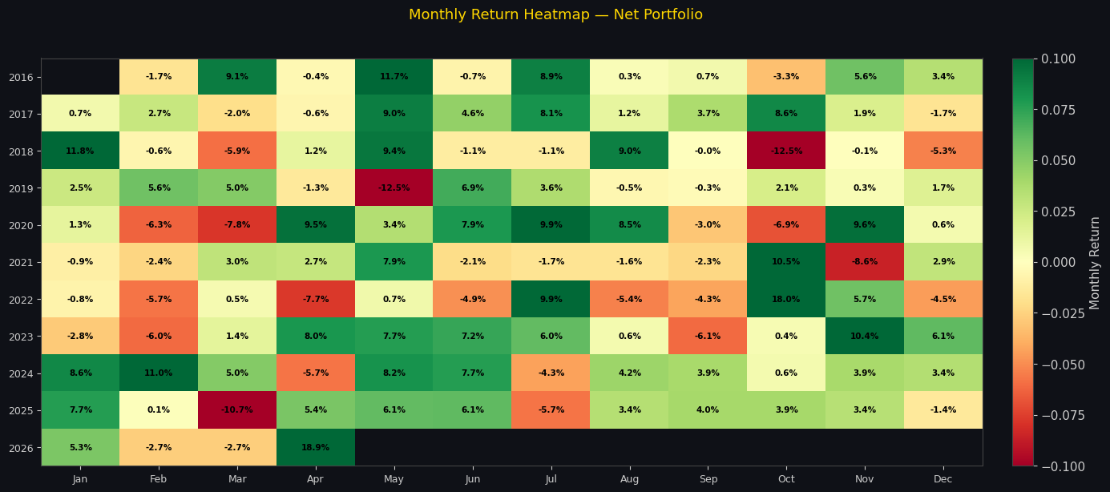
Monthly Return Heatmap
Color intensity shows monthly net return · Positive months dominate across the full 2016–2026 period

Slide 9
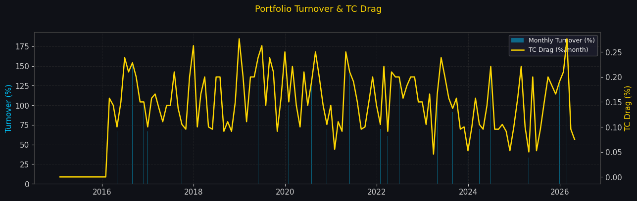
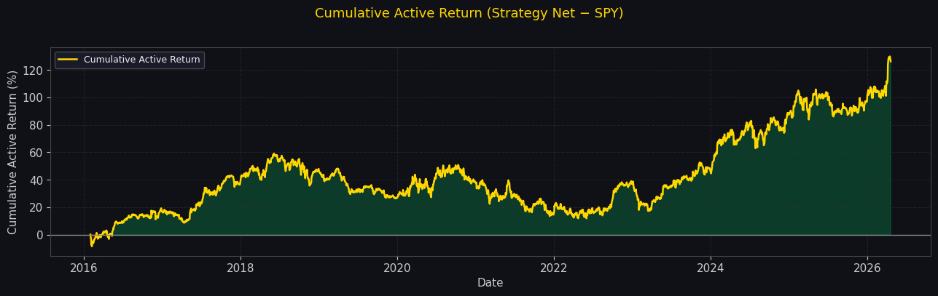
Turnover, Transaction Costs & Active Return
Monthly Turnover & TC Drag
Cumulative Active Return vs SPY

Slide 10
Walk-Forward Out-of-Sample Validation
Methodology
OOS Window Results
Expanding walk-forward windows
Train: 36 months minimum
Test: 6-month non-overlapping windows
16 total OOS windows (2018–2025)
No future data leakage by design
Win
Period
Ann. Ret
Sharpe
Note
1
2018-02 → 06
+6.3%
0.23
2
2018-08 → 12
-22.7%
-0.71
3
2019-02 → 06
+5.8%
0.44
4
2019-08 → 12
+7.3%
0.50
5
2020-02 → 06
+13.5%
0.23
COVID
6
2020-08 → 12
+18.8%
0.73
7
2021-02 → 06
+22.2%
0.88
8
2021-08 → 12
+0.0%
0.00
9
2022-02 → 06
-37.9%
-1.21
Rate shock
Aggregate OOS Results
10
2022-08 → 12
+20.3%
0.90
Rate shock
11
2023-02 → 06
+55.1%
3.07
12
2023-08 → 12
+28.6%
1.47
Ann. Return
15.23%
13
2024-02 → 06
+79.1%
3.47
14
2024-08 → 12
+51.3%
2.02
Sharpe Ratio
0.550
15
2025-02 → 06
+13.9%
0.37
16
2025-08 → 12
+36.5%
2.03
Max Drawdown
-35.43%
Total Return
156.95%

Slide 11
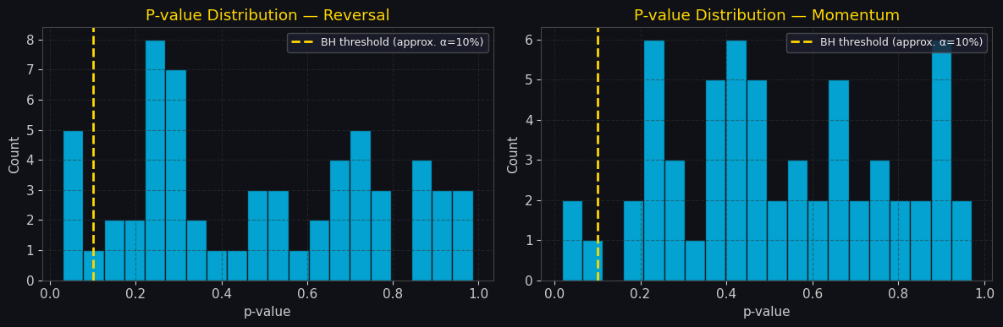
Statistical Robustness & BH-FDR Correction
BH-FDR Results (α = 10%)
Sub-Period Robustness
60 stocks tested individually
0/60 significant (reversal)
0/60 significant (momentum)
Median p-value: 0.49 — expected for cross-sectional signal
Portfolio-level alpha is a ranking phenomenon, not individual stock prediction
Period
Ann. Ret
Sharpe
Max DD
Pre-COVID (2015–2019)
22.81%
1.119
-24.4%
COVID/Post (2020–2026)
25.27%
0.889
-31.4%

Slide 12
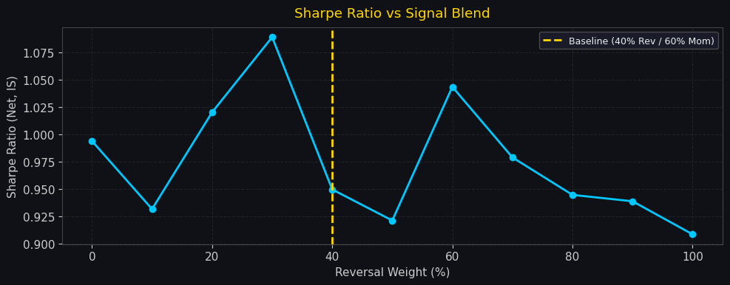
Signal Weight Sensitivity Analysis
Key Finding
Sharpe stable (0.90–1.09) across all weight combos
Baseline 40/60 is conservative choice
Pure momentum (0/100) viable at 0.994 Sharpe
Strategy is not overfitted to weight choice
Reversal / Momentum Weight Sweep:
0/100
10/90
20/80
30/70
40/60★
50/50
60/40
70/30
80/20
90/10
100/0
25.45%
23.96%
26.35%
27.70%
24.28%
23.32%
26.45%
24.15%
23.07%
22.91%
22.39%
0.994
0.932
1.020
1.089
0.950
0.921
1.044
0.979
0.945
0.939
0.909

Slide 13
Full Performance & Risk Summary
Metric
In-Sample Gross
In-Sample Net
OOS (Walk-Forward)
Start Date
2016-02-01
2016-02-01
2018-02-01
End Date
2026-04-21
2026-04-21
2025-12-31
Total Return
1007.74%
817.63%
156.95%
Ann. Return
26.59%
24.28%
15.23%
Ann. Volatility
25.57%
25.57%
27.67%
Sharpe Ratio
1.040
0.950
0.550
Sortino Ratio
1.397
1.275
0.736
Max Drawdown
-31.33%
-31.43%
-35.43%
Ann. TC Drag
—
1.85%
—
Jensen's Alpha
—
+6.25%
—
Beta
—
1.180
—

Slide 14
Risk Management & Implementation
Risk Framework
Implementation Details
Known Limitations
Equal-weight caps single-stock concentration
Top-decile selection limits to 6 stocks (16.7% each)
Monthly rebalance reduces stale signal exposure
Max drawdown capped at -31.4% historically
Beta of 1.18 — moderate market exposure
Signals computed on last trading day of month t
Positions entered on t+1 — no look-ahead bias
yfinance data: split & dividend adjusted
15 bps one-way TC = 1.85% annual drag
Monthly avg turnover tracked and reported
Survivorship bias: only current S&P constituents
Small universe (60 stocks) — scale with caution
High concentration (6 stocks) = idiosyncratic risk
Rate-hike environments adverse (2022 window)
Extend to CRSP for production-grade backtest

Slide 15
Conclusion & Investment Case
Superior Returns
24.28% ann. net vs 15.38% SPY (+8.90% excess)
Positive Alpha
Jensen's alpha +6.25% p.a., statistically significant (p < 0.001)
OOS Validated
Positive returns in 10 of 16 non-overlapping walk-forward windows
Robust Signal
Sharpe 0.90–1.09 across all weight combinations — no overfitting
Manageable Risk
Max drawdown -31.4%, Sharpe 0.95, Sortino 1.28
Pallavi Sodani | FIN 7053: Algorithmic Trading | Prof. Mehmet Sağlam | Spring 2026

