Slide 1

Project on OnLINE Pet Shop
Submitted By : Roll no 1126 Pallavi Chavan
ROLL No 1172 SAYALI PATARE

Slide 2
Purpose
E-commerce is fast gaining ground as an accepted and used business paradigm. More and more business houses are implementing web sites providing functionality for performing commercial transactions over the web. It is reasonable to say that the process of shopping on the web is becoming commonplace. The Online Pet Shop web application is intended to provide solution for customers and sellers to buy or sell their pet through a single gate way using the internet.

Slide 3
Scope
The scope of this system is divided into mainly two parts, customer and sellers. Customer and sellers who are literate with computers. Any user who wants to buy or sell pet can visit the website. The seller can add his pet by providing the details of pet on this website. The customer can browse through the shop and see a list of pets uploaded for sale by other sellers and purchase them online .This web application will provide an option for storing and managing the basic information about the user and also an option for storing and managing the basic information about pet.

Slide 4
Objectives
To produce a web-based system that allow the user to register, login.
To allow users i.e customers and sellers to buy/sell pet.
To ease user by providing different functionalities to it.

Slide 5
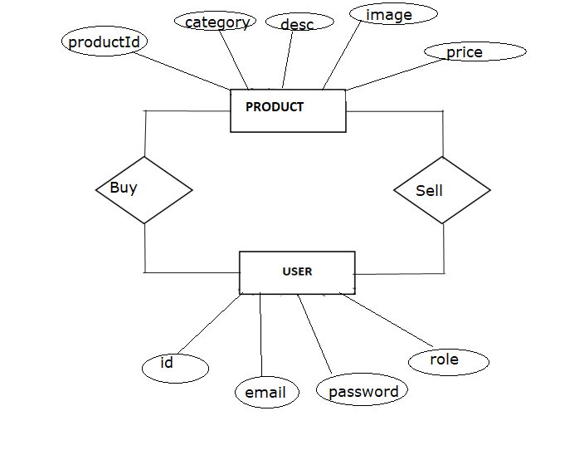
ER Diagram

Slide 6
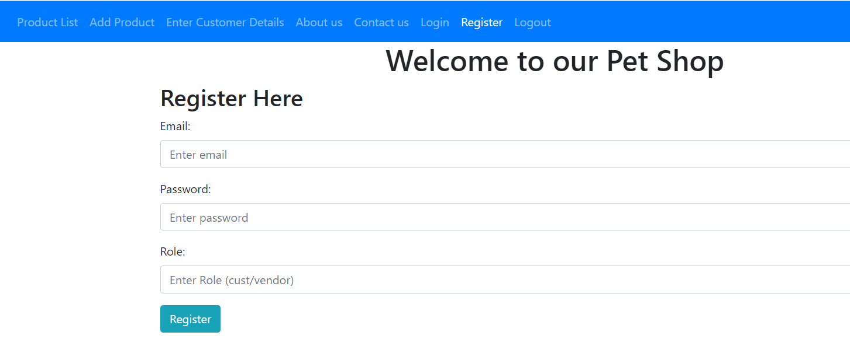
SCREENSHOTS

Slide 7
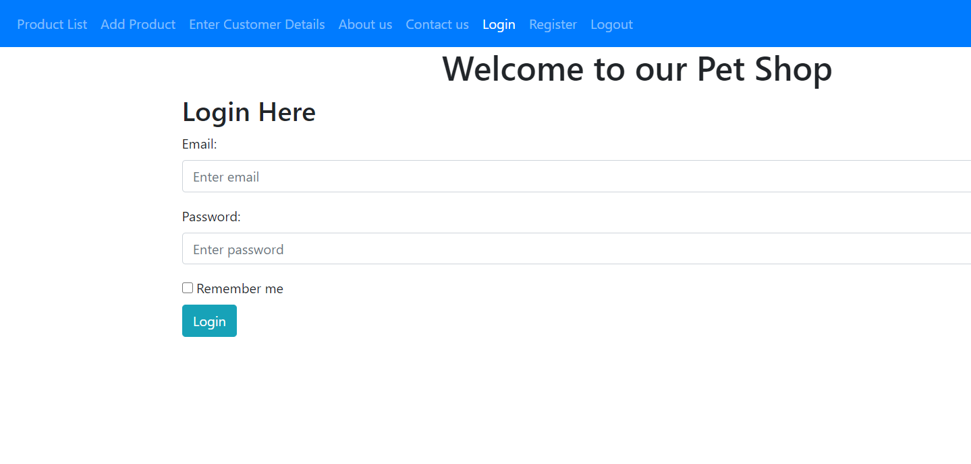

Slide 8
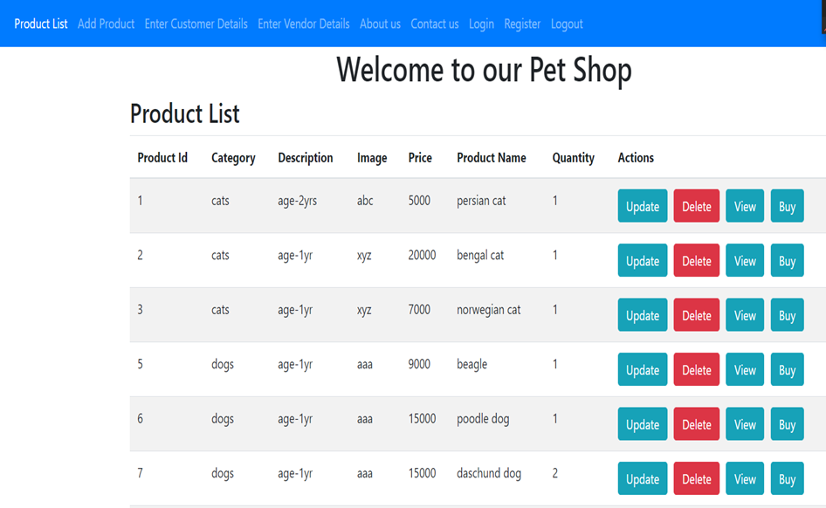
PRODUCT LIST

Slide 9
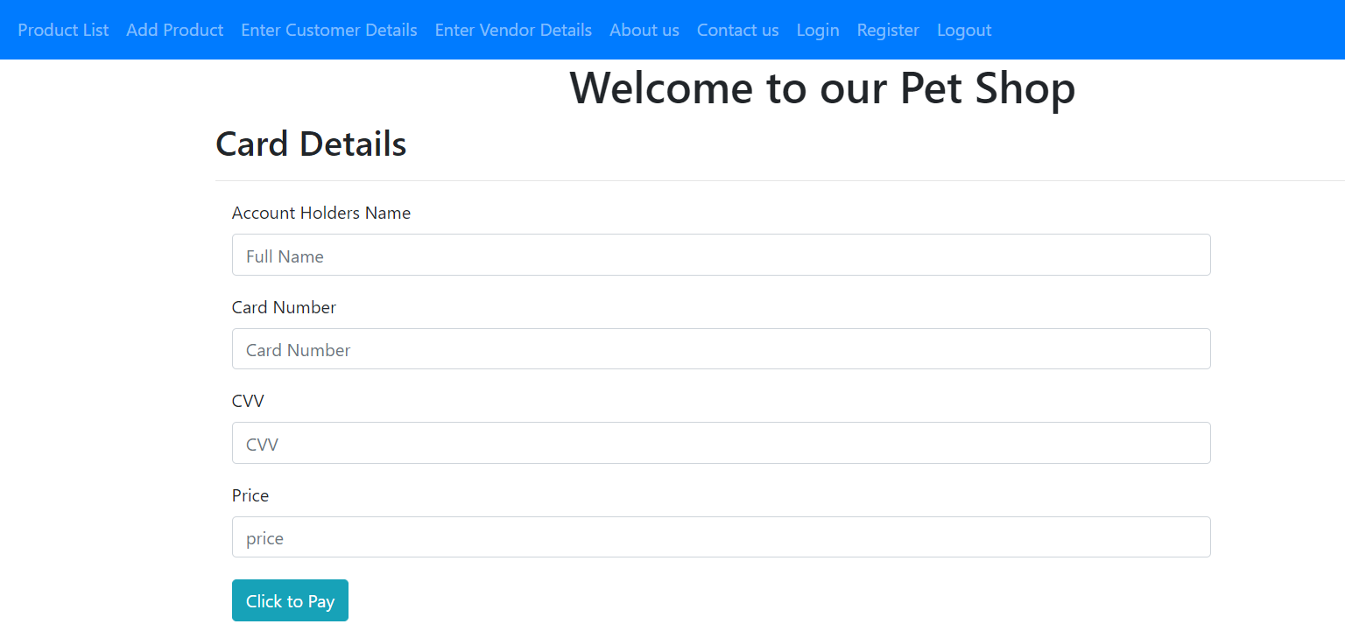
CARD DETAILS

Slide 10
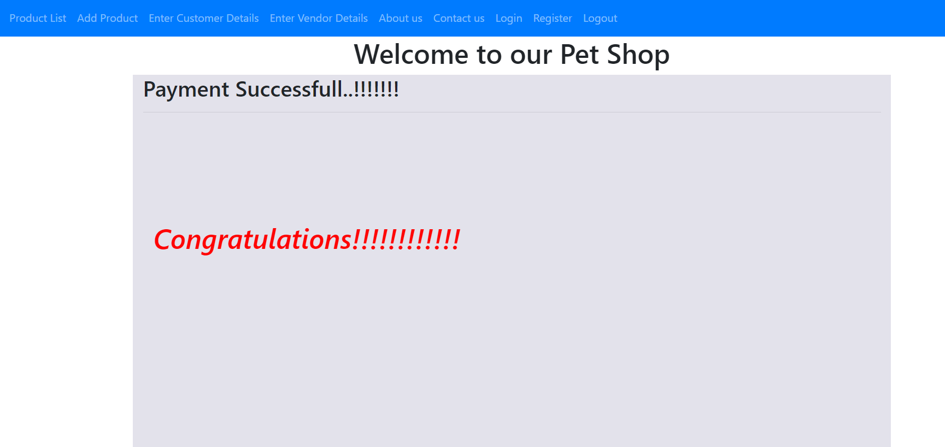
PAYMENT SUCCESS

Slide 11
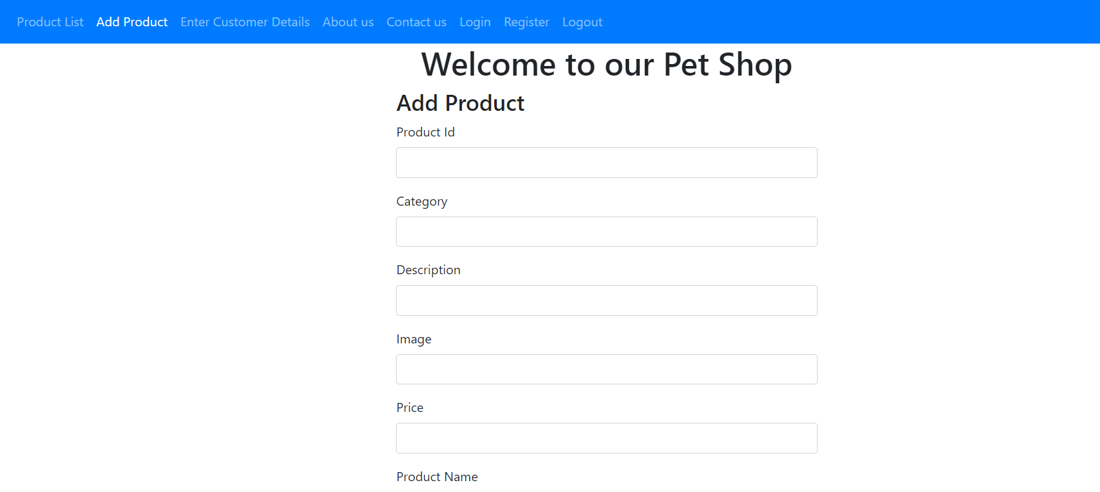
ADD Product details

Slide 12
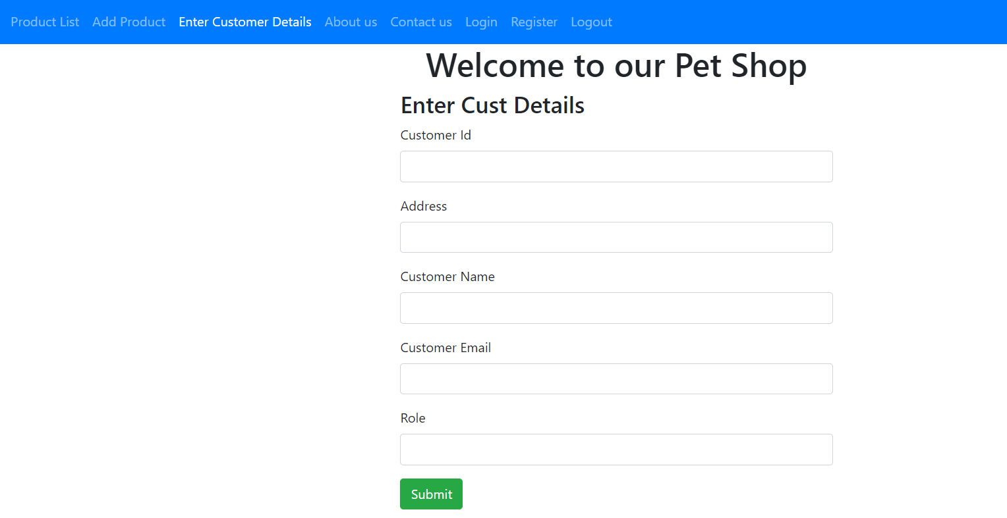
Enter Customer details

Slide 13
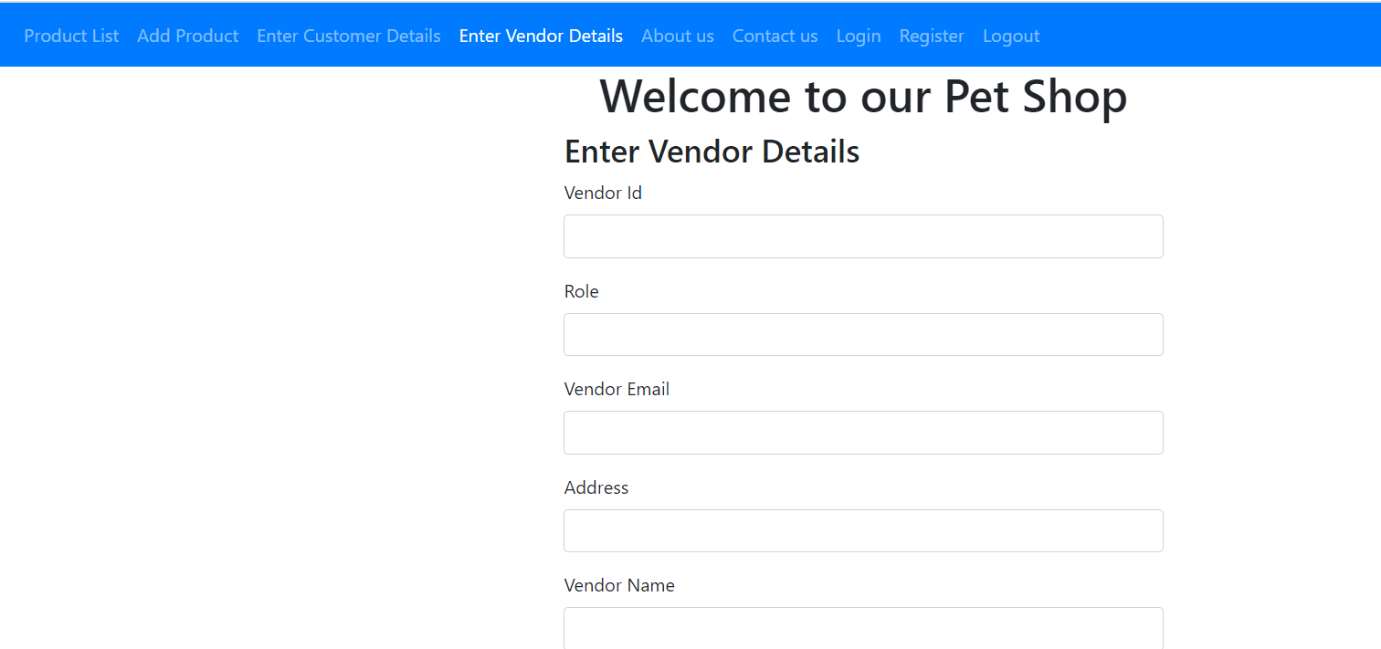
Enter Vendor Details

Slide 14
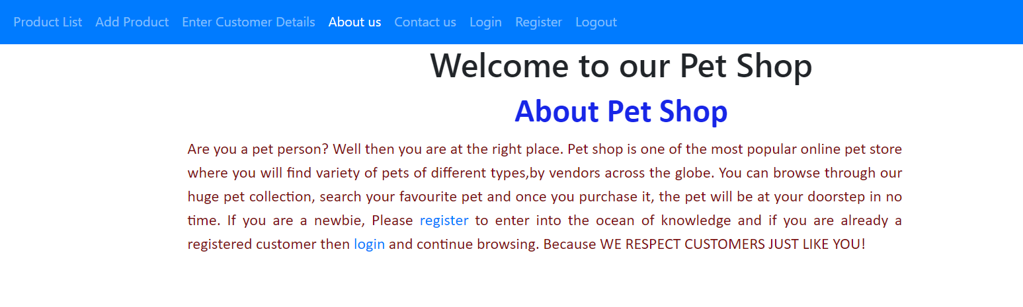
About us

Slide 15
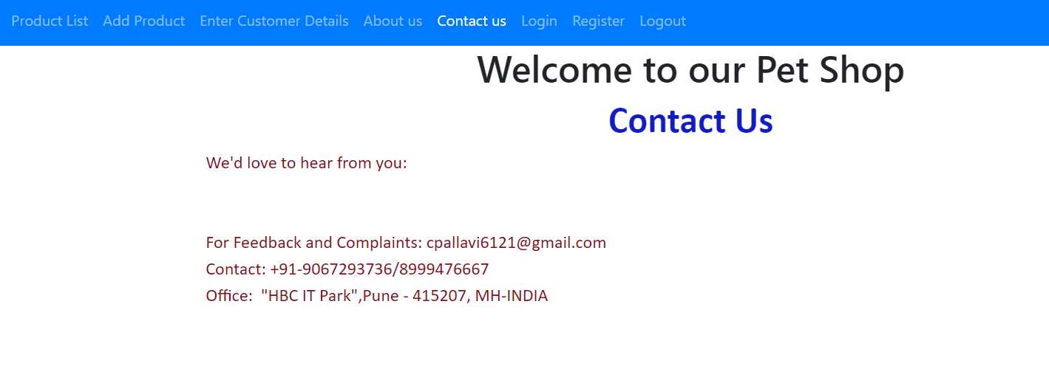
Contact us

Slide 16
REFerences
W3Schools online Web Tutorial
Elmasri, Ramez, Fundamentals of database systems. Pearson education in india 2008.
TechBiz online tutorial
"Ontario's Animal Protection Law Strongest In Canada". Retrieved 3 April 2014. [2] Crair, Ben (19 August 2015). "The World's Biggest Pet Store Has 250,000 Animals". Bloomberg Business. Retrieved 30 November 2019. [3] "Ten Fast Facts about Pet Shops". Retrieved 3 April 2014

Slide 17
CONCLUSION
The development of this Online Pet Shop is great improvement over the manual system which uses lots of manual work and paper. The computerization of the system speeds up the process.
The Online Pet Shop is fast, efficient and reliable, Avoids data redundancy and inconsistency. It contains all the functional features described in objective of the project.

Slide 18
THANK You

