Slide 1

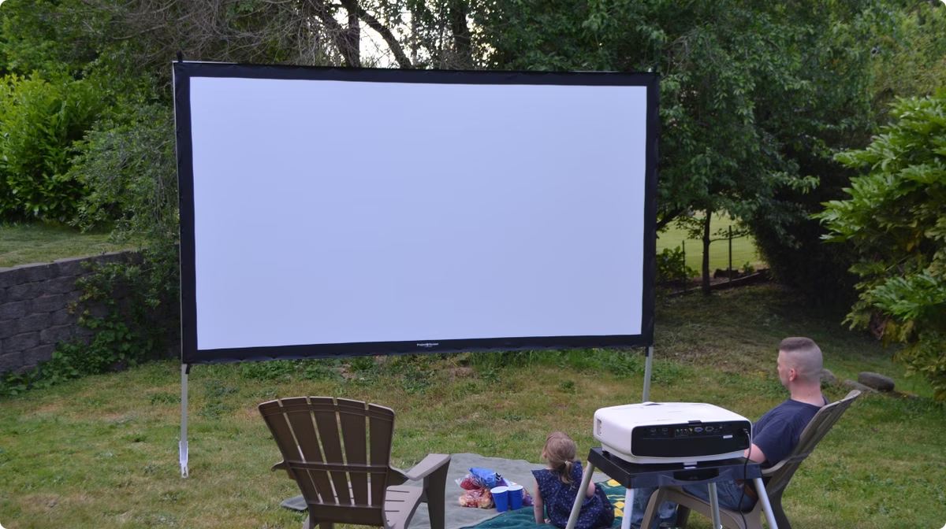
Movie Broadcasting Platform
Pallavi(30)
Suhana(54)
Saleema(44)
Shoyab(50)
Shoiab(49)

Slide 2
Introduction to Movie Broadcasting
In today's dynamic world, movie broadcasting is undergoing a profound shift. This presentation explores how technology and consumer behavior are revolutionizing the way we experience films, making it more accessible and immersive than ever before.

Slide 3

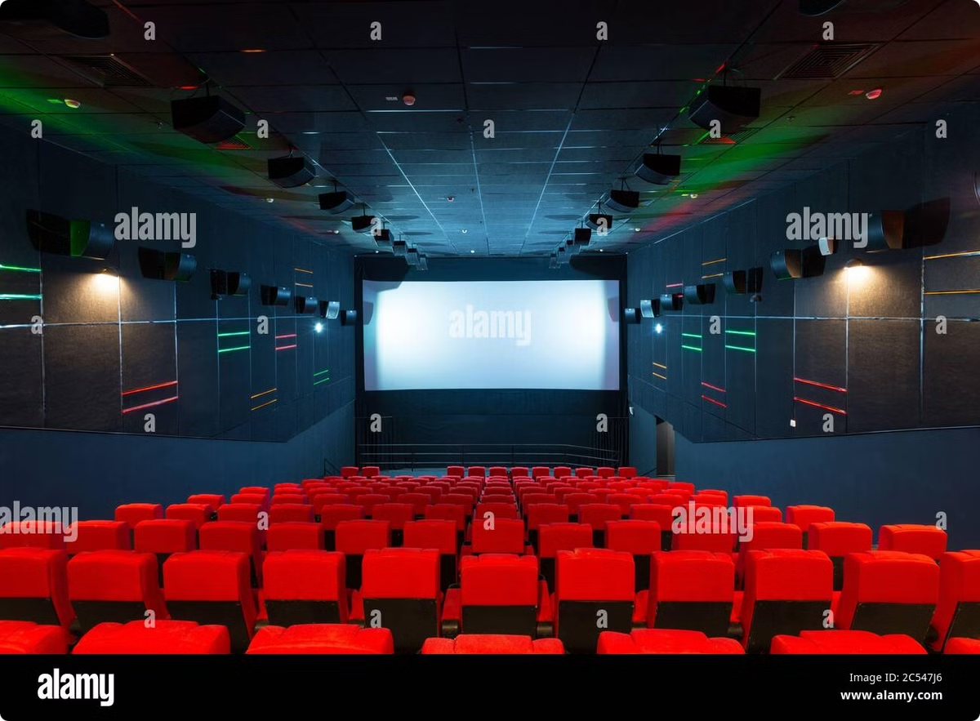
Content
1
Movie Library
2
Live Streaming
Hundreds of popular movies, new releases, and classics
Real-time broadcasts of live events and special premieres
3
Exclusive Content
4
Personalized Recommendations
Behind-the-scenes footage, interviews, and bonus material
Tailored suggestions based on user preferences

Slide 4
Abstract
This platform is designed to deliver the best movie experience to viewers worldwide.
Accessibility
Engagement
Access movies anywhere, anytime, on any device
Interactive features and community forums for fans
Quality
Innovation
High-resolution streaming and immersive audio
Leveraging cutting-edge technology for an unparalleled experience

Slide 5


Objective of the Project
To create a user-friendly and engaging platform for accessing and enjoying movies.
1
Target Audience
Movie enthusiasts, casual viewers, and families
2
Platform Development
Creating a robust and scalable platform
3
Content Acquisition
Licensing movies from distributors and studios
4
Marketing & Promotion
Reaching target audiences and driving user growth

Slide 6
Key Features of the Project
The platform will offer a wide range of features to enhance the viewing experience.
User Interface
Content Management
Payment System
Intuitive and easy-to-navigate design
Comprehensive system for organizing and managing movie content
Secure and reliable payment processing
Search functionality
Personalized profiles
Watchlist and queue
Subscription plans
Subtitles and dubbing
Pay-per-view options
Content filtering and recommendations
Multiple payment methods

Slide 7





System Workflow
The platform's workflow ensures seamless operation and efficient content delivery.
User Request
A user requests a movie to watch
Content Retrieval
The platform retrieves the requested movie
Streaming
The movie is streamed to the user's device
User Experience
The user enjoys a high-quality viewing experience

Slide 8
CONCLUSION
The future of movie broadcasting is bright ccharacterized by innovation and adaptability
As technology evolves ,so will the ways we enjoy films,fostering a rich and diverse entertainment landscape for generations to come

Slide 9
Thank you

