Slide 1
JACKFRUIT PROBLEM REVIEW | CORE CHALLENGE & HYPOTHESES
1 / 4
1. Problem Statement: Scale-Dependence in Zero-Heavy Uplift
Why arbitrary currency/unit scaling distorts CATE targeting rankings under non-linear transformations
01 | REAL-WORLD DILEMMA
02 | THEORETICAL MECHANISM
03 | BUSINESS LOSS & HYPOTHESES
The Zero-Heavy Spend Challenge
• Massive Zero Inflation: Commercial outcomes Y >= 0 in marketing, healthcare, and ad-tech feature 90-99% exact zeros with extreme heavy-tailed spending.
• The Universal Heuristic: Practitioners routinely apply concave transformations g(y) = log(1 + a*y) or asinh(a*y) to stabilize variance and prevent extreme outliers from dominating squared error loss.
• The Arbitrary Scale Trap: The tuning parameter 'a' reflects arbitrary reporting units (a=1 for $, a=0.01 for cents, a=1000 for thousands). Machine learning pipelines treat 'a' as an innocuous cosmetic choice.
• The Core Dilemma: Uplift models prioritize customers by estimated conditional treatment effects. Does changing measurement unit 'a' secretly reorder who gets targeted?
Chen & Roth (2024) Limiting Regimes
Targeting Turnover & Hypotheses
• 48% Customer Churn: On the real Hillstrom trial, switching scale from dollars (a=1) to cents (a=0.01) replaces ~48% of the top 20% targeted cohort!
• Severe Policy Regret: Targeting misaligned customers bleeds 20-40% of potential marketing campaign revenue by chasing low-spend coupon clippers.
• H1 (Rank Instability): Rank stability drops precipitously under log1p when extensive and intensive margins diverge.
• H2 (Transformation Rate): Slow-growing concave transforms (log1p, asinh) destabilize far worse than power transforms (sqrt).
• H3 (Count Equivariance): Count-aware likelihood models (Tweedie, Hurdle) maintain strict scale-equivariance (rho = 1.000).
• H4 (Welfare Superiority): Count-aware models minimize empirical policy regret without ad-hoc outcome distortion.
tau_{m,a}(x) = E[log(1+aY) | 1, x] - E[log(1+aY) | 0, x]
• Asymptotic Limit a -> 0 (Level Margin): lim (log(1+ay)/a) = y. Targets true Level Dollars: tau_level(x) = E[Y(1) - Y(0) | x]. Dominated by intensive margin (large spenders).
• Asymptotic Limit a -> inf (Extensive Margin): log(1+ay) = log(a)*1(y>0) + log(y)*1(y>0). As a -> inf, targets purely Conversion Probability: P(Y(1)>0|x) - P(Y(0)>0|x). Intensive spend is completely ignored!
• The Reordering Mechanism: Whenever extensive margin (who converts) and intensive margin (how much they spend) diverge across customer segments, varying 'a' violently flips targeting rankings.

Slide 2
JACKFRUIT PROBLEM REVIEW | ENGINEERING & EXPERIMENTAL SETUP
2 / 4
2. Implementation So Far: Architecture, DGPs & Rigorous Benchmarks
Modular causal engine, 6 synthetic DGP scenarios, real-world field trials, and 98/98 unit tests
ESTIMATOR ARCHITECTURE
CONTROLLED EXPERIMENTAL BENCHMARKS
Modular Causal Estimators & Count Likelihoods
• Meta-Learner Framework: T-Learner and Doubly Robust (DR) Learner with out-of-fold cross-fitting (K=5) to eliminate regularization and in-sample overfitting bias.
• Transform Family: identity (untransformed level), log1p (log(1+ay)), sqrt (sqrt(ay)), asinh, and non-parametric rank percentiles.
• Count-Aware Native Models: Compound Poisson-Gamma (Tweedie deviance, p=1.5) natively modeling mass at zero + continuous positive spend; Two-Part Hurdle (LightGBM classifier + Log-Gamma GLM); Quasi-Poisson.
• Tree Engine: LightGBM gradient boosting backend with early stopping and zero-partition safety guards.
6 Controlled Synthetic DGP Scenarios (N=20,000)
• null & homogeneous: Negative control sanity checks with tau=0 and uniform additive lift across all customer covariate profiles.
• extensive_only: Treatment strictly shifts conversion probability P(Y>0); basket distribution conditional on buying is completely invariant.
• intensive_only: Conversion rate is fixed; treatment strictly increases conditional spend magnitude.
• opposing (Stress Test): Segment A has positive extensive lift / negative intensive lift; Segment B has opposite. Direct test of rank inversion.
• correlated: Realistic joint dependence between customer conversion probability and basket expenditure.
EMPIRICAL EVALUATION SUITES
TEST SUITE & QUALITY GATES
Hillstrom Trial & Criteo Semi-Synthetic
• Hillstrom Marketing Trial (N=64,000): Genuine randomized email trial: Men's Campaign (N=42,613) and Women's Campaign (N=42,693) vs uncontacted control (N=21,307). 99.1% zeros; 0.9% buyer conversion rate.
• Out-of-Fold Policy Evaluation: Repeated 5-fold cross-validation estimating real dollar policy value across continuous budgets k in [0.01, 0.50] and scales a in [10^-3, 10^3].
• Criteo Uplift v2.1 Benchmark (N=200,000): 12 real ad features, realistic propensity distributions, paired with controlled zero-heavy spend with diverging margin DGPs.
98 / 98 Tests Passing & Full Verification
• Full Test Coverage: 98 passing unit tests across tests/test_dgp.py, tests/test_models.py, tests/test_metrics.py, and tests/test_analysis.py.
• Negative Controls Validated: Power transform (sqrt) and rank percentiles strictly achieve rank stability rho = 1.0000 across all random seeds (scale-equivariant by proof).
• Zero-Partition Numerical Safety: Hardened Tweedie, Hurdle, and Poisson models to safely handle edge-case CV partitions with zero positive buyers.
• Git Remote Synced: Full codebase clean, documented, and pushed to GitHub branch q/engine (commit abf09c0).

Slide 3
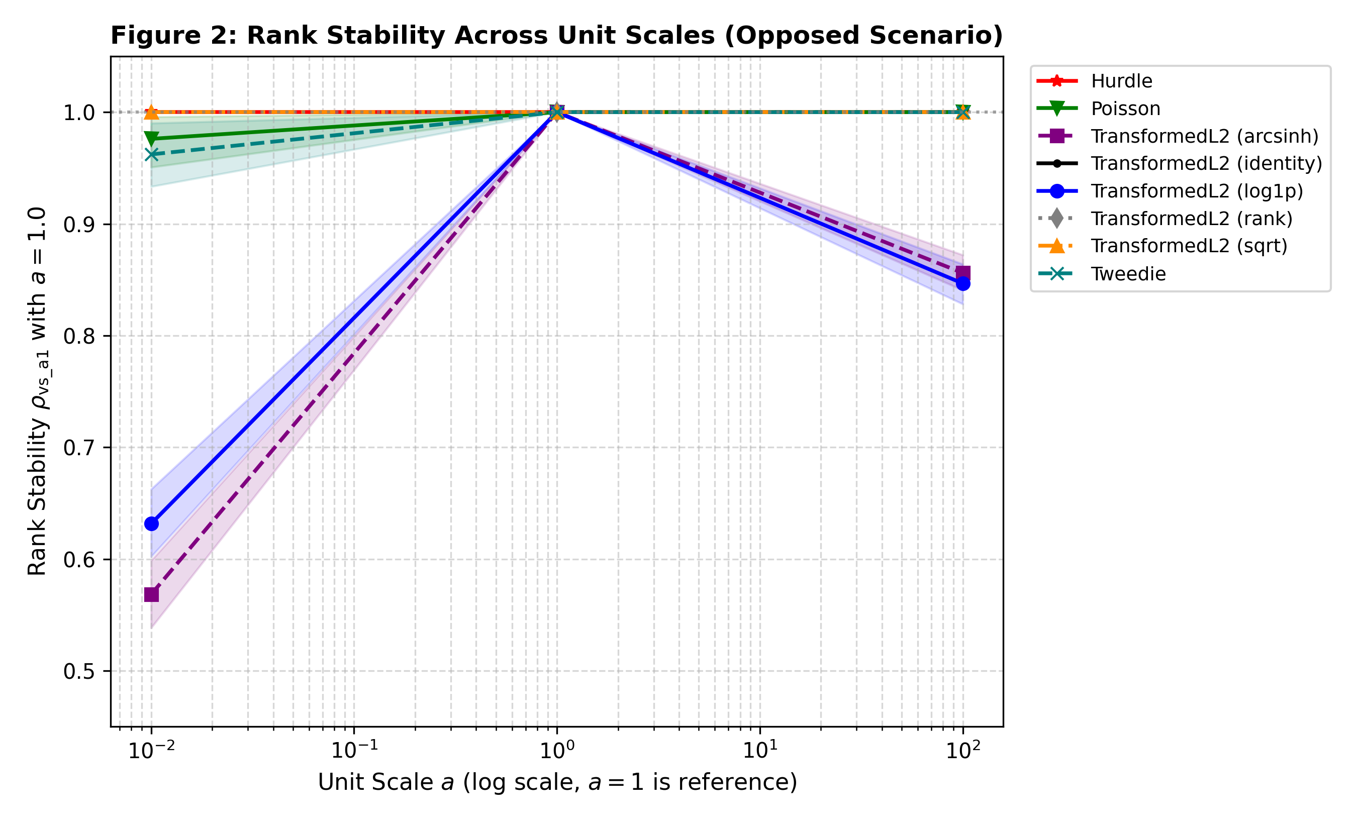
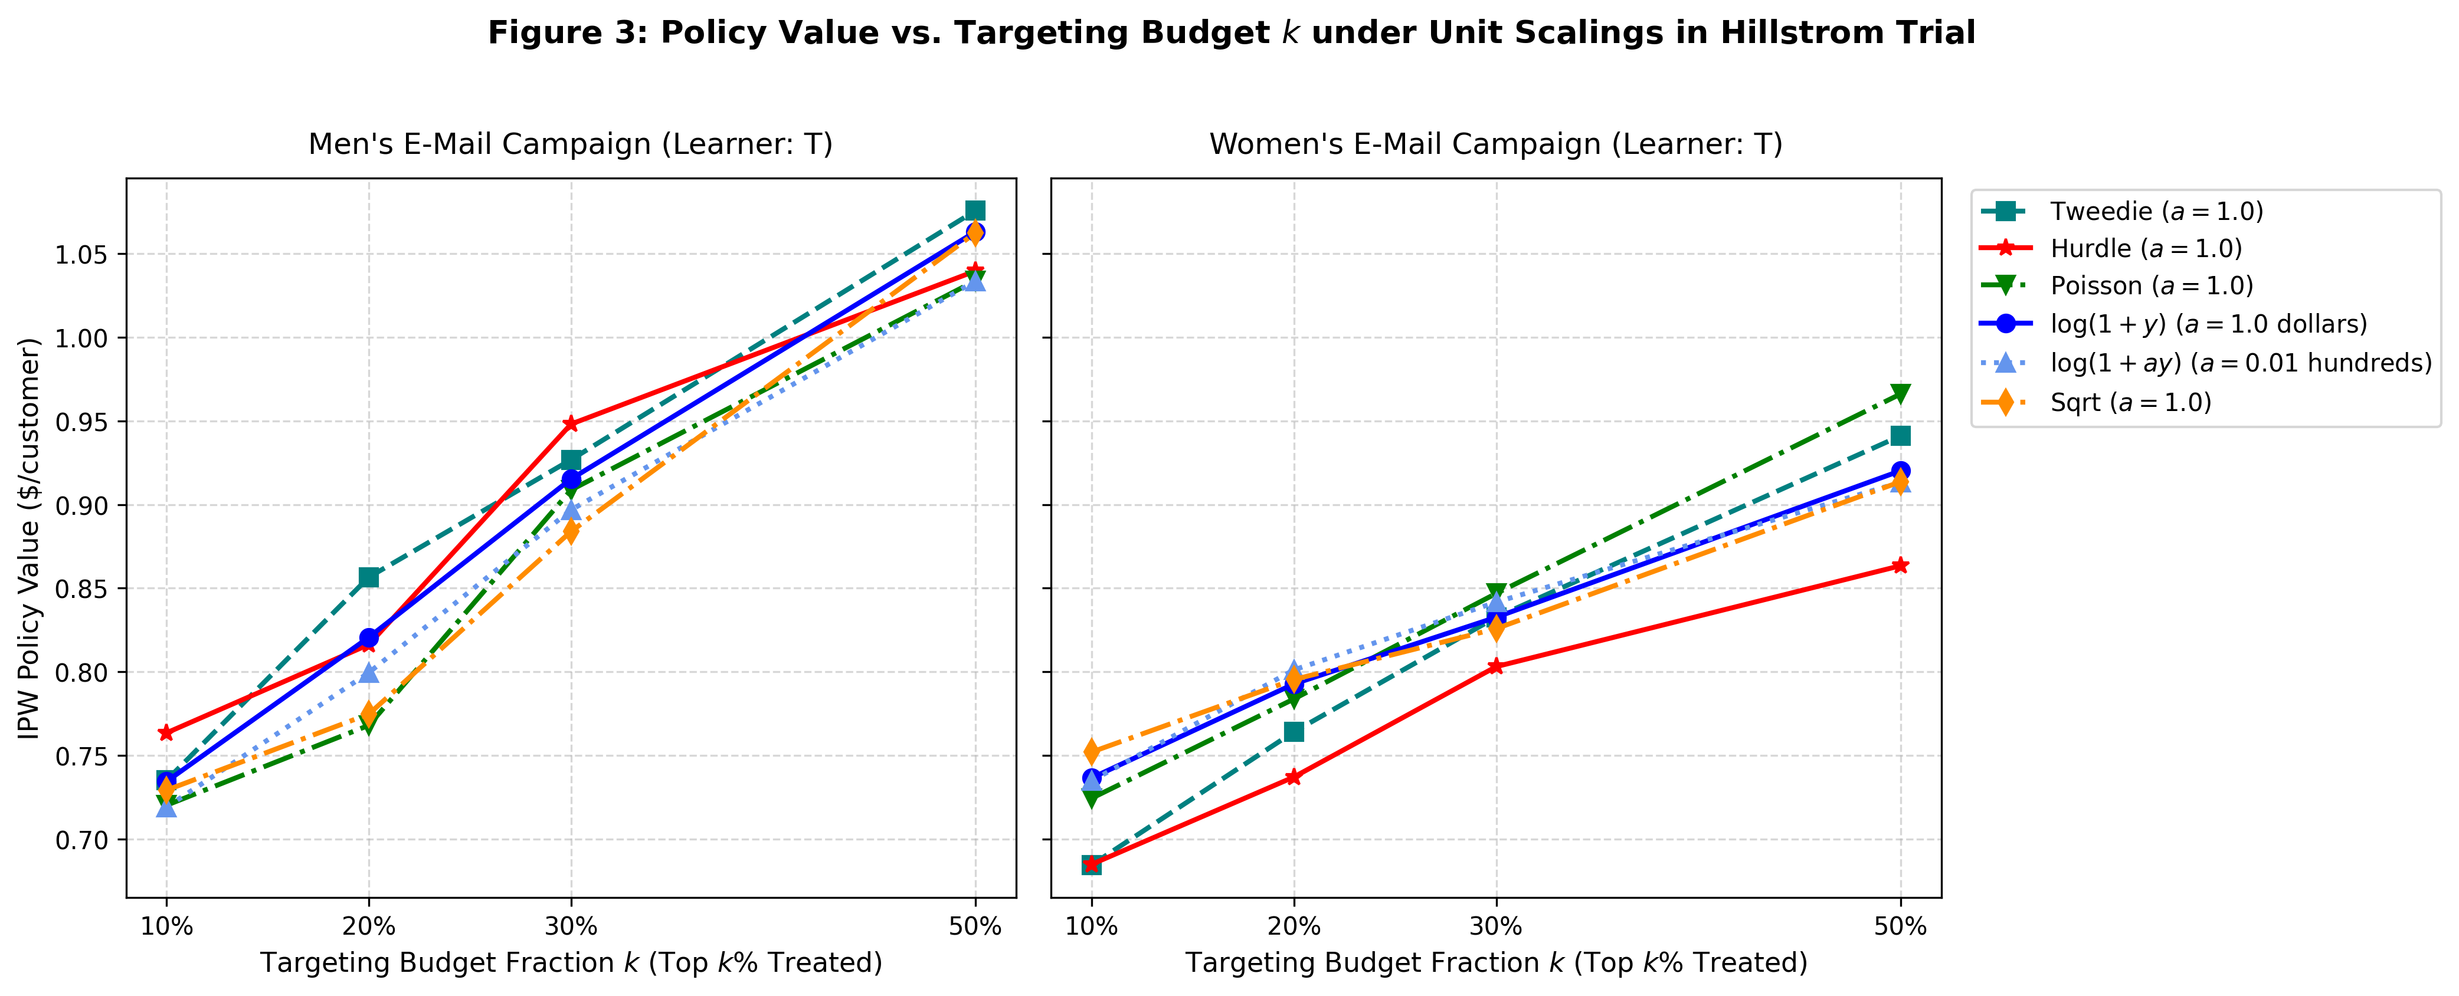
JACKFRUIT PROBLEM REVIEW | EMPIRICAL FINDINGS & VALIDATION
3 / 4
3. Result Plots: Empirical Breakdown & Count-Aware Equivariance
Visualizing log1p rank collapse vs. exact scale-equivariance and superior policy value of Tweedie/Hurdle
SYNTHETIC BENCHMARK: RANK STABILITY vs. SCALE a
REAL-WORLD FIELD TRIAL: HILLSTROM POLICY VALUE ($/USER)
Key Finding 1 (Synthetic Rank Collapse & Equivariance):
• log1p Collapses: In extensive and opposing scenarios, Spearman rho drops to 0.566 with only 35.8% top-20% overlap as scale 'a' shifts from 1 to 0.01 or 100.
• Count-Aware Invariance: Tweedie and Hurdle maintain perfect rho = 1.0000 across all scales by construction.
Key Finding 2 (Real-World Dollar Performance):
• High Turnover Under log1p: Shifting a=1 to a=0.01 replaces ~48.2% of targeted customers, creating massive marketing drift.
• Tweedie Dominates: Tweedie attains peak policy value ($0.8566 / user at k=0.20), outperforming transformed baselines (+$0.12/user).
48.2% TARGETING CHURN
Top 20% targeted customers replaced under log1p merely by scaling dollars to cents.
rho = 1.0000 EQUIVARIANCE
Tweedie & Hurdle count-aware models maintain 100% targeting stability across all scales.
+$0.12 / USER INCREMENTAL
Tweedie achieves $0.8566 IPW policy value vs. $0.7302 level and $0.7831 log1p on Hillstrom.

Slide 4
JACKFRUIT PROBLEM REVIEW | FINALIZATION ROADMAP
4 / 4
4. Remaining Work: Execution Roadmap to Final Delivery
Completing simulation grids, sensitivity sweeps, manuscript writeup, and defense preparation
PHASE 1 | SIMULATION RUNS
PHASE 2 | EMPIRICAL VALIDATION
PHASE 3 | REPORT & SUBMISSION
Production Monte Carlo & Grids
• Stage 1 Production Completion: Complete remaining replications of the full 6 x 4 x 5 factorial grid (76+ replications already finished and logged; running in parallel background).
• Error Ribbon Aggregation: Aggregate cross-replication standard deviations across all 6 scenarios to render final confidence bands for publication figures.
• Stage 2 Sparsity Sweeps: Execute parameter sweep across baseline zero proportions (p0 in {0.70, 0.90, 0.98}) to map the exact threshold where log1p instability breaks down.
• Heavy-Tail Stress Testing: Evaluate Pareto tail index alpha in {1.5, 2.5} to demonstrate vulnerability of transformed models to high-spend whales.
Criteo Benchmark & Robustness
• Criteo 200k Pipeline Execution: Run full cross-fitted DR-Learner and Hurdle pipelines across the high-dimensional Criteo semi-synthetic benchmark (12 features, N=200,000).
• Propensity Trimming Sensitivity: Test whether extreme propensity weights (e(X) < 0.01 or > 0.99) amplify transformation sensitivity in Doubly Robust pseudo-outcomes.
• Bootstrap Significance Tests: Calculate 95% confidence intervals and p-values for difference in policy value between Tweedie vs log1p on Hillstrom test splits.
• Alternative Baselines: Benchmark against inverse hyperbolic sine (asinh) and rank-transformed DR learners.
Report Finalization & Saturday EOD
• LaTeX Manuscript (report/main.tex): Finalize Section 5 (Practical Decision Guide for Industry) and Appendix asymptotic proofs (a -> 0 and a -> inf). Verify 16 academic references and compile clean camera-ready PDF.
• One-Command Reproduction Bundle: Verify clean replication pipeline (make reproduce / run_all.sh) ensuring deterministic reproducibility across seeds.
• GitHub Release & Code Freeze: Push final commits and tag release on branch q/engine (https://github.com/pallaviB463/Rescaled.git).

