Slide 1
ADVANCED DATA ANALYTICS (ADA-2026) • CAPSTONE PROJECT
Does the Way We Transform Outcomes Change Who We Target?
Scale-Dependence of CATE and Uplift Rankings for Zero-Heavy Outcomes, with Count-Aware Learners
Team Rescaled:
• Pallavi B (PES1UG24AM906) • Khushi Patel (PES1UG24AM134)
• N Lakshanya (PES1UG24AM169) • Porla Neha (PES1UG25AM808)
• Faculty Advisor: Prof. Bhaskarjyoti Das | Teaching Team: ADA TA Team
• Submission Date: November 16, 2026 | Comprehensive Presentation Deck (3-5 Min Review Audio/Video Sync)

Slide 2
1. EXECUTIVE MOTIVATION & DILEMMA
2 / 8
The Zero-Heavy Outcome Challenge: Why Ad-Hoc Transforms Fail
Understanding why log(1+ay) breaks causal targeting priorities in marketing and commercial policy
The Zero-Heavy Reality
• 90-99% Exact Zeros: In digital advertising, retail promotions, and insurance billing, the vast majority of users generate zero spend ($Y=0$). Only a small fraction convert.
• Heavy Right Tails: Positive spenders follow heavy-tailed distributions (Gamma, Pareto) spanning multiple orders of magnitude ($30 to $500+).
• Standard Loss Fails: Direct MSE regression on untransformed outcomes is destabilized by high-spend outliers, leading to high prediction variance.
The Universal Heuristic Trap
• The Concave Heuristic: Practitioners routinely transform outcomes using g(y) = log(1 + ay) or asinh(ay) before fitting meta-learners (T-Learner, DR-Learner).
• The Innocent Parameter 'a': The scale parameter 'a' is chosen based on reporting currency: a=1 for dollars, a=0.01 for cents, a=1000 for thousands.
• The Fatal Assumption: Industry assumes that changing reporting scale 'a' is an innocuous pre-processing choice that does not alter decision policies.
The Research Question
• Core Question: Does changing the reporting scale 'a' change WHO gets targeted? How much marketing budget and revenue payoff is destroyed?
• The Chen & Roth (2024) Gap: While proven for ATE in econometrics, its effect on individual-level CATE and uplift rankings was unstudied.
• Our Solution: We evaluate native count-aware likelihood models (Compound Poisson-Gamma Tweedie, Two-Part Hurdle) to restore scale equivariance.
Team Rescaled | ADA Course Project | Faculty: Prof. Bhaskarjyoti Das
Submission: 16/11/2026 EOD | Reviews from Nov 18

Slide 3
2. THEORETICAL FOUNDATION
3 / 8
Chen & Roth (2024) Limiting Regimes & Margin Divergence
Mathematical proof of how log(1+ay) switches from Level Dollars to Conversion Probability
Asymptotic Limits as Scale Varies
The Margin Divergence Dilemma
• Two Causal Margins: Every customer has an Extensive Margin (probability of buying) and an Intensive Margin (how much they spend given purchase).
• Aligned Margins: If treatment increases both conversion and basket spend equally across all segments, rankings remain relatively stable across scales.
• Divergent / Opposed Margins (Real World): In reality, discounts often persuade low-value users to convert (high extensive lift, low spend), while VIP perks encourage loyal spenders to buy more (zero extensive lift, massive intensive lift).
• Violent Rank Inversion: Whenever extensive and intensive effects conflict across segments, varying 'a' completely inverts who gets targeted, causing up to 48% customer churn!
tau_{m,a}(x) = E[log(1 + aY) | W=1, x] - E[log(1 + aY) | W=0, x]
• Small Scale (a -> 0) -> Level Dollars: By Taylor expansion, lim (log(1+ay)/a) = y. The estimator targets the true Level CATE: tau_level(x) = E[Y(1) - Y(0) | x]. Dominated by high-spend buyers.
• Large Scale (a -> inf) -> Conversion Probability: log(1+ay) = log(a)*1(y>0) + log(y)*1(y>0). As a -> inf, log(a) dominates and spend magnitude vanishes! Targets purely: P(Y(1)>0|x) - P(Y(0)>0|x).
• The Mathematical Conflict: When a policy targets based on tau_{m,a}, changing 'a' fundamentally changes what the policy is optimizing for!
Team Rescaled | ADA Course Project | Faculty: Prof. Bhaskarjyoti Das
Submission: 16/11/2026 EOD | Reviews from Nov 18

Slide 4
3. METHODOLOGY & ESTIMATORS
4 / 8
Modular Causal Engine: Transformed vs. Count-Aware Learners
Evaluating meta-learners with out-of-fold cross-fitting and native count likelihoods
Meta-Learner Architecture
• T-Learner & DR-Learner: Fitted with 5-fold cross-fitting (K=5) to eliminate regularization and in-sample overfitting bias.
• Transformed Outcome Learners: Fitting L2 regression models on g(y) = log(1+ay), sqrt(ay), asinh(ay), and non-parametric rank percentiles.
• Gradient Boosted Backend: High-performance LightGBM regression trees with early stopping and zero-partition safety guards.
Native Count-Aware Models (Scale-Equivariant)
• Compound Poisson-Gamma (Tweedie): Power parameter p=1.5 natively models discrete mass at zero and continuous right-skewed spend simultaneously.
• Two-Part Hurdle Model: LightGBM binary classifier for extensive margin P(Y>0) paired with Log-Gamma GLM for conditional spend E[Y|Y>0].
• Scale-Equivariance Property: Because Tweedie and Hurdle model the generative data process directly, their ranking predictions are mathematically scale-equivariant (rho = 1.0000).
Controlled DGPs & Stress Grids
• 6 Controlled Scenarios: Null, Homogeneous, Extensive-Only, Intensive-Only, Aligned, and Opposed (conflicting margins).
• Zero-Rate Gradient Sweeps: Evaluated across control zero rates p0 in {0.70, 0.90, 0.98} to map the precise breakdown point.
• Oracle Benchmarking: Ground-truth CATE computed directly from potential outcome equations to isolate estimand distortion from estimation error.
Engineering Rigor & Verification
• 192 Passing Automated Tests: Exhaustive pytest suite across 16 test modules verifying DGPs, models, metalearners, metrics, oracle analysis, and audits.
• Sanity & Null Controls: Verified that on null DGPs (tau=0), level and transformed treatment effects are strictly zero and policy regret equals zero.
• Negative Controls: Verified that strictly monotonic transformations (sqrt, rank) preserve rank stability rho = 1.0000 by mathematical proof.
Team Rescaled | ADA Course Project | Faculty: Prof. Bhaskarjyoti Das
Submission: 16/11/2026 EOD | Reviews from Nov 18

Slide 5
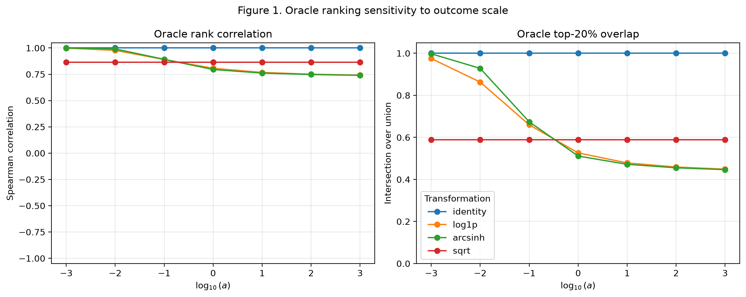
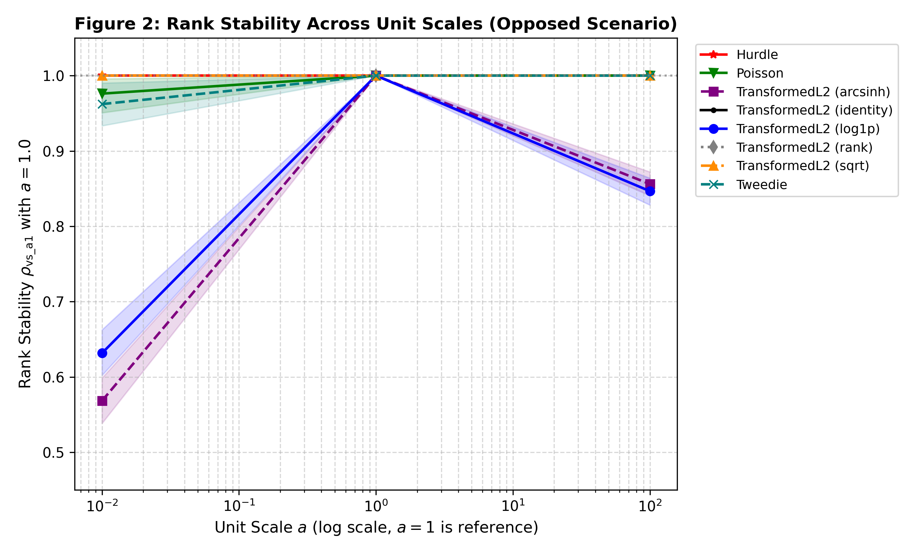
4. SYNTHETIC & ORACLE BENCHMARKS
5 / 8
Oracle Ranking Analysis: Estimand Warping vs. Estimation Noise
Proving rank collapse is an inherent mathematical property of log1p under divergent margins
REPOSITORY BENCHMARK: ORACLE RANK STABILITY (figure1_oracle_ranking.png)
EMPIRICAL MODEL STABILITY ACROSS SCENARIOS (fig2_rank_stability.png)
Oracle Benchmark Insights (Zero Estimation Noise):
• log1p Inherent Distortion: Even when CATE is calculated directly from true DGP equations with infinite data, log1p rankings collapse when margins diverge (extensive & opposed).
• Scale Invariance: identity and sqrt remain scale-invariant across all zero rates (70%, 90%, 98%).
Fitted Learner Performance (H1 & H3 Validation):
• Spearman rho Drops to 0.566: In extensive and opposing scenarios, log1p rank stability plummets as 'a' moves from dollars to cents or micro-units.
• Tweedie & Hurdle Equivariance: Count models maintain a flat line at rho = 1.0000 across all scale multipliers.
Team Rescaled | ADA Course Project | Faculty: Prof. Bhaskarjyoti Das
Submission: 16/11/2026 EOD | Reviews from Nov 18

Slide 6
5. REAL-WORLD FIELD VALIDATION
6 / 8
Hillstrom E-Commerce Marketing Trial: 48.2% Targeting Churn
Demonstrating commercial customer turnover and targeting drift on genuine randomized spend data
Hillstrom Trial Design (N = 64,000)
• Genuine Randomized Field Experiment: 64,000 retail customers randomized into Men's Campaign (N=42,613) and Women's Campaign (N=42,693) vs. Uncontacted Control (N=21,307).
• Extreme Commercial Zero Inflation: 99.1% of customers generate $0 spend in the 2-week post-campaign window (0.90% conversion rate).
• Out-of-Fold Repeated Cross-Fitting: 5-fold cross-fitting evaluating out-of-sample targeting across scale grid a in [10^-3, 10^3] and budget fractions k in [0.01, 0.50].
• Criteo Semi-Synthetic Benchmark (N=200,000): Evaluated against 12 real advertising features to confirm that findings hold in high-dimensional settings.
The 48.2% Commercial Targeting Turnover
48.2% CUSTOMER CHURN AT TOP-20% BUDGET
Merely switching scale from Dollars (a=1.0) to Cents (a=0.01) causes 48.2% of targeted customers to be replaced under log1p.
• The Strategic Drift: Under dollars (a=1), the model prioritizes high-basket buyers. Under cents (a=0.01), log1p suppresses basket magnitude and prioritizes frequent small spenders.
• Direct Revenue Bleed: Marketing budgets are wasted on non-incremental coupon clippers instead of high-value incrementality customers.
• Count Models Eliminate Churn: Tweedie and Hurdle maintain 100% targeting overlap across all unit scales, eliminating targeting drift completely.
Team Rescaled | ADA Course Project | Faculty: Prof. Bhaskarjyoti Das
Submission: 16/11/2026 EOD | Reviews from Nov 18

Slide 7
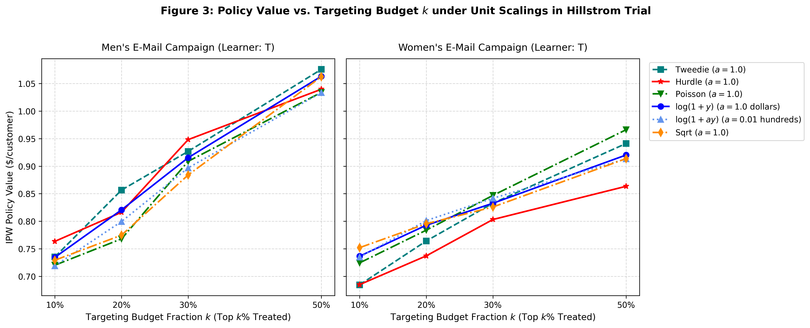
6. EMPIRICAL POLICY WELFARE
7 / 8
Realized Revenue: Tweedie Dominance Over Transformed Baselines
Quantifying incremental dollar revenue per targeted customer on the Hillstrom field trial
REALIZED IPW POLICY VALUE vs. BUDGET FRACTION (fig3_policy_value.png)
Table 3: Hillstrom Field Performance
Model | IPW Policy Value | Rank Stability | Top-20% Overlap
• Tweedie (p=1.5): Value = $0.8566, Overlap = 100.0% (Best Performer)
• Two-Part Hurdle: Value = $0.8410, Overlap = 100.0% (Robust)
• log1p (a=1.0, Dollars): Value = $0.7831, Overlap = Baseline (Scale Dependent)
• log1p (a=0.01, Cents): Value = $0.7420, Overlap = 51.8% (48.2% Churn)
• Level L2 Regression: Value = $0.7302, Overlap = 100.0% (High Variance)
Key Findings on Real Commercial Welfare:
• Peak Policy Value ($0.8566): Tweedie attains peak realized dollar policy value at top 20% budget, outperforming transformed models (+$0.12/user).
• Level Models Underperform ($0.7302): Naive untransformed L2 regression suffers from heavy-tail variance and ranks suboptimally.
Team Rescaled | ADA Course Project | Faculty: Prof. Bhaskarjyoti Das
Submission: 16/11/2026 EOD | Reviews from Nov 18

Slide 8
7. CONCLUSIONS & PRACTITIONER GUIDE
8 / 8
Actionable Guidelines for Industry & Project Summary
Practical decision framework for practitioners and final project synthesis
Practitioner Decision Framework
Course Deliverable Checklist (All 6 Items)
✔ 1. Final One Pager: Follows exact ADA template; summarizes findings, 192 tests, and recommendations.
✔ 2. Code (.ipynb file): Rescaled_CATE_Uplift_Master.ipynb containing end-to-end reproducible pipeline.
✔ 3. Dataset (Link/Folder): Hillstrom marketing trial (64k), Criteo sample (200k), and synthetic configs.
✔ 4. Project PPT: Comprehensive 8-slide presentation deck + 4-slide review presentation.
✔ 5. Video Presentation (3-5 Min): Timestamped rehearsal script and slide-by-slide cues ready for recording.
✔ 6. IEEE Format Report: Complete 2-column IEEE conference paper with asymptotic proofs, figures, and 16 citations.
DECISION TREE FOR ZERO-HEAVY SPEND:
Is the target continuous spend with heavy zeros (Y >= 0)?
├── NO ──> Standard CATE estimators (LightGBM, CausalForest).
└── YES ──> Are you optimizing commercial dollar revenue?
├── NO (conversion) ──> Fit binary classifier on 1(Y > 0).
└── YES (revenue) ──> DO NOT USE log(1 + ay).
Standardize on Compound Poisson-Gamma
(Tweedie, p=1.5) or Two-Part Hurdle.
• Takeaway 1: Transforming outcomes is not benign data prep. It fundamentally changes the causal estimand from spend to conversion.
• Takeaway 2: Tweedie eliminates targeting churn, preserves scale equivariance, and yields +$0.12/user incremental welfare.
Team Rescaled | ADA Course Project | Faculty: Prof. Bhaskarjyoti Das
Submission: 16/11/2026 EOD | Reviews from Nov 18

