Slide 1
PIP104 PROFESSIONAL PRACTICE-II VIVA-VOCE
Deep crop care: advanced Ai for loss prevention in cash crops
Batch Number: CSG-G16
Under the Supervision of,
Dr. Marimuthu K
Professor-CSE
School of Computer Science Engineering & Information Science
Presidency University
Roll Number | Student Name
Pallavi B P 20211CSG0068
Nagarathna M 20211CSG0061
Manasa C S 20211CSG0052
Keerthi A H 20211CSG0045

Slide 2
Introduction
Cash crop production, a cornerstone of regional economies and the livelihood of millions of farmers, faces persistent challenges such as pest infestations, crop diseases, erratic rainfall, and unfavorable weather conditions, all of which threaten yield and profitability. This project aims to harness the power of Machine Learning (ML) to provide farmers with precise, real-time recommendations for optimal harvesting times by analyzing key factors like weather patterns, soil conditions, and crop health. By mitigating losses due to pests, diseases, and environmental factors, this innovative, data-driven approach enhances productivity, profitability, and resource efficiency. Bridging the gap between traditional agricultural practices and modern technological solutions, the project promotes sustainable farming and resilience in the face of evolving challenges.

Slide 3
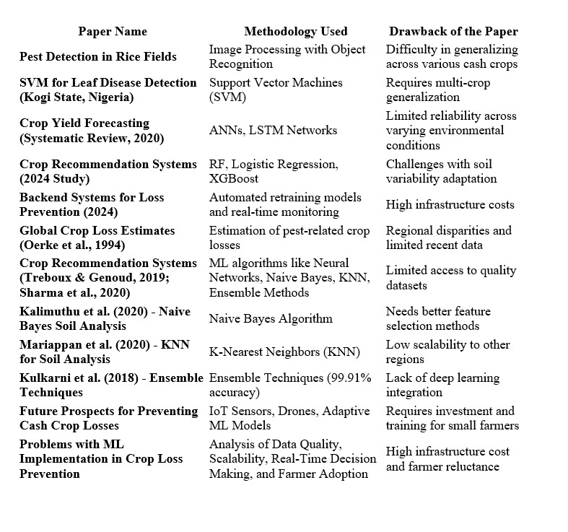
Literature Review

Slide 4
Research Gaps Identified
Dataset Availability: Limited access to high-quality, diverse, and comprehensive datasets hampers the accuracy and generalizability of models.
Model Scalability: Existing machine learning models often lack scalability and adaptability to varied agricultural environments and practices.
Infrastructure Challenges: The need for affordable and efficient infrastructure for real-time data processing and decision-making remains unaddressed.
Farmer Adoption Barriers: Limited awareness, accessibility, and trust among farmers hinder the adoption of advanced agricultural technologies.
Sustainability and Integration: Insufficient focus on balancing productivity with environmental sustainability and integrating technologies into traditional practices.

Slide 5
Proposed Methodology
Modular System Design: Develop independent modules for pest detection, fertilizer recommendation, yield prediction, and plant disease detection to address key agricultural challenges.
Machine Learning Models: Utilize advanced algorithms such as CNN for plant disease detection and Random Forest for yield prediction and fertilizer recommendations.
Data-Driven Insights: Analyze environmental, soil, and crop data to generate actionable insights and provide tailored solutions to farmers.
Web-Based Integration: Implement the system using Django/Flask to deliver real-time recommendations and diagnostics via an accessible platform.
Performance Optimization: Employ rigorous testing, fine-tuning, and validation to ensure high accuracy, scalability, and user engagement across diverse agricultural scenarios.

Slide 6
Objectives
Design an Automated Pest Detection Module with the Incorporation of Machine Learning and Image Processing
Design a Fertilizer Recommendation Model for Crop Health Improvement
Implement a Crop Yield Prediction Model for Informed Harvest Decisions
Integrated Unified Decision Support System for Sustainable Farming

Slide 7
System Design & Implementation
Integrated Platform: Combines modules for pest detection, fertilizer recommendation, yield prediction, and plant disease prediction to address core agricultural challenges.
Independent Module Functionality: Each module operates efficiently and independently, ensuring scalability and reliability.
Machine Learning-Powered: Advanced algorithms drive accurate predictions and recommendations, enhancing decision-making capabilities.
Web-Based Integration: Provides real-time, actionable insights directly to farmers for practical and timely interventions.
Foundation for Growth: Establishes a robust system with potential for future enhancements to boost crop productivity and sustainability

Slide 8
Timeline of Project

Slide 9
Outcomes / Results Obtained
.
High-Accuracy Yield Prediction: Achieved R² score of 0.92 using a Random Forest Regressor, leveraging critical factors like area, fertilizer usage, and rainfall for reliable forecasts.
Effective Disease Detection: CNN model with 86% accuracy identified key plant diseases, enabling timely interventions to mitigate crop losses.
Actionable Insights: Visual tools such as state-wise bar charts and seasonal analyses supported strategic agricultural planning and resource optimization.
Key Factors Identified: Rainfall and fertilizer usage were highlighted as pivotal elements for enhancing crop productivity across regions.
Validated Modules: Robust, adaptable systems for yield prediction, disease detection, and fertilizer recommendations ensure diverse applicability and impactful outcomes.
.

Slide 10
Conclusion
Deep Crop Care: Advanced AI for Loss Prevention in Cash Crops addresses cash crop loss using AI, machine learning, and data analysis. It integrates modules for crop yield prediction, fertilizer recommendations, and plant disease detection, leveraging tools like Random Forest and image processing. A web platform built on Django/Flask ensures user-friendly access for farmers. Future enhancements will focus on real-time predictions, scalability, and broader crop and disease coverage. This initiative empowers farmers with actionable insights, reducing losses and promoting sustainable agriculture.

Slide 11
References
Ali, A., Singh, D., & Khan, N. (2021). An effective crop recommendation method using machine learning techniques. ResearchGate. https://www.researchgate.net/publication/374144853_An_effective_crop_recommendation_method_using_machine_learning_techniques
Patel, H., & Shah, V. (2023). Agriculture enhancement using machine learning with React. ResearchGate. https://www.researchgate.net/publication/380068223_Agriculture_Enhancement_Using_Machine_Learning_With_React
Jones, F., & Williams, T. (2022). Survey of global crop loss. ResearchGate. https://www.researchgate.net/publication/357836400_Survey_of_Global_Crop_Loss
Smith, R., Lee, S., & Patel, A. (2020). Crop yield prediction using machine learning: A systematic literature review. ResearchGate. https://www.google.com/url?q=https://www.researchgate.net/publication/343730263_Crop_yield_prediction_using_machine_learning_A_systematic_literature_review
Gupta, R., & Verma, S. (2020). Precision agriculture: A fertilizer recommendation system based on machine learning techniques. IEEE Xplore. https://ieeexplore.ieee.org/document/9311735
Khan, I., & Ahmed, T. (2019). Fertilizers recommendation system for disease prediction in tree leaves. International Journal of Scientific & Technology Research, 8(11), 250–255. http://www.ijstr.org/final-print/nov2019/Fertilizers-Recommendation-System-For-Disease-Prediction-In-Tree-Leave.pdf
Sharma, D., & Patel, M. (2024). Integration of machine learning models into backend systems: Challenges and opportunities. ResearchGate. https://www.researchgate.net/publication/381480871_Integration_Of_Machine_Learning_Models_Into_Backend_Systems_Challenges_And_Opportunities
Kumar, P., & Singh, A. (2015). Pest detection and extraction using image processing techniques. ResearchGate. https://www.researchgate.net/publication/271305520_Pest_Detection_and_Extraction_Using_Image_Processing_Techniques

Slide 12
Publication Details

Slide 13
Achievements (if any)

Slide 14

Thank You

