Slide 1
Navigating The Future Of
Online Shopping
Analysis and visualization of sales, Top Products, and Customer Habits
By Pallavi Gosar

Slide 2
Project Overview
The data consists of details regarding customers, products, orders and sellers on e-commerce platform.
100000+ successful orders between 2016 and 2018 are studied.
Goal : How e-commerce platform can increase revenue and retain customers.

Slide 3


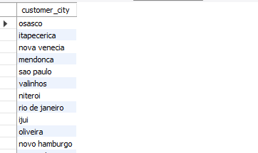
List all unique cities where customers are located
Python Code
SQL Query

Slide 4
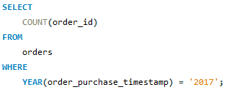

Count the number of orders placed in 2017
Python Code
SQL Query

Slide 5

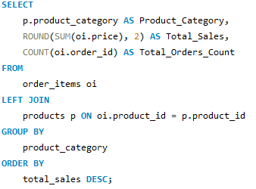
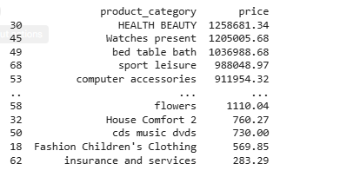
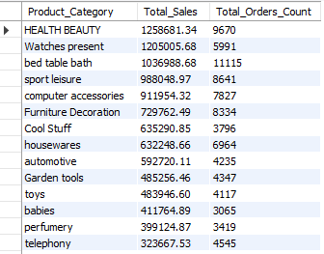
Find the total sales per category
Python Code
SQL Query

Slide 6
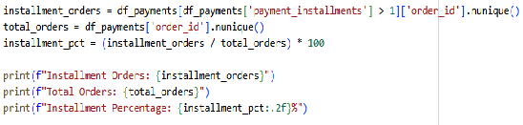
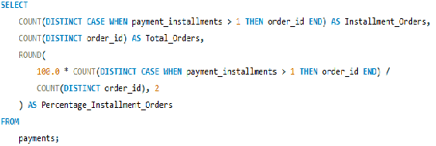


Calculate the percentage of orders that were paid in installments
Python Code
SQL Query

Slide 7

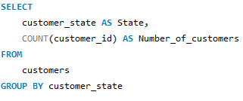
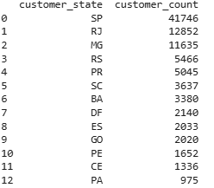
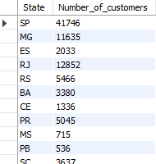
Count the number of customers from each state.
Python Code
SQL Query

Slide 8

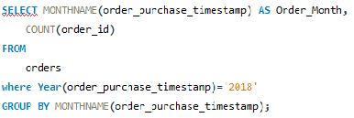
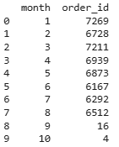
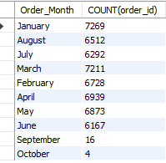
Calculate the number of orders per month in 2018
Python Code
SQL Query

Slide 9
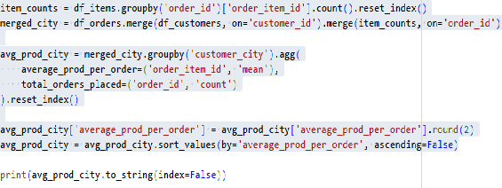
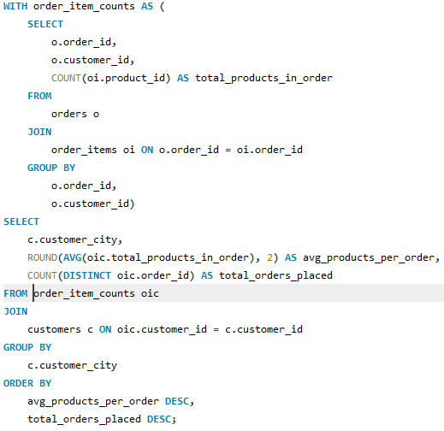
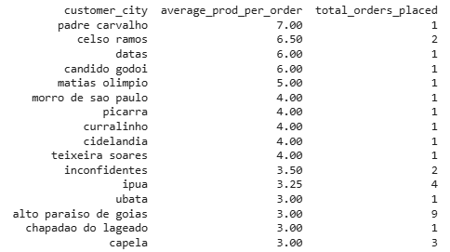
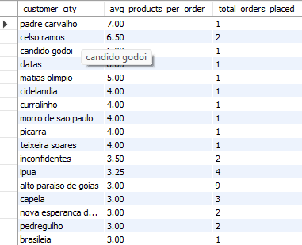
Find the average number of products per order, grouped by customer city
Python Code
SQL Query

Slide 10
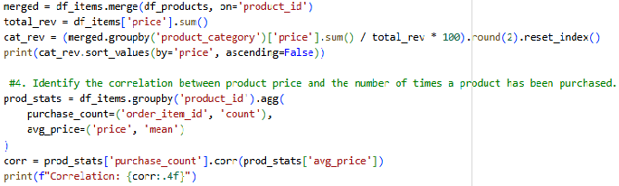
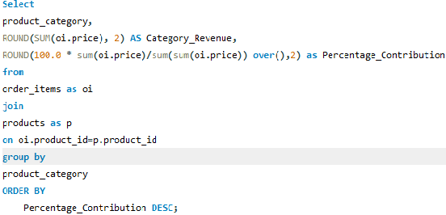
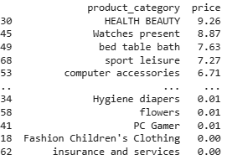
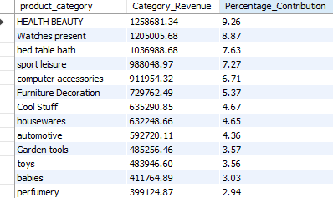
Calculate the percentage of total revenue contributed by each product category
Python Code
SQL Query

Slide 11
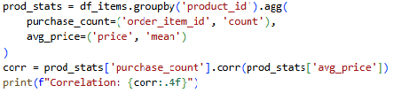
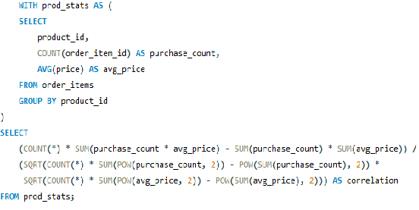

Identify the correlation between product price and the number of times a product has been purchased
Python Code
SQL Query

Slide 12
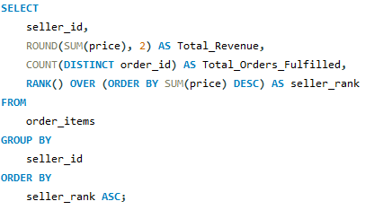
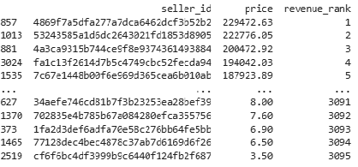
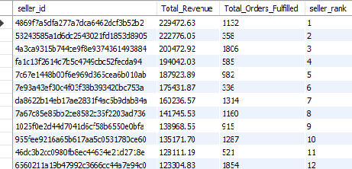
Calculate the total revenue generated by each seller, and rank them by revenue
Python Code
SQL Query

Slide 13

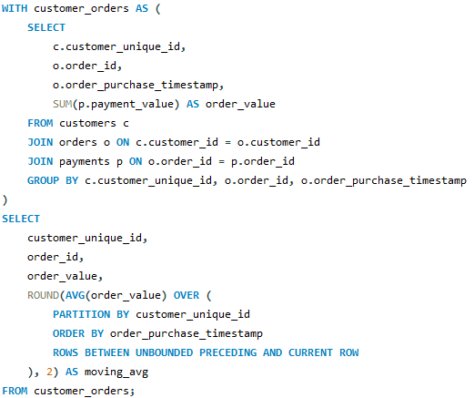
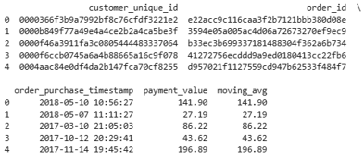
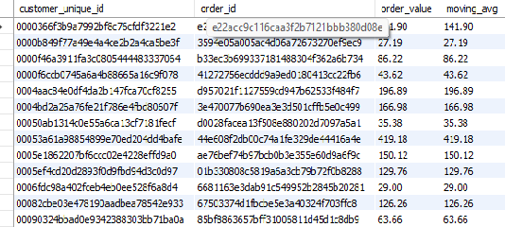
Calculate the moving average of order values for each customer over their order history
Python Code
SQL Query

Slide 14
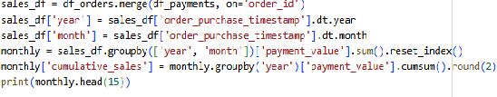
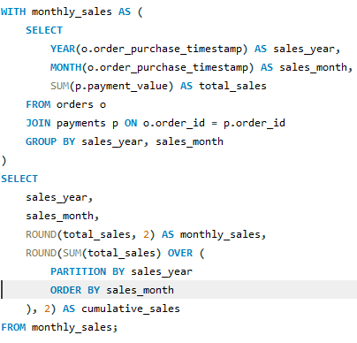
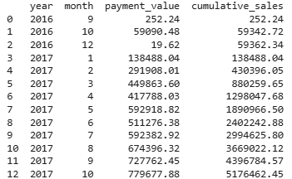
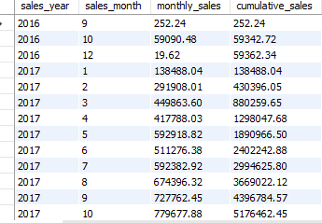
Calculate the cumulative sales per month for each year
Python Code
SQL Query

Slide 15

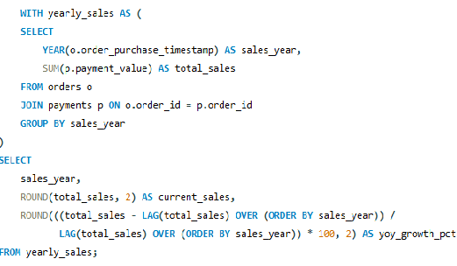


Calculate the year-over-year growth rate of total sales
Python Code
SQL Query

Slide 16
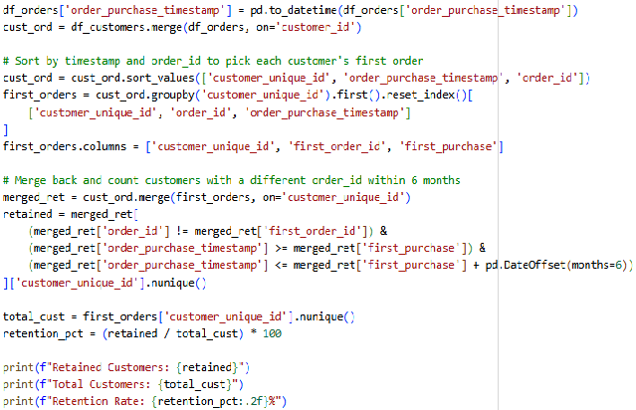
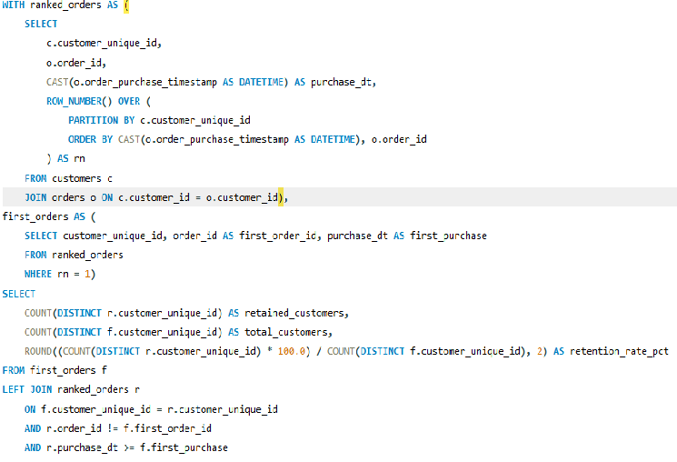


Calculate the retention rate of customers, defined as the percentage of customers who make another purchase within 6 months of their first purchase
Python Code
SQL Query

Slide 17
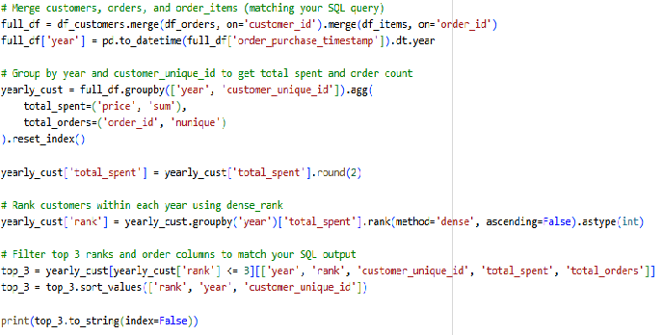
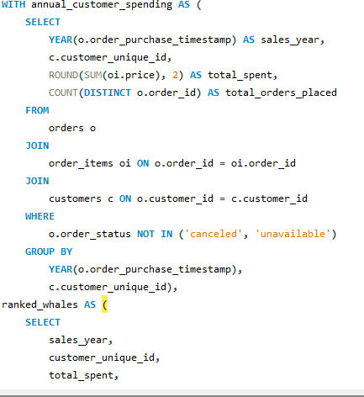
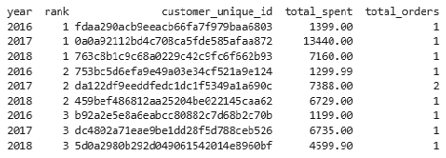
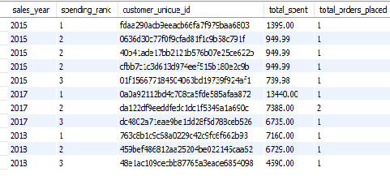
Identify the top 3 customers who spent the most money in each year
Python Code
SQL Query

Slide 18
Tracking Sales Over Time
Key Chart : The line chart showing monthly sales matching by year.
Insights:
  Sales in 2018 grew much faster than in 2017. By August 2018, total sales passed 7 million BRL. It took the company until December to reach that amount in 2017.
  The flat line at the end of 2018 just means the file stops tracking data in August, not that people stopped buying things.
Action:
The business is growing fast every month. Company needs to make sure their servers and staff are ready to handle more orders.

Slide 19
Top revenue generating products
Key Chart : The bar chart showing top products.
Insights:
  Health Beauty Wins : This is #1 category on the platform, bringing in 9.4% of total revenue.
  Top 3 pillars: Health Beauty (9.4%), Watches & Present (9.0%) and Bed Table Bath (7.7%) make up over 26% of all sales.
  Top 10 categories alone make up more than 63% of all sales.
Action:
Spend most of the advertisement money on Health & Beauty and Watches. These items are already very popular and guaranteed to make money.

Slide 20
Does lowering prices help sell more?
Key Chart : The scatter plot showing price vs sales volume.
Insights:
  Pearson is -0.033 and Spearman is -0.064, which is almost 0.
  Price does not matter: Lowering the price does not make people buy an item more often. Cheap items do not sell faster than expensive items.
Action:
Suggest sellers to stop cutting their prices to beat competitors. Instead, they should keep their prices fair to protect their profits and focus on getting good customer reviews and fast shipping.

Slide 21
Why Customers Don't Come Back?
Key Chart : The pie chart showing retention.
Insights:
  One-and-Done: 98.38% of customers buy something once and never return. Only 1.62% of people buy a second time within 6 months.
  When people buy, they think they are buying from the giant department store website. They usually do not see the name of seller so they do not become loyal to seller.
Action:
Start sending follow-up emails with discount coupons a few months after a purchase, put physical discount codes inside the shipping boxes to invite buyers back for second order.

Slide 22
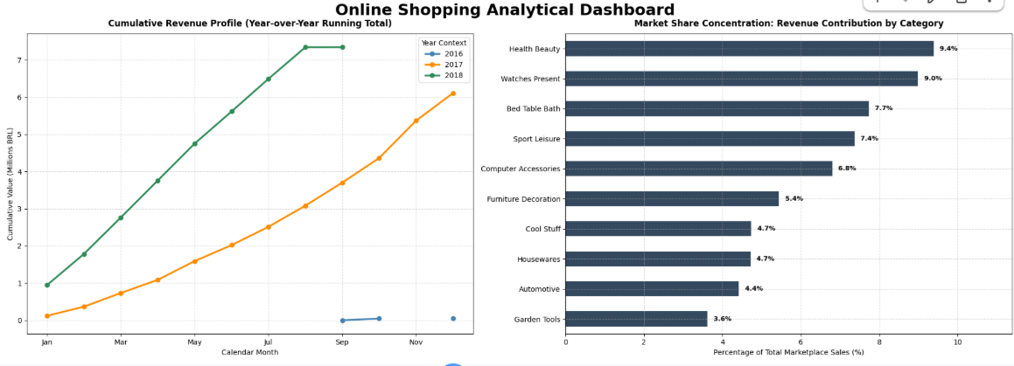

Slide 23
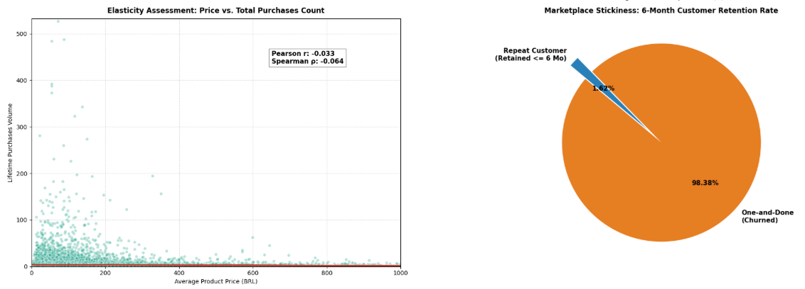

Slide 24
Summary and Recommendations
Focus on Winners : Keep supporting Health & Beauty category because it is main money-maker.
Stop Cheap Discounts: Teach sellers to win customers with high quality and good service not by lowering prices.
Bring Buyers Back: Use email coupons and box inserts to change “one-time buyers” into repeat customers.

