Slide 1


SeoulBike
Explore Seoul
On Two Wheels
PRESENTED BY
Pallavi Sanjay Jadhav

Slide 2
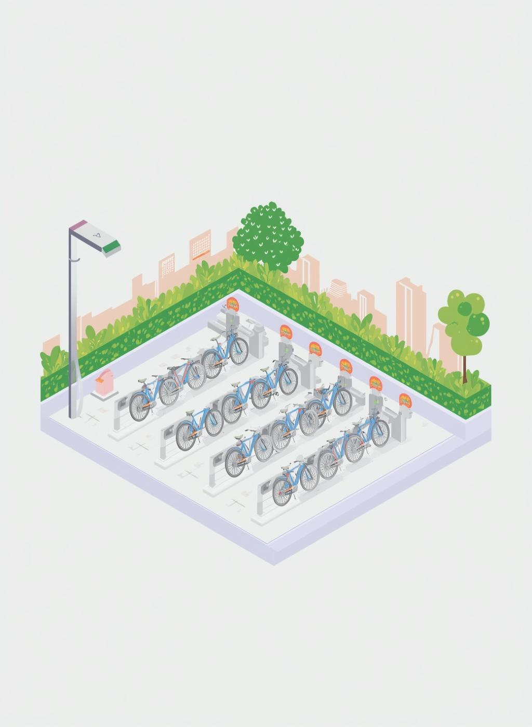
▶What is SeoulBike?
SeoulBike is an innovative public bicycle sharing system designed to make exploring Seoul convenient and eco-friendly, promoting a healthier lifestyle for its residents and visitors.

Slide 3
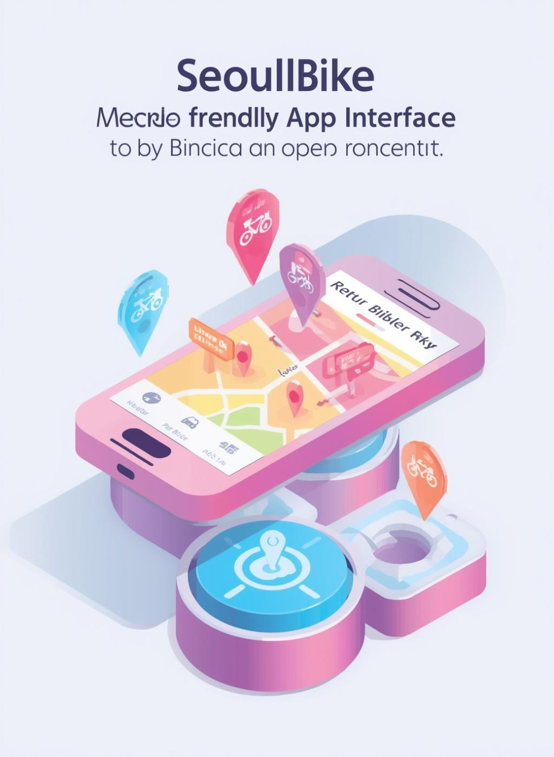
▶How to Use
Renting and returning bikes with SeoulBike is easy! Follow our simple steps using the user-friendly mobile app to explore the city efficiently and enjoyably.

Slide 4

▶Benefits of SeoulBike
SeoulBike promotes eco-friendly transportation while encouraging a healthy lifestyle. By cycling, you can reduce your carbon footprint and enjoy the beautiful cityscape of Seoul.

Slide 5
▶ Project Summary
The Seoul Bike Data project highlights how weather and time factors shape bike rental demand in the city.
By analyzing hourly data with features like temperature, humidity, rainfall, snowfall, and holiday indicators.
The study shows that rentals peak during commuting hours, rise in summer and autumn, and drop sharply in bad weather.
The temperature and seasonality emerging as the most influential drivers. Overall, the project provides clear insights to improve bike availability, support urban mobility, and promote sustainable transport in Seoul.

Slide 6
▶ Problem Statement
The core problem addressed in the Seoul Bike dataset is the challenge of predicting hourly rental demand so that bikes are available when and where people need them.
Demand fluctuates based on weather conditions, seasons, holidays, and commuting hours, making it difficult to maintain an optimal supply. Without accurate forecasting, users may face shortages during peak times or excess bikes during low demand periods.
This project aims to build reliable prediction models that help optimize bike distribution, improve urban mobility, and support sustainable transportation planning in Seoul.

Slide 7
▶ Define Your Business Objective?
The business objective of the Seoul Bike dataset project is to accurately forecast hourly rental demand so that bike availability matches user needs across different times and weather conditions.
By reduce shortages during peak hours, and avoid excess supply during low-demand periods. Ultimately, this supports efficient urban mobility planning, enhances customer satisfaction, and promotes sustainable transportation solutions in Seoul.

Slide 8
▶ Know Your Data
Total Records: 8760
Columns: 14
Numerical & Categorical data
▶Import Libraries
import numpy as np
import pandas as pd
import matplotlib.pyplot as plt
import seaborn as sns

Slide 9
▶ Dataset Loading
import pandas as pd
Load the patient master CSV file into a Pandas DataFrame
df = pd.read_csv('/content/drive/MyDrive/Data_Csv/Pandas Project/SeoulBikeData.csv', encoding='latin1')

Slide 10
Unique Variable Dataset
1.Rented Bike Count = [254, 204, 173, 107, 78, 100, 181, 460, 930, 4...
2.Hour = [0, 1, 2, 3, 4, 5, 6, 7, 8, 9, 10, 11, 12, 13,...
3. Temperature(°C) = [-5.2, -5.5, -6.0, -6.2, -6.4, -6.6, -7.4, -7....
4.Humidity(%) = [37, 38, 39, 40, 36, 35, 27, 24, 21, 23, 25, 2...
5. Wind speed (m/s) = [2.2, 0.8, 1.0, 0.9, 2.3, 1.5, 1.3, 1.1, 0.5,
6.Visibility (10m) = [2000, 1928, 1996, 1936, 793, 1913, 1687, 1380...
7.Dew point temperature(°C) = [-17.6, -17.7, -18.6, -18.7, -19.5, -19.3, -19...
8.Solar Radiation (MJ/m2) = [0.0, 0.01, 0.23, 0.65, 0.94, 1.11, 1.16, 1.01...
9.Rainfall(mm) = [0.0, 0.5, 1.0, 2.5, 0.1, 0.2, 0.3, 0.7, 1.6, ...
10.Snowfall (cm) = [0.0, 0.1, 0.3, 0.4, 0.2, 1.0, 0.9, 0.8, 0.7, ...
11.Seasons = [Winter, Spring, Summer, Autumn]
12.Holiday = [No Holiday, Holiday]
13. Functioning Day = [Yes, No]
14.Day = [1, 2, 3, 4, 5, 6, 7, 8, 9, 10, 11, 12, 13, 14...
15.Month = [12, 1, 2, 3, 4, 5, 6, 7, 8, 9, 10, 11]
16.Year = [2017, 2018]
17.WeekDay = [Friday, Saturday, Sunday, Monday, Tuesday, We...

Slide 11
▶Features
•Date, Hour, Bike Count
•Temperature, Humidity
•Wind, Visibility
•Rainfall, Snowfall
•Seasons, Holiday

Slide 12
▶Data Exploration
No missing values
No duplicates
Data is clean

Slide 13
▶Data Transformation
•Converted Date
•Extracted Month & Day
•Created Temperature Category
•Created Peak Hour

Slide 14
▶Filtering Insights
•High rentals in warm temp
•Low rentals in rain & snow
•Winter has low demand

Slide 15
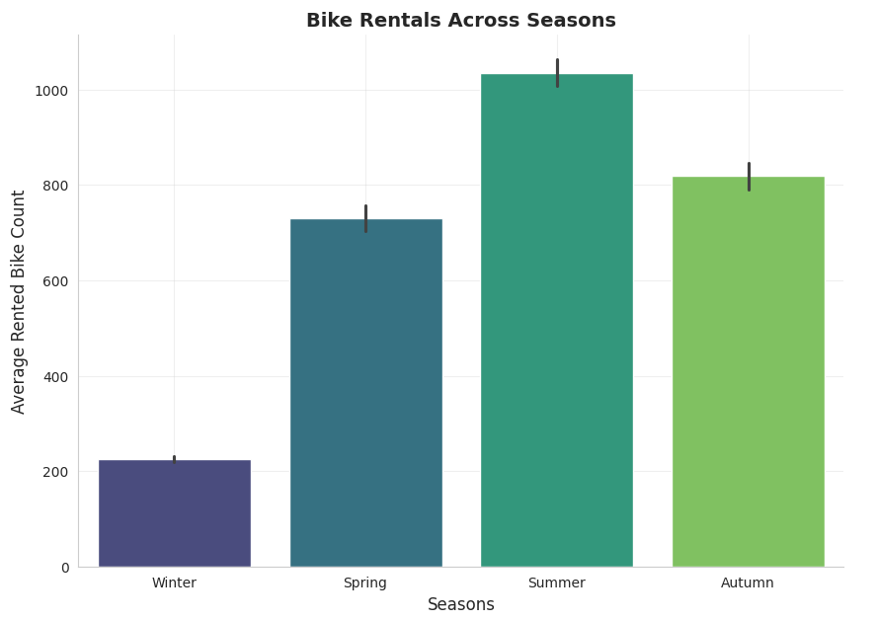
▶Seasonal Analysis
•Summer highest rentals
•Winter lowest demand

Slide 16
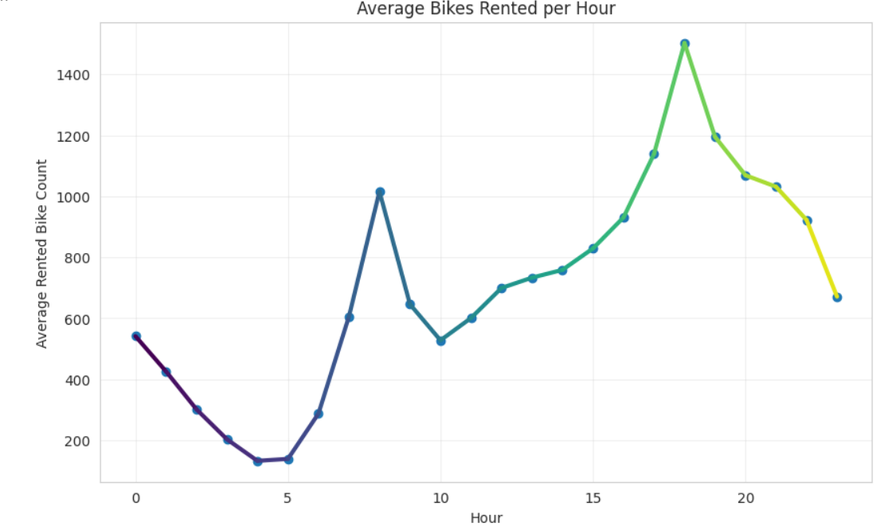
▶Hourly Analysis
• Peak: 7-9 AM & 5-7 PM
• Office commute impact

Slide 17
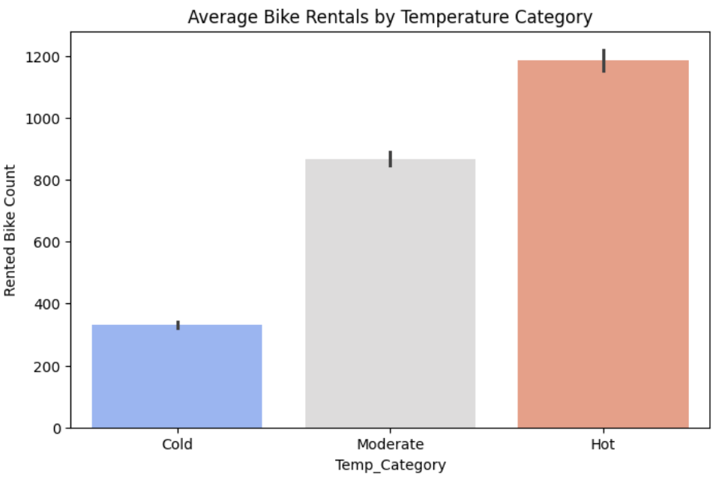
▶Weather Impact
•Rain reduces demand
•Snow further reduces demand

Slide 18
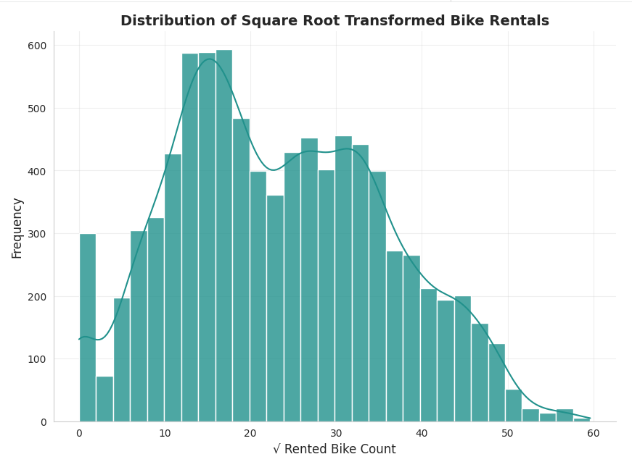
▶Advanced Analysis
•Highest demand at 6 PM
•Summer peak season

Slide 19
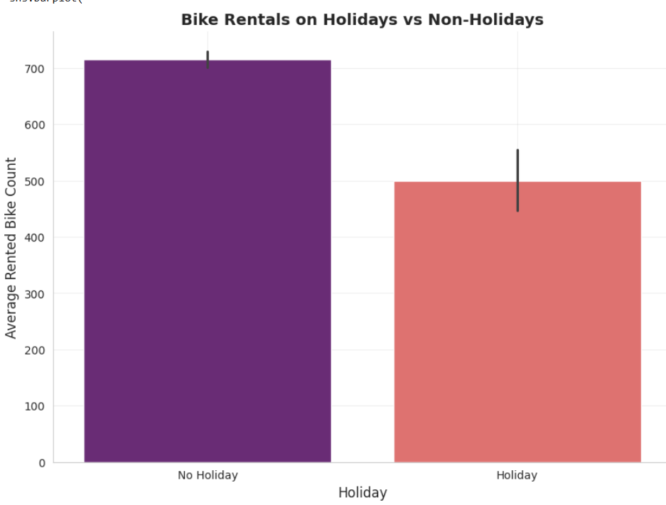
▶Category Comparison
•Non-holidays higher rentals
•Routine impacts demand

Slide 20

▶Key Insights
•Peak hours important
•Weather impacts usage
•Season matters

Slide 21
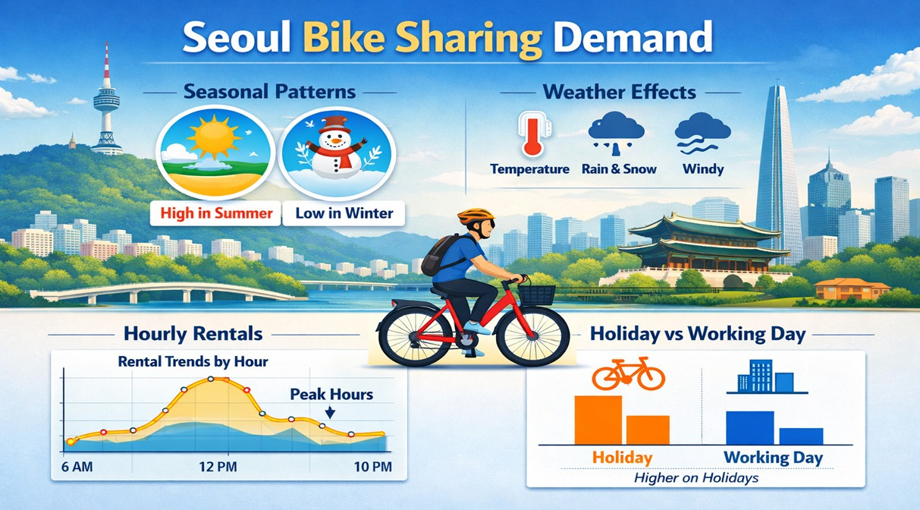
▶Recommendations
•Increase bikes in peak hours
•More bikes in summer
•Offers in low demand

Slide 22
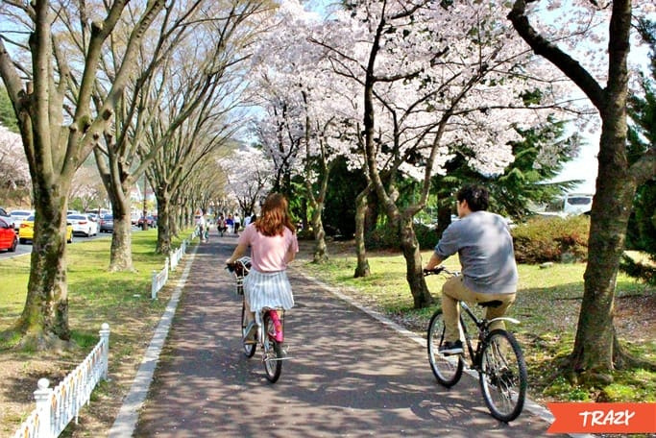
▶Conclusion
•Weather & time affect demand
•Use data for better decisions

Slide 23
THANK YOU

