Slide 1

E-COMMERCE
OLIST STORE ANALYSIS
BY GROUP-3

Slide 2

Meet our Team
1) Pallavi Saidurga K
2) Kotte Rahul
3) Sameer Sanjay Jawale
4) Mehul Ravsaheb Bhadane
5) Vaddi Narender

Slide 3

Introduction To E-Commerce
E-Commerce refers to buying and selling of products or services through the internet. It provides global reach and convenience to both sellers and buyers.
Types of E-Commerce
-B2C (Business to consumer): Amazon, Flipkart
-B2B(Business to Business):India Mart
-C2C(Consumer to Consumer):OLX, eBay
-C2B(Consumer to Business): Fiveer, Shutterstocks

Slide 4
Tools Used
EXCEL:
Analysing and transforming data, pivot tables, static dashboard
POWER-BI:
Loading data,creating interactive dashboard
TABLEAU:
Advanced visualization,drill-down,dashboard creation
MYSQL:
Importing data, managing database, queries for kpi

Slide 5
PROJECT PROCES
Extract Data
Transformation
Load &Using Tool
Creating Dashboard

Slide 6
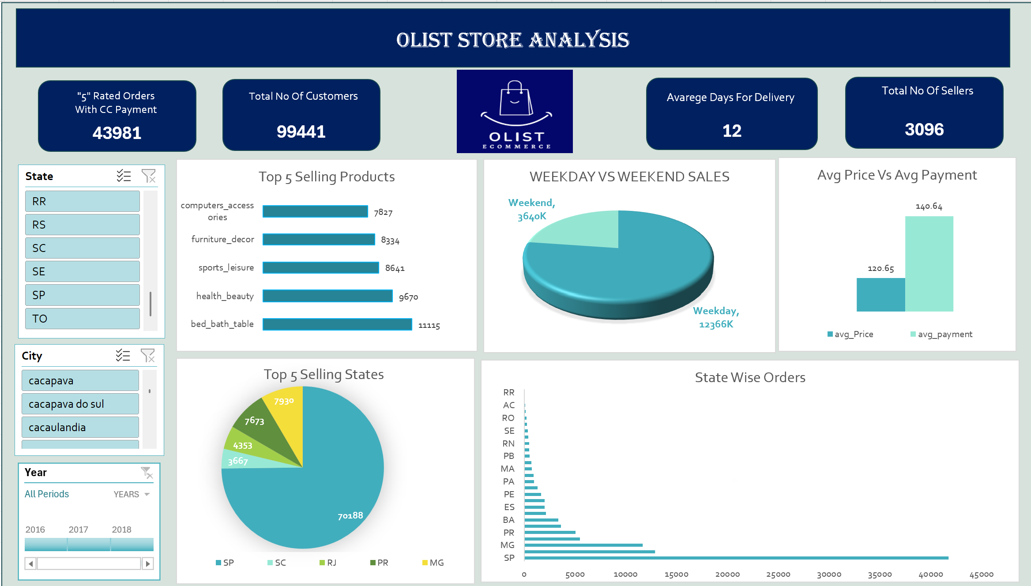
Excel Dashboard

Slide 7
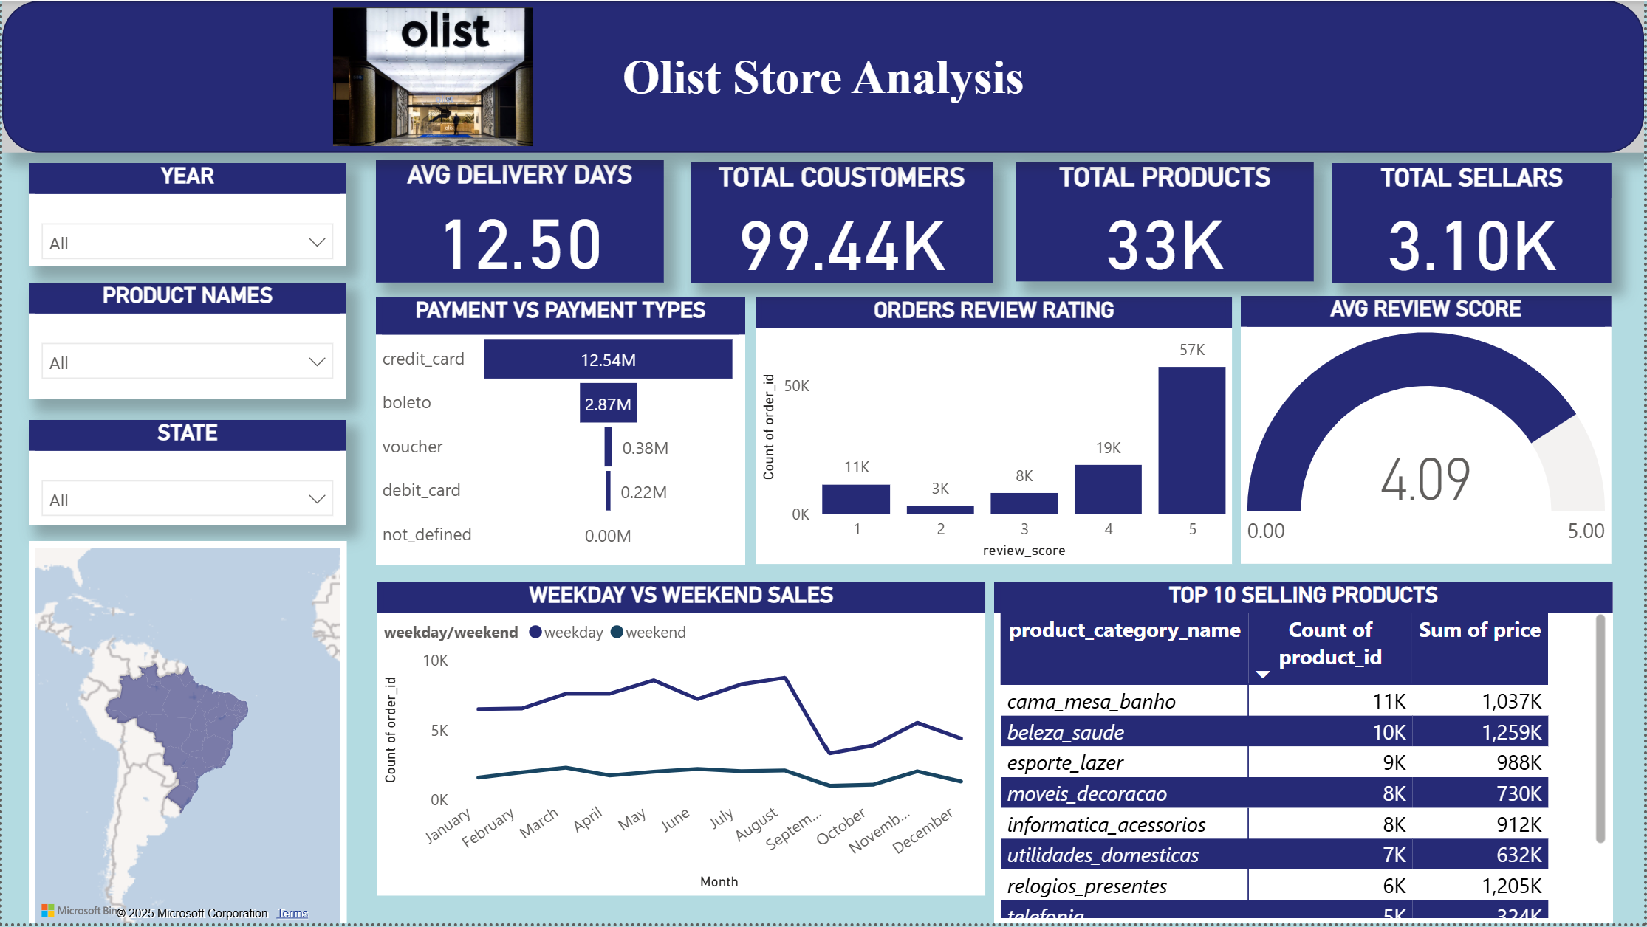
Power BI Dashboard

Slide 8
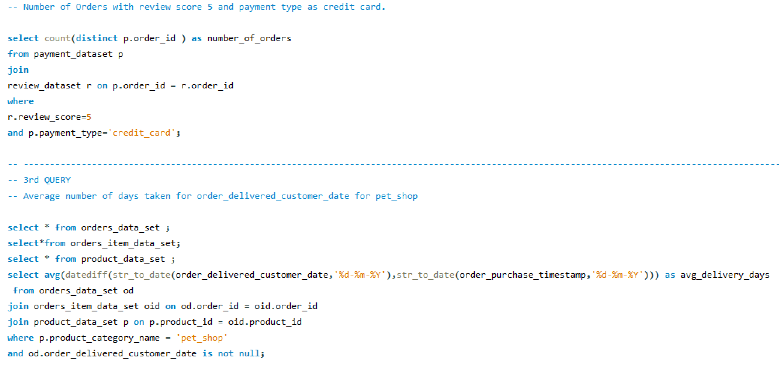
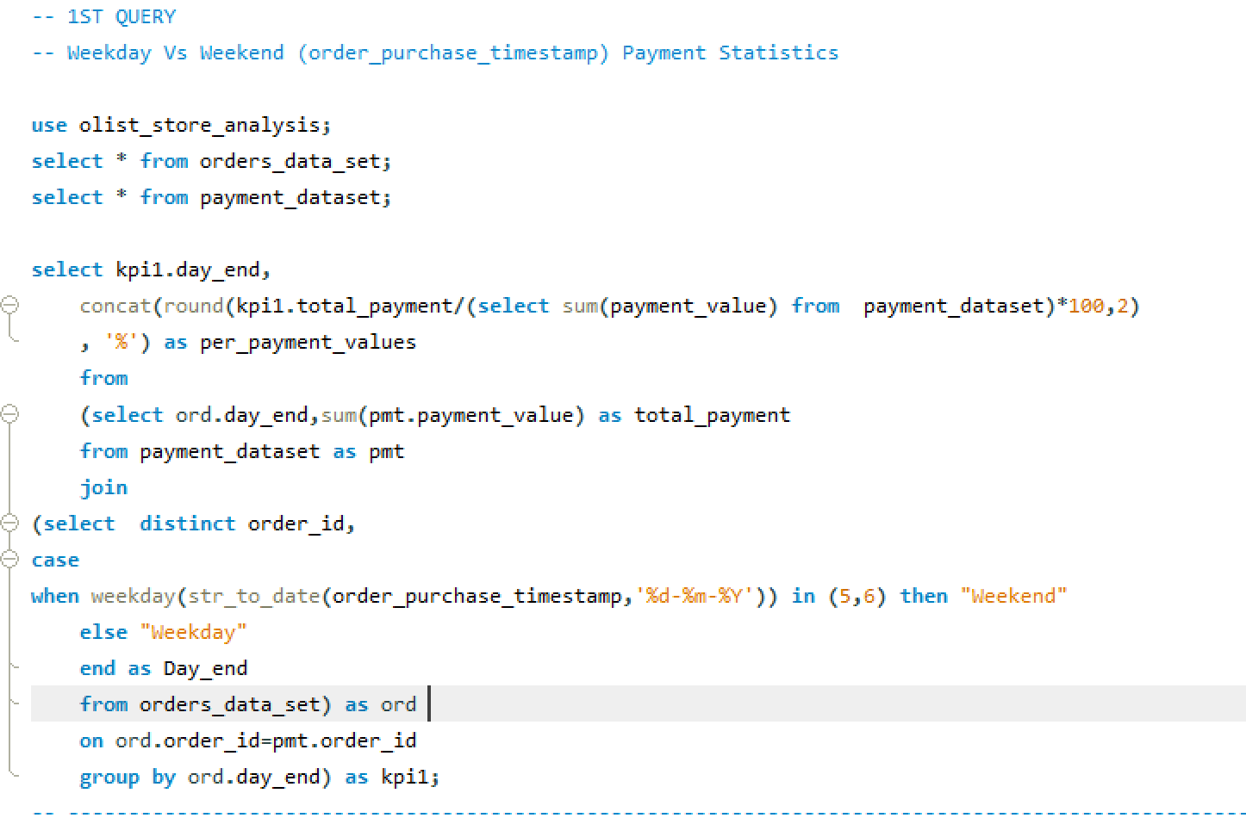
MySQL
Dashboard

Slide 9
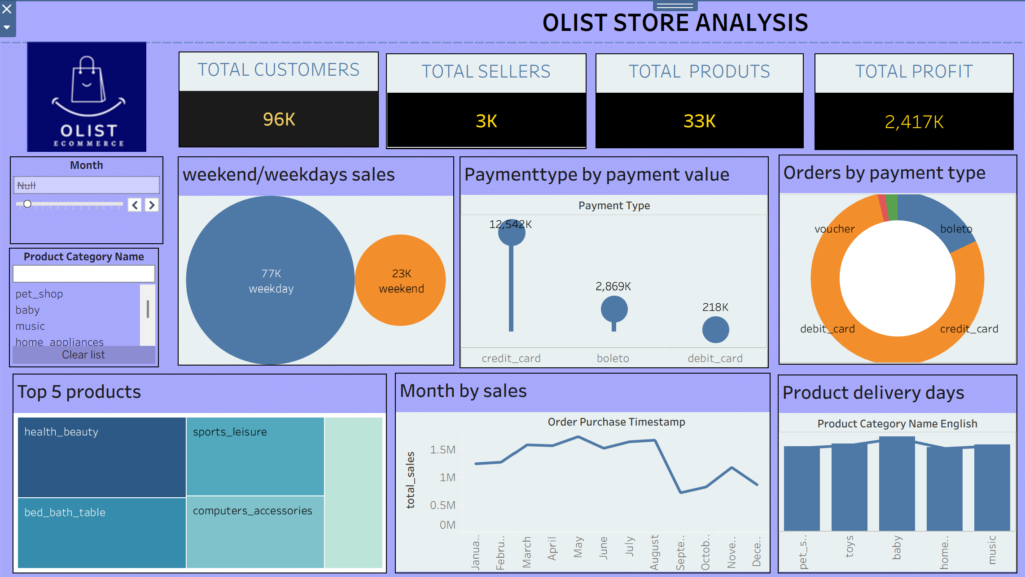
Tableau
Dashboard

Slide 10

Key KPIs Measured
Weekday vs Weekend sales
-weekday sales are77k and 23k sales in weekend sales.
Total Orders with review score 5 & Payment type is Credit Card
-Nearly 4k orders are done with Credit Card and review score is 5.
Average Delivery Days
-The average delivery days taken is 12 days it show shipping efficiency.
Average Review score
-The avg review score is 4.18 it shows customer satisfaction.
Average payment value
- The avg payment value is 151.73 it says that the amount paid per transaction.

Slide 11


Slide 12

THANK YOU

