Slide 1
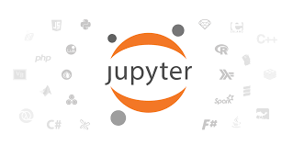
Introduction to Jupyter Notebook

Slide 2
Histroy of Jupyter Notebook:
It was spun off from IPython in 2014 by Fernando Pérez. Project Jupyter's name is a reference to the three core programming languages supported by Jupyter, which are Julia, Python and R, and also a homage to Galileo's notebooks recording the discovery of the moons of Jupiter.
What is a Jupyter Notbook?
Jupyter is a free, open-source, interactive web tool known as a computational notebook, which researchers can use to combine software code, computational output, explanatory text and multimedia resources in a single document.
In Jupyter notebook there are types of cells.
Code
Markdown
Raw

Slide 3
What is Code cell?
A code cell allows you to edit and write new code, with full syntax highlighting and tab completion. The programming language you use depends on the kernel, and the default kernel (IPython) runs Python code. When a code cell is executed, code that it contains is sent to the kernel associated with the notebook.
What is Markdown cell?
These cells contain text formatted using markdown language. All kinds of formatting features are available like making text bold and italic, displaying ordered or unordered list, rendering tabular contents etc. Markdown cells are especially useful to provide documentation to the computational process of the notebook.

Slide 4
Thank You!

