Slide 1
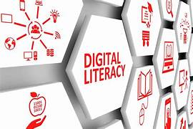
Digital Literacy Awareness VITYARTHI
STUDENT DETAIL:-
Pallavi Kumari
Registration No: 25BAI10352
CSE (AI & ML)
VIT Bhopal University

Slide 2

What is Digital Literacy
Digital literacy is the ability to use digital technology effectively, safely, and responsibly.
It includes internet usage, communication, and protecting personal data.

Slide 3

Importance of Digital Literacy
• Helps in online learning
• Improves communication
• Enhances career opportunities
• Promotes safe internet usage
• Improves productivity

Slide 4

Digital Footprint
Digital footprint is the information we leave online.
Examples:
• Social media posts
• Comments
• Photos
• Online searches

Slide 5

Cyber Security Awareness
• Use strong passwords
• Avoid suspicious links
• Do not share OTP
• Use secure websites
• Update software regularly

Slide 6
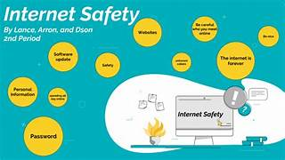
Safe Internet Usage
• Verify information
• Avoid fake websites
• Protect personal data
• Use trusted platforms

Slide 7

Digital Learning Platforms
• Coursera
• NPTEL
• YouTube Learning
• LinkedIn Learning

Slide 8
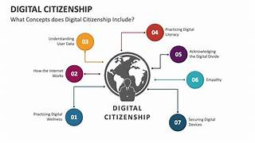
Responsible Digital Citizen
• Respect others online
• Avoid cyberbullying
• Use technology responsibly
• Follow digital ethics

Slide 9

Conclusion
Digital literacy is essential for students in today's digital world.
It helps in learning, communication, and career growth.

Slide 10

Thank You
Pallavi Kumari
CSE (AI & ML)
VIT Bhopal University

