Slide 1
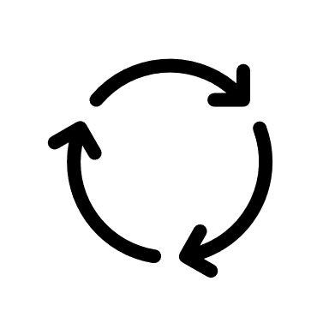



Create Project
Create Issue
Work In Progress
Review Fix
Resolved
Defect Dashboard
Create Project
Process
Review Project
Total Issue

Slide 2
Login
Welcome to DefectBoard
Username -
Password -
New User ?
Forgot password ?
Login

Slide 3
Register New User
Welcome to DefectBoard
Username -
New Password -
Email -
User ?
Forgot password ?
Create User

Slide 4
Create Project
Project *
Project Summary *
Project Type *
Project Details
Team Size *
Owner *
Create

Slide 5



Project Status Page
Quick Filter
Select Project
TO DO | WIP | REVIEW | Done
Summary – Impact on P1 INC00001 Sev 1 26/05
Create Issue
Review Issue

Slide 6
Review Project
Filter
Project ID | Project | Project Type | Team | Owner | Status
1 | Steady State | Prod | 10 | Sachin | WIP

Slide 7

Create Issue
Project *
Issue Summary *
Issue Type *
Issue Details *
Severity *
Reporter *
Assignee *
Issue logs -
Create

Slide 8
Review Issue
Filter
INC | Issue Summary | Issue Type | Severity | Reporter | Assignee | Issue logs | Status
INC00001 | Impact on p1 | Prod | Sev 1 | Sachin | Dinesh | NA

