Slide 1

Project Title - Seasonal Agriculture Performance Analysis
Student Name: Pallavi R
College Name: Maharani Lakshmi Ammanni College For Women
AICTE STU ID : STU68c6922c476671757844012

Slide 2

PROBLEM STATEMENT
Agricultural activities are influenced by seasonal variations in environmental conditions, farming practices, resource availability, and market conditions. As a result, agricultural performance may differ from one season to another.
However, raw agricultural data does not clearly explain how agricultural performance changes across seasons or what patterns can be observed in different seasonal conditions.
The problem is to analyze the given agricultural dataset and investigate seasonal differences in agricultural performance by identifying meaningful patterns, trends, relationships, and variations within the available data.

Slide 3
Project Description
This project conducts exploratory and inferential data analytics on a 4,000-record agricultural dataset across Kharif, Rabi, and Zaid seasons. The scope covers end-to-end data processing:
Data Cleaning and Imputation: Handled missing values in environmental/yield parameters (Rainfall_mm, Soil_Moisture_pct, Yield_Tonnes_Ha) using KNNImputer (k=5).
Exploratory and Comparative Analysis: Analyzed statistical distributions, univariate balance across seasons, and bivariate relationships between seasonal climate factors and profit returns.
Multivariate and Efficiency Modeling: Evaluated crop-specific seasonal yields, resource efficiency across irrigation types (Flood, Drip, Sprinkler), and crop resilience under disease/pest risks.

Slide 4

WHO ARE THE END USERS?
Agricultural Policy Makers & Extension Officers: To design evidence-based, region-specific crop guidelines and optimize resource planning.
Farmers & Local Cooperatives: To guide season-appropriate crop selection, adoption of modern micro-irrigation systems, and input planning (seed quality selection).
Agri-Business Stakeholders & Analysts: To anticipate seasonal supply/yield variations, manage supply chain logistics, and optimize market pricing strategies.

Slide 5

Technology Used
Programming Language: Python 3.x
Data Manipulation & Processing: Pandas, NumPy
Data Visualization: Matplotlib, Seaborn
Data Imputation & Preprocessing: Scikit-learn (KNNImputer)
Development Environment: Google Colab

Slide 6
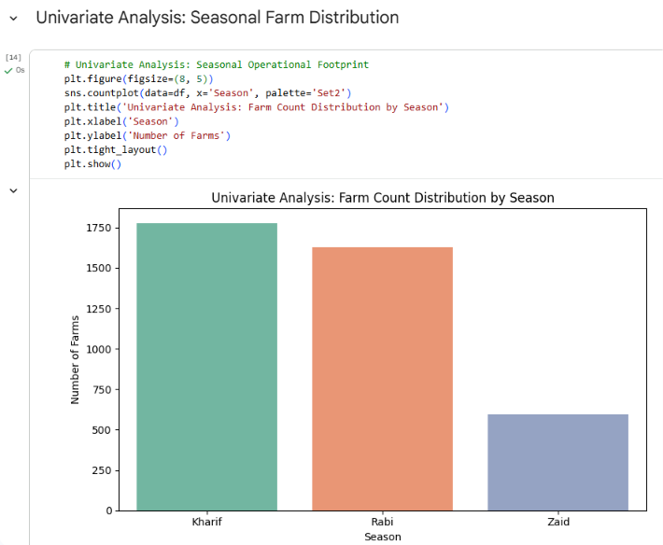
RESULTS
[Add screen shots of your code ]

Slide 7
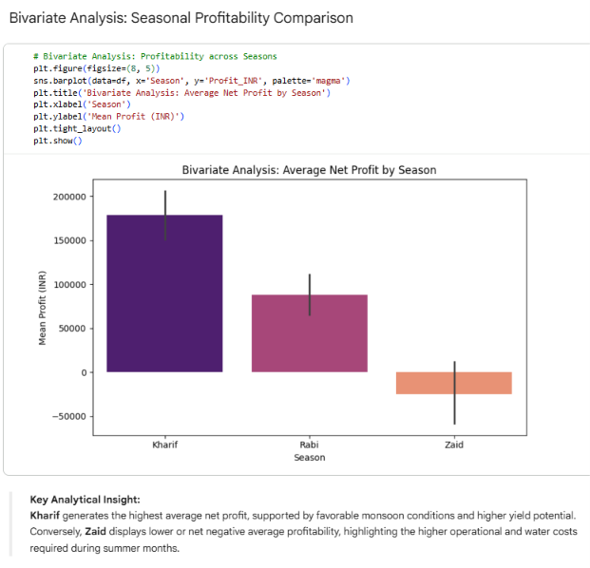
RESULTS
[Add screen shots of your code ]

Slide 8
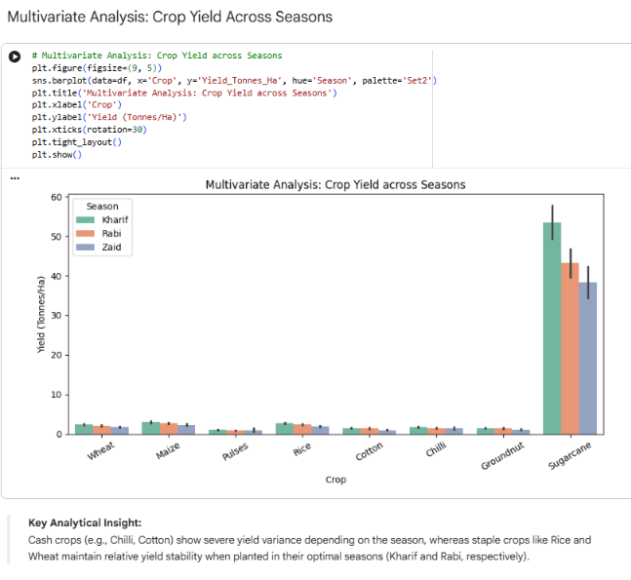
RESULTS
[Add screen shots of your code ]

Slide 9
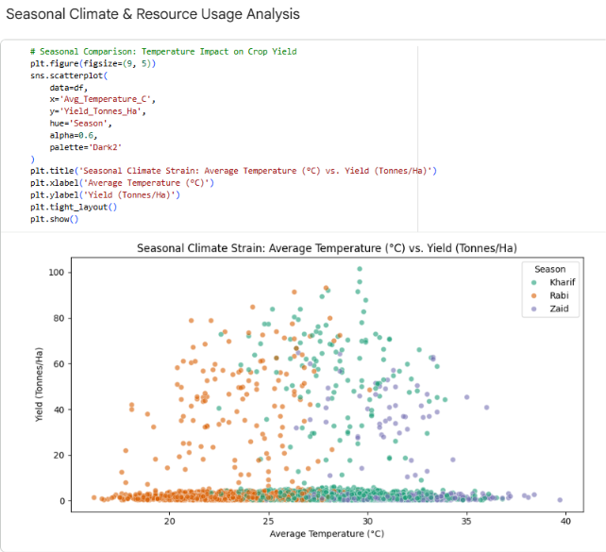
RESULTS
[Add screen shots of your code ]

Slide 10
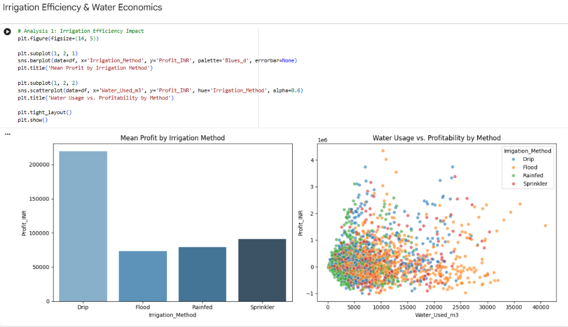
RESULTS

Slide 11
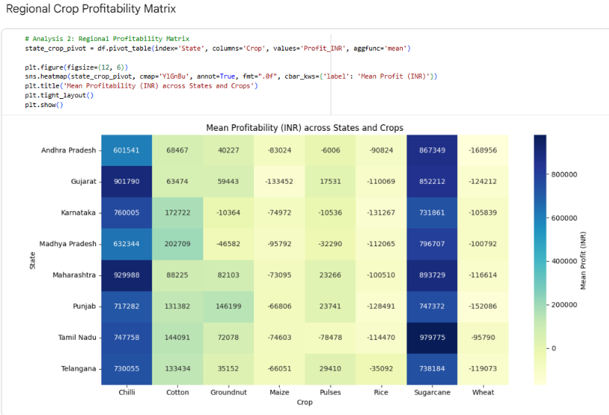
RESULTS

Slide 12
Future scope
Predictive Yield & Profit Modeling: Integrating Machine Learning algorithms (e.g., Random Forest, XGBoost) to forecast seasonal yields and optimal crop market pricing.
Real-Time Climate & Remote Sensing Integration: Incorporating live satellite weather feeds and soil sensor data to dynamically adjust seasonal irrigation schedules and pest risk alerts.
Policy & Subsidy Optimization Engine: Developing a decision-support model to evaluate government subsidy allocation (e.g., micro-irrigation grants, seed distribution) and simulate its direct impact on regional farm profitability.
Interactive Stakeholder Dashboards: Developing Streamlit or PowerBI interactive interfaces for real-time scenario planning and decision-making by agricultural officers and local cooperatives.

Slide 13
GitHub Link
https://github.com/pallavir24/Seasonal-Agriculture-Performance-Analysis

Slide 14
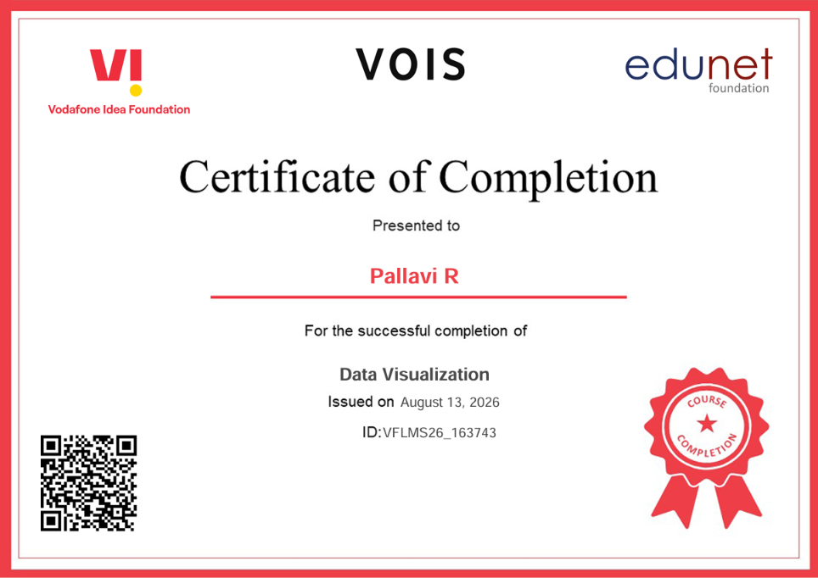
VOIS Course completion certificate - Course name- Data Visualization

Slide 15
Thank you

