Slide 1
TASK- 2 Hotel Reservations Analysis with SQL
Presented by
Pallavi Raj

Slide 2
Content
Project Overview
Dataset Description
Problem Statement
Analysis(Queries)
Summary

Slide 3
Hotel Reservation Analysis
Overview:
Analyzing hotel reservations involves examining various aspects of booking data to gain insights into trends, customer behavior, and operational efficiency. The process begins with collecting relevant data, which typically includes information on booking dates, check-in and check-out dates, customer demographics, room types, booking statuses (such as Cancelled or Not Cancelled), payment methods, and other pertinent details.

Slide 4
Columns Description
Booking_ID: A unique identifier for each hotel reservation.
no_of_adults: The number of adults in the reservation.
no_of_children: The number of children in the reservation.
no_of_weekend_nights: The number of nights in the reservation that fall on weekends.
no_of_week_nights: The number of nights in the reservation that fall on
weekdays.
type_of_meal_plan: The meal plan chosen by the guests.
room_type_reserved: The type of room reserved by the guests.
lead_time: The number of days between booking and arrival.
arrival_date: The date of arrival.
market_segment_type: The market segment to which the reservation belongs.
avg_price_per_room: The average price per room in the reservation.
booking_status: The status of the booking.

Slide 5
Problem Statement
The hotel industry relies on data to make informed decisions and provide a better guest experience. In this internship, you will work with a hotel reservation dataset to gain insights into guest preferences, booking trends, and other key factors that impact the hotel’s operations. You will use SQL to query and analyze the data, as well as answer specific questions about the dataset.

Slide 6
Here are 15 questions for which you will write SQL queries to gain insights:
1.What is the total number of reservations in the dataset?
2. Which meal plan is the most popular among guests?
3. What is the average price per room for reservations involving children?
4. How many reservations were made for the year 20XX (replace XX with the desired year)?
5. What is the most commonly booked room type?
6. How many reservations fall on a weekend (no_of_weekend_nights > 0)?
7. What is the highest and lowest lead time for reservations?
8. What is the most common market segment type for reservations?

Slide 7
9. How many reservations have a booking status of "Confirmed“?
10. What is the total number of adults and children across all reservations?
11. What is the average number of weekend nights for reservations involving children
12. How many reservations were made in each month of the year?
13. What is the average number of nights (both weekend and weekday) spent by guests for each room
type?
14. For reservations involving children, what is the most common room type, and what is the average price for that room type?
15. Find the market segment type that generates the highest average price per room.

Slide 8


1.What is the total number of reservations in the dataset?
ANS: The total number of reservations in the dataset is 700.

Slide 9
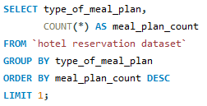

2. Which meal plan is the most popular among guests?
ANS: Meal Plan 1 is the most popular among guests.

Slide 10


3. What is the average price per room for reservations involving children?
Ans: The average price per room for reservations involving children is 144.57.

Slide 11


4. How many reservations were made for the year 20XX (replace XX with the desired year)?
Ans: The reservation made for the year 2018 is 577.

Slide 12
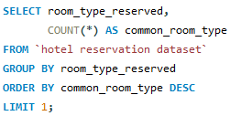

5. What is the most commonly booked room type?
Ans: The most commonly booked room type is Room_Type 1

Slide 13


6. How many reservations fall on a weekend (no_of_weekend_nights > 0)?
Ans: There are 383 reservations fall on a weekend.

Slide 14

7. What is the highest and lowest lead time for reservations?
Ans: The highest and lowest lead time for reservations are 443 and 0 respectively.

Slide 15
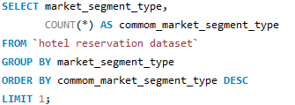

8. What is the most common market segment type for reservations?
Ans: The most common market segment type for reservations is Online market segment.

Slide 16


9. How many reservations have a booking status of "Confirmed“?
Ans: There are 493 reservations which has a booking status “Confirmed”.

Slide 17

10. What is the total number of adults and children across all reservations?
Ans: There are 1316 adults and 69 childrens across all reservations.

Slide 18


11. What is the average number of weekend nights for reservations involving children
Ans: The average number of weekend nights for reservations involving childrens is 1.00

Slide 19

12. How many reservations were made in each month of the year?

Slide 20
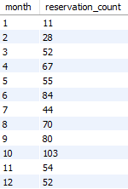
Output:

Slide 21

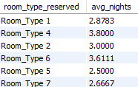
13. What is the average number of nights (both weekend and weekday) spent by guests for each room type?
Output:

Slide 22
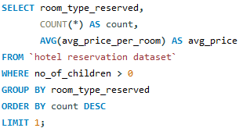

14. For reservations involving children, what is the most common room type, and what is the average price for that room type?
Output:

Slide 23
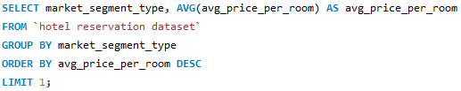

15. Find the market segment type that generates the highest average price per room.
Ans: Online market are the market segment type that generate the highest price per room

Slide 24
THANK YOU

