Slide 1
Scalatest

Slide 2
Scalatest
The design of ScalaTest can be summed up in one sentence:
“ScalaTest allows you to ask a suite of tests to run itself”.
A test can be anything with a name that can start and either succeed, fail, be pending, or canceled.
The central unit of composition in ScalaTest is Suite, which represents a suite of tests.
Various styles of writing test-case
FunSuite
FlatSpec-Tag tests, Ignore Tests, Matchers, BDD support, Junit support,etc..
FunSpec
WordSpec
FreeSpec
Spec
PropSpec
FeatureSpec

Slide 3

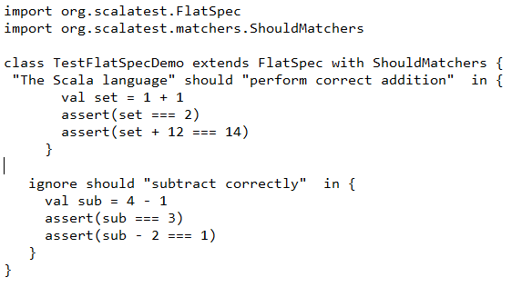
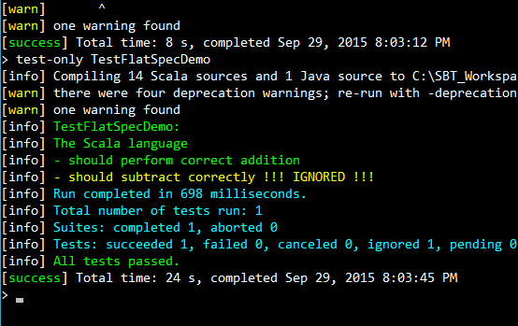
ScalaTest + Play
PlaySpec
PlaySpec is a style of writing test-suites for play-framework application.
You get WordSpec , MustMatchers by extending PlaySpec.
ScalaTest provides an integration library -> ScalaTest + Play
A sample test Output

Slide 4
Thank You!

