Slide 1
Bridge Architecture
raisel.melian@viacom.com

Slide 2
Agenda
JHipster
Bridge Architecture
Architecture overview
Load balancers
Distributed data management

Slide 3











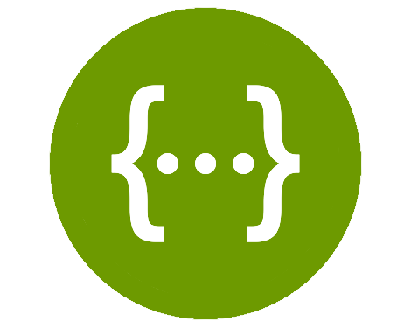



Spring framework stack & more
Spring boot
Spring Cloud
Spring Data
Spring Security
Camunda
ElasticSearch
Swagger

Slide 4





Architecture Overview
Camunda
Microservice 1
Microservice 4
Amazon RDS
Message Broker
API Gateway
Zuul
Microservice 2
Microservice 5
Amazon ElasticSearch
Microservice 3
Microservice 6
Amazon DynamoDB
Java 8/Spring boot
Java 8/Spring boot

Slide 5
Architecture Overview
ADF
Authorization Service
Validate Token
Get roles to authorize user
Microservice n
API Gateway
Microservice 2
Microservice n
Microservice 3
Microservice n
Java 8/Spring boot
Java 8/Spring boot

Slide 6

Order customization attachments
File handler Service
2 - POST/PUT File Metadata
3 - return File Metadata with ID
1 - PUT order with
attachments
API Gateway
4 - PUT Order with Attachment ID
OMF
client
5 - return Order
6 - update File Metadata with activity ID

Slide 7
Order customization attachments
OMF
1 - Get Order
2 - return Order
1 - get order with
attachments
API Gateway
3 - get Files Metadata with activities Ids
File handler Service
client
4 - return List of File Metadata

Slide 8
Create Thumbnail
Try to get Thumbnail from S3.
If Thumbnail exists return back to client
If Thumbnail doesn't exists: create Thumbnail in S3 and return back to client
File handler Service
1 - get a Thumbnail
API Gateway
2 - get a Thumbnail
client
3 - Thumbnail response

Slide 9
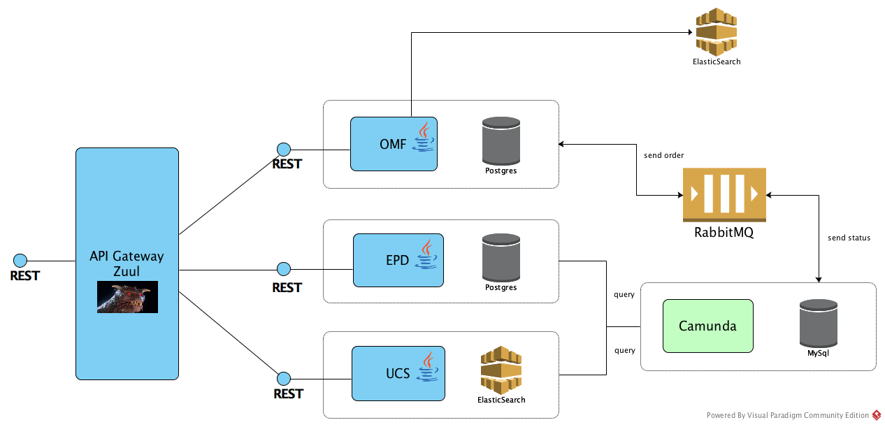
Interaction(old -> needs to be updated)

Slide 10
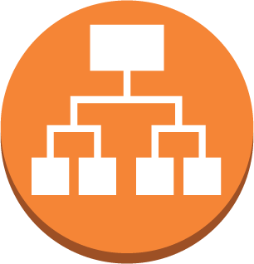

Internal load balancer
https://dev.api.lb.content-platform.viacom.com
Application Load Balancer
/omf
/ucc
/upd
/bomi
instances
instances
instances
instances

Slide 11
Public load balancer
dev.api.lb.content-platform.viacom.com
dev.gateway.bridge.viacom.com
Application Load Balancer
Application Load Balancer
/api/v1
/omf
/ucc
/upd
/bomi
Gateway
instances
OMF
instances
UCC
instances
UPD
instances
BOMI
instances

Slide 12
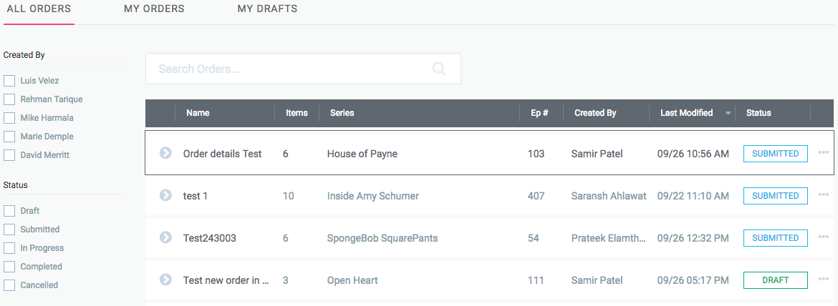
Distributed Data Management
OMF Service
UCC Service
UPD Service

Slide 13
SQL + Text Search Engine
ElasticSearch
Microservice 1
Microservice 2
Microservice 3
SQL
SQL
SQL
How to maintain consistency?

Slide 14
Events to the rescue
Services publish events when state changes
Services subscribe to events
Maintains eventual consistency in multiple datastores
Synchronize replicated data

Slide 15
Events to the rescue
Search Order
1-Create Order
Order service
Index service
2-Save Order
3-Order Created
4-Order Created
5-Index Order
SQL
Elasticsearch
Message Broker

Slide 16
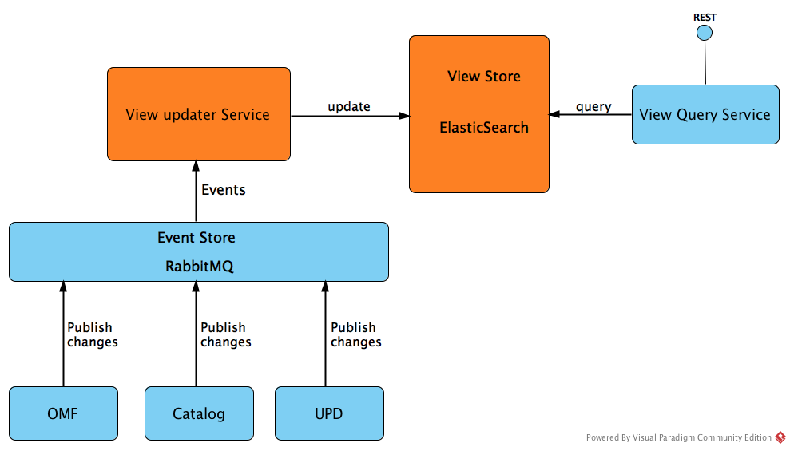
Data Aggregation

Slide 17
Create/Update comments
1-create/update
Gateway
Notification Service
2-create/update
Comment Service
3-create/update
RabbitMQ

Slide 18
Submit for Approval
1-submit for approval
Gateway
4-update activity status
5-update activity status
RabbitMQ
Workflow
6-updated activity status
2-save comment
3- save event with comment id
7-updated activity status
COS
TLS
OMF

Slide 19


Upload Files
7- save file info
6- create/update order
ADFS
Gateway
OMF API
File-handler API
3- get identity id and token
1- login
2- get identity id and token
UI
5- create/update order
4- upload files to private bucket
Amazon S3 Temp bucket
Amazon Cognito
Amazon RDS
Amazon DynamoDB

Slide 20
Get Files(this is not GOOD, refactoring)
5- get order with attachment ids
ADFS
Gateway
OMF API
3- get identity id and token
1- login
2- get identity id and token
UI
4- get order with attachment ids
6- get files
Amazon S3 Temp bucket
Amazon Cognito
Amazon RDS

Slide 21
Activity status update
OMF
Activity Update
RabbitMQ
Activity Update
Workflow
BABS
Activity Update

Slide 22
Services (To make these services reusable some changes are still needed)
OMF
Order Management Framework
UPD
User Profile
UCC
Catalog Service
COS
Communication Service:
EPD
Endpoint Profile
TLS
Time Line Service: crud operations for event types like activity submitted for approval, approved, rejected etc
File Handler
File Handler Service: allow to save file’s metadata

Slide 23
Bridge specific Services
BABS
Bridge Activities Bundles Service
BNO
Bridge Notification
BOMI
Bridge Order Management Index
Gateway
Bridge Gateway

Slide 24
Lessons learned
Exchange - routing keys - queues setup difficult

Slide 25
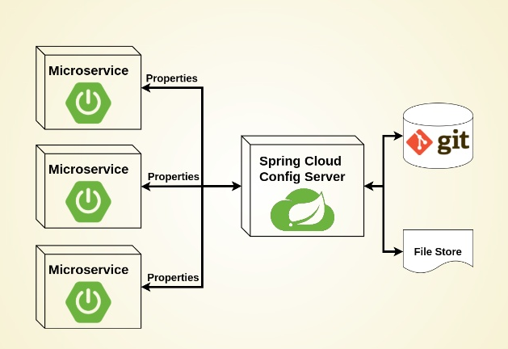
Config Server

Slide 26

JHipster
JHipster is a development platform to generate, develop and deploy Spring Boot + Angular Web applications and Spring microservices.

Slide 27
JHipster
DEMO

Slide 28
Next steps
Hibernate 2nd level cache
Spring Cloud Config(DONE)
Service discovery (Eureka/Consul/etc)
Metrics

