Slide 1
B.TECH COMPUTER SCIENCE AND ENGINEERING
SmartLibrary
Intelligent Digital Library Platform
Data Structures and Algorithms project for a B.Tech Computer Science and Engineering review.
PROJECT REVIEW
FORMAT
Search · similarity · optimization
Java · CSV

Slide 2
THE PROBLEM
THE RESPONSE
Why library search needs more than keywords
One platform, many algorithm demonstrations
SmartLibrary aims to combine search, similarity, optimization, graph, approximation, randomized, and parallel algorithm demonstrations.
Simple keyword search can miss useful documents when queries contain typing mistakes.
Large collections need efficient searching and organization.
Comparing related research documents takes time.
SEARCH
SIMILARITY
GRAPHS
SCALE
02

Slide 3
SYSTEM PATH
From CSV records to console results
A menu selection moves through the data layer, the document model, and the selected algorithm.
01
02
03
04
User selects
DatasetLoader
Document objects
Algorithm modules
Operation from the Java menu.
Reads the CSV dataset.
ID, title, author, publication year, abstract, keywords, and citation count.
The selected algorithm processes the input.
ARCHITECTURE FLOW
CSV Dataset → DatasetLoader → Document Objects → Algorithm Modules → Console Output.
03

Slide 4
QUERY ROUTING
1
2
Query routing connects each question to the right technique
User query
Keyword search
Accept a query from the user.
Send keyword searches to string-matching algorithms.
Accept a query from the user, then route it by intent.
3
4
Similarity
Optimization
Send similarity requests to edit-distance or sequence-alignment methods.
Send optimization requests to the relevant algorithm demonstration.
DESIGN BOUNDARY
TextHack is a proposed design or future enhancement unless it exists in the implementation.
04

Slide 5
SEARCH EVIDENCE
String matching turns document text into searchable evidence
TECHNIQUE | WHAT IT DEMONSTRATES | STATUS
Naive matching | Simple comparison baseline. | Baseline
KMP | Prefix table avoids repeated comparisons. | Pattern search
Z Algorithm | Z-array identifies pattern matches. | Pattern search
Rabin–Karp | Rolling hashes compare candidate matches. | Hash-based
Aho–Corasick | Trie and failure links search multiple patterns. | Multi-pattern
Suffix Array and LCP | Indexed search and common-prefix analysis. | Indexed search
Advanced or conceptual unless verified as implemented: suffix trees, suffix automata, and SA-IS.
05

Slide 6
DOCUMENT DIFFERENCE
SMALL TRANSFORMATION
Edit distance explains how documents differ
CAT → CUT
One substitution changes the middle character.
 | C | U | T
 | 0 | 1 | 2
C | 1 | 0 | 1
A | 2 | 1 | 1
T | 3 | 2 | 1
Levenshtein distance counts insertions, deletions, and substitutions.
Damerau–Levenshtein also considers adjacent-character transpositions.
Needleman–Wunsch performs global sequence alignment.
Smith–Waterman finds the best local sequence alignment.
Dynamic-programming table for the Levenshtein distance between CAT and CUT.
ALSO DEMONSTRATED
Matrix Chain Multiplication, Optimal Binary Search Tree, and Bitmask TSP use dynamic programming for optimization.
06

Slide 7
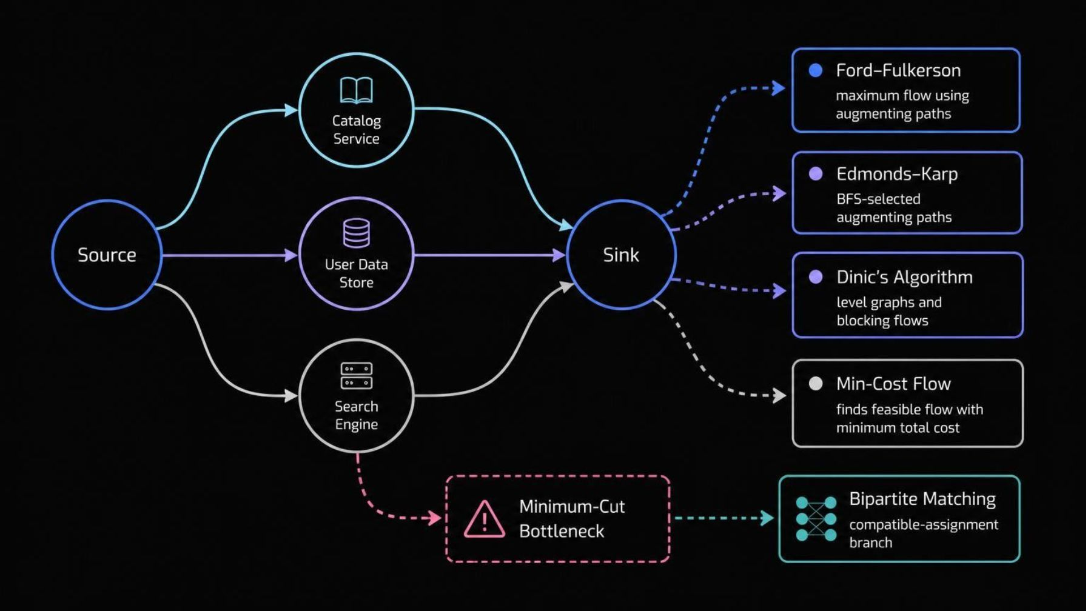
FLOW NETWORKS
Graphs reveal flow, bottlenecks, and assignments
Frame these as algorithm demonstrations unless the project actually models library traffic or resources.
Minimum Cut exposes a bottleneck; Bipartite Matching assigns compatible resources and tasks.
07

Slide 8
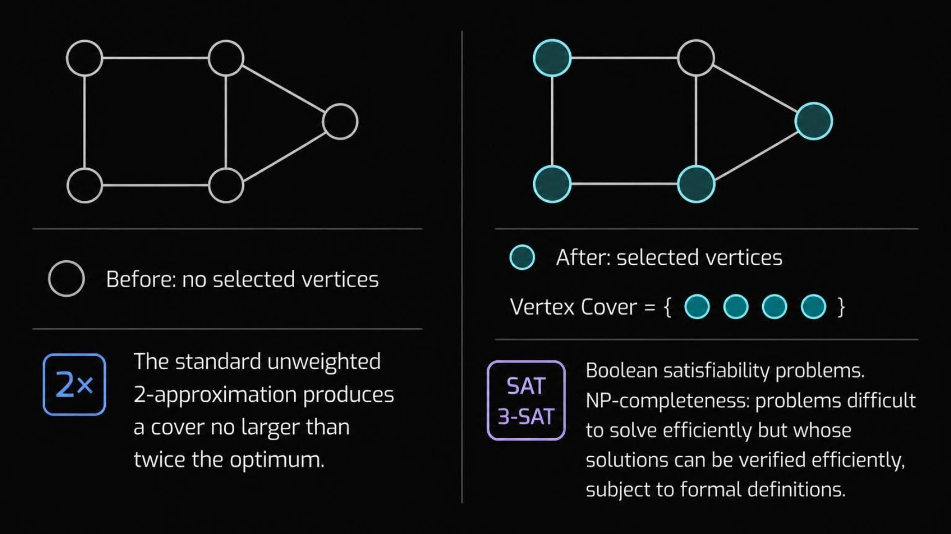
PRACTICAL APPROXIMATION
Approximation makes hard graph problems practical
SAT / 3-SAT
BOUNDARY
Illustrate Boolean satisfiability problems.
Do not claim SAT solvers or formal reductions are implemented unless verified in source code.
08

Slide 9

SCALABLE IDEAS
Randomization and parallelism show scalable ideas
RANDOMIZED METHODS
PARALLEL CONCEPTS
Adapt as uncertainty grows
Split work, then combine it
Randomized QuickSort reduces the chance of consistently poor pivot choices.
Miller–Rabin provides probabilistic primality testing.
Reservoir Sampling selects k items from a stream whose total size may be unknown.
Parallel Reduction combines values across workers.
Parallel Prefix Scan computes cumulative results such as prefix sums.
Parallel algorithms are clearly labelled implemented or conceptual depending on the actual code.
09

Slide 10

SMARTLIBRARY · JAVA PROJECT
SmartLibrary brings many DSA ideas into one Java project
Loads document records from a CSV dataset; provides a menu-based way to test algorithm demonstrations.
Connects text search, text similarity, graph optimization, approximation, randomized methods, and parallel concepts; uses Java, Eclipse IDE, and CSV as the stated implementation environment.
FUTURE SCOPE
GUI or web app, database storage, advanced indexes, autocomplete, semantic search, ranking, and larger-scale benchmarking.
Thank You – Questions?

