Slide 1
Bus Management System
Presented By:
Tupake Pallavi

Slide 2
INTRODUCTION
Since old times,bus are used as the most They provide convenient, cheap mode of transportation and hence is popular.[8] But there are certain problems regarding use of bus as means of transportation like safety of passengers, availability of buses, delay of buses due to traffic congestion at local area.[2] A system having barcode scanning software program is used for managing all the buses by scanning individual bus which is very difficult and time consuming task for the company. [1] Therefore, for reducing the difficulty of managing the buses and improving the facility and security to the passengers, a bus management system having GPS and RFID is planned which is used to find thebcurrent location of bus.

Slide 3
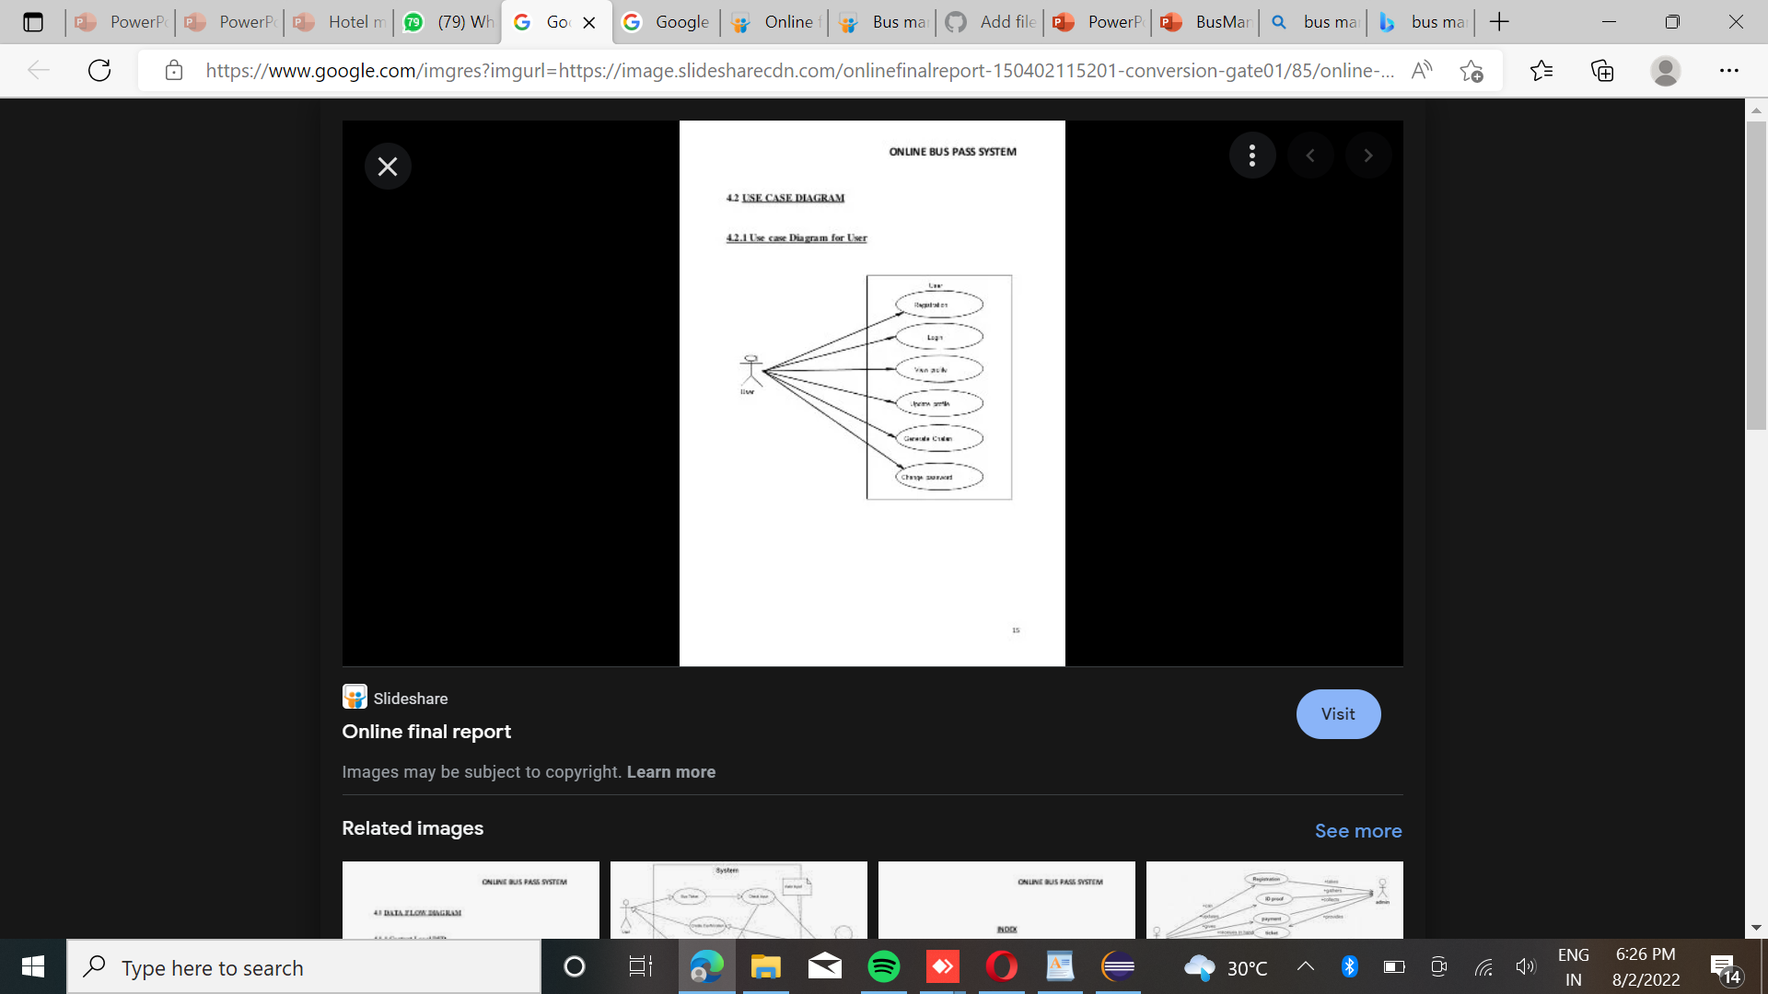
Use Case Diagram

Slide 4
Module Implementation
The Basic System of GPS. Bus Management System is operated by GPS which is synched with RFID Reader. GPS from satellite receives signals, and then position co-ordinates with latitudes and longitudes are determined by it. The location is determined with the help of GPS and n transmission mechanism. After receiving the data the tracking data can be transmitted using any wireless communications

Slide 5
Proposed system
We so proposed a new system which solve the drawback of current system. Our system handles all the data like current location of bus, management of buses, its schedule and security of passengers. Some technologies like GPS, RFID are used for development purpose. Our system provides the relevant information regarding all the buses from source and destination with the route details, real time location, availability, and passenger’s information and security, and driver details. Generally, our system

Slide 6
Future Scope
Due to rapid increase in population and no proper system, there is need for efficient bus management system. Initially, buses lack regularisation and management. There is increased burden on bus transportation because most of the population relies on the bus. Therefore, remote users need a real time system which provides real time information of bus. The management of the buses was still left unaddressed no grounds for the safety of the passengers was put forth.Hence this gave rise to the need of a reliable, user-friendly and real time Bus management system

Slide 7
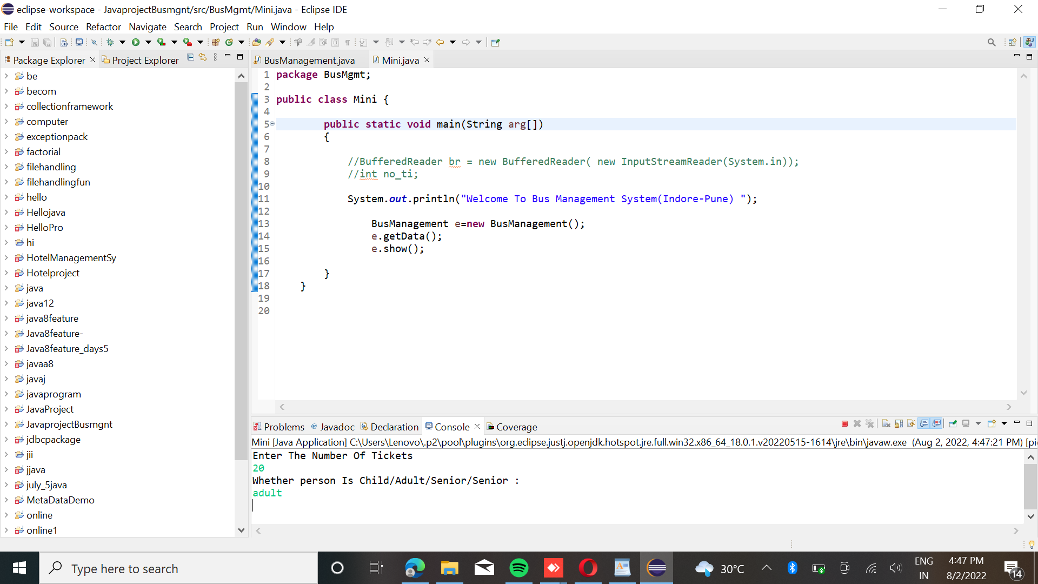

Slide 8
Conclusion
In this paper we have reviewed a various existing techniques of bus management system. By implementing those ideas, we can improve the transportation safety and the quality of services of the buses. The system will have latest technology and optimized algorithms with moderate cost. This system gives the information about the bus location, arrival, routes and passenger details. The proposed system is more users friendly.

Slide 9
References
http://www.google.com
http://www.youtube.com

Slide 10
Thank You

