Slide 1
Diffusion Models

Slide 2
Generative Models
Given observed samples x from a distribution of interest, the goal of a generative model is to learn to model its true data distribution p(x). Once learned, we can generate new samples from our approximate model at will.
Several well-known directions in current literature: Generative Adversarial Networks (GANs), autoregressive models, normalizing flows, and Variational Autoencoders (VAEs), energy-based modelling, Score-based modelling.

Slide 3


Evidence Lower Bound (ELBO)
We can think of the data we observe as represented or generated by an associated unseen latent variable, which we can denote by random variable z. We can imagine the latent variables and the data we observe as modeled by a joint distribution p(x; z).
Two ways we can manipulate this joint distribution to recover the likelihood of purely our observed data p(x); we can explicitly marginalize out the latent variable z:
or, we could also appeal to the chain rule of probability
Directly computing and maximizing the likelihood p(x) is difficult because it either involves integrating out all latent variables z, which is intractable for complex models, or it involves having access to a ground truth latent encoder p(z|x).

Slide 4
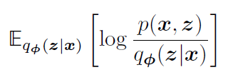
We can derive a term called the Evidence Lower Bound (ELBO), which as its name suggests, is a lower bound of the evidence.
Maximizing the ELBO becomes a proxy objective with which to optimize a latent variable model; in the best case, when the ELBO is powerfully parameterized and perfectly optimized, it becomes exactly equivalent to the evidence.
Formally, the equation of the ELBO is:
Here, q(z|x) is a flexible approximate variational distribution with parameters that we seek to optimize.
Intuitively, it can be thought of as a parameterizable model that is learned to estimate the true distribution over latent variables for given observations x; in other words, it seeks to approximate true posterior p(z|x).

Slide 5
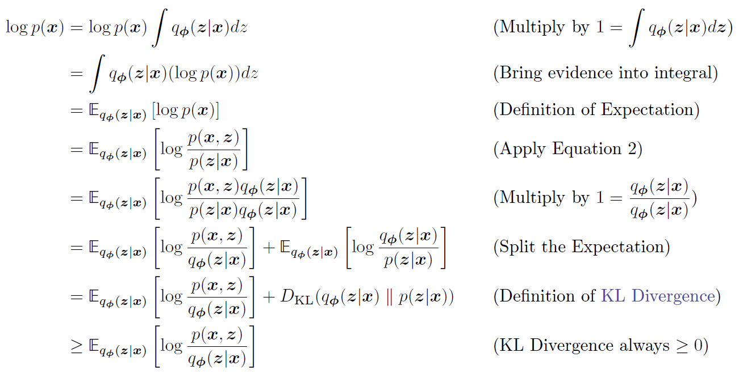
Since the ELBO and KL Divergence terms sum up to a constant, any maximization of the ELBO term with respect to necessarily invokes an equal minimization of the KL Divergence term. Thus, the ELBO can be maximized as a proxy for learning how to perfectly model the true latent posterior distribution; the more we optimize the ELBO, the closer our approximate posterior gets to the true posterior.
CHECK

Slide 6
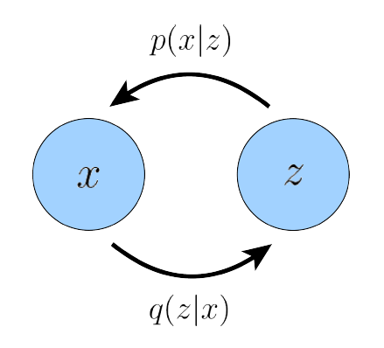
Variational Autoencoders
A Variational Autoencoder graphically represented. Here, encoder q(zjx) defines a distribution over latent variables z for observations x, and p(xjz) decodes latent variables into observations.
In the default formulation of the Variational Autoencoder (VAE), we directly maximize the ELBO. This approach is variational, because we optimize for the best q(z|x) amongst a family of potential posterior distributions parameterized by . It is called an autoencoder because it is reminiscent of a traditional autoencoder model, where input data is trained to predict itself after undergoing an intermediate bottleneck.

Slide 7
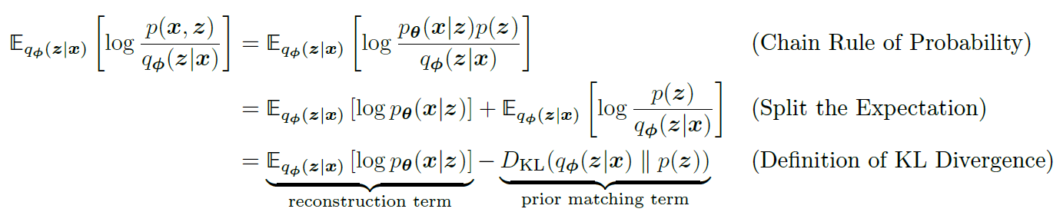
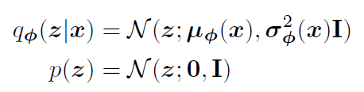
We learn an intermediate bottlenecking distribution q(z|x) that can be treated as an encoder; it transforms inputs into a distribution over possible latents. Simultaneously, we learn a deterministic function p(x|z) to convert a given latent vector z into an observation x, which can be interpreted as a decoder.
The first term measures the reconstruction likelihood of the decoder from our variational distribution; this ensures that the learned distribution is modeling effective latents that the original data can be regenerated from. The second term measures how similar the learned variational distribution is to a prior belief held over latent variables. Maximizing the ELBO is thus equivalent to maximizing its first term and minimizing its second term.
A defining feature of the VAE is how the ELBO is optimized jointly over parameters and . The encoder of the VAE is commonly chosen to model a multivariate Gaussian with diagonal covariance, and the prior is often selected to be a standard multivariate Gaussian.

Slide 8
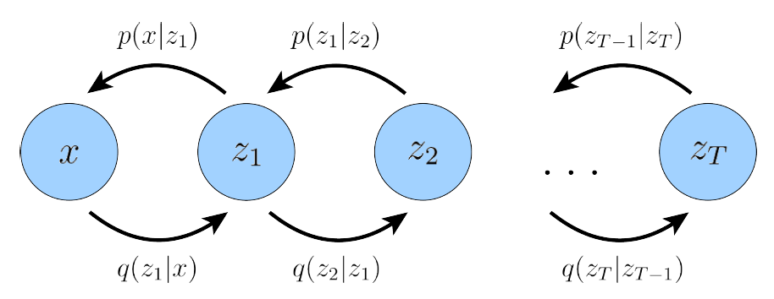
Hierarchical Variational Autoencoders
A Hierarchical Variational Autoencoder (HVAE) is a generalization of a VAE that extends to multiple hierarchies over latent variables. Under this formulation, latent variables themselves are interpreted as generated from other higher-level, more abstract latents.
In the general HVAE with T hierarchical levels, each latent is allowed to condition on all previous latents, in this work we focus on a special case which we call a Markovian HVAE (MHVAE). In a MHVAE, the generative process is a Markov chain; that is, each transition down the hierarchy is Markovian, where decoding each latent zt only conditions on previous latent zt+1. Intuitively, and visually, this can be seen as simply stacking VAEs on top of each other.

Slide 9
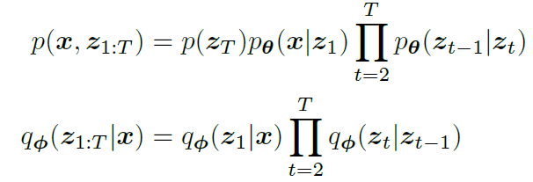
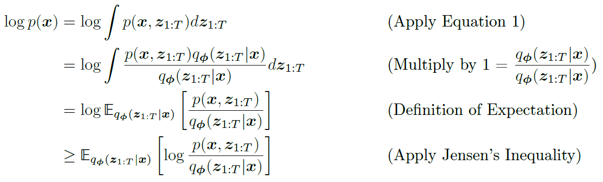
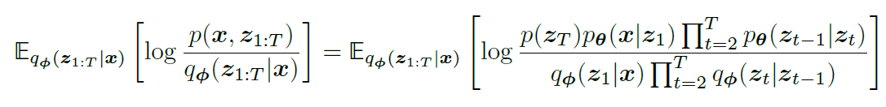
Mathematically, we represent the joint distribution and the posterior of a Markovian HVAE as:
We can easily extend the ELBO to be:

Slide 10
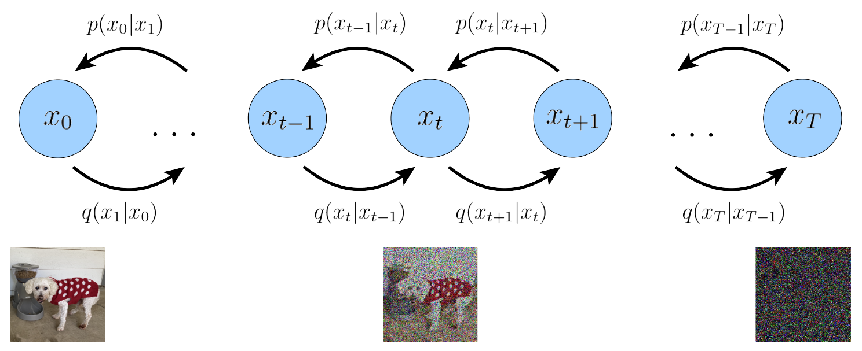
Variational Diffusion Models
The easiest way to think of a Variational Diffusion Model (VDM) is simply as a Markovian Hierarchical Variational Autoencoder with three key restrictions:
The latent dimension is exactly equal to the data dimension
The structure of the latent encoder at each timestep is not learned; it is pre-defined as a linear Gaussian model. In other words, it is a Gaussian distribution centered around the output of the previous timestep
The Gaussian parameters of the latent encoders vary over time in such a way that the distribution of the latent at final timestep T is a standard Gaussian

Slide 11
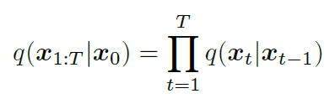

From the first restriction, with some abuse of notation, we can now represent both true data samples and latent variables as xt, where t = 0 represents true data samples and t 2 [1; T] represents a corresponding latent with hierarchy indexed by t. The VDM posterior is the same as the MHVAE posterior, but can now be rewritten as:
From the second assumption, we know that the distribution of each latent variable in the encoder is a Gaussian centered around its previous hierarchical latent. Unlike a Markovian HVAE, the structure of the encoder at each timestep t is not learned; it is fixed as a linear Gaussian model, where the mean and standard deviation can be set beforehand as hyperparameters [5], or learned as parameters [6]. We parameterize the Gaussian encoder with mean t(xt) = P txt􀀀1, and variance t(xt) = (1 􀀀 t)I, where the form of the coefficients are chosen such that the variance of the latent variables stay at a similar scale; in other words, the encoding process is variance-preserving. Note that alternate Gaussian parameterizations are allowed, and lead to similar derivations. The main takeaway is that t is a (potentially learnable) coefficient that can vary with the hierarchical depth t, for flexibility. Mathematically, encoder transitions are denoted as:

Slide 12
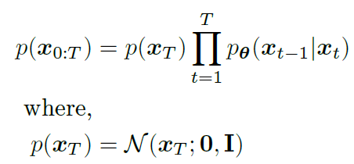
From the third assumption, we know that t evolves over time according to a fixed or learnable schedule structured such that the distribution of the final latent p(xT ) is a standard Gaussian. We can then update the joint distribution of a Markovian HVAE (Equation 23) to write the joint distribution for a VDM as:
Collectively, what this set of assumptions describes is a steady noisification of an image input over time; we progressively corrupt an image by adding Gaussian noise until eventually it becomes completely identical to pure Gaussian noise.
Our encoder distributions q(xtjxt􀀀1) are no longer parameterized by, as they are completely modeled as Gaussians with defined mean and variance parameters at each timestep. Therefore, in a VDM, we are only interested in learning conditionals p(xt􀀀1jxt), so that we can simulate new data. After optimizing the VDM, the sampling procedure is as simple as sampling Gaussian noise from p(xT ) and iteratively running the denoising transitions p(xt􀀀1jxt) for T steps to generate a novel x0.

Slide 13

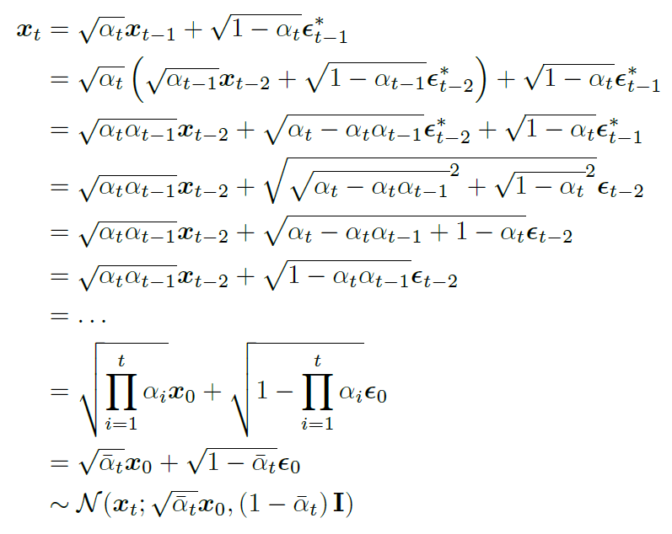
Denoising
By Bayes rule, we have:
Samples xt q(xtjxt􀀀1) can be rewritten as:

Slide 14
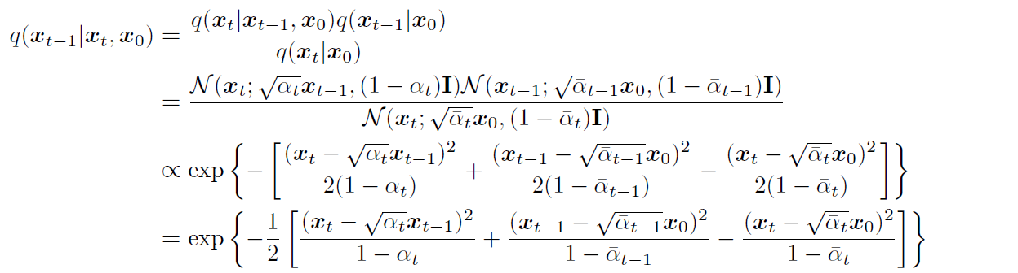
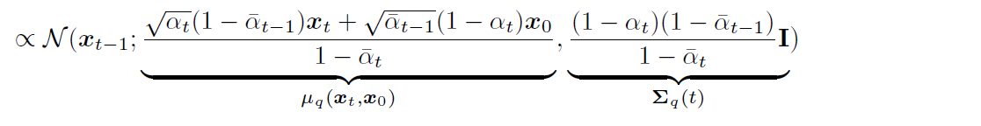
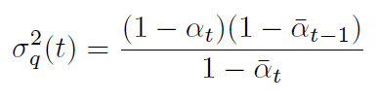
We can proceed to calculate the form of q(xt􀀀1jxt; x0) by substituting into the Bayes rule expansion:
We have therefore shown that at each step, xt􀀀1 q(xt􀀀1jxt; x0) is normally distributed, with mean q(xt; x0) that is a function of xt and x0, and variance q(t) as a function of coefficients. These coefficients are known and fixed at each timestep; they are either set permanently when modeled as hyperparameters, or treated as the current inference output of a network that seeks to model them. Following Equation 84, we can rewrite our variance equation as q(t) = 2 q (t)I, where:

Slide 15
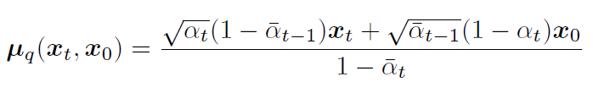
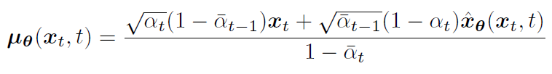
3 Ways for Denoising
1. In order to match approximate denoising transition step p(xt􀀀1jxt) to ground-truth denoising transition step q(xt􀀀1jxt; x0) as closely as possible, we can also model it as a Gaussian. Furthermore, as all terms are known to be frozen at each timestep, we can immediately construct the variance of the approximate denoising transition step to also be q(t) = 2 q (t)I. We must parameterize its mean (xt; t) as a function of xt, however, since p(xt􀀀1jxt) does not condition on x0.
We want to optimize a (xt; t) that matches q(xt; x0):
As (xt; t) also conditions on xt, we can match q(xt; x0) closely by setting it to the following form:
Where ^x(xt; t) is parameterized by a neural network that seeks to predict x0 from noisy image xt and time index t.

Slide 16

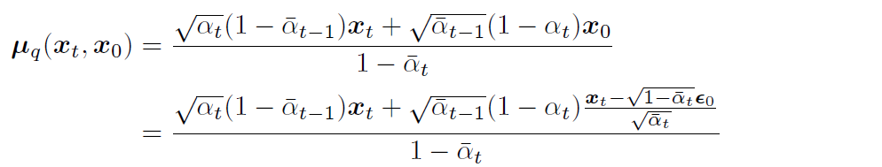
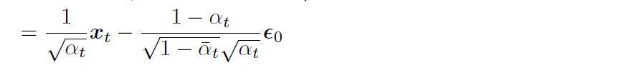
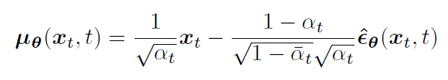
2. We can utilize the reparameterization trick:
Plugging this into our previously derived true denoising transition mean:
Therefore, we can set our approximate denoising transition mean (xt; t) as:
This method works the best

Slide 17


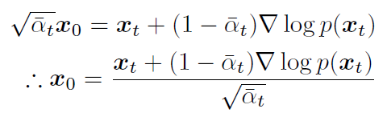
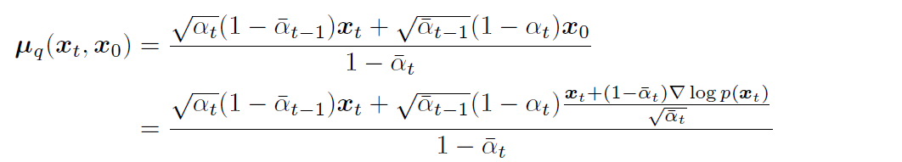

3. Tweedie’s Formula states that the true mean of an exponential family distribution, given samples drawn from it, can be estimated by the maximum likelihood estimate of the samples (aka empirical mean) plus some correction term involving the score of the estimate.
Mathematically, for a Gaussian variable z N(z;z;z), Tweedie’s Formula states that:
We apply it to predict the true posterior mean of xt given its samples by Tweedie’s Formula:
Therefore, we get:
We can plug Equation 133 into our ground-truth denoising transition mean q(xt; x0) once again and derive a new form:

Slide 18
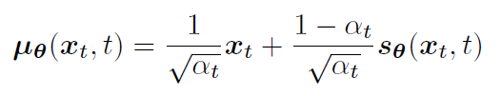

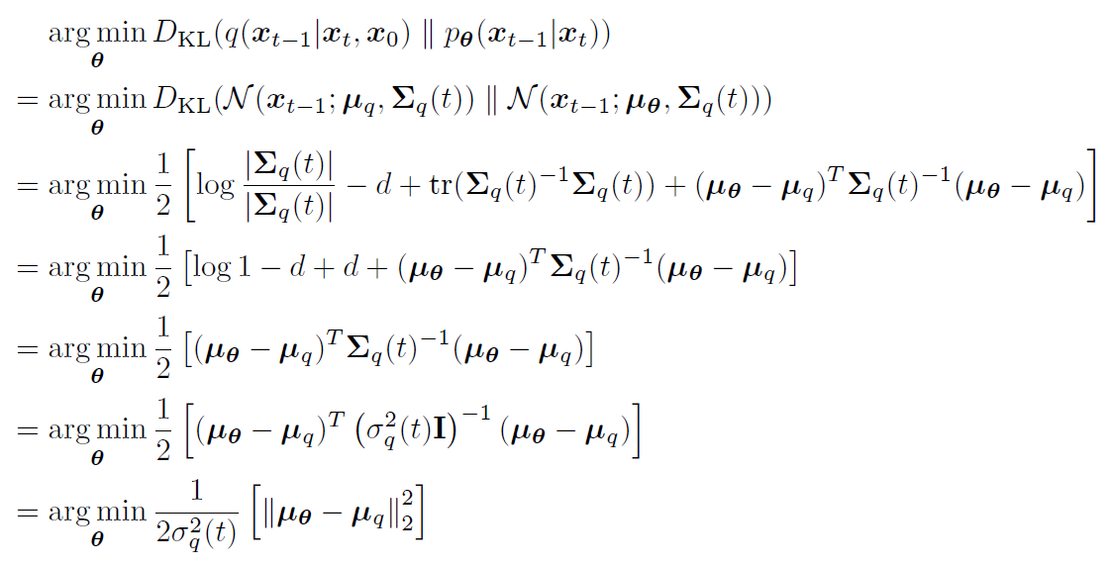
Therefore, we can also set our approximate denoising transition mean (xt; t) as:
Here, s(xt; t) is a neural network that learns to predict the score function rxt log p(xt), which is the gradient of xt in data space, for any arbitrary noise level t.
For all 3 ways, Maximizing the ELBO is majorly contributed by minimizing the following term, a modification of which can be used as a cost function for training the neural networks:
In our case, where we can set the variances of the two Gaussians to match exactly, optimizing the KL Divergence term reduces to minimizing the difference between the means of the two distributions:

Slide 19


We have focused on modeling just the data distribution p(x). However, we are often also interested in learning conditional distribution p(x|y), which would enable us to explicitly control the data we generate through conditioning information y.
A natural way to add conditioning information is simply alongside the timestep information, at each iteration.
Then, to turn this into a conditional diffusion model, we can simply add arbitrary conditioning information y at each transition step as:
For example, y could be a text encoding in image-text generation, or a low-resolution image to perform super-resolution on. We are thus able to learn the core neural networks of a VDM as before, by predicting
for each desired interpretation and implementation.

Slide 20
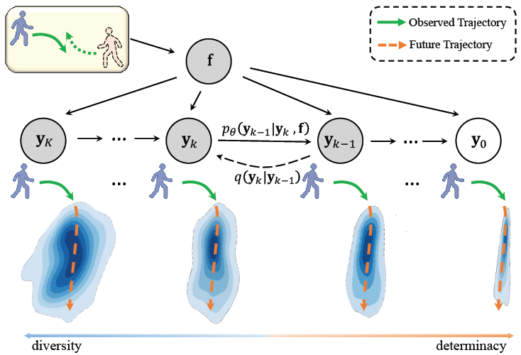
Trajectory Prediction

Slide 21
We consider the future positions as particles in thermodynamics in our framework.
The particles (positions) gather and deform to a clear trajectory under low indeterminacy, while stochastically spread over all walkable areas under high indeterminacy. The process of particles evolving from low indeterminacy to high indeterminacy is defined as the diffusion process.
Conditioned on the observed trajectories.
By choosing different lengths of the chain, we can obtain the predictions with a flexible indeterminacy that is capable of adapting to dynamic environment. Moreover, our method is more efficient to train than GANs, and is capable of producing more high-quality samples than CVAEs.
Wncode the history human trajectories and the social interactions as state embedding via a spatial-temporal graph network. Then, we exploit this state embedding as condition in the Markov chain to guide the learning of reverse diffusion process.
We optimize the model with the variational lower bound, and during the inference, we sample the reasonable trajectories by progressive denoising from a noise distribution

Slide 22
