Slide 1

A TECHNICAL APPROACH TO DETECT AGGRESSIVE BEHAVIOUR ON SOCIAL MEDIA WEBSITES THROUGH MACHINE LEARNING
DEPARTMENT
OF
COMPUTER AND SCIENCE ENGINEERING
SRINIVASA INSTITUTE OF TECHNOLOGY AND SCIENCE
Submitted by
N.Amrutha Varsha
(199h1d5805)
Under the Esteemed Guidance of
S.Ramesh babu(associate professor) m.tech

Slide 2
CONTENTS
ABSTRACT
INTRODUCTION
EXISTING SYSTEM
DISADVANTAGES
PROPOSED SYSTEM
ADVANTAGES
SYSTEM REQUIREMENTS
SYSTEM ARCHITECTURE
MODULE
UML DIAGRAMS
TESTING AND TESTCASES
SCREENSHOTS
CONCLUSION
FUTURE ENHANCEMENT
REFERENCES

Slide 3
Abstract
Social technologies have created a revolution in user-generated information and online human networks.
Cascading of sensitive information that is private contents and rumors is a severe issue in social networks.
One approach for limiting the sensitive information constraining the diffusion among social network users.

Slide 4
Introduction
Social media, which enable people to interact with each other by creating and sharing information.
Users of social media services create a huge amount of information.
Such user-generated content is the lifeblood of social media.

Slide 5
Existing System
Current Systems does not provides controlling of Cyber bullying as no filters available.
Cyber bullying detection can be formulated as a supervised problem but which cannot control all bullying.
Profile information ,developed a gender-based approach for Cyber bullying prediction by using datasets.

Slide 6
Disadvantages
The System is not much affective due to Semi Supervised machine learning techniques.
The system doesn’t have sentiment classification for Cyber bullying.

Slide 7
Proposed System
Proposed system is constructing cyber bullying prediction models.
Supervised and Semi Supervised are Provided.
Effective Cyber bullying prediction is to have a set of features that are extracted and engineered.

Slide 8
Advantages
The system is more effective classification and Unsupervised machine learning.
A model that involves computing orientation for a document from the semantic orientation of words.

Slide 9
Hardware Requirements
Processor : Pentium IV 2.4 GHz or More
Hard Disk : 40 GB(min)
RAM : 2 GB(min)

Slide 10
Software Requirements
Operating System : Windows Family
Programming : JDK
Server : Tomcat
Database : MySQL

Slide 11
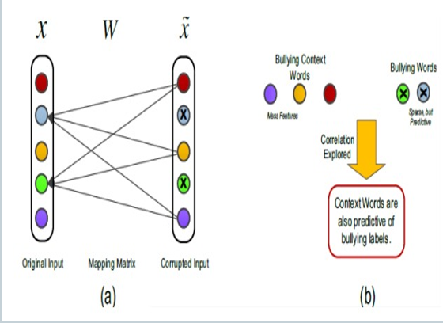
SYSTEM ARCHITCTURE

Slide 12
MODULES
ADMIN MODULE
USER MODULE

Slide 13
ADMIN MODULE
Admin
Viewing and authorizing users
View all post
Detect cyber bullying users
Find cyber bullying reviews chart

Slide 14
USER MODULE
In this module there are n number of users are present.
Registration
Successful registration

Slide 15
POST CONTROLLING
In this module, the user can see their own profile details.
Add posts
View on comment on your friends post.

Slide 16
UML Diagrams

Slide 17
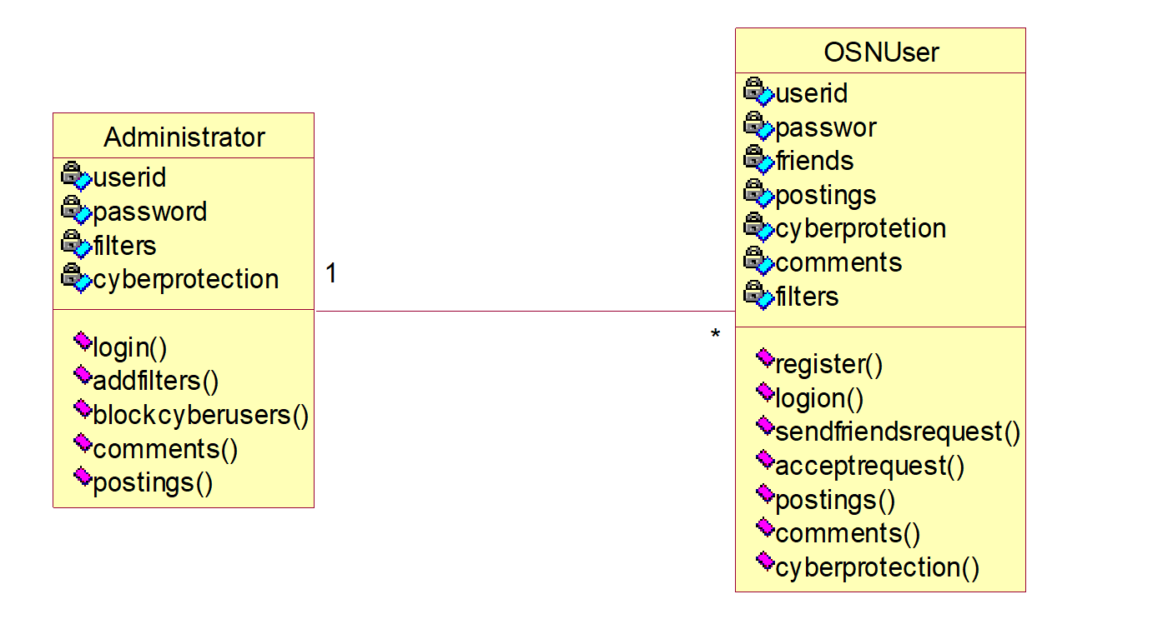
Class diagram

Slide 18
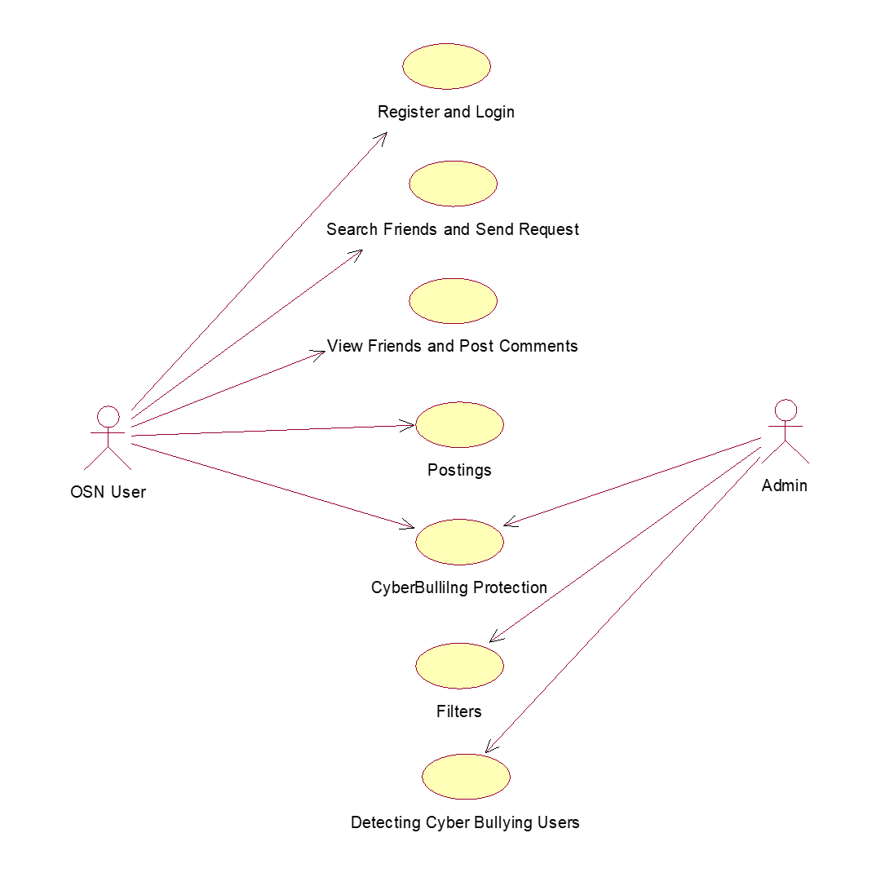
Use Case Diagram

Slide 19
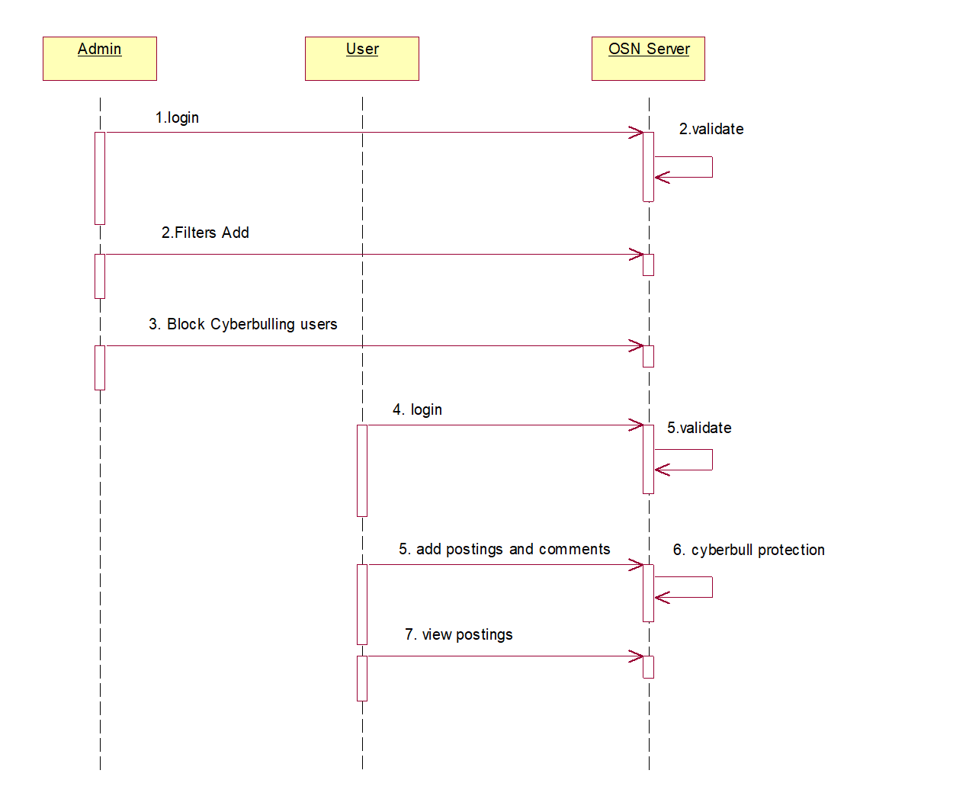
Sequence Diagram

Slide 20
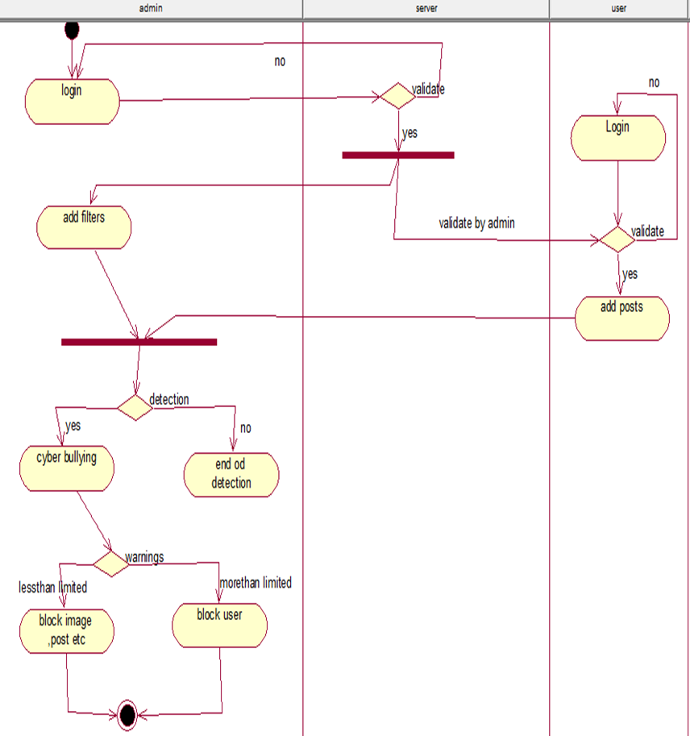
Activity Diagram

Slide 21
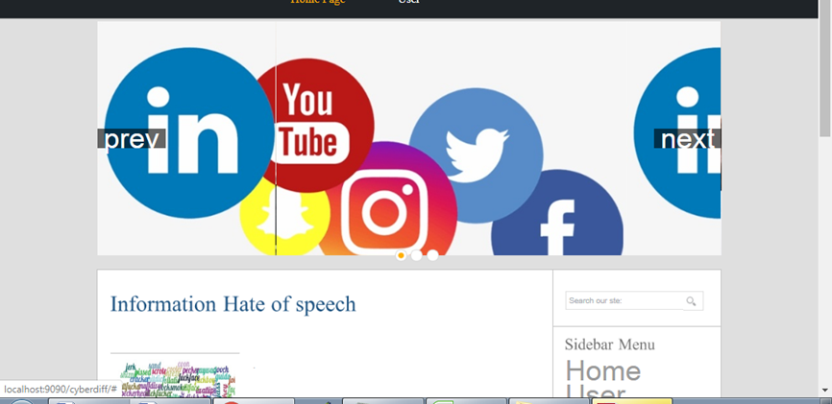
Screenshots

Slide 22
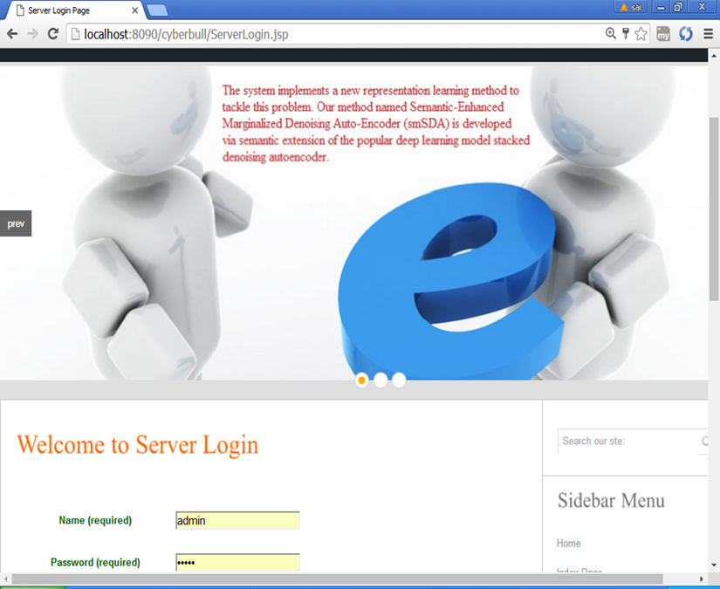

Slide 23
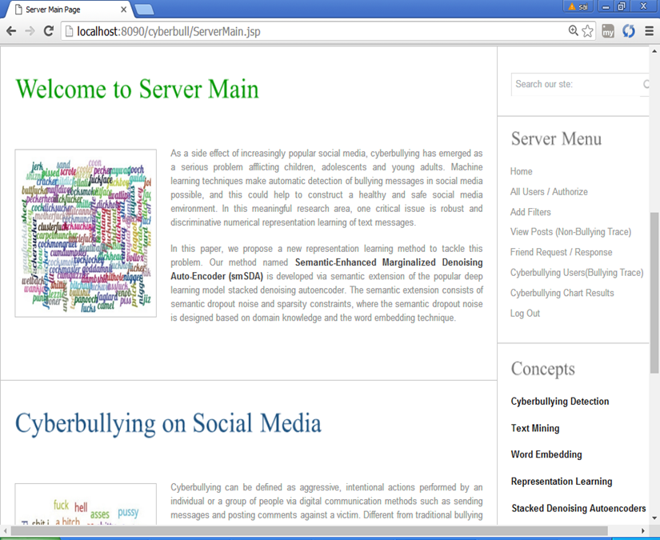

Slide 24
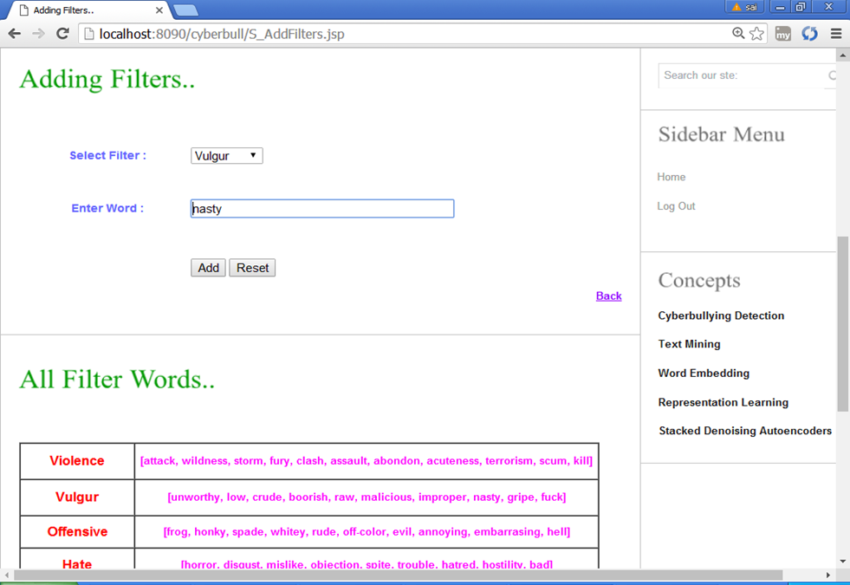

Slide 25
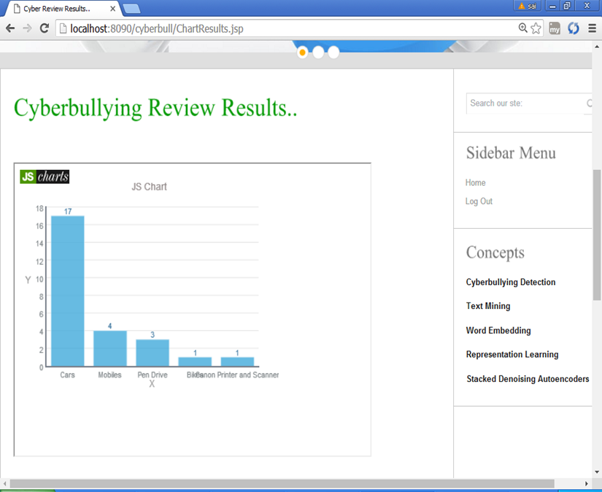

Slide 26
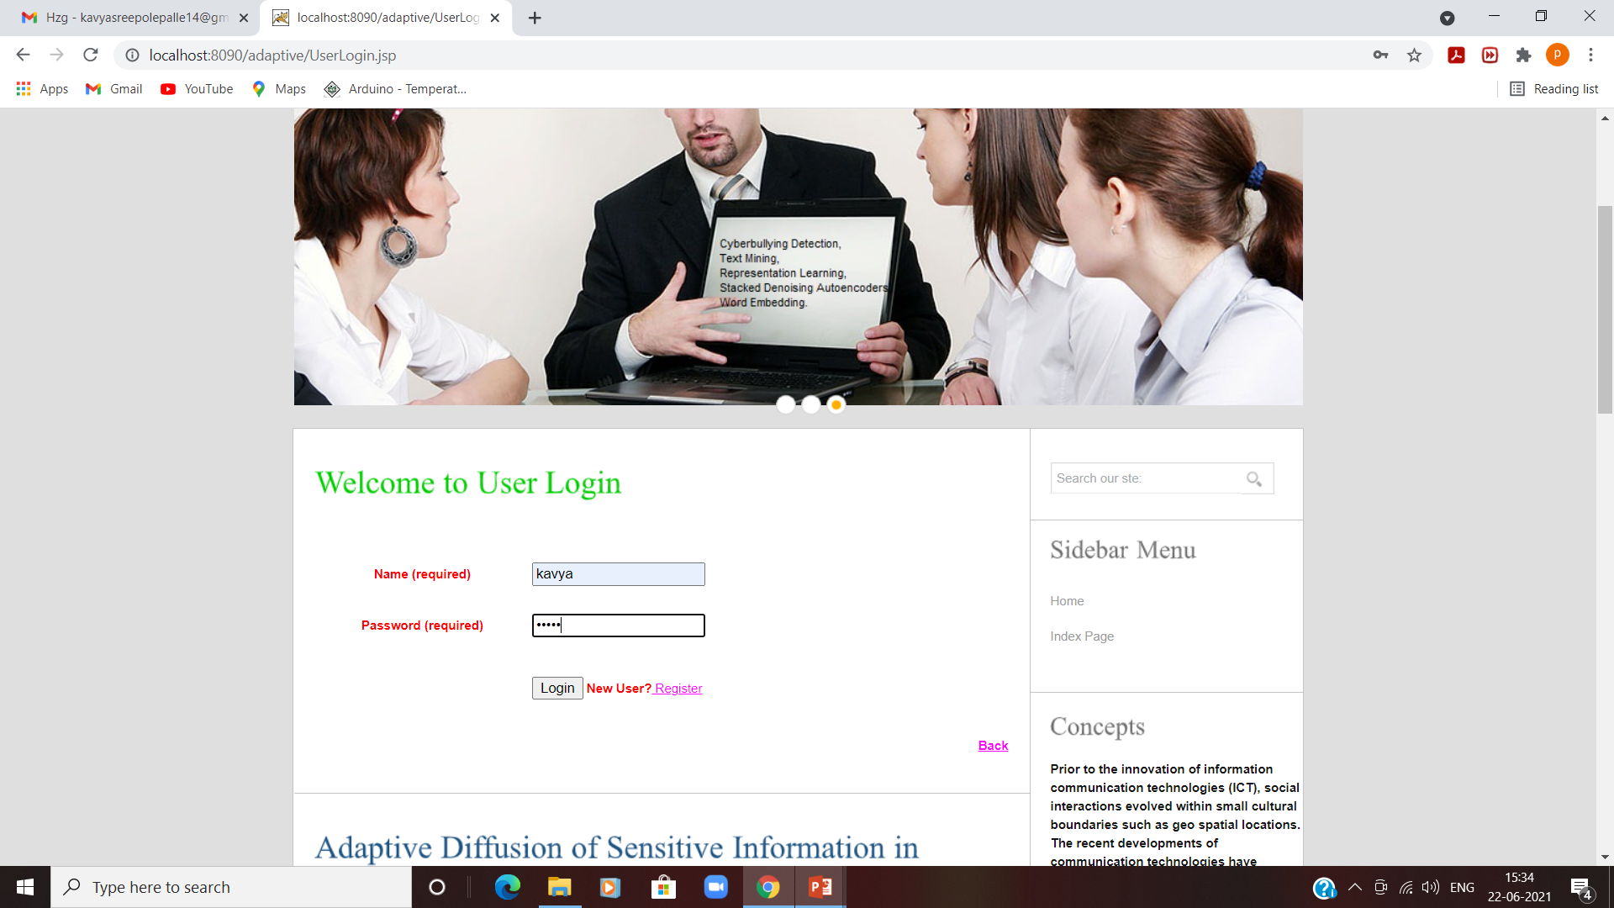

Slide 27
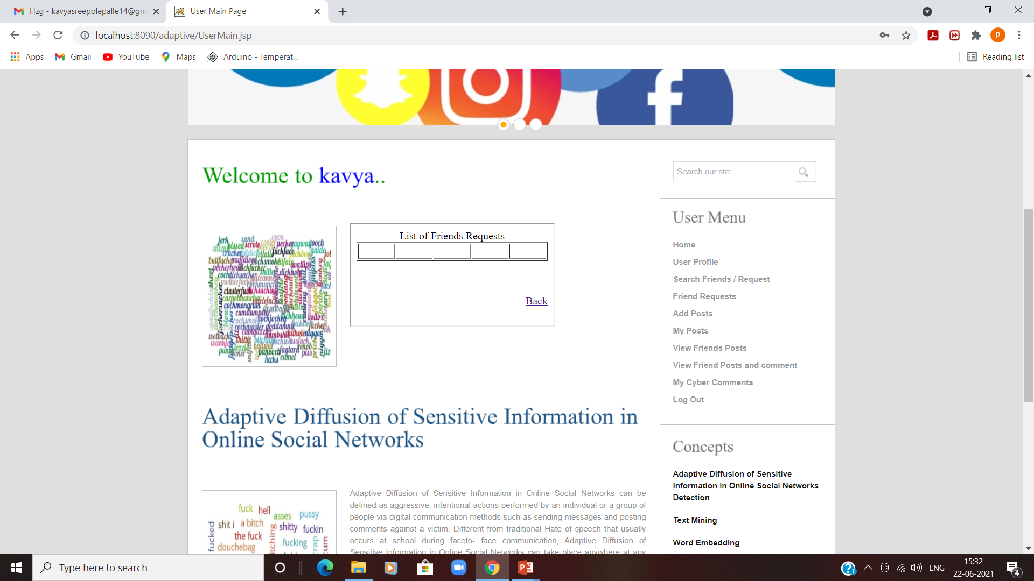

Slide 28
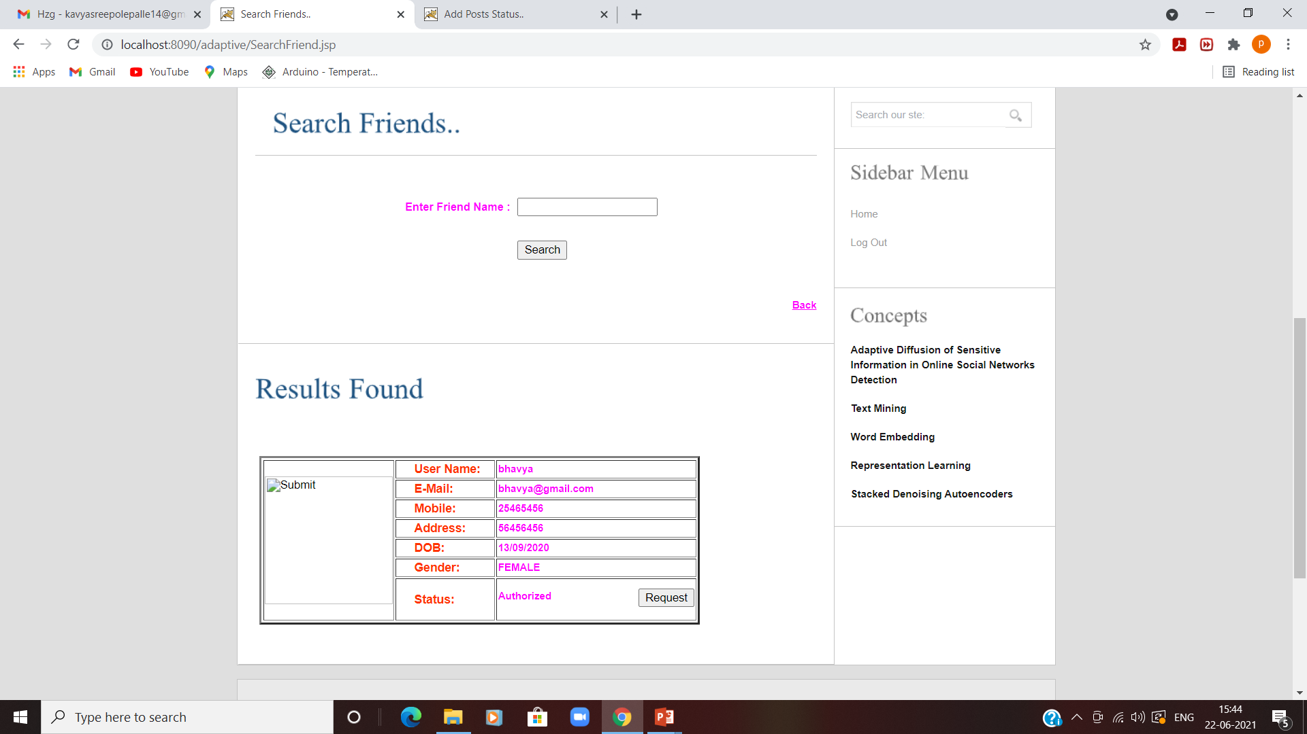

Slide 29
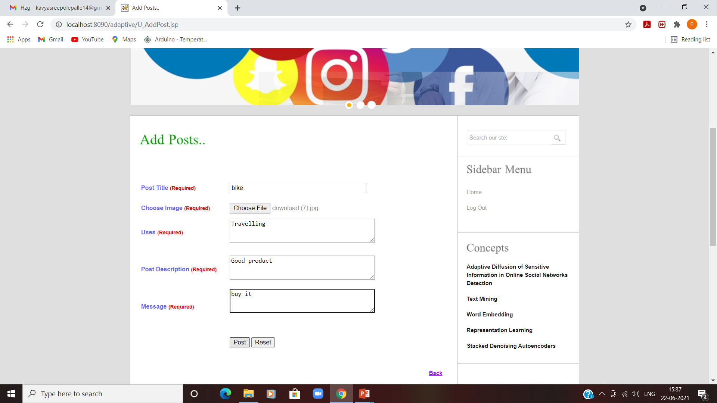

Slide 30
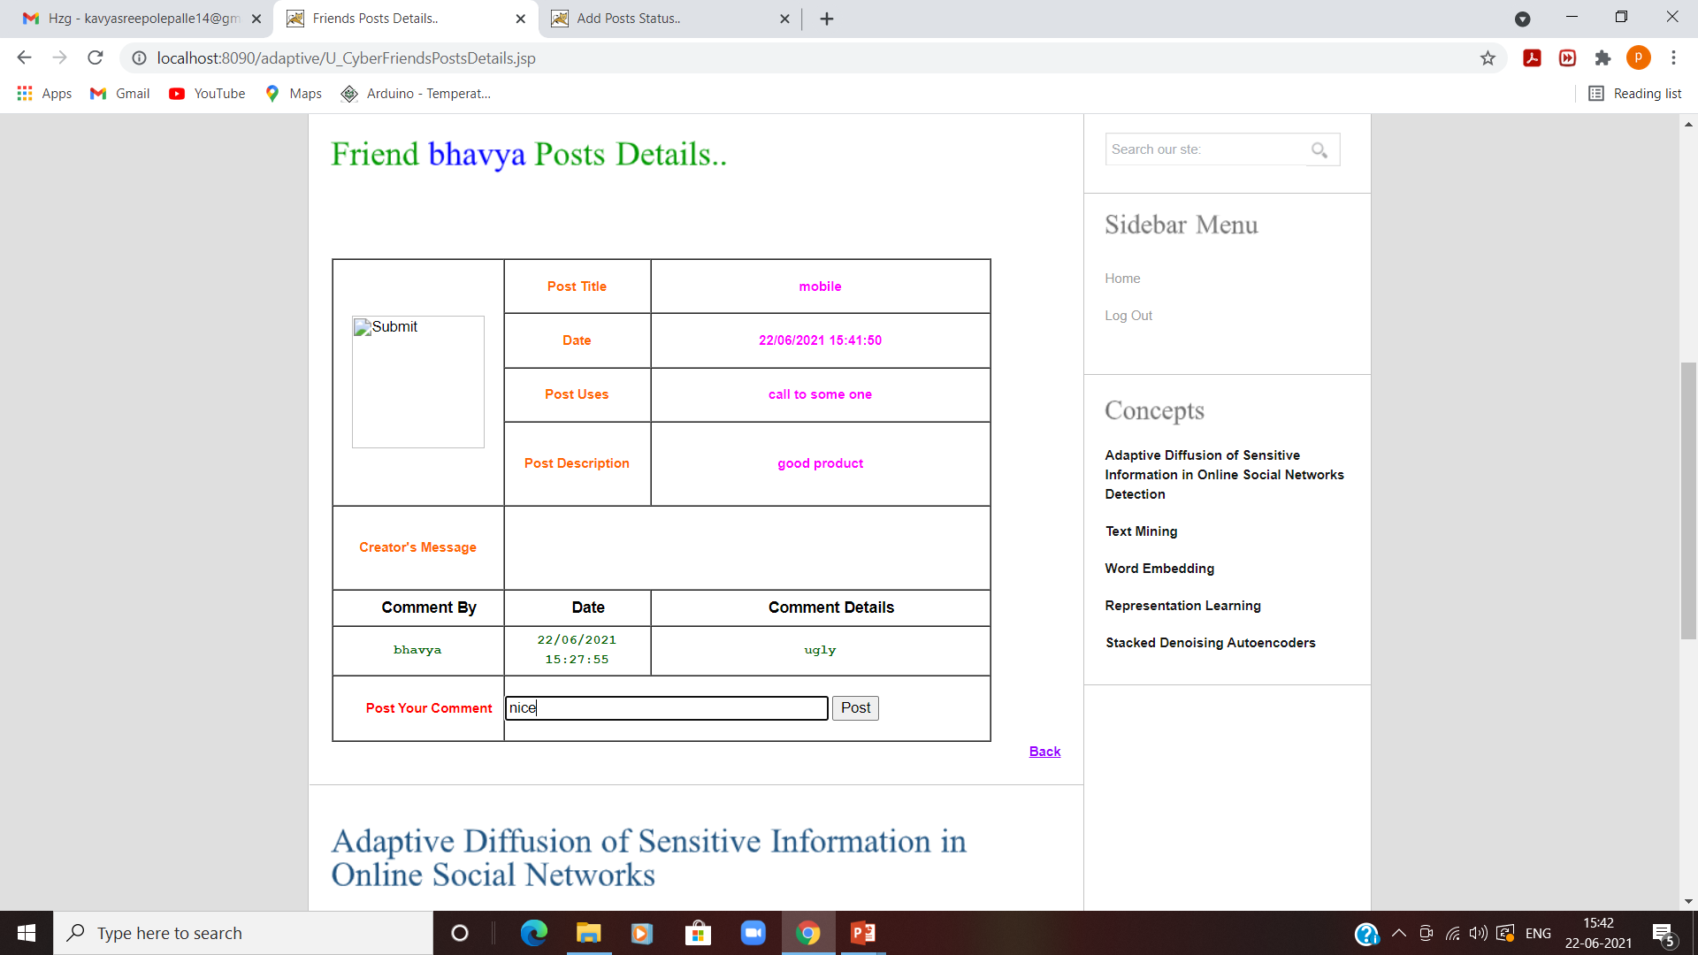

Slide 31
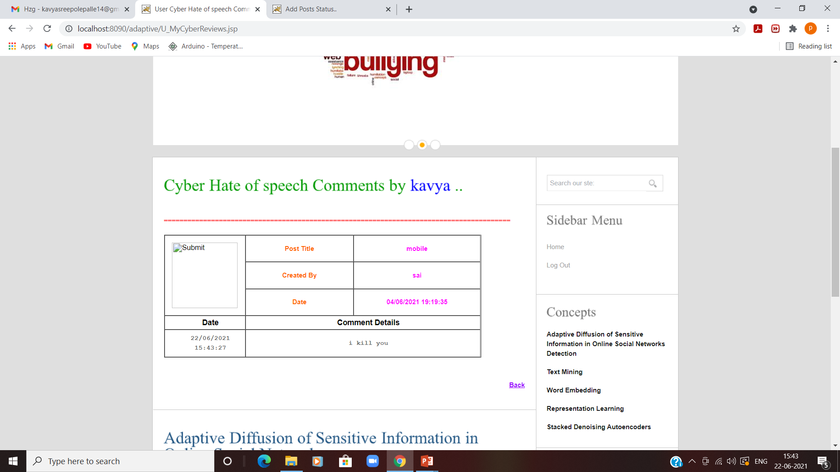

Slide 32
Conclusion
This study reviewed existing literature to detect aggressive behavior on SM websites.
Specially reviewed four aspects of detecting cyberbullying messages.
Several types of discriminative features that were used to detect cyberbullying in SM were also summarized.

Slide 33
Future enhancement
As future Scope of project to be extended for detecting cyber bullying for all languages and Images.
Finally, the main issues and open research challenges were described and discussed.

Slide 34
references
[1] V. Subrahmanian and S. Kumar, ``Predicting human behavior: The next frontiers,'' Science, vol. 355, no. 6324, p. 489, 2017.
[2] H. Lauw, J. C. Shafer, R. Agrawal, and A. Ntoulas, ``Homophily in the digital world: A LiveJournal case study,'' IEEE Internet Comput., vol. 14, no. 2, pp. 1523, Mar./Apr. 2010.
[3] M. A. Al-Garad, K. D. Varathan, and S. D. Ravana, ``Cybercrime detection in online communications: The experimental case of cyberbullying detection in the Twitter network,'' Comput. Hum. Behav., vol. 63, pp. 433443, Oct. 2016.

Slide 35
THANK you

