Slide 1
Soil Monitoring for Improved Crop Yield
Team Name: Farmtech Visioneries
Team Members:
K. L Prasanna (22BQ1A4925)
T. Manasa (22BQ1A4944)
P. Priyanka (23BQ5A4902)

Slide 2
Why Soil Monitoring
Improves Crop Yield: Tracks moisture and temperature to ensure ideal conditions.
Saves water: Helps avoid overwatering by showing real-time soil humidity.
Increases Yield: Ensures plants get the right conditions for better productivity.
Supports Smart Farming: Enables automation using sensors and apps like Blynk.

Slide 3
Smart Solution
IOT based system using ESP-32
Measures soil moisture, temperature and humidity
The data will be sent to the Thingspeak cloud and stored in it
A dashboard is created using Blynk app
A html page is created for the parameters soil moisture, temperature and humidity

Slide 4
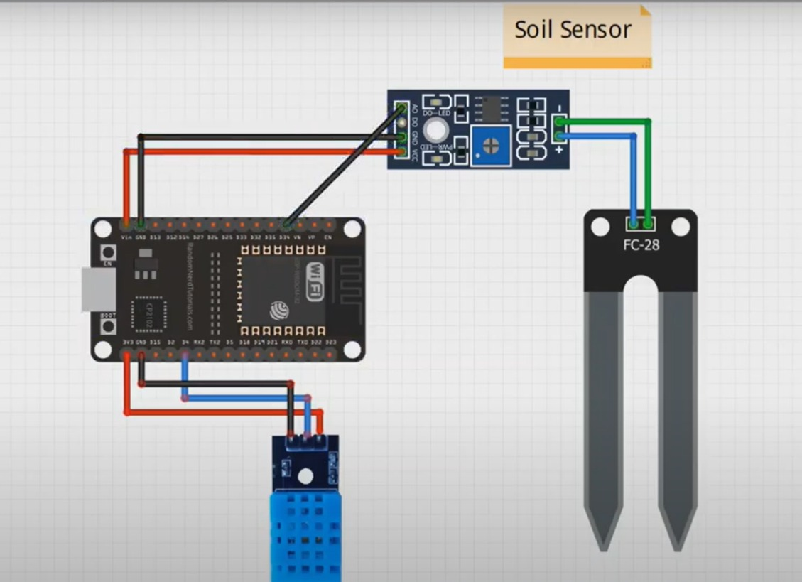
Components and Software used:
Components:
Esp-32 microcontroller
Soil moisture sensor
DHT-11 sensor
USB cable for power supply
Jumper wires
Software:
Arduino IDE
Thingspeak cloud
Blynk app
HTML, CSS

Slide 5
Overview of the system
ESP-32 reads the sensor values
Sends data to Thingspeak cloud
Blynk app dashboard displays the live data
A html page gives the data of the soil moisture, temperature and humidity

Slide 6
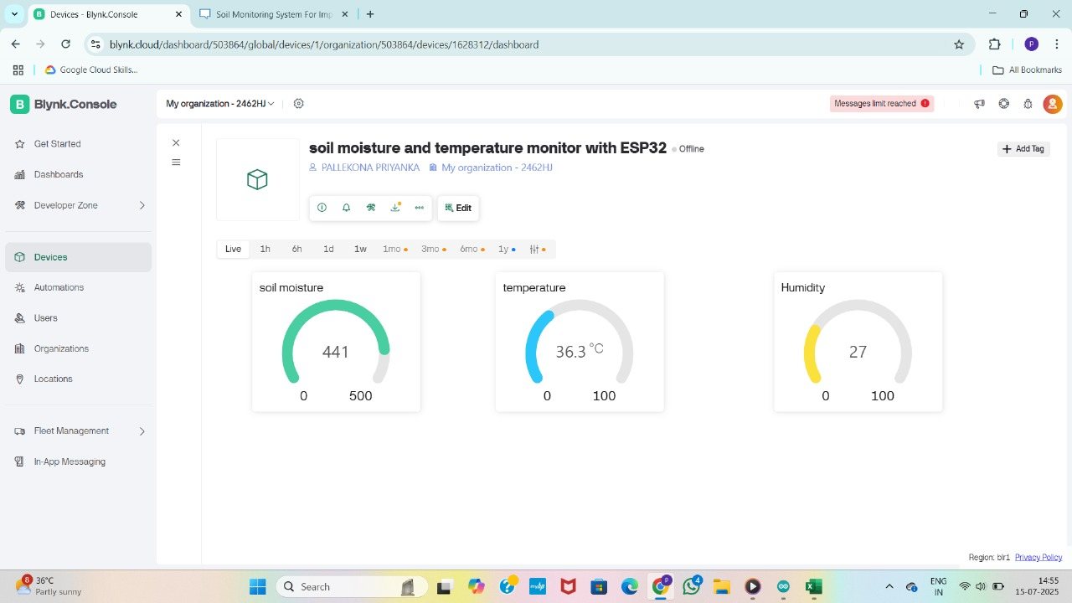
Blynk App:

Slide 7
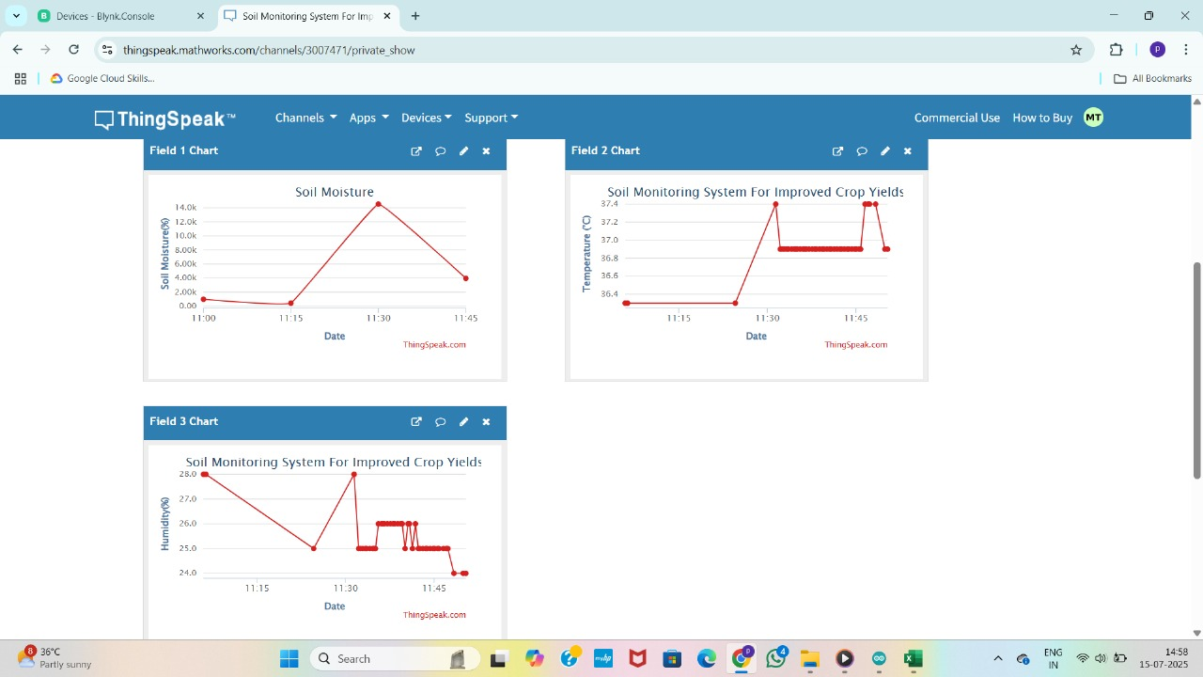
Thingspeak Cloud Integration:

Slide 8
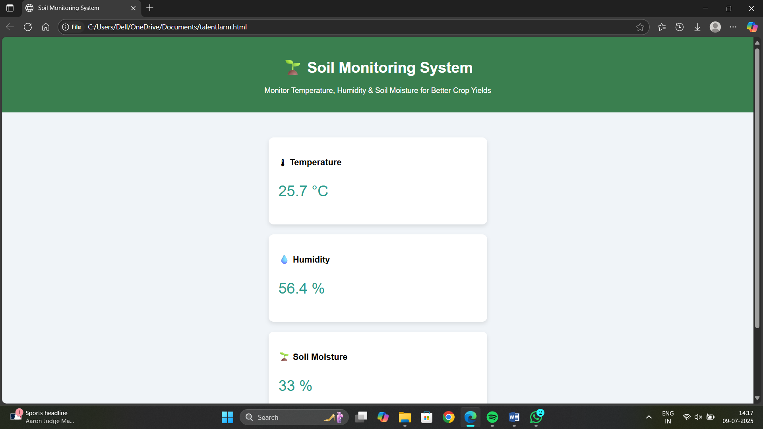
HTML Page:

Slide 9
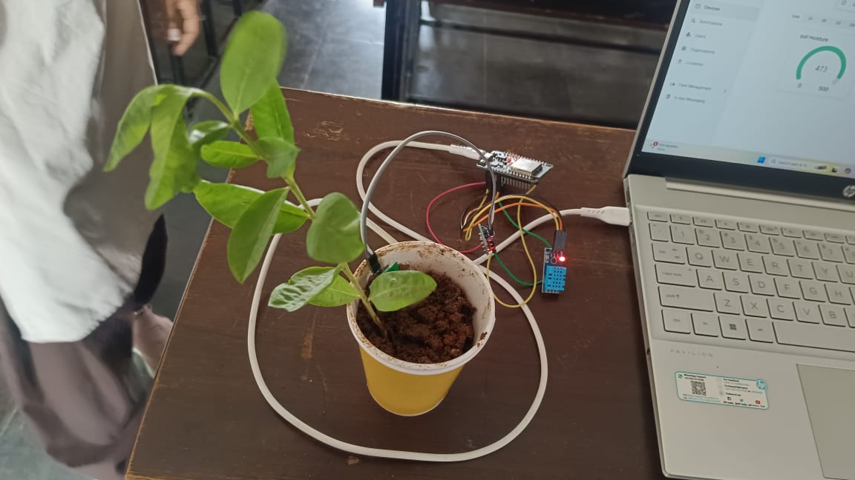
Real Time System:

Slide 10
Conclusion:
Developed a smart and affordable soil monitoring system using IOT.
Monitors soil moisture, temperature and humidity in real time.
Sends data to Thingspeak and displays it on a Blynk app
Helps optimize irrigation and supports better crop management.
Gained hands on experience with sensors, ESP32, cloud platforms and web development.
Shows how IOT can promote smart farming and sustainable agriculture.

