Slide 1


Efficient Strategies for Improving
Partitioning-Based Author Coreference by Incorporating Web Pages as Graph Nodes
Pallika Kanani
Andrew McCallum
Information Extraction & Synthesis Laboratory
Department of Computer Science
University of Massachusetts, Amherst
Contact: pallika@cs.umass.edu

Slide 2
This is a completely different approach to improving author coreference discussed in the previous talk
You just saw that it is a pretty hard problem,
So I’ll skip the examples!!

Slide 3
Resource Bounded Information Gathering
[Kanani, McCallum, Pal, IJCAI’07]
We just saw how we can use machine learning methods to solve author co-reference.
But Sometimes, there’s just not enough information available, about the entities.
How can we use information from the web to improve author co-reference?
Under resource constraints, can we query the web selectively, while maintaining improvement?

Slide 4
Six References Example
(A) …, H. Wang, … Background Initialization…, ICCV,…2005.
(B) …, H. Wang, … Tracking and Segmenting People…, ICIP, 2005.
(C) …, H. Wang, … Gaussian Background Modeling…, ICASSP, 2005.
(D) H. Wang and N. Ahuja, Facial Expression Decomposition, IEEE International Conference on Computer Vision (ICCV), 2003.
(E) …, H. Wang, … Tensor Approximation…, SIGGRAPH. 2005.
(F) …, H. Wang, … High Speed Machining…, ASME, (JMSE), 2005.

Slide 5
Machine Learning Model For Co-reference
(A)
(B)
Fully connected, weighted, undirected graph
Vertices: Citations
Edge weights: Probability that two citations are by same author.
Partitions: Citations by the same author.
This is also our baseline, as in the previous talk
(F)
(C)
(E)
(D)

Slide 6
Pairwise-Similarity Matrix
A B C D E F
A
B
C
D
E
F
Similarity between mentions E and F.
(Darker = more similar)
Dark Triangles aligned along the diagonals indicate one group
Where does D belong?
With A, B, C?
With E, F?
By itself?

Slide 7
Dataset Description
Corpus | Ambiguous Names (e.g. L. Lee) | Author Entities (e.g. Lillian Lee, Cornell) | Author Mentions (Citations) | Author MentionPairs (Citation Pairs)
DBLP | 17 | 97 | 841 | 37938
Rexa | 4 | 219 | 1302 | 145835
Penn | 7 | 93 | 1588 | 202283
Total | 32 | 409 | 3731 | 386056
e.g. 79 Different L. Lee’s!!
Total # of Pairwise Decisions !
Notes:
Three Hand Labeled Corpora, with around 30 ambiguous names, 400 real authors, 4,000 citations, and half a million citation pairs
Different datasets have different characteristics, like average number of citations by one author

Slide 8
All Pairs
Resource Bounded
1
3
Web
Feature
2
4
Web
Mention

Slide 9
All Pairs
Resource Bounded
3
Web
Feature
2
4
Web
Mention
Notes:
We’ll see how information obtained from the web can be used as an additional feature to calculate edge weights.

Slide 10

Use of Web : A Simple Query
“paper title D” “paper title E”

Slide 11
Use of Web - Method 1
(A)
(B)
(A)
(B)
(F)
(C)
(F)
(C)
(E)
(D)
(E)
(D)
Additional feature in the classifier:
Does the query return any web pages?

Slide 12
All Pairs
Resource Bounded
3
Web
Feature
4
Web
Mention

Slide 13
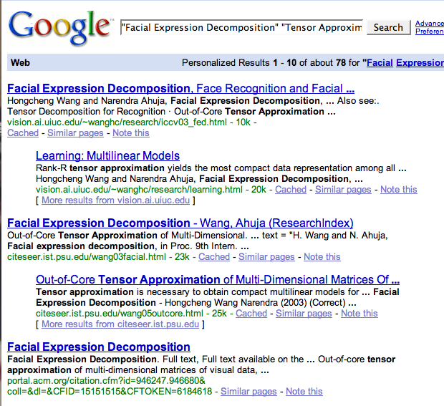
Use of Web - Method 2
(A)
(B)
(F)
(C)
(E)
(D)
Additional Nodes in the graph

Slide 14
Expanding the Graph
A B C D E F
1 2 3 4 5 6 7 8 9 10
A
B
C
D
E
F
C2C
C2W
W2W
1
2
3
4
5
6
7
8
9
10

Slide 15
Pairwise-Similarity Matrix
A B C D E F 1 2 3 4 5 6 7 8 9 10
A
B
C
D
E
F
1
2
3
4
5
6
7
8
9
10
Vertex 1 is
similar to D, E & F.
By transitivity, D is now more likely to belong to
E, F cluster.
For example, Web mention 1 might be
the Publication list of Hongcheng Wang
from UIUC

Slide 16
Pairwise-Similarity Matrix
A B C D E F 1 2 3 4 5 6 7 8 9 10
A
B
C
D
E
F
1
2
3
4
5
6
7
8
9
10
“Double transitivity”, through similarity between Web mentions.

Slide 17
Using the Web Helps : New Extensive Results
Corpus | Method | Precision | Recall | F1
DBLP | Baseline | 88.6 | 44.3 | 59.1
 | Google Feature | 92.5 | 68.9 | 79.0
 | Web Mention | 91.9 | 92.6 | 92.2
Rexa | Baseline | 84.7 | 97.4 | 90.6
 | Google Feature | 82.8 | 98.6 | 90.0
 | Web Mention | 84.2 | 96.4 | 89.9
Penn | Baseline | 98.7 | 14.4 | 25.2
 | Google Feature | 98.6 | 17.4 | 29.6
 | Web Mention | 95.6 | 22.0 | 35.8
Notes:
Large no. of negative examples..therefore F1

Slide 18
Resource-bounded information gathering (RBIG) from the web
Can we use Web information selectively and still achieve significant accuracy gain?

Slide 19
All Pairs
Resource Bounded
Web
Feature
4
Web
Mention

Slide 20
Expected Entropy Criterion
[Kanani, McCallum, Pal, IJCAI’07]
Measures how much the result of a single query affects the overall partitioning of the entire graph and reduces the uncertainty
Entropy is calculated over graph partitioning using several runs of stochastic graph partitioning algorithm. Expectation is taken over two possible results of the query
Notes:
We wish to order the query candidate, based on some criterion. The ee criterion measures how much the result of a single query affects the overall partitioning of the entire graph.
We calculate the entropy of the graph over graph partitioning by running a stochastic graph partitioner several times.
Refer to paper.

Slide 21
All Pairs
Resource Bounded
Web
Feature
Web
Mention
Main Focus of this paper

Slide 22
Resource-bounded Information Gathering
We ask the following questions:
How to efficiently select queries using information from the test data to gather additional mentions, so as to reduce querying cost?
How to efficiently select nodes obtained as a result of queries, so as to reduce computational cost?
How to combine the two approaches to get most performance gain with least investment of resources?

Slide 23
Resource-bounded Information Gathering
A B C D E F 1 2 3 4 5 6 7 8 9 10
A
B
C
D
E
F
1
2
3
4
5
6
7
8
9
10
?
We need to select a subset of the edges in the original graph for querying, so as to get most benefit
?
?

Slide 24
Resource-bounded Information Gathering
A B C D E F 1 2 3 4 5 6 7 8 9 10
A
B
C
D
E
F
1
2
3
4
5
6
7
8
9
10
?
We need to select a subset of the edges in the original graph for querying, so as to get most benefit
?
?
We also need to select a subset of the vertices to be added - selectively fill the entries in a potentially infinite matrix

Slide 25
Selecting Nodes : Using Set-cover
Web Pages : Set of citations
Set of citations by each author
Classic Set Cover : Given a Finite set U and a collection C = {S₁, S₂, …, S_{m}) of subsets of U. Find a minimum sized cover C’⊆C , such that every element of U is contained in at least one element of C’.
A Greedy approach provides an Ω(ln n) approximation to this NP-Complete problem
The goal is to “cover” most citations using least number of web pages, where “cover” is defined by some heuristic. Apply a modified greedy approach
Selected Nodes

Slide 26
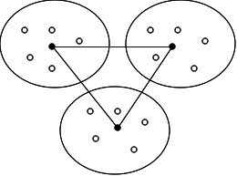
Selecting Queries: Inter-cluster Queries
Start with some initial partitioning.
Pick “centroids” as the nodes that are most tightly connected to other members of its cluster. Select the queries that connect the centroids.
Helps Bring together clusters that should not have been split.

Slide 27
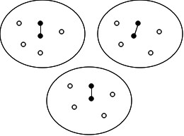
Selecting Queries : Intra-cluster Queries
Start with some initial partitioning.
Select edges between two strongly connected nodes.
Helps find additional information about a currently hypothesized entity.
More likely to find relevant information, eg, home page

Slide 28
Results
Corpus | WebMen | SetCover | InterClust | IntraClust
DBLP | 180 | 53 | 16 | 84
Rexa | 438 | 99 | 2 | 45
Penn | 601 | 195 | 240 | 335
Total | 1219 | 347 | 258 | 464
No. of documents gathered by different methods
Intra-cluster queries return more web pages than inter-cluster queries.
Set-cover helps retain most of the performance gain with fewer mentions
Performance depends on data characteristics
Notes:
Why are we comparing the results for the number of web pages

Slide 29
Hybrid Approach and Results
Use intra-cluster approach to select a subset of the queries and gather additional web documents
Apply set-cover method to select a subset of the returned documents
74% of the total improvement using only
18% of all web mentions

Slide 30
Theoretical Issues
[Kanani, McCallum, COLT’07 Open Problem]
Consider abstracting away from the web domain and generalize this problem of resource bounded information gathering.
Gives rise to interesting theoretic issues!
Recent interest in Correlational clustering
We present a new class of problem:
Resource Bounded Information Gathering under graph partitioning

Slide 31
Conclusions
Using information obtained from the web can help improve pair-wise F1 for author coreference task.
We present two different methods for incorporating web information : As an additional feature to alter the edge weights and as additional node in the graph
Proposed methods help reduce the cost of making queries, as well as cost of processing and incorporating additional nodes, yet retaining most of the performance improvement.
Hybrid selection criteria can be designed by doing appropriate cost-benefit analysis

Slide 32
Thank You!

Slide 33
Extra Slides

Slide 34
Related Work
Error bounds for correlation clustering
Learning and inference under constraints
  Resource-bounded reasoning
  Value of information
  Budgeted learning
  Active learning
Property testing of graphs
Semi-supervised learning
Sensitivity analysis

Slide 35
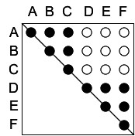
Pairwise-Similarity Matrix
Result of Query Q1
A B C D E F
A
B
C
D
E
F
Q1
Where does D belong?
Less noisy edge weights
With A, B, C?
With E, F?
By itself?

Slide 36
Given two similar person names, are they referring to the
same person or not?
Let’s examine this in citations data

Slide 37
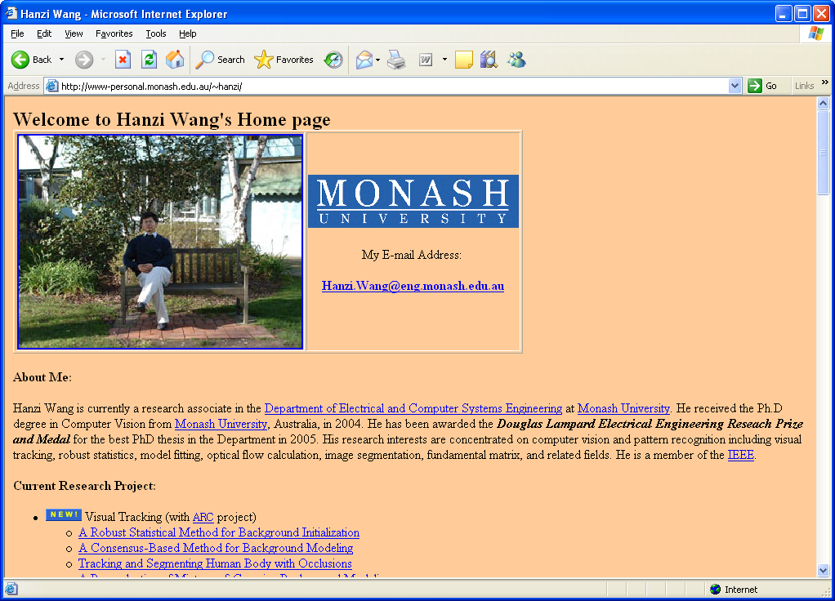
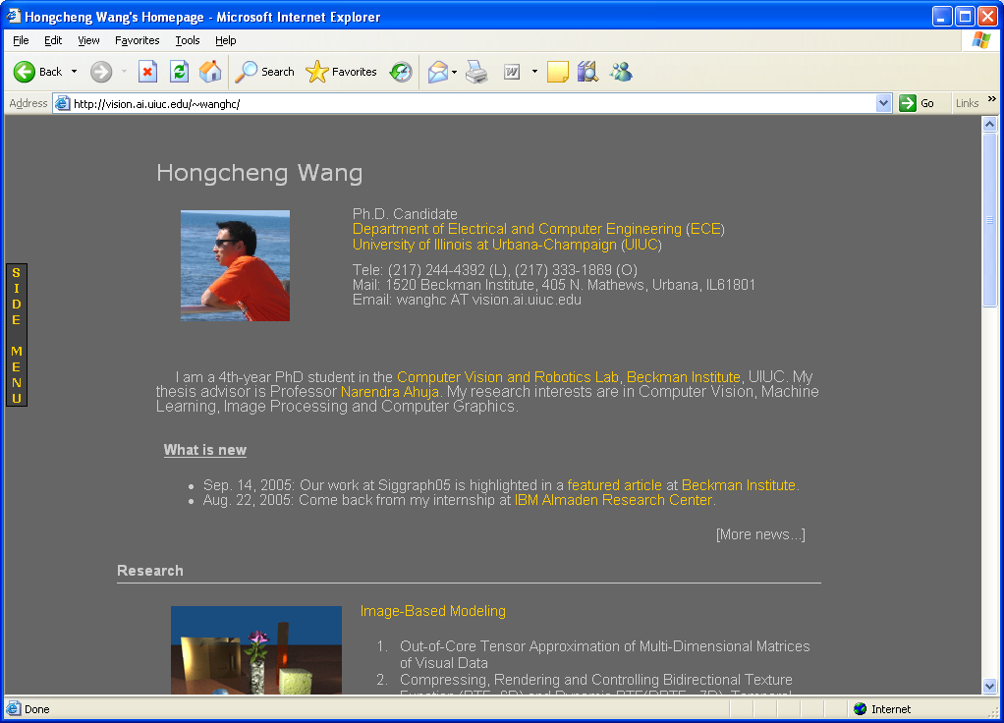
Q: Did one H. Wang have two papers at ICCV?
H. Wang and D. Suter. Variable Bandwidth QMDPE and Its Application in Robust Optic Flow Estimation. 9th IEEE International Conference on Computer Vision (ICCV), Nice, France, pages 178-183, October 2003.
H. Wang and N. Ahuja, Facial Expression Decomposition, IEEE International Conference on Computer Vision (ICCV), 2003.
H. Wang, Computer Vision,
Monash Univ.
H. Wang, Computer Vision,
UIUC

Slide 38
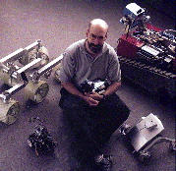

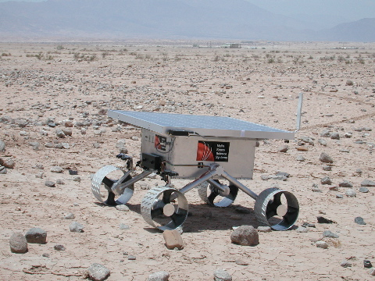
Q: Are these papers written by the same D. Miller?
T. Dean, R.J. Firby and D.P. Miller, Hierarchical Planning with Deadlines and Resources
Readings in Planning, pp. 369-388, Allen, Hendler, & Tate eds., Morgan Kaufman, 1990.
D.P. Miller and C. Winton. Botball Kit for Teaching Engineering Computing. In Proceedings of the ASEE National Conference. Salt Lake City, UT. June 2004.
A. Winterholler, M. Roman, T. Hunt, and D.P. Miller. Design Of A High-Mobility Low-Weight Lunar Rover.
Proceedings of iSAIRAS 2005. Munich Germany. September 2005.

Slide 39
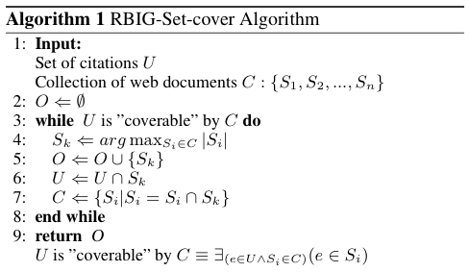
Selecting Nodes : Using Set-cover
The goal is to “cover” most citations using least number of web pages, where “cover” is defined by some heuristic. Apply a modified greedy approach
Notes:
The goal is to “cover” most citations using least number of web pages, where “cover” is defined by some heuristic. Apply a modified greedy approach

Slide 40
RBIG for Web Mentions
Selecting Nodes - Set Cover
Selecting Queries
  Inter-cluster queries
  Intra-cluster queries
Hybrid Approach
Cost-benefit Analysis

