Slide 1


Resource-bounded
Information Gathering for Correlation Clustering
Pallika Kanani and Andrew McCallum
With Special Thanks To
Avrim Blum, CMU
Information Extraction & Synthesis Laboratory
Department of Computer Science
University of Massachusetts, Amherst
Contact: pallika@cs.umass.edu

Slide 2
Problem Definition

Slide 3
Correlation Clustering
[Bansal, Blum, Chawla, 2002]
Weighted, undirected graph G(V,E), with n nodes and real-valued edge weights, w_{ij}
Goal is to partition nodes in V by minimizing disagreements (or maximizing agreements)
The number of partitions is unknown
(A)
(B)
(F)
(C)
(E)
(D)

Slide 4
Correlation Clustering
Our specific problem setting
Graph is fully connected
There exists a true partitioning P
w_{ij} ∈ [-∞,+∞], assumed to be drawn from a noise model, correlated with P
Goal is to find ‘best’ partitioning P_{a}, which will be evaluated against an arbitrary loss function L(P, P_{a})

Slide 5
Information Gathering : Queries
We may issue queries for additional information to reduce loss L
New information may be incorporated by one of the two possible ways
  Update the weight on an existing edge
  Adding a new vertex and edges connecting it to existing vertices
(B)
(A)
(B)
(A)
(C)
(F)
(C)
(F)
(E)
(E)
(D)
(D)
Notes:
The queries may be issued to a possibly adversarial oracle.
The new node might show high affinity towards multiple nodes and hence help bring together nodes which are far away from each other in the original graph

Slide 6
Information Gathering : Queries
Q1: takes as input edge e_{ij} and returns a new edge weight w_{ij}´, drawn from a different distribution,with higher correlation with true partitioning P
Q2: takes as input original graph and returns a new set of vertices
Cost associated with each type of query, as well as with processing additional vertices

Slide 7
Resource-bounded Information Gathering for Correlation Clustering
Let c(q) be the cost associated with query q ∈ Q1 ∪ Q2. Let b be the total budget
Find distinct queries q₁, q₂…q_{m} ∈ Q1 ∪ Q2 and the resulting partition P_{a}, to minimize loss L(P,P_{a}) s.t. ∑_{qi} c(q_{i}) ≤ b

Slide 8
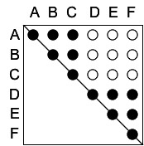
Pairwise-Similarity Matrix
Result of Query Q1
A B C D E F
A
B
C
D
E
F
Q1
Where does D belong?
Less noisy edge weights
With A, B, C?
With E, F?
By itself?
Notes:
Let us look at the Adjacency matrix of the same graph
After issuing queries of type Q1 on each edge, the new edge weights are less noisy

Slide 9
Expanding the Graph:
Result of Query Q2
A B C D E F
1 2 3 4 5 6 7 8 9 10
A
B
C
D
E
F
1
2
3
4
5
6
7
8
9
10
Notes:
After issuing queries of type Q2, we obtain new vertices that can be added to the graph

Slide 10
Pairwise-Similarity Matrix
A B C D E F 1 2 3 4 5 6 7 8 9 10
A
B
C
D
E
F
1
2
3
4
5
6
7
8
9
10
Vertex 1 is
similar to D, E & F.
By transitivity, D is now more likely to belong to
E, F cluster.

Slide 11
Pairwise-Similarity Matrix
A B C D E F 1 2 3 4 5 6 7 8 9 10
A
B
C
D
E
F
1
2
3
4
5
6
7
8
9
10
“Double transitivity”, through similarity between Web mentions.

Slide 12
Resource-bounded Information Gathering
A B C D E F 1 2 3 4 5 6 7 8 9 10
A
B
C
D
E
F
1
2
3
4
5
6
7
8
9
10
?
We need to select a subset of the edges in the original graph for querying, so as to get most benefit
?
?
Notes:
Issuing all possible queries is clearly very expensive

Slide 13
Resource-bounded Information Gathering
A B C D E F 1 2 3 4 5 6 7 8 9 10
A
B
C
D
E
F
1
2
3
4
5
6
7
8
9
10
?
We need to select a subset of the edges in the original graph for querying, so as to get most benefit
?
?
We also need to select a subset of the vertices to be added - selectively fill the entries in a potentially infinite matrix
Notes:
The expanded graph is extremely large and there is also a cost associated with processing additional vertices, hence we need to selectively add vertices to the graph

Slide 14
EXAMPLE
Given two similar person names, are they referring to the same person or not?
Author Coreference
Find true identities of authors in citations that mention similar author names
Notes:
For example, given several papers by B. Smith, we need to figure out which papers are written by a particular B. Smith

Slide 15
Six References Example
(A) …, H. Wang, … Background Initialization…, ICCV,…2005.
(B) …, H. Wang, … Tracking and Segmenting People…, ICIP, 2005.
(C) …, H. Wang, … Gaussian Background Modeling…, ICASSP, 2005.
(D) H. Wang and N. Ahuja, Facial Expression Decomposition, IEEE International Conference on Computer Vision (ICCV), 2003.
(E) …, H. Wang, … Tensor Approximation…, SIGGRAPH. 2005.
(F) …, H. Wang, … High Speed Machining…, ASME, (JMSE), 2005.
Notes:
Using Co-author information, we might already be pretty sure that A,B and C are written by one person, E,F is written by another person, but we are unsure if D belongs to the first group, the second group, or in a group of its own

Slide 16
Graph for Author Coreference
(A)
(B)
Fully connected, weighted, undirected graph
Vertices: Citations
Edge weights: Degree to which two mentions refer to the same real author
Partitions: Citations by the same author.
(F)
(C)
(E)
(D)
Notes:
ML model for coreference - based on previous work
We start with a fully connected, weighted undirected graph.
Vertex - citation or a ‘mention’
Edge weights - similarity metric
ABC - strongly…
We express this as a log linear model that also enforces transitivity.
Y’s are the yes/no coreference decisions for each mention pair
X’s are the input features of the mentions.
Coreference by partition..

Slide 17

Use of Web : Query of type Q1
“paper title D” “paper title E”
Additional feature in the classifier:
Does this query return any web pages?
Notes:
There are many different ways one can imagine doing it. Here’s the first one.
The new feature helps get better estimate on the edge weights

Slide 18
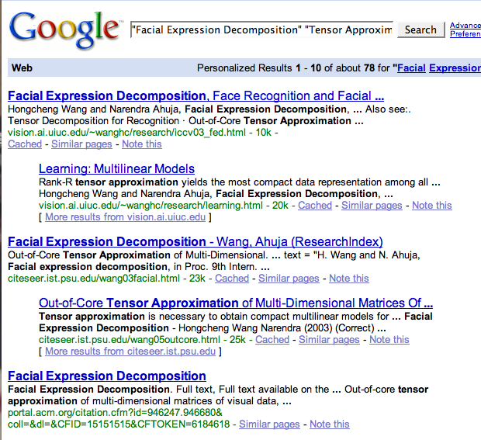
Use of Web : Query of type Q2
Additional Nodes in the graph
Notes:
Note that we might be able to obtain the homepage of a person, which might help bring together all the citations referring to that person

Slide 19
Related Work
And Current Solution

Slide 20
Related Work
Error bounds for correlation clustering
Learning and inference under constraints
  Resource-bounded reasoning
  Value of information
  Budgeted learning
  Active learning
Property testing of graphs
Semi-supervised learning
Sensitivity analysis

Slide 21
Expected Entropy Criterion
[Kanani, McCallum, Pal, 2007]
Measures how much the result of a single query affects the overall partitioning of the entire graph and reduces the uncertainty
Entropy is calculated over graph partitioning using several runs of stochastic graph partitioning algorithm. Expectation is taken over two possible results of the query
Notes:
We wish to order the query candidate, based on some criterion. The ee criterion measures how much the result of a single query affects the overall partitioning of the entire graph.
We calculate the entropy of the graph over graph partitioning by running a stochastic graph partitioner several times.
Refer to paper.

Slide 22
Thank You!

