Slide 1


Resource-Bounded Information Gathering for Entity Resolution
Pallika Kanani
Andrew McCallum, Chris Pal
Information Extraction & Synthesis Laboratory
Department of Computer Science
University of Massachusetts, Amherst
Contact: pallika@cs.umass.edu

Slide 2
Given two similar person names, are they referring to the same person or not?
Let’s examine this in citations data

Slide 3
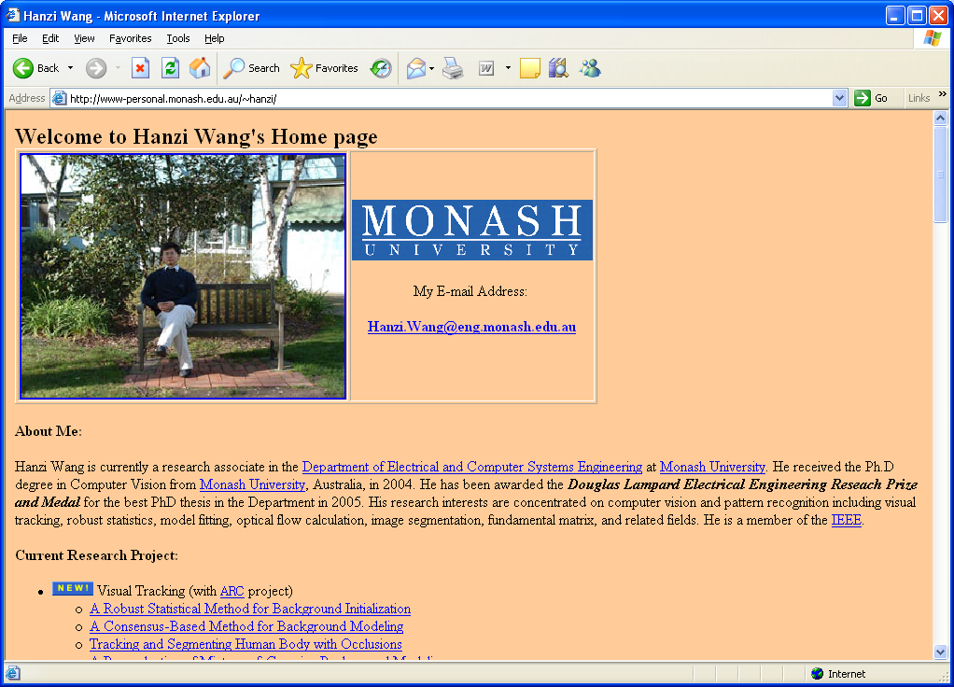
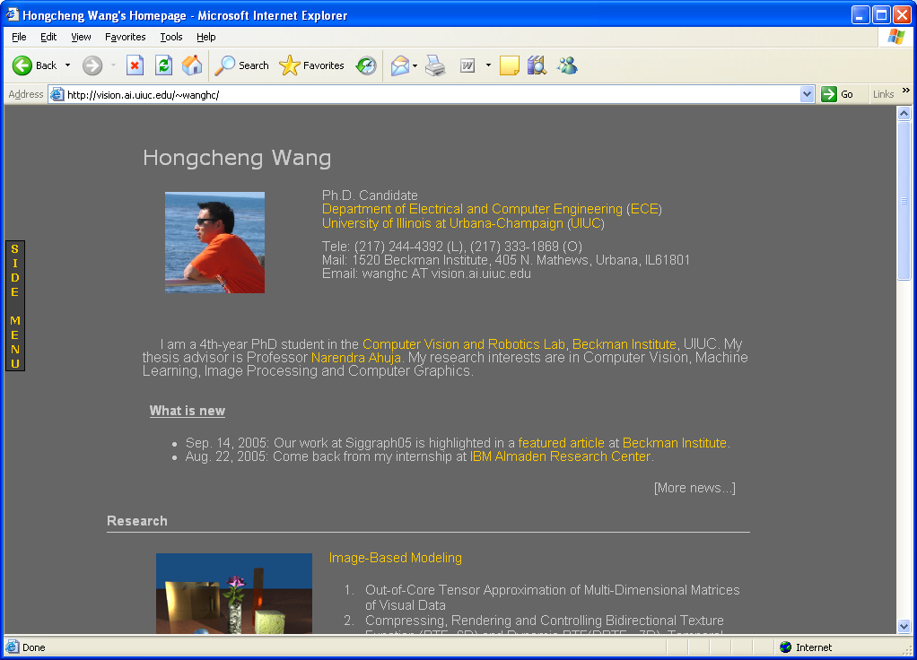
Q: Did one H. Wang have two papers at ICCV?
H. Wang and D. Suter. Variable Bandwidth QMDPE and Its Application in Robust Optic Flow Estimation. 9th IEEE International Conference on Computer Vision (ICCV), Nice, France, pages 178-183, October 2003.
H. Wang and N. Ahuja, Facial Expression Decomposition, IEEE International Conference on Computer Vision (ICCV), 2003.
H. Wang, Computer Vision,
Monash Univ.
H. Wang, Computer Vision,
UIUC

Slide 4
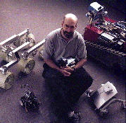

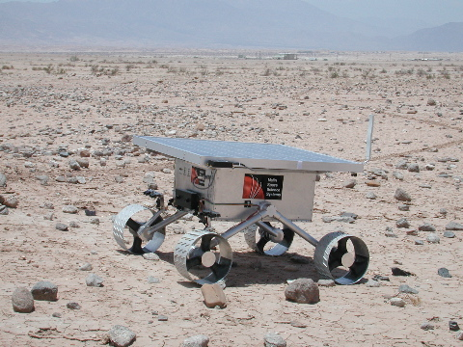
Q: Are these papers written by the same D. Miller?
T. Dean, R.J. Firby and D.P. Miller, Hierarchical Planning with Deadlines and Resources
Readings in Planning, pp. 369-388, Allen, Hendler, & Tate eds., Morgan Kaufman, 1990.
D.P. Miller and C. Winton. Botball Kit for Teaching Engineering Computing. In Proceedings of the ASEE National Conference. Salt Lake City, UT. June 2004.
A. Winterholler, M. Roman, T. Hunt, and D.P. Miller. Design Of A High-Mobility Low-Weight Lunar Rover.
Proceedings of iSAIRAS 2005. Munich Germany. September 2005.

Slide 5
Resource Bounded Information Gathering
How should we use machine learning methods to solve author co-reference?
How can we use information from the web to improve author co-reference?
Under resource constraints, can we query the web selectively, while maintaining improvement?
Notes:
I’m going to address three questions in my talk.

Slide 6
Six References Example
(A) …, H. Wang, … Background Initialization…, ICCV,…2005.
(B) …, H. Wang, … Tracking and Segmenting People…, ICIP, 2005.
(C) …, H. Wang, … Gaussian Background Modeling…, ICASSP, 2005.
(D) H. Wang and N. Ahuja, Facial Expression Decomposition, IEEE International Conference on Computer Vision (ICCV), 2003.
(E) …, H. Wang, … Tensor Approximation…, SIGGRAPH. 2005.
(F) …, H. Wang, … High Speed Machining…, ASME, (JMSE), 2005.
Notes:
Using Co-author information

Slide 7
Machine Learning Model For Co-reference
(A)
(B)
Fully connected, weighted, undirected graph
Vertices: Citations
Edge weights: Probability that two citations are by same author.
Partitions: Citations by the same author.
(F)
(C)
(E)
(D)
Notes:
ML model for coreference - based on previous…
We start with a fully connected, weighted undirected graph.
Vertex - citation or a ‘mention’
Edge weights - similarity metric or prob that 2 cits are by same author
ABC - strongly…
We express this as a log linear model that also enforces transitivity.
Y’s are the yes/no coreference decisions for each mention pair
X’s are the input features of the mentions.
Coreference by partition..
Best satisfied by ..

Slide 8
Pairwise-Similarity Matrix
A B C D E F
A
B
C
D
E
F
Similarity between mentions E and F.
(Darker = more similar)
Dark Triangles aligned along the diagonals indicate one group
Where does D belong?
With A, B, C?
With E, F?
By itself?
Notes:
Let us look at the different representation of the same graph
Adjacency matrix
Rows colums

Slide 9
Dataset Description
Corpus | Ambiguous Names (e.g. L. Lee) | Author Entities (e.g. Lillian Lee, Cornell) | Author Mentions (Citations) | Author MentionPairs (Citation Pairs)
DBLP | 18 | 103 | 945 | 43338
Rexa | 8 | 289 | 1459 | 207379
Penn | 7 | 139 | 2021 | 455155
Total | 33 | 531 | 4425 | 705872
e.g. 79 Different L. Lee’s!!
Total # of Pairwise Decisions !
Notes:
Hand annotated

Slide 10
Using the Web to improve co-reference
Method 1
web pages = edge features

Slide 11
All Pairs
Resource Bounded
1
3
Web
Feature
2
4
Web
Mention

Slide 12
All Pairs
Resource Bounded
3
Web
Feature
2
4
Web
Mention
Notes:
We’ll see how information obtained from the web can be used as an additional feature to calculate edge weights.

Slide 13
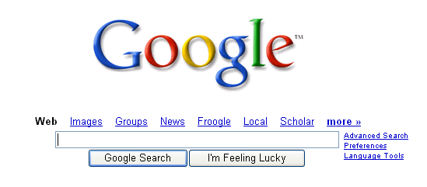
Use of Web
“paper title D” “paper title E”
The feature is simply:
Does this query return any web pages?
Notes:
There are many different ways one can imagine doing it. Here’s the first one.

Slide 14
Using the Web Helps
Corpus | Method | Precision | Recall | F1
DBLP | Baseline | 81.43 | 68.25 | 74.26
 | With Web | 94.94 | 83.00 | 88.57
Rexa | Baseline | 63.38 | 91.26 | 74.80
 | With Web | 70.06 | 97.17 | 81.42
Penn | Baseline | 83.69 | 21.07 | 33.65
 | With Web | 94.48 | 61.70 | 74.65
On average, 20.64% Increase in F1!
Notes:
Large no. of negative examples..therefore F1

Slide 15
Using the Web to improve co-reference
web pages = graph nodes
“web as a mention”

Slide 16
All Pairs
Resource Bounded
3
Web
Feature
4
Web
Mention

Slide 17
Expanding the Graph
A B C D E F
1 2 3 4 5 6 7 8 9 10
A
B
C
D
E
F
C2C
C2W
W2W
1
2
3
4
5
6
7
8
9
10

Slide 18
Pairwise-Similarity Matrix
A B C D E F 1 2 3 4 5 6 7 8 9 10
A
B
C
D
E
F
1
2
3
4
5
6
7
8
9
10
“Web” mention 1 is
similar to D, E & F.
By transitivity, D is now more likely to belong to
E, F cluster.
For example, Web mention 1 might be
the Publication list of Hongcheng Wang
from UIUC

Slide 19
Pairwise-Similarity Matrix
A B C D E F 1 2 3 4 5 6 7 8 9 10
A
B
C
D
E
F
1
2
3
4
5
6
7
8
9
10
“Double transitivity”, through similarity between Web mentions.

Slide 20
Pairwise-Similarity Matrix
A B C D E F 1 2 3 4 5 6 7 8 9 10
A
B
C
D
E
F
1
2
3
4
5
6
7
8
9
10
Feature asks:
Does there exist a
Web-mention (e.g. 5) that is close to both
citation-mentions, D, E.

Slide 21
Results - Web as Mention
On DBLP Dataset, with 1,360 web pages
 | Precision | Recall | F1
Baseline | 0.8143 | 0.6825 | 0.7426
With Google as feature | 0.9494 | 0.8300 | 0.8857
With Google as extra mention | 0.8634 | 0.9462 | 0.9029

Slide 22
Measuring all these extra similarities
is very time consuming!
A B C D E F 1 2 3 4 5 6 7 8 9 10
A
B
C
D
E
F
1
2
3
4
5
6
7
8
9
10
The Web Queries for 705,872 mentions take several DAYS to execute.
Also, processing the additional web mentions can be expensive.

Slide 23
Resource-bounded information gathering from the web
Can we use Web information selectively and still achieve significant accuracy gain?

Slide 24
All Pairs
Resource Bounded
Web
Feature
4
Web
Mention

Slide 25
Finding the ‘Centroid’
Start with initial clustering
Centroid: Most tightly connected vertex
Connect all the centroids -> candidate queries
Order them according to some criterion for querying

Slide 26
Uncertainty Based Approach
Uncertainty Based Approach:
if P(true | no web info) < .9 or
P(false | no web info) < .9
then Search web and run classifier using web features
Drawbacks:
  Does not consider the uncertainty in the entire graph
  Ignores the effect of one query on the overall graph structure
  Can’t handle cases when classifier is confidently wrong

Slide 27
Gravitational Force Straw man
Intuition: Merging two large clusters, close to each other - more effective than - merging two small clusters, far apart.
Drawbacks:
  Ignores the ‘purity’ of the resulting clusters
  Ignores the overall uncertainty of the graph

Slide 28
Expected Entropy Criterion
Measures how much the result of a single query affects the overall partitioning of the entire graph and reduces the uncertainty
Entropy is calculated over graph partitioning using several runs of stochastic graph partitioning algorithm. Expectation is taken over two possible results of the query
Notes:
We wish to order the query candidate, based on some criterion. The ee criterion measures how much the result of a single query affects the overall partitioning of the entire graph.
We calculate the entropy of the graph over graph partitioning by running a stochastic graph partitioner several times.
For each query, there are two possible results, so what would be the entropy of the graphh if we…
We take an expectation over..
Refer to paper.

Slide 29
Results - RBIG Web Features
After each query, we rerun the classifier and graph partitioner, plot precision, recall and F1, average across datasets and record the area under the curve.
Method | AUC Precision | AUC Recall | AUC F1
Random | 63.97 | 89.46 | 64.23
Uncertainty | 64.95 | 87.83 | 63.54
Gravitational Force | 63.10 | 92.37 | 64.55
Expected Entropy | 73.72 | 87.92 | 72.37

Slide 30
Resource bounded information gathering
…for “web as a mention”

Slide 31
All Pairs
Resource Bounded
Web
Feature
Web
Mention

Slide 32
RBIG on web as a mention
We use intra-cluster approach for formulating the queries.
Start with initial partitioning of the data
For each cluster, pick two or three tightly connected citations.
Clean the titles and remove stop words to form a query
Notes:
Current work we compare inter-cluster and intra cluster queries

Slide 33
Results - RBIG Web Mentions
We achieve 91% of the original F1 by adding only 15% of the web mentions.

Slide 34
Theoretical Issues
Consider abstracting away from the web domain and generalize this problem of resource bounded information gathering.
Gives rise to interesting theoretic issues!
Recent interest in Correlational clustering
We present a new class of problem:
Resource Bounded Information Gathering under graph partitioning

Slide 35
Conclusions
Using the web can help improve F1 for author coreference task by 20% on avg.
Using the extra mentions from the web further improves performance.
The proposed expected entropy based approach provides a strong framework for resource bounded information gathering.
We achieve 91% of the original F1 by adding only 15% of the web mentions using intra-cluster queries.
Opens up interesting theoretical questions.

Slide 36
Future Work
Alternative queries
More sophisticated querying criteria
New and more scaleable approaches for resource bounded information gathering on web as mentions
Other theoretical formulations and bound proofs

Slide 37
Thank You!

