Slide 1


Resource-bounded Information Extraction: Acquiring Missing Feature Values On Demand
Pallika Kanani, Andrew McCallum and Shaohan Hu
Information Extraction & Synthesis Laboratory
Department of Computer Science
University of Massachusetts, Amherst
Contact: pallika@cs.umass.edu
Notes:
Good afternoon, My name is Pallika Kanani Madhwani, and I’m going to talk about Resource-bounded Information Extraction.

Slide 2
Traditional Information Extraction
IE
_x0019__x0019__x0019_
Segment
Classify
Associate
Cluster
?
?
?
?
?
?
?
?
?
?
Query,
Search
?
?
?
?
?
?
?
?
?
?
?
?
?
?
?
Document
collection
Train extraction models
Database With Template Slots
Label training data
Notes:
In traditional information extraction, you’re given a bunch of documents and you extract as many relations as possible or fill a given template in a database. In many…

Slide 3
A New Information Extraction Scenario
IE
_x0019__x0019__x0019_
Extract only Relevant Information
?
?
?
Query,
Search
?
?
?
?
?
?
?
World Wide Web Or Other External Data Source
Database with only a few missing records or missing fields
In many scenarios, we have a partial database with only a few missing records or missing fields. Using traditional IE for extracting them is wasteful, and in most cases, computationally intractable.

Slide 4
Resource-bounded Information Extraction
In general, the resources required for this task may include : Computer Processing, Network Bandwidth, Database Schema Mapping, Monetary Cost, Human Cost and Time.
Acquiring all features for all instances may be prohibitively expensive and unnecessary – acquiring a random subset may be sub-optimal.
Inherent interdependency within the data can sometimes be exploited for efficient information acquisition.
We need a new framework to extract required information from a large, external source such as the web, using limited resources.
Notes:
Work some more on this slide

Slide 5
How can we efficiently acquire information from external sources under limited resources?
We Introduce Resource-bounded Information Extraction Framework

Slide 6
Outline
Motivational Example
Resource Bounded Information Extraction Framework
Exploiting Temporal Constraints
Experiments and Results
Conclusion
Notes:
Work some more on this slide

Slide 7
Outline
Motivational Example
Resource Bounded Information Extraction Framework
Exploiting Temporal Constraints
Experiments and Results
Conclusion
Notes:
Work some more on this slide

Slide 8

Find Year Example
Rexa is a database of scientific publication citations.
Here’s a paper header used to extract citation information such as paper title, author names, etc.
But what year was it published in?
Approximately, one third of papers in Rexa have a missing year of publication!!
Notes:
Let’s look at an example. In applications like Rexa, Citeceer, and Google Scholar, the year of publications are missing sometimes, if the data was extracted from paper headers. However, when presenting information to users, we need to show the publication year. Traditional IE can’t work because we would need to parse the entire web. Let’s see how RBIE framework can be applied to solve this problem.

Slide 9
Outline
Motivational Example
Resource Bounded Information Extraction Framework
Exploiting Temporal Constraints
Experiments and Results
Conclusion
Notes:
Work some more on this slide

Slide 10
FindYear Using RBIE Framework
Resource-bounded Information Extraction
_x0019__x0019__x0019_
?
Query, Search
?
?
?
?
?
?
?
?
?
Input for Queries
More useful queries first
Author names, Paper title ..
Selected
Queries
Form queries using keywords
Database with Missing or
Uncertain Feature Values
Query Engine
Citations with missing Publication Year
Web documents
Returned
Documents
Get
More
Queries
Required Information
Year of publication
Combine evidence, Predict using thresholds
Confidence
Evaluation
Get More Documents
Document
Filter
Remove Irrelevant Documents
Learned
Model
Prediction
Multiclass Classification
Information
Extraction
Selected
Documents
Original Features
None
Year on page, title proximity etc
New Features
Notes:
We now propose a new framework called RBIE. We start with a database with missing values. We use the available information as an input to the query engine that automatically formulates queries. These queries are prioritized and issued to a web API, which returns web documents. After removing irrelevant documents, the required information is extracted. The confidence evaluation module here requests more information until it is sure enough to return the answer to the original database.
Let us now look at some of these modules in more detail and explore some open issues.

Slide 11
Resource-bounded Information Extraction
Automatically formulate queries, prioritize them optimally, and issue them to a search interface.
?
_x0019__x0019__x0019_
?
Query, Search
?
?
?
?
?
?
?
?
Input for Queries
Selected
Queries
Database with Missing Values
Query Engine
Returned
Documents
Get
More
Queries
Required Information
Get More Documents
Confidence
Evaluation
Document
Filter
Learned
Model
Prediction
Information
Extraction
Selected
Documents
Original Features
New Features

Slide 12
Design of Query Engine
Input selection module decides which feature values should be acquired
Query formulation module combines input values from database with domain knowledge to formulate queries
Open Question: Can we Learn to rank the queries in an effective order for better utilization of resources?
Notes:
In the near future, I would like to work on Learning to ..
For this, we can use Feedback from confidence evaluator to learn which queries are more effective than others for the given problem.

Slide 13
Resource-bounded Information Extraction
?
_x0019__x0019__x0019_
?
Query, Search
?
?
?
?
?
?
?
?
Input for Queries
Selected
Queries
Database with Missing Values
Query Engine
Returned
Documents
Get
More
Queries
Remove irrelevant documents and prioritize the remaining documents for processing.
Required Information
Get More Documents
Confidence
Evaluation
Document
Filter
Learned
Model
Prediction
Information
Extraction
Selected
Documents
Original Features
New Features

Slide 14
Design of Document Filter
Document relevance returned by the search engine is only with respect to the query. E.g. Person name ambiguities.
Irrelevant documents are filtered out.
Open Question: Can we develop an independent ranking mechanism that takes into account relational nature of the data?
Notes:
Note that document relevance…
For example, if we issue a query with author name and key work “publcation list”, we might get the publication list of some one else with the same name. Such a document might be highly ranked by the search engine, but irrelevant to our data.
Another example: Conference page might be ranked higher by the search engine, but person home page might be more useful for extracting multiple years of publication for an author.
Hence we really do need an independent…

Slide 15
Resource-bounded Information Extraction
?
_x0019__x0019__x0019_
?
Query, Search
?
?
?
?
?
?
?
?
Input for Queries
Selected
Queries
Database with Missing Values
Query Engine
Returned
Documents
Get
More
Queries
Required Information
Get More Documents
Confidence
Evaluation
Document
Filter
Learned
Model
Prediction
Information
Extraction
Selected
Documents
Original Features
New Features
Extract required information from selected documents by combining original and external features

Slide 16
Information Extraction
In our task, missing values can take finite number of values. View this extraction as multi-class classification
Probabilistic Prediction Model:
Label
Citation
Document
Normalizer
Feature Weight
Feature Function
Notes:
In our example, the features are proximity of a year to the title, similarity between the web document and the citation and so on.

Slide 17
Resource-bounded Information Extraction
?
_x0019__x0019__x0019_
?
Query, Search
?
?
?
?
?
?
?
?
Input for Queries
Selected
Queries
Database with Missing Values
Query Engine
Returned
Documents
Decide when to stop requesting information, and provide feedback to other modules to aid learning
Get
More
Queries
Required Information
Get More Documents
Confidence
Evaluation
Document
Filter
Learned
Model
Prediction
Information
Extraction
Selected
Documents
Original Features
New Features

Slide 18
Confidence Evaluation
Better confidence evaluation can improve performance of data mining system that uses the data extracted by the system.
It can also make better precision recall tradeoffs.
Currently uses entropy threshold to decide when to stop acquiring information
Open Questions: Can we use this module to provide feedback for learning query and document ranking? At train time, how can we use this module for evaluating the “goodness” of trained model?
Notes:
So far, my focus has been on using RBIE at test time. If we are trying to learn a model with constrained resources, then CE module can be used to evaluate the goodness of the model trained using information so far, and deciding when to stop requesting more.

Slide 19
Resource-bounded Information Extraction
Query, Search
C1
C6
C9
Input for Queries
Selected
Queries
C4
C10
Query Engine
Returned
Documents
C2
C7
C11
C5
Interdependency within the original database can be exploited for better resource utilization.
C3
C8
C12
Get
More
Queries
Required Information
Get More Documents
Confidence
Evaluation
Document
Filter
Learned
Model
Prediction
Information
Extraction
Selected
Documents
Original Features
New Features

Slide 20
Outline
Motivational Example
Resource Bounded Information Extraction Framework
Exploiting Temporal Constraints
Experiments and Results
Conclusion
Notes:
Work some more on this slide

Slide 21
Exploiting Temporal Constraints in Data
C6
C9
Citation link structure can be used for inferring temporal constraints
C1
C4
C10
C2
C7
C11
C5
C3
C8
C12
True Labels
‘01
‘02
‘03
‘04
E.g. Paper C4 cites paper C1 => label(C4) >= label(C1)
Notes:
Along with fields like title and author, we are also given citation link structure such as this one.
Assuming that papers from the future can’t be cited

Slide 22
Uncertainty Propagation in Graphs
C1
C6
C9
Probability P(X=x)
C4
C10
C2
C7
C11
C5
C3
C8
C12
‘01
‘02
‘03
‘04
Labels (x)
True Labels
‘01
‘02
‘03
‘04
Initially, we start with uniform distribution over all possible labels for each node
Notes:
Let’s look at a few citations here. Initially..so, we have 25% prob for each possible year.

Slide 23
Exploiting Temporal Constraints
C1
C4
C6
Notes:
A little bit of notation.

Slide 24
Exploiting Temporal Constraints
C1
C4
C6
,citation which is being queried
,citation a cites citation b
X , r.v. that represents year of publication of c.
,probability that X take value x.
,posterior obtained from the doc. classifier
Notes:
C is the citation being queried and the arrow means a cites b. Cb and Ca are the citations that cite c and are cited by c respectively. X is the random variable that .. Pc, … and P prime..

Slide 25
Exploiting Temporal Constraints
Web Information
C1
C4
C6
If C6 was published in ‘03, then C4 must be published in or before ‘03. The probability distribution of C4 can be updated by redistributing the probability mass to years before ‘03
We take a weighted average over all possible labels for a citation and pass a message to its neighbors as follows:
Propagation
Update
Notes:
Now let’s say we find from the web that C6..
The prob distribution of C4 can be update by redistributing the prob. Mass to years before ‘03

Slide 26
Exploiting Temporal Constraints
Web Information
Web Information
C1
C4
C6
If C1 was published in ‘02, then C4 must be published in or after ‘02.
The corresponding message and updates are:
Notes:
Similarly, If C1…
The correspnding..

Slide 27
Exploiting Temporal Constraints
Web Information
Web Information
C1
C4
C6
Along with passing message to its neighbors, the node updates itself by combining information from the document classifier and the graph structure
Combination
Notes:
Along..

Slide 28
Exploiting Temporal Constraints
Web Information
Web Information
C1
C4
C6
We try different variations of propagation, update and combination methods
Propagation
Best Index, Weighted Average
Update
Uniform, Scaling
Combination
Basic, Sum, Product
Notes:
Please see the paper for the details on these method variations.

Slide 29
Outline
Motivational Example
Resource Bounded Information Extraction Framework
Exploiting Temporal Constraints
Experiments and Results
Conclusion
Notes:
Work some more on this slide

Slide 30
Dataset and Setup
Dataset includes 5 citation graphs with 462 citations over 20 years, which led to 7K queries and 15K documents.
Queries are formed by combining paper titles and authors names with keywords like “publication list”, “resume”, “cv”, “year”, and “year of publications”.
Document classification features include year on page, number of different years, years in order, following preceding year, between the same year, etc.
Used MALLET for training and testing and Google Search API for issuing queries.
Notes:
In Conclusion,

Slide 31
Effect of Entropy Threshold
Measure the effect of entropy threshold on Precision, Recall and F1.
Stop obtaining more documents or issuing queries when threshold is reached.
No citation network information.
Entropy Threshold | Precision | Recall | F1 | #Queries | #Docs
0.1 | 0.93 | 0.73 | 0.82 | 4497 | 9564
0.3 | 0.91 | 0.82 | 0.86 | 3752 | 8010
0.5 | 0.90 | 0.87 | 0.88 | 3309 | 7158
0.7 | 0.88 | 0.90 | 0.89 | 2987 | 6535
0.9 | 0.86 | 0.91 | 0.88 | 2768 | 6088
Notes:
Increasing Threshold reduces Precision. F1 peaks at 0.7

Slide 32
Experiments : Exploiting Citation Network
Update | Combination | Propagation | F1 (at 0.7)
Uniform | Basic | Best Index | 0.72
Uniform | Basic | Weighted Avg | 0.72
Uniform | Sum | Best Index | 0.72
Uniform | Sum | Weighted Avg | 0.58
Uniform | Product | Best Index | 0.65
Uniform | Product | Weighted Avg | 0.34
Scaling | Basic | Best Index | 0.72
Scaling | Basic | Weighted Avg | 0.72
Scaling | Sum | Best Index | 0.69
Scaling | Sum | Weighted Avg | 0.54
Scaling | Product | Best Index | 0.63
Scaling | Product | Weighted Avg | 0.43
87.7% of the baseline F1 by using only 13.2% of the documents using graph based method
Uniform
Scaling
Notes:
F1 is measured at entropy threshold = 0.7

Slide 33
Combining Evidence in Feature Space v.s. Output Space
Combining evidence in feature space : merge all features from the documents to a single feature function.
Combining evidence in output space:
  Majority Vote : Class with the highest number of y_{ik} is predicted as winning class
  Highest Confidence : take the most confident vote
Confidence Evaluation for combining evidence in output space:
  Max votes : if % of of docs in winning class exceeds a threshold, make prediction
  Highest confidence : if highest confidence exceeds threshold, make prediction

Slide 34
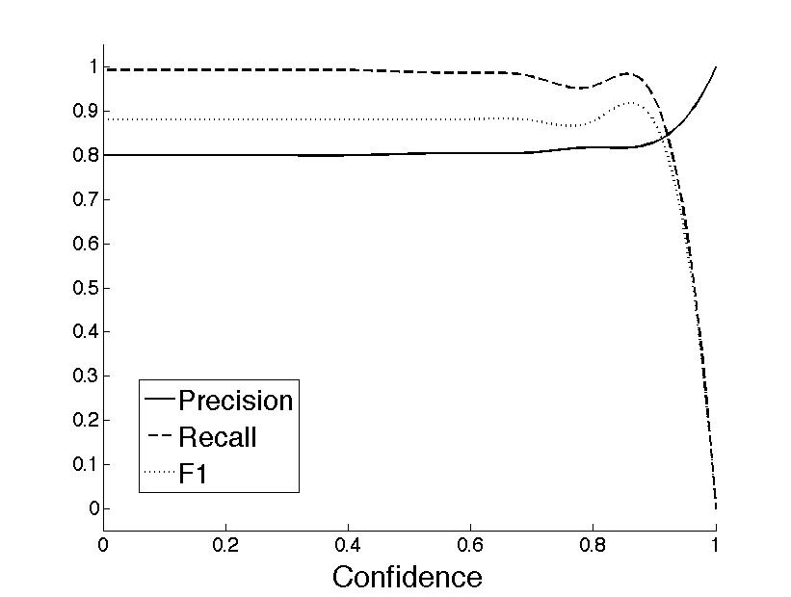
Results
Majority Vote, Highest Confidence Scheme
Notes:
we obtain high values of precision and recall for reasonable values of confidence. That is, in the confidence region below 0.9, we obtain a good F1 value.

Slide 35
Outline
Motivational Example
Resource Bounded Information Extraction Framework
Exploiting Temporal Constraints
Experiments and Results
Conclusion
Notes:
Work some more on this slide

Slide 36
Conclusion
Electronic information available to mankind continues to explode at an exponential rate.
Computational and other resources insufficient to process it.
Despite reducing costs, resource-bounded information acquisition methods more relevant than ever before.
Methods that exploit relational nature of data and consider end-goal of data mining system that the data is used for are important.
This is an exciting emerging field with several interesting problems.
Notes:
In Conclusion,

Slide 37
Questions?

Slide 38
Extra Slides

Slide 39
How Is This Related To ….?
IE from the Web
  KnowItAll (OpenIE - related, but different Goal) - We are looking for specific with a known schema
  InfoSleuth - The sources are given
  Kylin - Only Wikipedia articles
  Classical IR - Need to automate query formulation, need a specific value, rather than just documents or snippets
  QA Systems - target a single piece requested by the user, rather than interdependent pieces of information
Notes:
In Conclusion,

Slide 40
How Is This Related To ….?
Active Information Acquisition
  Active Learning - select best labels
  Active Feature Acquisition - Learning models from incomplete instances
  Budgeted Learning - identify best acquisitions given a fixed budget
  Learning using noisy labels
  Resource Bounded Information Gathering (Kanani et al., 2007) selecting instances to query under limited resources
Notes:
In Conclusion,

Slide 41
Propagation Methods
Best Index:
Weighted Average:
Notes:
I have looked at this problem in three problem domains:
In the first one,
In the second one,
And in my current work, given a database with missing feature values, we extract them from web documetns by exploiting interdependency
I will also, of course, talk about my proposed research.

Slide 42
Update Methods
Uniform Update
Scale Update

Slide 43
Combination Method

Slide 44
Exploiting Citation Network
We explore several variations of methods to combine evidence
“Update” Methods : Incorporating information obtained from the web to the graph - uniform, scaling
“Combination” Methods : Combine evidence from classifier output at a node with that obtained from its neighbors in the graph - basic, sum, product
“Propagation” Methods : Passing the uncertainty message to the neighbors of c.
Notes:
Please Refer to the paper for the details on these experiments.

Slide 45
Given a database with missing feature values. We assume this database is relational in nature and may be used for some data mining task.
Missing feature values are efficiently extracted from web documents by exploiting interdependency within the original database

Slide 46
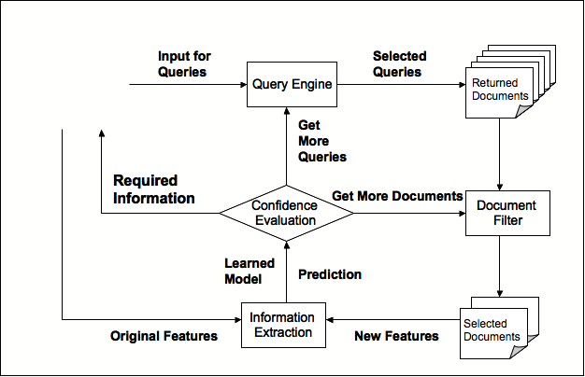
Resource-bounded Information Extraction
Query, Search
C1
C6
C9
C4
C10
C2
C7
C11
C5
C3
C8
C12
Interdependency within the original database can be exploited for better resource utilization.
Notes:
What’s really interesting about this problem though is

Slide 47
Acquiring External Information
Features
y
?
?
?
?
-
Instances
?
?
?
+
?
?
?
?
?
+
Data Mining
Algorithm
Prediction
Task
?
?
?
?
?
-
?
?
?
?
?
?
-
?
?
?
+
?
?
x_{i,j}
?
?
?
+
Accuracy
Cost
  Accuracy of most data mining applications can be improved by acquiring additional information from an external source, such as other databases, or the web.
  Resources required for this task may include : Computer Processing, Network Bandwidth, Database Schema Mapping, Monetary Cost, Human Cost and Time.
Notes:
Most data mining applications can do better if we obtain additional information …
But you can’t buy all the databases or crawl the entire web. In general, resources required
In general, resources..

Slide 48
Acquiring External Information
Features
y
?
?
?
?
-
Instances
?
?
?
+
?
?
?
?
?
+
Data Mining
Algorithm
Prediction
Task
?
?
?
?
?
-
?
?
?
?
?
?
-
?
?
?
+
?
?
x_{i,j}
?
?
?
+
Accuracy
Cost
  Acquiring all features for all instances may be prohibitively expensive and unnecessary – acquiring a random subset may be sub-optimal.
  Inherent interdependency within the data can sometimes be exploited for efficient information acquisition.
Notes:
Under such resource-constraints, you can only acquire a subset of features for a subset of instances. Also, exploiting inherent interdependency within the data can lead to better utiliazation of the given resources. So, the question underlying my research has been..

