Slide 1


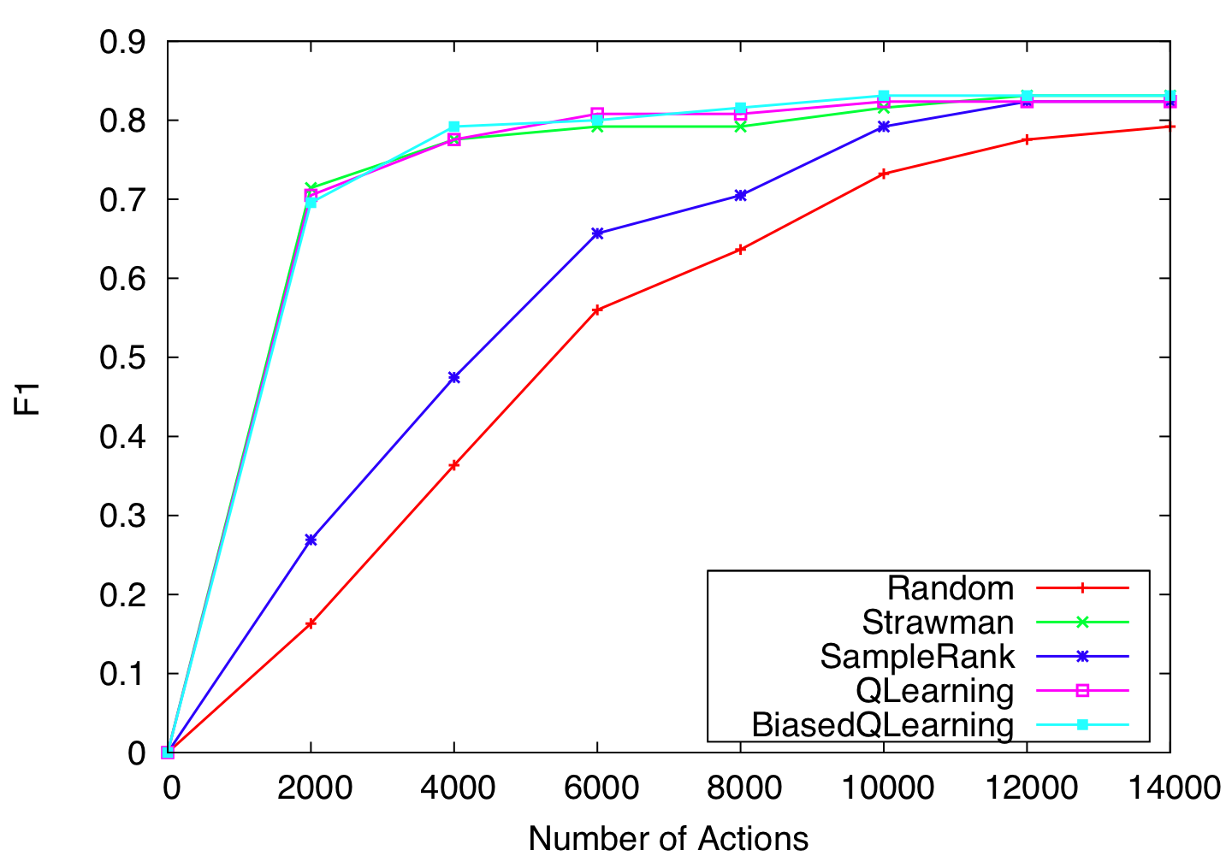
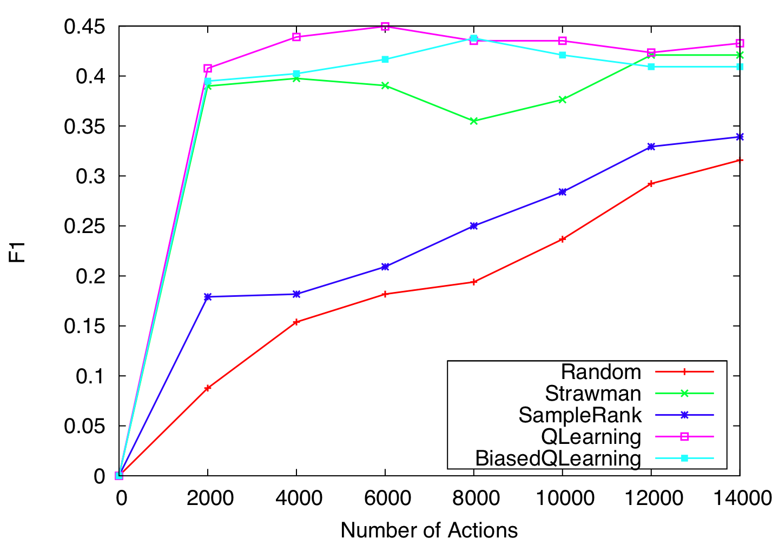
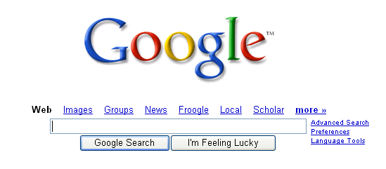

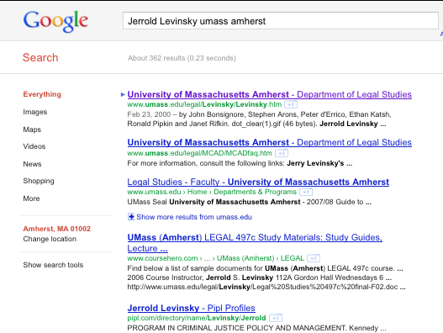
Learning to Select Actions for Resource-bounded Information Extraction
Pallika H. Kanani and Andrew K. McCallum, University of Massachusetts, Amherst
Traditional Information Extraction
Markov Decision Process for RBIE
Temporal Difference Q-learning for RBIE
Baselines
  Random
  Straw-man :
    First query in the list for each test instance is issued
    First hit from the search result for each test instance is downloaded and processed for extraction
    Subsequent hits from search results are downloaded and processed
    Subsequent queries are issued, followed by their corresponding download and extract actions
    Almost like an “Optimal” policy
IE
_x0019__x0019__x0019_
Select ‘Best’ action at each point of time, given the state of the database, and what we have seen so far, so as to acquire most information under a limited action budget.
Input:
Training Database, DB
Initial Parameters, θ
Q Function, Q_{θ}(a,S) = Σ_{i} θ_{i}φ_{i}(a,S)
Reward Function, R(S)
Learning Rate, α
Discount factor, γ
S₀ = Initial State of DB
for t = 0 to number of training iterations T do
ε = 1 – 1/T
  With probability ε, pick a random action, a_{t}
  With probability 1 − ε, pick a_{t} = arg max_{a} Q_{θt} (a, S_{t} )
  S_{t+1}=a_{t} (S_{t} ) //perform a_{t}
  Let a′ be all the valid actions from state, S_{t+1}
  for i = 0 to number of features do
  θ^{i}_{t+1}= θ^{i}_{t}+α [R(S_{t+1}) + γmax_{a′}Q_{θt}(a′,S_{t+1}) - Q_{θt}(a_{t},S_{t})] φ_{i}(a_{t},S_{t})
  end for
  end for
Segment
Classify
Associate
Cluster
?
?
?
?
?
Query,
Search
?
?
?
?
?
?
?
?
?
?
?
?
?
?
?
Document
collection
?
?
?
?
?
State S_{t}<DB_{t}, I_{t}, I’_{t}>
  S_{t,}state of the database at time, t
  I_{t,} list of intermediate URL results
  I’_{t} list of intermediate page results
MDP
  S_{0,} initial state
  γ, discount factor
  T(S, a, S’), state transition probability distribution
  R(S), reward function
Challenges:
  Very large state space
  The download and extract actions are dynamically generated => Not a fixed state space
  Difficult to learn the state transition probability and value function accurately
  Need to approximate it, using features of the states and actions from training data
  Designing the right reward function
  γ, discount
Database With Template Slots
Given a partial database with only a few missing records or missing fields. Using traditional IE for extracting them is wasteful, and in most cases, computationally intractable.
A New Information Extraction Scenario
Results Oracle
IE
_x0019__x0019__x0019_
Extract only Relevant Information
?
?
Query,
Search
?
?
?
?
?
Custom reward function, R(S) is weighted sum of correct, incorrect and total number of filled values in the database, along with properties of the intermediate results.
?
?
?
World Wide Web Or Other External Data Source
?
Database with only a few missing records or missing fields
We need a new framework to extract required information from a large source such as the web, using limited resources
The features include : Type of corresponding query, hit value in the search result, whether URL is from UMass, Title contains keywords, faculty name, document is appropriate size, etc.
Biased-q-learning initializes policy using straw-man approach. Q-learning performs better than SampleRank by modeling delayed rewards.
Resource-bounded Information Extraction
Resource-bounded Information Extraction
SampleRank for RBIE (Wick, et al., NIPS’09)
Results with Extraction
_x0019__x0019__x0019_
?
Assume Input:
  Database DB with missing entries
  Value Function, V(a, S)
  An Extraction Model, M_{e}
  Time budget, b
For t = 0; t<= b; t++
  Select next best action,
    a_{t+1} = argmax_{a} V(a, S_{t})
  Perform a_{t+1}
Online, error driven learning algorithm
We assume the following functional form of the value function:
  V(a, DB_{t}, I_{t}, I’_{t}) = exp (Σλ_{k}f_{k}(a, DB_{t}, I_{t}, I’_{t}))
  Where, λ_{k} are model parameters and f_{k} are features.
Starting with initial state, consider all available actions, and sample from the resulting states
Samples are ‘in error’ if ranked differently by the value function learned so far, and the reward function
When this happens, update parameters using perceptron update rule
?
?
?
?
?
?
?
?
?
?
Database with only a few missing records or missing fields
Some Documents
88.8% of the final F1 is obtained using only 8.6 % of actions
Example : Finding Faculty Information
Extraction Model
Conclusions and Future Work
UMass Amherst Faculty Database
Faculty Name | Email | Job Title | Dept Name
Andrew McCallum | ? | ? | ?
Jerrold Levinsky | ? | ? | ?
Edward Voigtman | ? | ? | ?
Robert Paynter | ? | ? | ?
We really want to learn where to start looking for information. What order to process it.
Q-Learning gains from modeling future rewards. Can be extended by
  More sophisticated RL
  Extend framework (more actions etc)
Opens up many new interesting research directions
A novel extraction technique that can scale well for large scale, information gathering tasks
Learning based approach in many resource-conscious, real-world domains.
Extract Action
UMass Amherst Faculty Database
Faculty Name | Email | Job Title | Dept Name
Andrew McCallum | ? | ? | ?
Jerrold Levinsky | ? | ? | ?
Edward Voigtman | ? | ? | ?
Robert Paynter | ? | ? | ?
Current Value | Instructor
Confidence | 0.8
Candidates
Use lexicons and regular expressions to find matches in web pages
Features of “mentions” for each candidate are merged
Features of the candidates, and true labels used to learn a Maximum Entropy classification model:
Features for Email Extractor | Features for Jobs Title / Dept Extractor
Email domain is from UMass | Too many matches found on page
Web page domain name from UMass | Web page domain name from UMass
Email host, web page URL host match | Web page URL contains faculty name
Match between faculty name and email username | Position of match on the document
Similarity between faculty name and email username | Keywords precede match
Relative position of faculty name and match | Relative position of faculty name and match
Query Action
Download Action
True Values :
Instructor,
Lecturer
Candidate | Value | Label | Mentions/Features
Candidate1 | Instructor | true | instructor, DomainNameFromUMass = 1
Candidate2 | Lecturer | true | Lecturer, LastNameNextToTitle= 1
Candidate3 | Professor | false | professor, LastNameWithinThreshold20=1
Given a database of faculty names, find their email, job title, and department affiliation

