Slide 1


Selecting Actions for Resource-bounded Information Extraction using Reinforcement Learning
Pallika Kanani and Andrew McCallum
University of Massachusetts at Amherst

Slide 2
Traditional Information Extraction
IE
Segment
Classify
Associate
Cluster
_x0019__x0019__x0019_
?
?
?
?
?
?
?
?
?
?
Query,
Search
?
?
?
?
?
?
?
?
?
?
?
?
?
?
?
Document
collection
Database With Template Slots
Notes:
In traditional information extraction, you’re given a bunch of documents and you extract as many relations as possible or fill a given template in a database. In many…

Slide 3
A New Information Extraction Scenario
IE
_x0019__x0019__x0019_
Extract only Relevant Information
?
?
?
Query,
Search
?
?
?
?
?
?
?
?
World Wide Web Or Other External Data Source
Database with only a few missing records or missing fields
Using traditional IE is wasteful, or intractable
Notes:
In many scenarios, we have a partial database with only a few missing records or missing fields. Using traditional IE for extracting them is wasteful, and in most cases, computationally intractable.

Slide 4
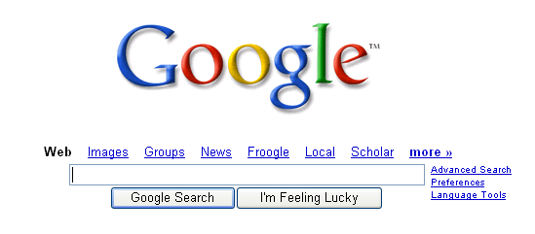
Resource-bounded Information Extraction
_x0019__x0019__x0019_
?
?
?
?
?
?
?
?
?
?
?
Database with only a few missing records or missing fields
Some Documents

Slide 5

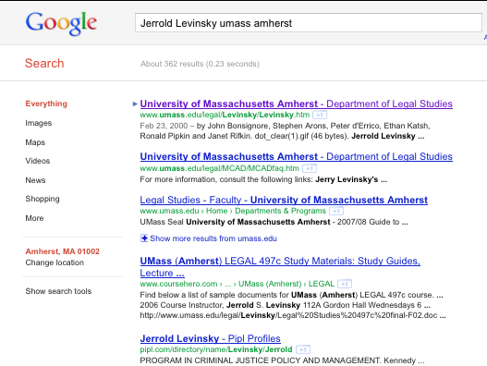
Resource-bounded Information Extraction
UMass Amherst Faculty Database
Faculty Name | Email | Job Title | Dept Name
Andrew McCallum | ? | ? | ?
Jerrold Levinsky | ? | ? | ?
Edward Voigtman | ? | ? | ?
Robert Paynter | ? | ? | ?
Extract Action
Query Action
Download Action

Slide 6
Why is this problem difficult?
UMass Amherst Faculty Database
Faculty Name | Email | Job Title | Dept Name
Andrew McCallum | ? | ? | ?
Jerrold Levinsky | ? | ? | ?
Edward Voigtman | ? | ? | ?
Robert Paynter | ? | ? | ?
Q01 | Name
Q02 | Name + Univ
Q03 | Name + Univ + Curriculum Vitae
Q04 | Name + Univ + Resume
Q05 | Name + Univ + Profile
Q06 | Name + Univ + Bio
Q07 | Name + Curriculum Vitae
Q08 | Name + Resume
Q09 | Name + Profile
Q10 | Name + Bio
Q11 | Name in quotes + Univ
Q12 | Name with middle name + Univ
Q13 | Name + HomePage
Q14 | Name + Contact Name In Univ
Q15 | Name in quotes In Univ
Q16 | Name with middle name In Univ
Q17 | Name + HomePage In Univ
Q18 | Name + Contact In Univ
Computational Explosion :
Many Instances
Many Queries Per Instance

Slide 7

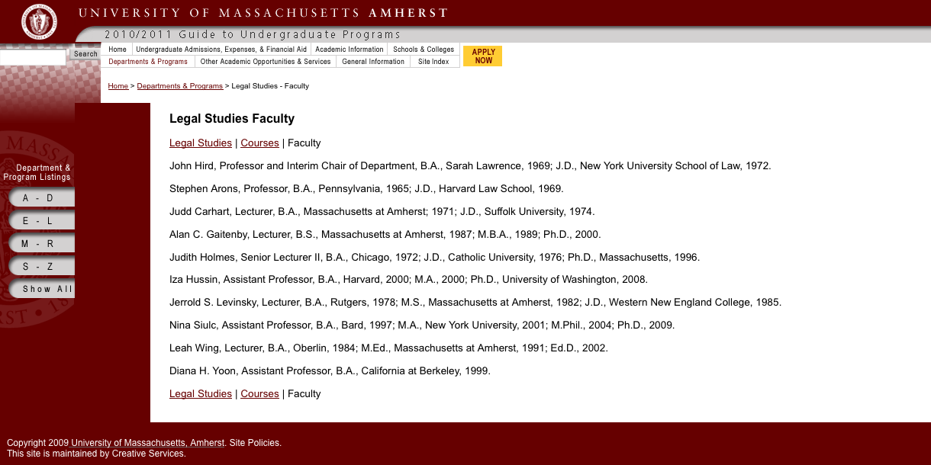
Why is this problem difficult?
Q01 | Name
Q02 | Name + Univ
Q03 | Name + Univ + Curriculum Vitae
Q04 | Name + Univ + Resume
Q05 | Name + Univ + Profile
Q06 | Name + Univ + Bio
Q07 | Name + Curriculum Vitae
Q08 | Name + Resume
Q09 | Name + Profile
Q10 | Name + Bio
Q11 | Name in quotes + Univ
Q12 | Name with middle name + Univ
Q13 | Name + HomePage
Q14 | Name + Contact Name In Univ
Q15 | Name in quotes In Univ
Q16 | Name with middle name In Univ
Q17 | Name + HomePage In Univ
Q18 | Name + Contact In Univ
Many
Search
Results
Notes:
Before we know, the number of possible actions explode!

Slide 8
Markov Decision Process
We need to select ‘Best’ action at each point of time, given the state of the database, and what we have seen so far, so as to acquire most information under a limited action budget.
Notes:
we can formalize RBIE as a MDP

Slide 9
Markov Decision Process Formulation
State
  state of the database at time, t
  list of intermediate URL results
  list of intermediate page results
MDP,
  initial state
  discount factor
  state transition probability distribution
  reward function
Notes:
T is the probability that action a in state S at time t will lead to state S′ at time t+1,

Slide 10
Resource-bounded Information Extraction (RBIE) for the Web
Assume Input:
  Database DB with missing entries, E_{i}
  Value Function,
  An Extraction Model, M_{e}
  Time budget, b
For t = 0; t<= b; t++
  Select next best action,
  Perform
Notes:
Animate this slide

Slide 11
RBIE as MDP : Challenges
Very large state space
The download and extract actions are dynamically generated => Not a fixed state space
Difficult to learn the state transition probability
Difficult to learn the value function accurately
Need to approximate it, using features of the states and actions from training data
Designing the right reward function

Slide 12
Learning Value Function : SampleRank (Wick, et. al, NIPS’09)
Online, error driven learning algorithm
We assume the following functional form of the value function:
  Where, are model parameters and are features.
Starting with initial state, consider all available actions, and sample from the resulting states
Samples are ‘in error’ if ranked differently by the value function learned so far, and the reward function
When this happens, update parameters using perceptron update rule

Slide 13
Learning Value Function : Temporal Difference Q-Learning
We need to model delayed reward
Since it is difficult to learn the state transition model, we use temporal difference, or TD Q-learning
Since the state space is too large, we use function approximation.
The Q-function can be represented as:
    Where,
    Contd…

Slide 14
Learning Value Function : Temporal Difference Q-Learning
We use the following equation for updating the parameters:
  Where,
We use approach to explore the state space and control random exploration with time.
We design a custom reward function, R(S) as a weighted sum of correct, incorrect and total number of filled values in the database, along with properties of the intermediate results.

Slide 15
Features for Learning Value Function
Type of Features
Type of the corresponding query
Hit value in the search result
URL is from UMass
Webpage is HTML
Title contains keywords
Title contains faculty name
Appropriate Size
Bad request code found

Slide 16
Building the Extraction Model
UMass Amherst Faculty Database
Faculty Name | Email | Job Title | Dept Name
Andrew McCallum | ? | ? | ?
Jerrold Levinsky | ? | ? | ?
Edward Voigtman | ? | ? | ?
Robert Paynter | ? | ? | ?
Current Value | Instructor
Confidence | 0.8
Candidates
Candidate | Value | Label | Mentions/Features
Candidate1 | Instructor | true | instructor, DomainNameFromUMass = 1
Candidate2 | Lecturer | true | Lecturer, LastNameNextToTitle= 1
Candidate3 | Professor | false | professor, LastNameWithinThreshold20=1
True Values :
Instructor,
Lecturer
Notes:
One more missing piece of the puzzle is the Extraction Model..Here I show a simple method..which can be replaced by more sophisticated approaches… For Each ‘Entry’ in the table, we maintain a list of candidates,

Slide 17
Candidate “Mentions” for Job-title
Candidates
Instructor

Slide 18
Candidate “Mentions” for Job-title
Candidates
Instructor
Interim Chair
Professor
Lecturer
Senior Lecturer II
Assistant Professor
Notes:
Make animation showing lexical matches. Which also have features. We merge features across all mentions for a candidate

Slide 19
Building the Extraction Model
Use lexicons and regular expressions to find matches in web pages
Features of “mentions” for each candidate are merged
Features of the candidates, and true labels used to learn a Maximum Entropy classification model:

Slide 20
Features for Extraction Models
Features for Email Extractor | Features for Jobs Title / Dept Extractor
Email domain is from UMass | Too many matches found on page
Web page domain name from UMass | Web page domain name from UMass
Email host, web page URL host match | Web page URL contains faculty name
Match between faculty name and email username | Position of match on the document
Similarity between faculty name and email username | Keywords precede match
Relative position of faculty name and match | Relative position of faculty name and match

Slide 21
Datasets and Evaluation Metrics
Dataset | #Faculty | #Queries | #Docs | Total Actions
Training | 70 | 1400 | 13686 | 28772
Testing | 30 | 600 | 6065 | 12730
Total | 100 | 2000 | 19751 | 41502
No. of Correctly Filled Entries in the Database
Precision =
No. of Filled Entries in the Database
No. of Correctly Filled Entries in the Database
Recall =
No. of Test Entries in the Database
No. of Correct Candidates Extracted
Extraction Recall =
No. of Filled Entries in the Database
2 * Precision * Recall
F1 =
(Precision + Recall)

Slide 22
Baselines
Baselines
  Random
  Straw-man :
    First query in the list for each test instance is issued
    First hit from the search result for each test instance is downloaded and processed for extraction
    Subsequent hits from search results are downloaded and processed
    Subsequent queries are issued, followed by their corresponding download and extract actions
    Almost like an “Optimal” policy

Slide 23
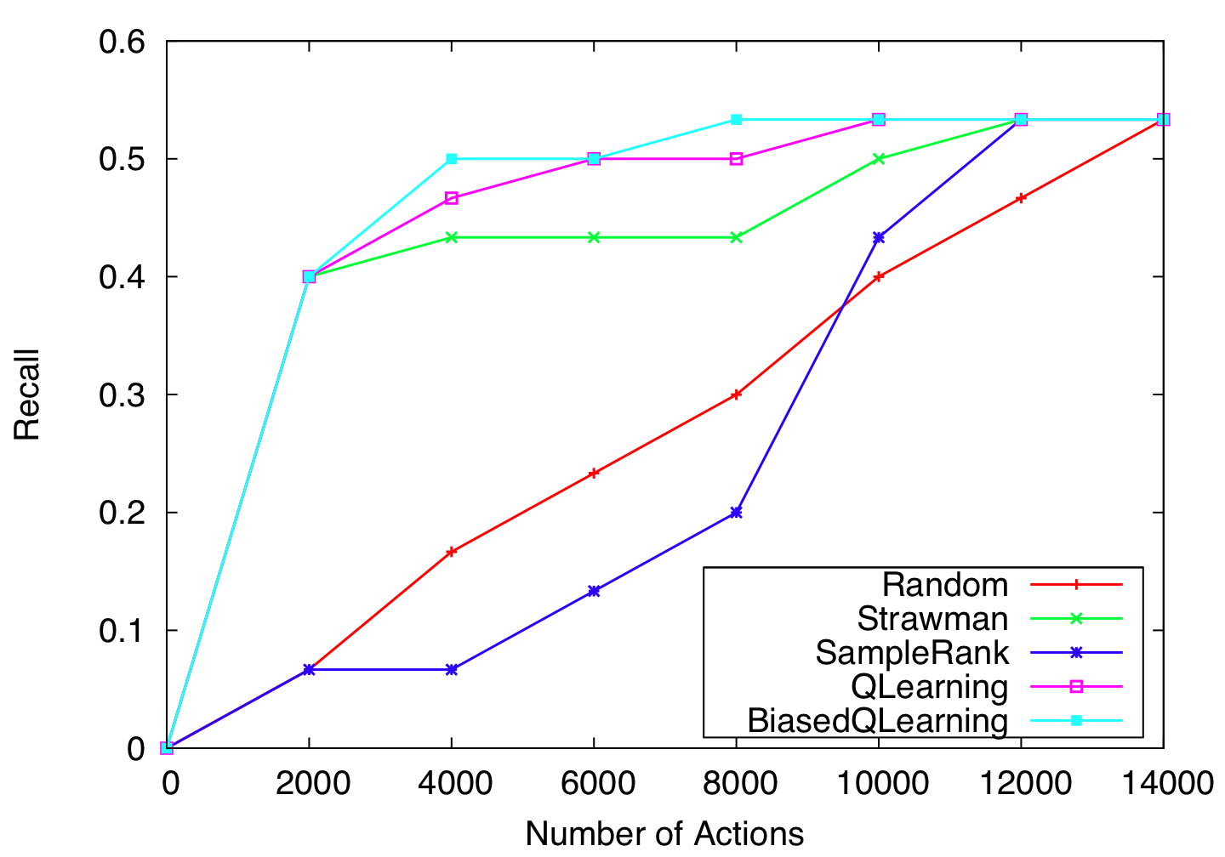
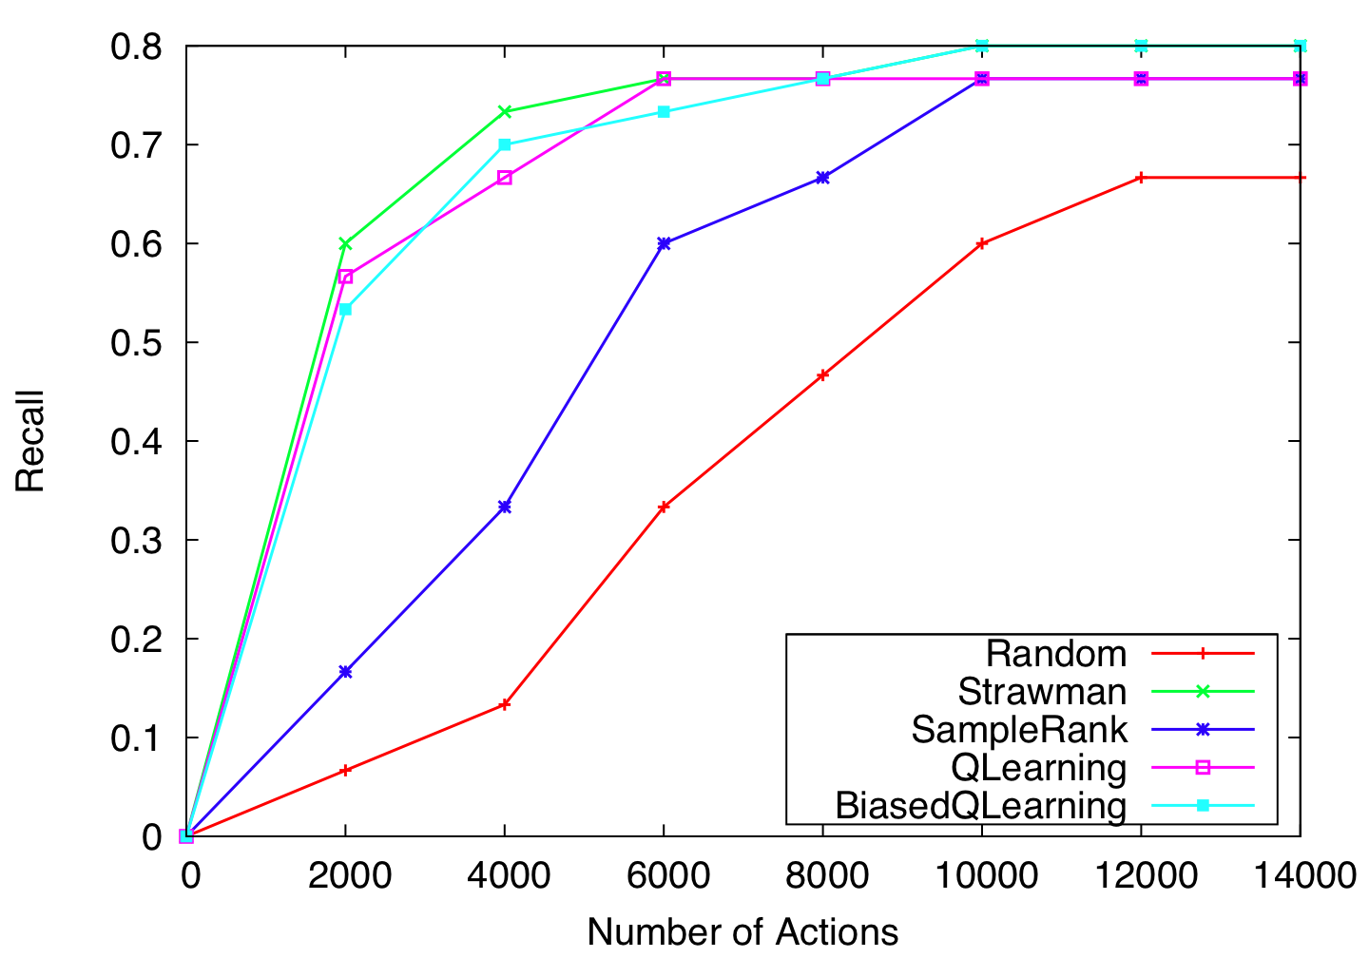
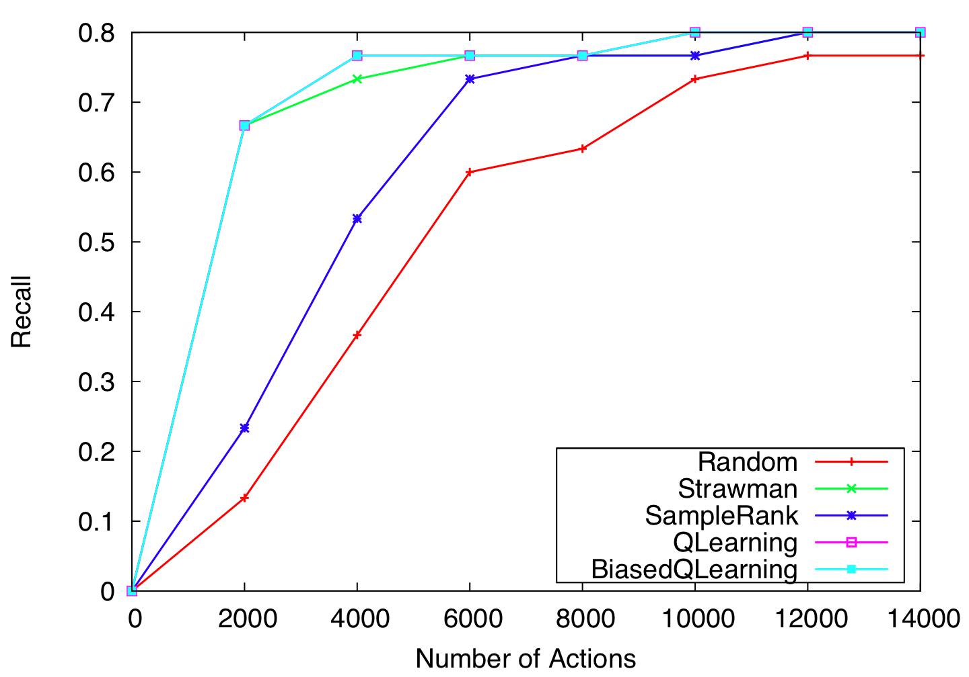
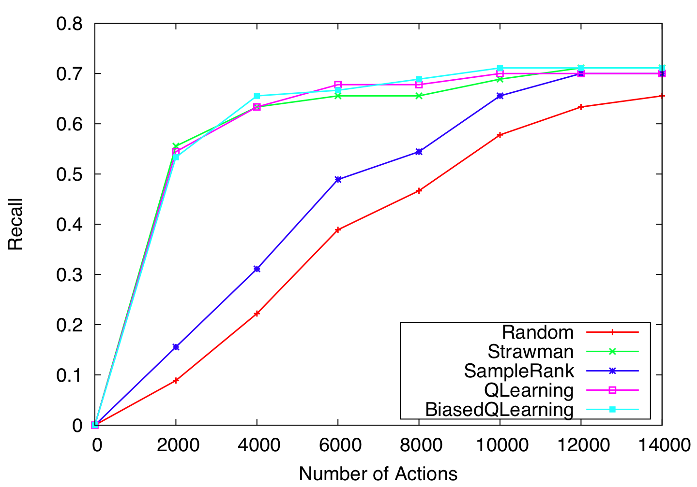
Results (Using Oracle)
Email
Job Title
Department Name
Total Entries

Slide 24
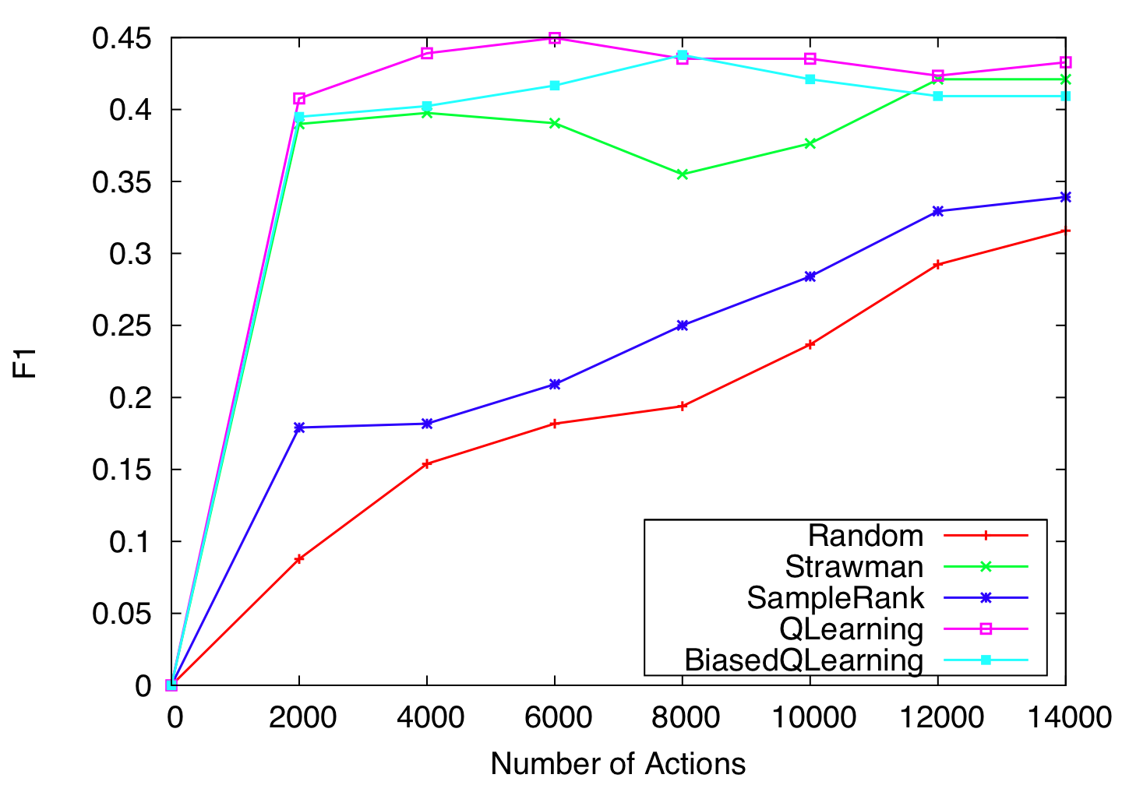
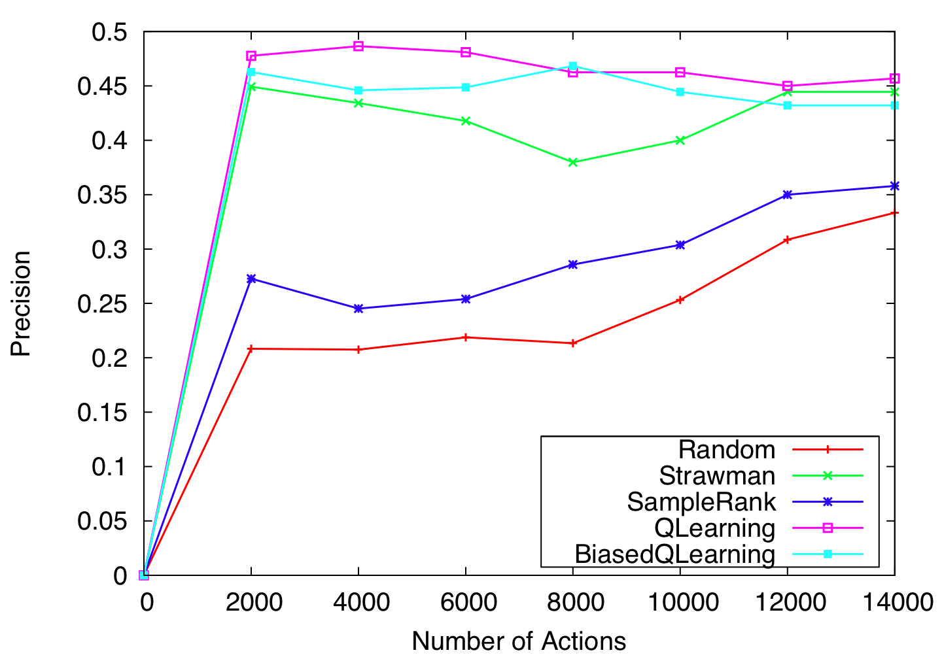
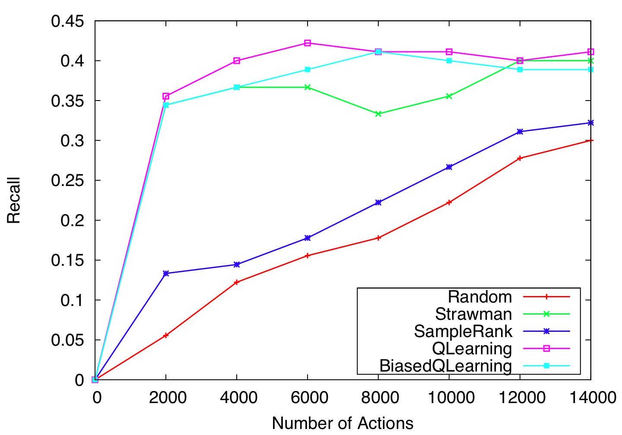
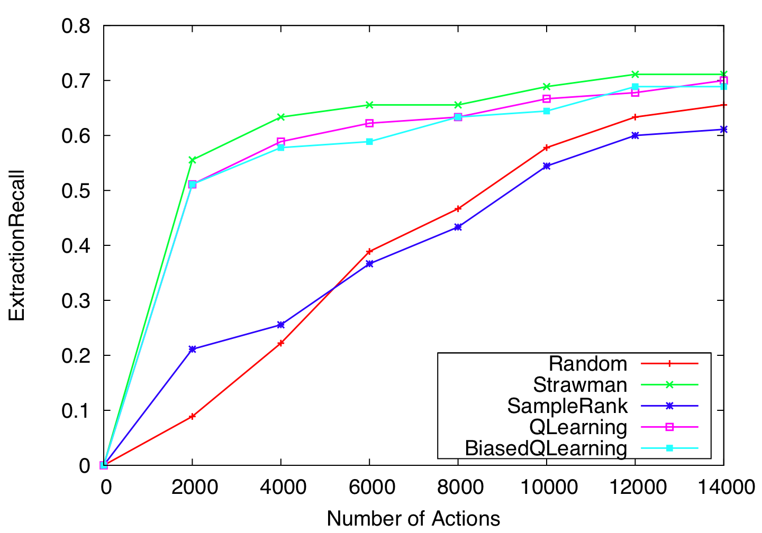
Results (Total Number of Entries)
Q-Learning achieves 88.8% of the final F1,
by only using 8.6% of the total actions

Slide 25
Conclusions
Markov Decision Process Formulation for Resource-bounded Information Extraction for the Web
Q-Learning performs better than SampleRank due to its ability to model delayed reward
Also presented novel extraction technique that can scale well for large scale, information gathering tasks
We really want to learn where to start looking for information. What order to process it
Opens up many new interesting research directions
Notes:
RBIE is a very important problem to study and deserves more attention

Slide 26
Future Work
MDP formulation opens up many possibilities for improvement
  Explore other Reinforcement Learning techniques, such as SARSA
  Use nested actions to improve SampleRank
General framework can be extended
  Use more sophisticated extraction techniques
  Use other information gathering actions
Learning based approach can be applied in many resource-conscious, real-world domains.

Slide 27
Questions?

Slide 28
Extra Slides

Slide 29
Extraction Model Performance
Measure | Email | Job Title | Department
Accuracy | 97.9 | 92.7 | 95.8
Yes Precision | 100.0 | 42.8 | 38.7
Yes Recall | 43.7 | 23.0 | 44.4
Yes F1 | 60.8 | 30.0 | 41.3
No Precision | 96.8 | 94.6 | 98.0
No Recall | 100.0 | 97.7 | 97.5
No F1 | 98.4 | 96.1 | 97.8
Notes:
Low-recall is fine, due to redundancy

Slide 30
Learning Value Function : SampleRank (Wick, et. al, NIPS’09)
We say the ranking of samples is ‘in error’ if:
  Where
When this condition is true, we update the parameters using perceptron update:

Slide 31
RBIE Algorithm (Animation showing how actions are added and performed)
Q01
Q02
Q03
Q04
Q05
Q06
Q07
Q02
Q03
Q04
Q05
Q06
Q07
Q01 H1
Q01 H2
Q01 H3
Q01 H4
Q01 H5
Q06
Q05 H1
Q04 H10
Q05
H2
Q05 H3
Q07
Q05 H1
Q04 H10
Q05
H2
Q05 H3
Q07
Q06 H1
Q06 H2
Q06 H3
Q06 H4
Q06 H5
Query Action
Q04 H10
Q05
H2
Q05 H3
Q07
Q06 H1
Q06 H2
Q06 H3
Q06 H4
Q06 H5
Q05 H1
Download Action
Q05 H1
Q04 H10
Q05
H2
Q05 H3
Q07
Q06 H1
Q06 H2
Q06 H3
Q06 H4
Q06 H5
Extract Action
Q04 H10
Q05
H2
Q05 H3
Q07
Q06 H1
Q06 H2
Q06 H3
Q06 H4
Q06 H5
Notes:
Finish Animation. Use the extraction model Me to fill entries in the database

