Slide 1
Facility Layout 5
Computerized Block Layout Algorithms:
BLOCPLAN, MULTIPLE

Slide 2
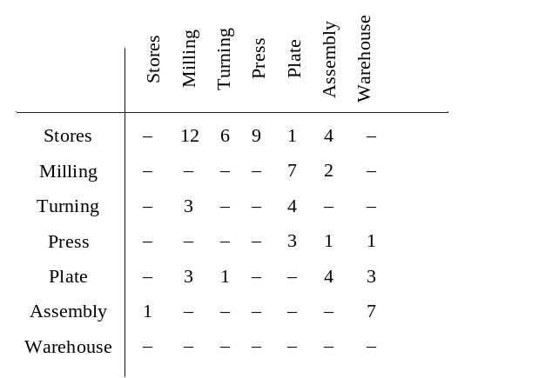
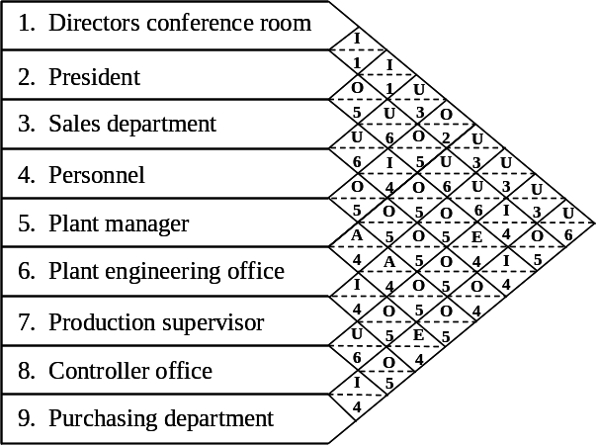
BLOCPLAN (1)
Relationship chart or From-to chart as input data
Can be used as a
  construction type or
  improvement type algorithm (may not be possible to capture the exact layout)
The layout cost can be determined by:
  distance-based objective, or
  adjacency-based objective
Continuous representation

Slide 3
BLOCPLAN (2)
Three bands to which each of the departments are assigned
18 potential department addresses – up to one department per address
Departments are rectangular in shape as all are in a “band”
The building is also rectangular in shape
A
B
C
D
E-L
E-R
F
3 bands
G
H
I

Slide 4
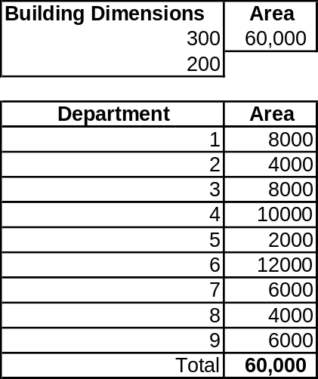
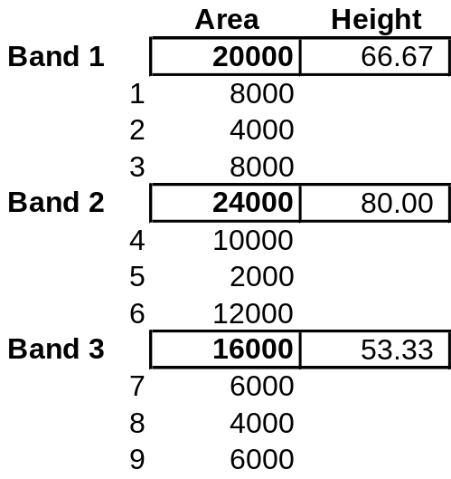
BLOCPLAN (3)
Assign all the departments to the layout
Calculate the width of the band by adding the area of the departments and dividing it by the building length
Calculate the length of the individual departments by dividing the area of the departments by the width of the band
300
1
2
3
66.67
200
4
5
6
80
7
8
9
53.33

Slide 5
Blocplan (4)
Consider all the possible two way exchanges of the departments.
Choose the one with the most improvement in the objective function (A-based or D-based)
1
2
3
4
5
6
7
8
9
What should happen to the layout and the bands every time an exchange is tried?

Slide 6
BLOCPLAN (cont.)
BLOCPLAN implicitly assumes all c_{ij}’s are equal to 1.0
Input data given in the form of a relationship chart, BLOCPLAN converts it using a closeness rating of
A=10, E=5, I=2, O=1, U=0, X= -10
Adjacency score is :
  Not affected by U relationships
  Adversely affected by X relationships
Even if a from-to chart is given BLOCPLAN computes the adjacency score on the basis of the relationship chart.
Provides REL-DIST score based on numerical closeness ratings and distance.

Slide 7

RELDIST/R-Score
Distance based score
RELDIST =
Attempt to normalize with lower bound (LB) and upper bound (UB)
R-Score = 1-[(RELDIST-LB)/(UB-LB)]
Order all rewards and all distances with this layout
LB = largest reward X shortest distance+ ….. Smallest reward X longest distance
UB= largest reward X longest distance + …. Smallest reward X shortest distance
Use RELDIST to compare layouts and not R-Score

Slide 8
BLOCPLAN Limitations
3 tiers may be limiting
Due to randomness, can run multiple times
Can lead to poor department shapes (long and skinny departments)
Cannot exactly represent obstacles and fixed departments
Number of departments per tier will remain the same as in the initial layout
1
2
3
4
5
6
7
8
9

Slide 9
MULTIPLE
MULTI-floor Plant Layout Evaluation (MULTIPLE)
  Improvement type
  From-To chart as input
  Distance based objective function (rectilinear distances between centroids).
  Improvements: Two way exchanges and steepest descent

Slide 10
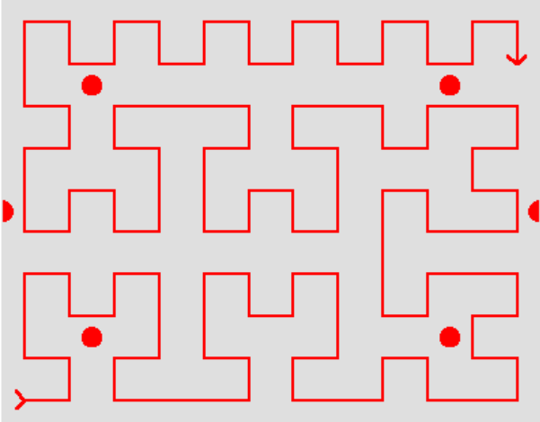
MULTIPLE (cont.)
MULTIPLE can exchange departments that are not adjacent to each other.
The layout is divided into grids
Space Filling Curves are generated so that the curve touches each grid in the layout.

Slide 11
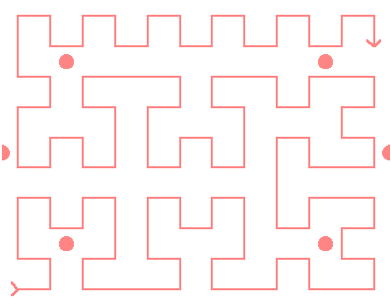
MULTIPLE (cont.)
Order = 1, 2, 3
A layout vector (DEO) is specified and the departments are added to the layout using the layout vector.
To exchange departments, the positions of the departments in the layout vector are exchanged.
Order = 2, 3, 1
Depts: 1 = 12 grids
2 = 4 grids
3 = 6 grids

Slide 12
MULTIPLE vs. CRAFT
Multi-floor capabilities
Accurate cost savings
Exchange any two departments
Considers exchanges across floors

Slide 13
MULTIPLE review
The result of running MULTIPLE is a 2-opt solution with respect to the initial SFC.
  True or False
The advantage(s) of MULTIPLE over CRAFT is(are):
  Exchange any two departments
  Exchanges departments that are unequal in size and non-adjacent
  Checks the cost of all exchanges before making the selection
  All of the above
  (a) and (b)

Slide 14
Department Shapes
Department shape is an important consideration in finalizing a block layout
Measures used to detect irregular shapes
  Smallest Enclosing Rectangle (SER)
  SER long side/ SER short side
  Normalized Shape Factor (also called Omega)
  Ideal shape factor = Shape factor when the shape is a square with same area
  Normalized Shape Factor (Ω)
  = Shape factor/ Ideal shape factor
  = Perimeter/ Perimeter for a square with same area
Generally not recommended to use shape factor as a constraint

Slide 15
Other Methods and Tools
MIP:
  formulate the facility layout problem as a mixed integer programming (MIP) problem by assuming that all departments are rectangular.
SABLE:
  Like MULTIPLE, but instead of steepest descent pair-wise exchanges, it uses simulated annealing to search for exchanges.
  Less likely to get “stuck” in a local optima

Slide 16
Other Methods and Tools (Cont.)
Simulated Annealing (SA) and Genetic Algorithms (GA)
  All methods/tools based on steepest descent approach (forces an algorithm to terminate the search at the first two-opt or three-opt solution it encounters), result in a solution which is likely locally optimal.
  Steepest descent algorithms are highly dependent on the initial solution (path dependent).
  SA-based procedure may accept non-improving solutions several times during the search in order to “push” the algorithm out of a solution which may be only locally optimal.
  GA is originated from the “survival of the fittest” (SOF) principle, which works with a family of solutions to obtain the next generation of solutions (good ones propagate in multiple generations)

