Slide 1
PERL DBI module
Data Base Interface

Slide 2
SQL Basics
Data types.
  int (size)
  char (size)
  varchar(size)
  date
  text
  mediumtext
  longtext
  enum(value1,value2,value3,...)

Slide 3
SQL Basics
Basic SQL statements.
  create table
  select
  insert
  update

Slide 4
SQL Basics
Syntax of create table statement.
Create table <table_name> (<col1> <type> [auto_increment] [not null], <col2>…
,primary key (<col_name>));
Exercise:
create a table “user_details” with the following fields
1) id - number (primary key)
2)userid varchar
3)password varchar

Slide 5
SQL Basics
Syntax of insert statement.
insert into <table_name> [(<column_names)] values (<set of values>);
Exercise:
use the table “user_details” to
1) insert username and passwords into it.

Slide 6
SQL Basics
Syntax of select statement.
select <column_names> from <table_name> [where where_definitions] [order by <col_name> [ASC|DESC] ];
Exercise:
use the table “user_details” to
1) select users whose user_id is > 2
2)select all users in the alphabetic order.
3) select all the rows with all the columns

Slide 7
SQL Basics
Syntax of update statement.
update <table_name> set <col1>=<val1>, col2=<val2> … [where where_definitions];
Exercise:
use the table “user_details” to
1) update the password for the first user
2) update the username and password for
the 3rd user.

Slide 8
What is DBI?
DBI = DataBase Interface
DBI is database-independent
DBI allows you to write
code that interacts with databases
independent of the underlying database
A DBI program will work with little, or no,
modification on Oracle, Informix, MySQL and
so on...

Slide 9
What are DBDs?
DBD = DataBase Drivers
Drivers are used by DBI to perform the
actual database work.
Drivers are database dependent
Drivers exist for most popular databases
including Oracle,Informix,MySQL etc.

Slide 10
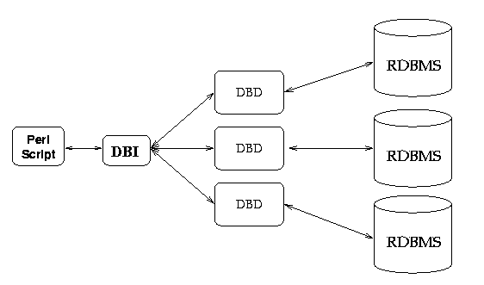
DBI Architecture

Slide 11
Database Handles
Database handle encapsulate a single
connection to a database.
Database handles are created via the
DBI->connect($url, $user, $pass) method.
$url - DBI:database_type:database_location:key=value;...
$dbh = DBI->connect (“DBI:mysql:testdb”, “test”, “test”);

Slide 12
Database Handles
Once all the work is done the database handle can be freed
To close a connection to the database we make a call to disconnect() .
  $dbh->disconnect();

Slide 13
Statement Handles
Perform Simple queries
Statement handle encapsulate a statement
to be issued to the database.
Statement handles are created via a
database handle like
$sth = $dbh->prepare(“select * from foo”);

Slide 14
Statement Handles
Retrieving data is a four step process
  Prepare the statement.
  Execute the statement.
  Fetch the data.
  Finish the statement.

Slide 15
Statement Handles
Retrieving data (code snippet)
use DBI;
$dbh = DBI->connect (“DBI:mysql:testDB”, “test”, “test”);
$stmt = $dbh->prepare(“select id,name from test”);
$stmt->execute();
while (@rset =$stmt->fetchrow_array()) {
print (“Id:$rset[0]\t Name:$rset[1]\n”);
}
$stmt->finish();
$dbh->disconnect();

Slide 16
Statement Handles
Exercises
1) write a CGI script to list all the
users in the table “user_details”
2) implement the CGI script for login
password validation using the DB table
“user_details”.

Slide 17
Statement Handles
Additional functions to fetch result sets
fetchrow() If only one field is being queried
fetchrow_arrayref() returns a reference to the field list

Slide 18
Statement Handles
Updating data is a three step process
  Prepare the statement.
  Execute the statement.
  Finish the statement.

Slide 19
Statement Handles
Updating data (code snippet)
use DBI;
$dbh = DBI->connect (“DBI:mysql:testDB”, “test”, “test”);
$stmt = $dbh->prepare(“update test set name=‘foo’ where id=7”);
$stmt->execute();
$stmt->finish();
$dbh->disconnect();

Slide 20
Statement Handles
Exercises
1) write a CGI script update the password
for a given user in the “user_details” table
use the login CGI script to verify the same.

Slide 21
Bind Values
A value that can be bound to a place holder within the SQL statement.
Performance advantage: As statements doesn’t need to be prepared more than once.

Slide 22
Bind Values
use DBI;
$dbh = DBI->connect (“DBI:mysql:testDB”, “test”, “test”);
$stmt = $dbh->prepare(“select name from test where id=?”);
for ($i = 1; $i <10; $i ++) {
$stmt->bind_param(1, $i);
$stmt->execute();
while ($rset = stmt->fetchrow ()) {
print (“Name:$rset\n”);
}
}
$stmt->finish();
$dbh->disconnect();

