Slide 1
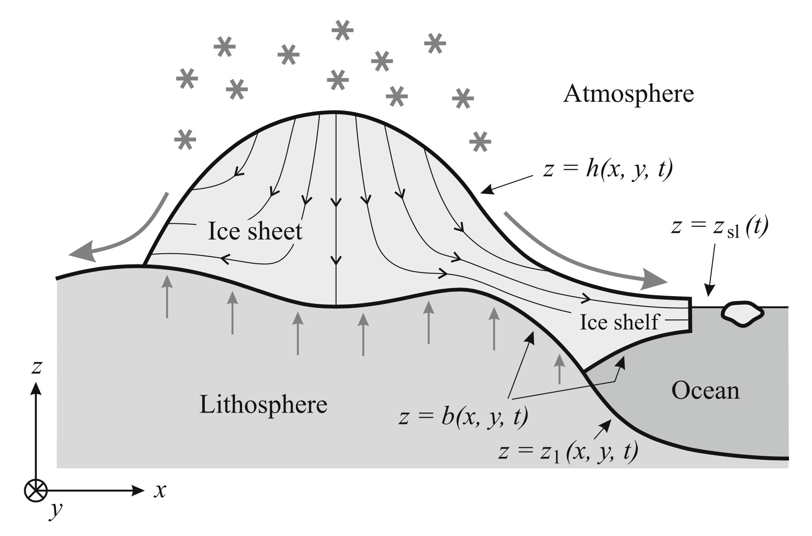
Greve and Blatter (2009)

