Slide 1


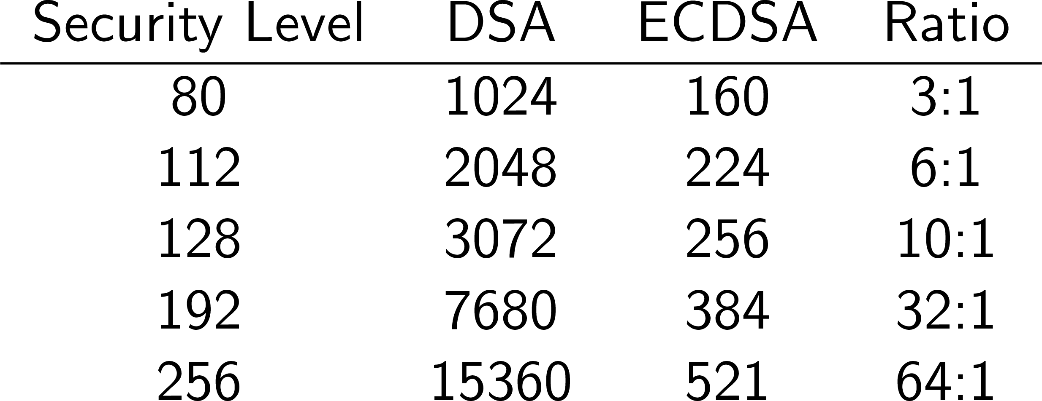
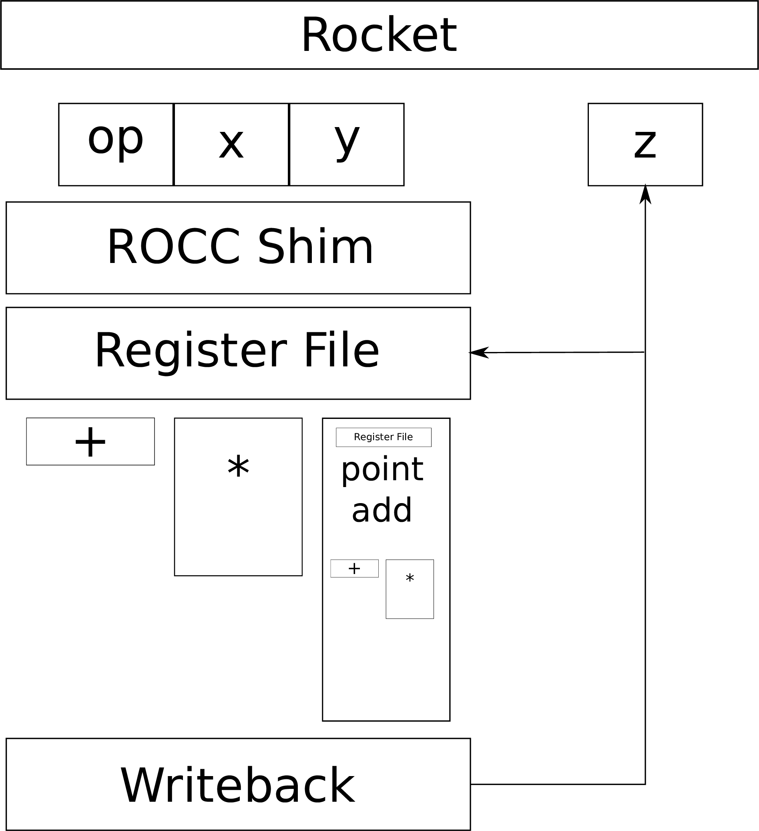
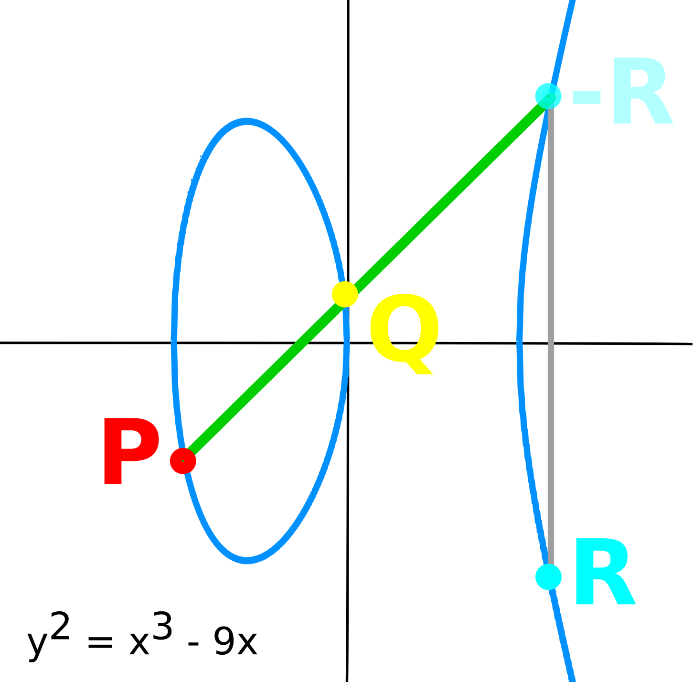
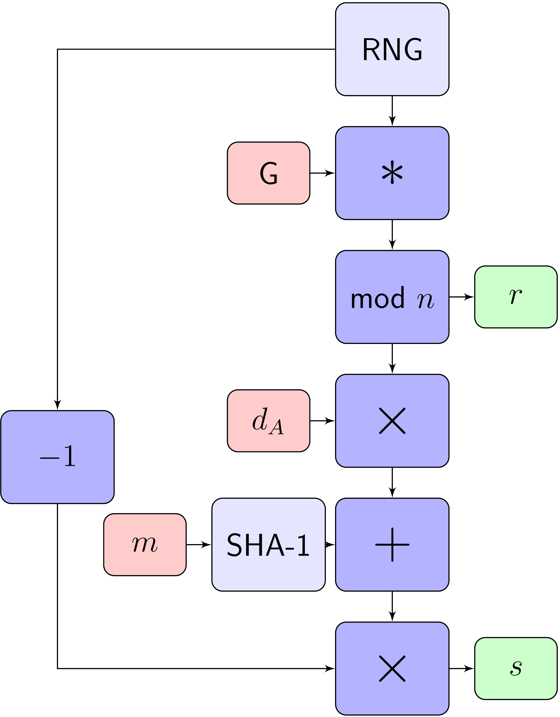
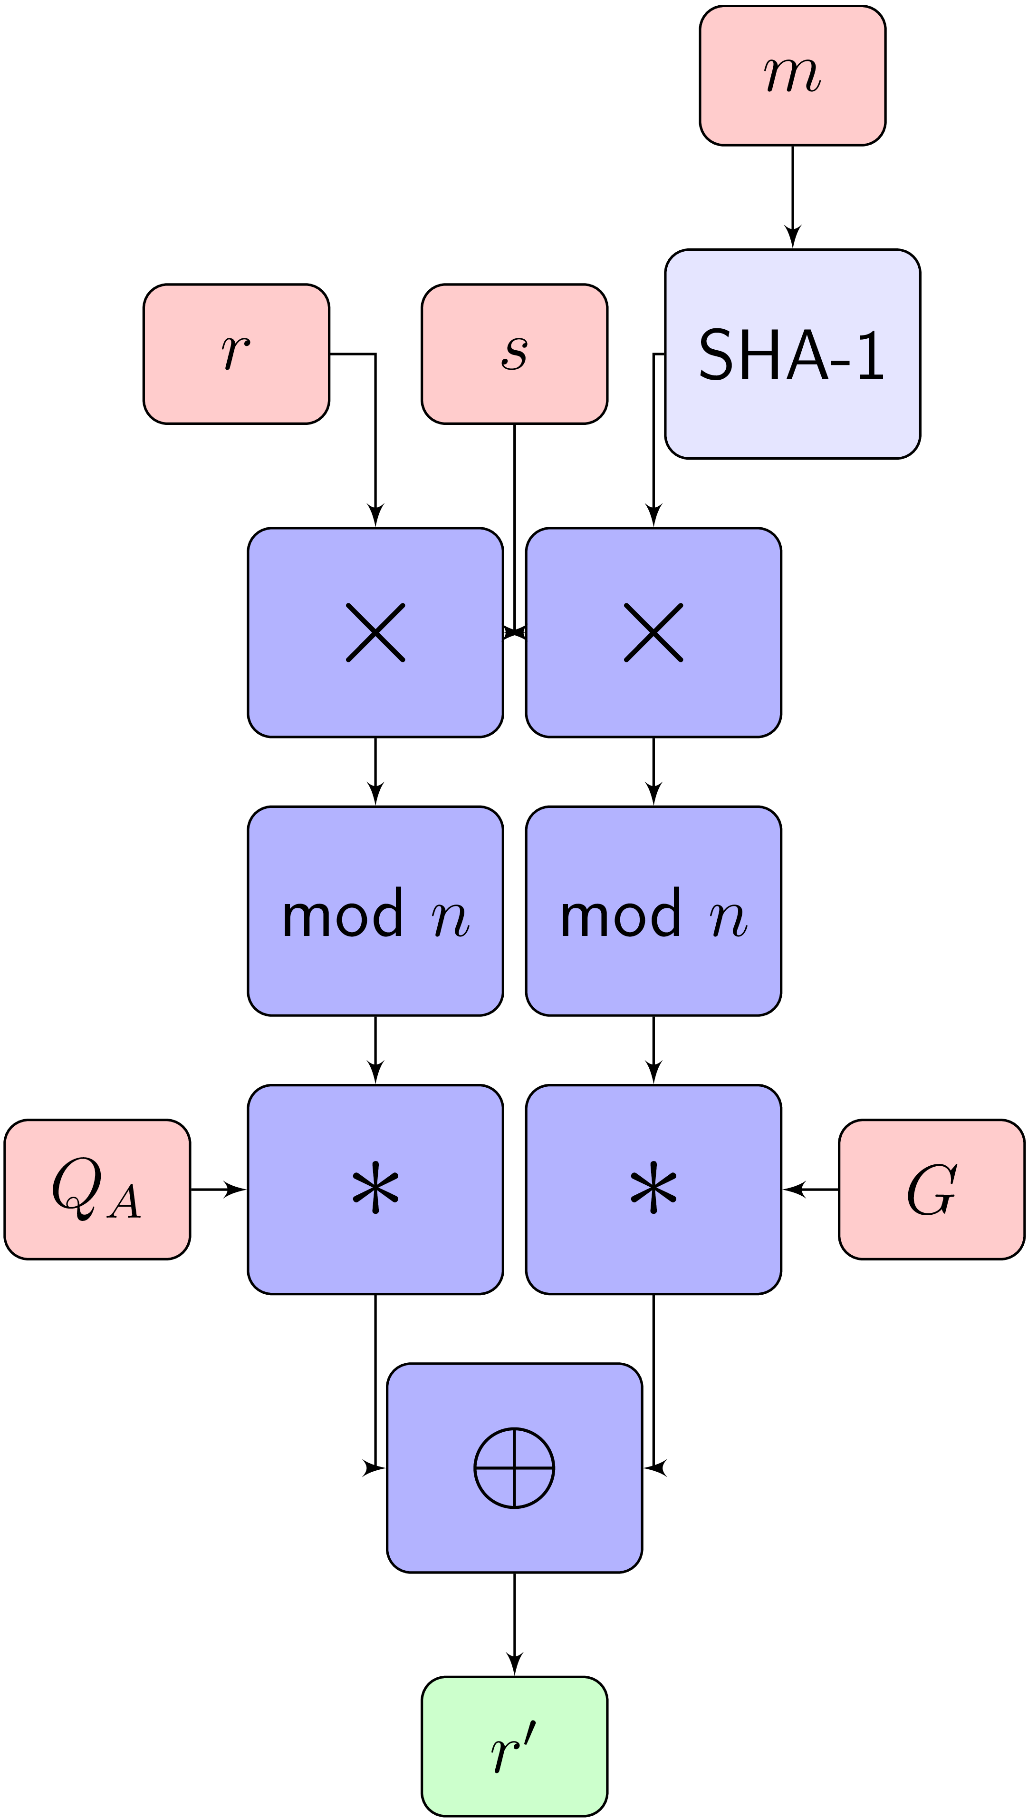
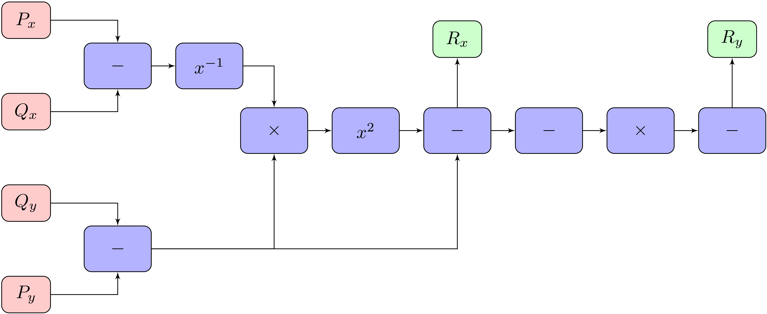
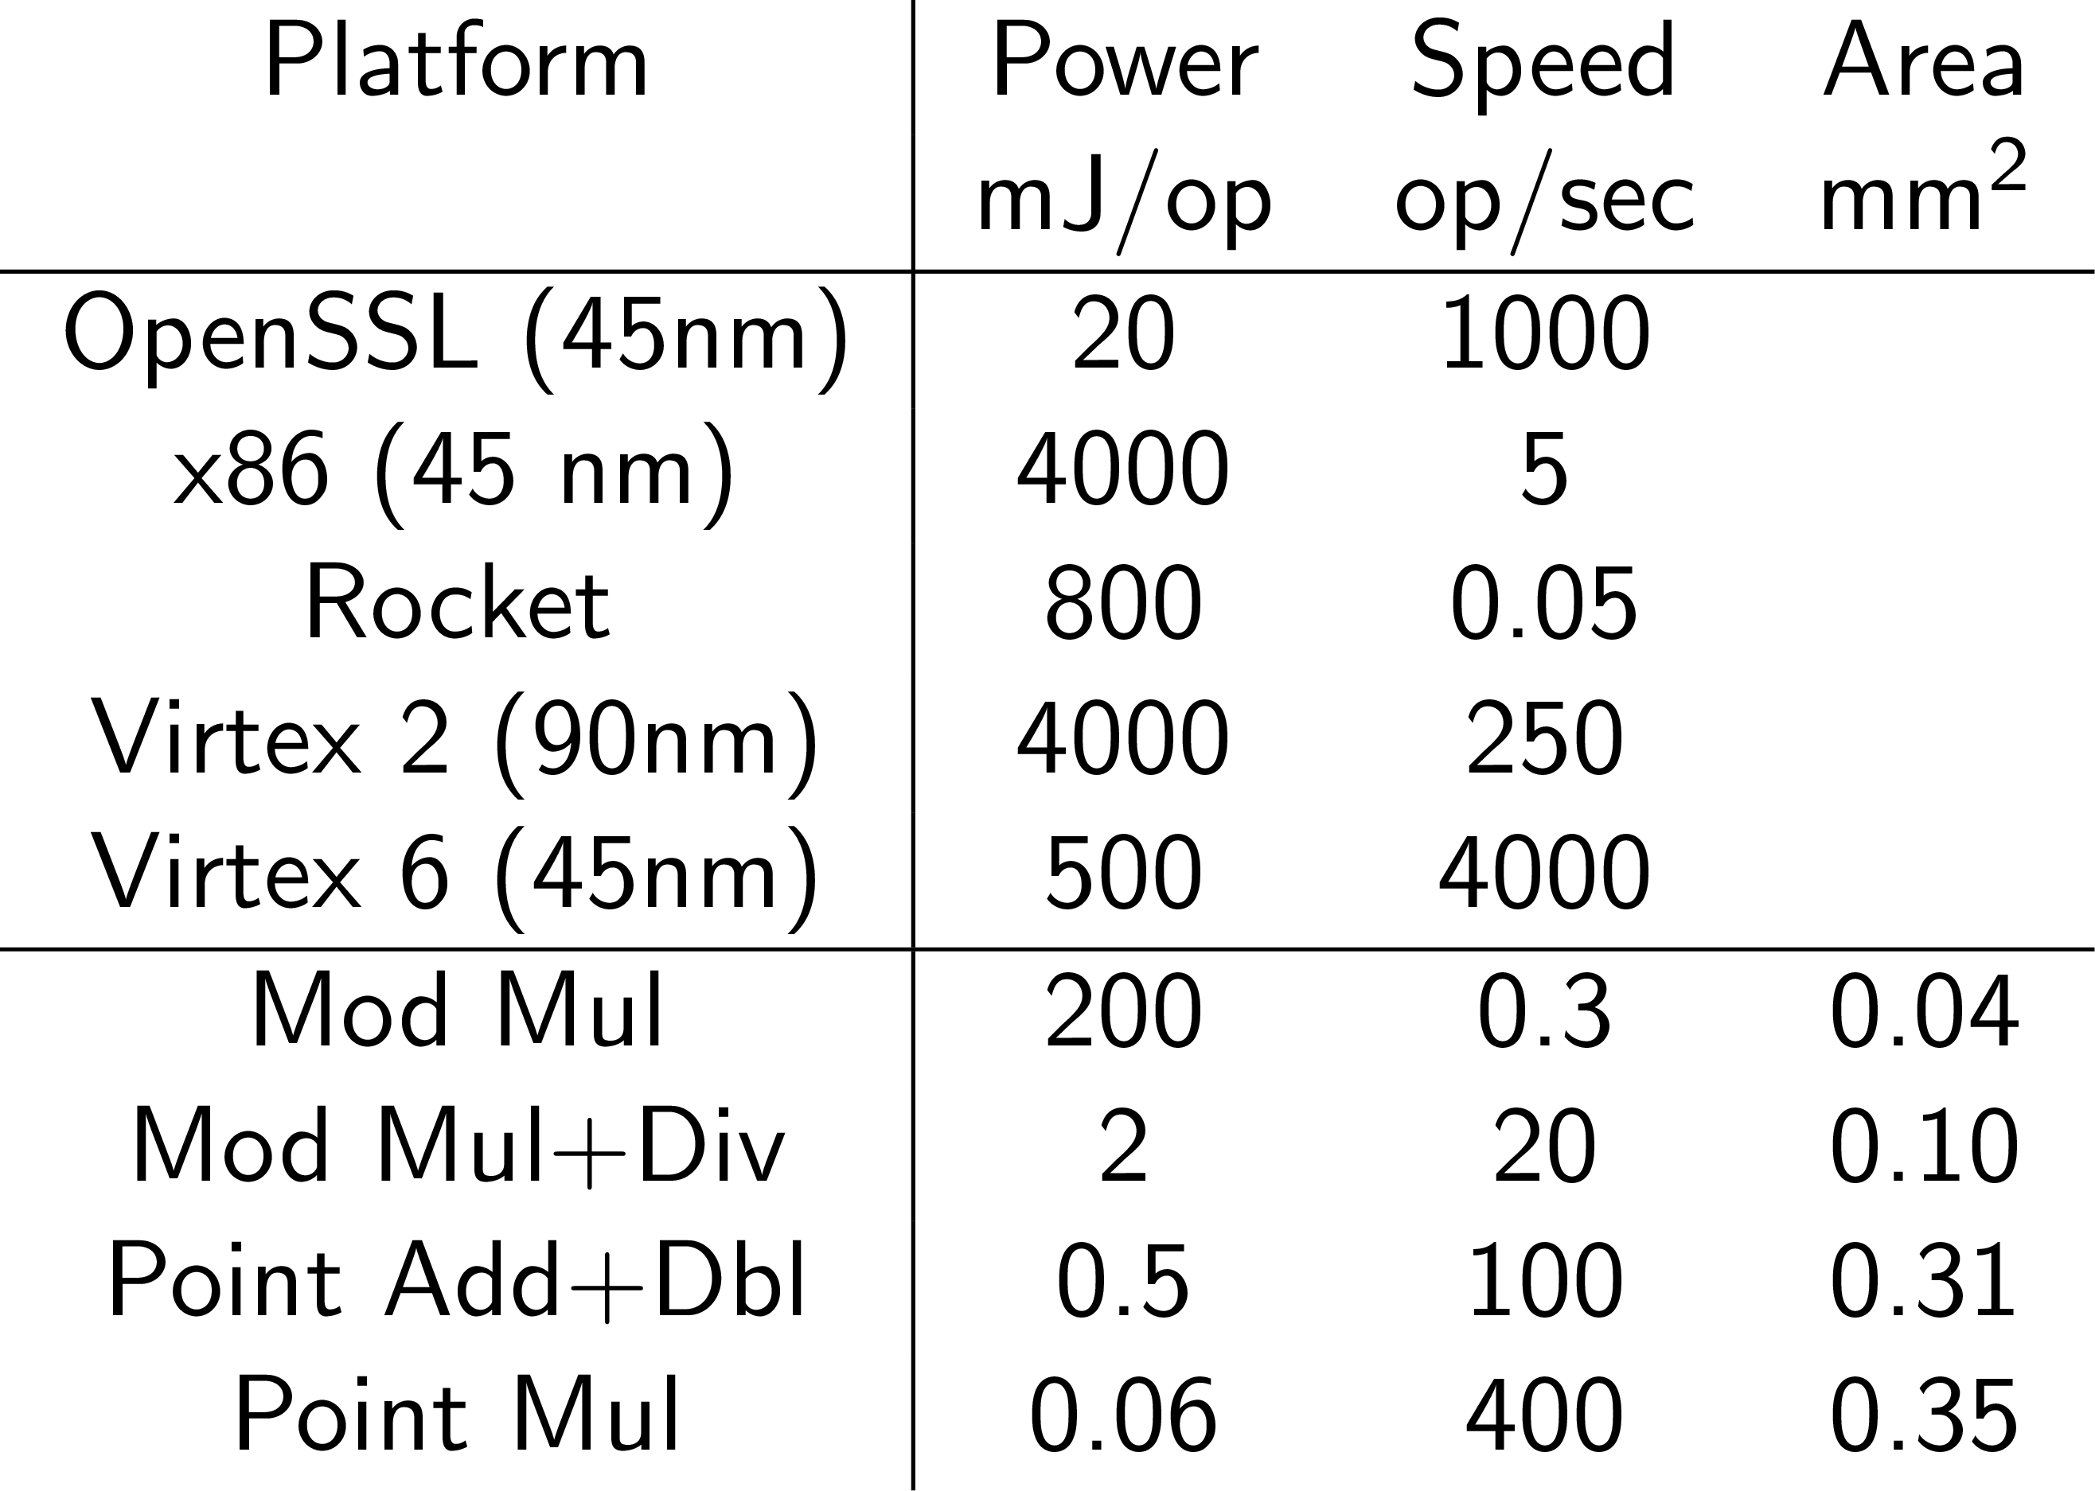
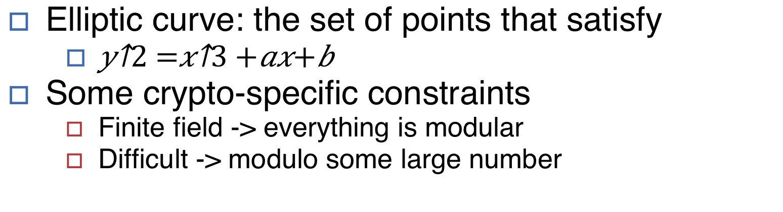
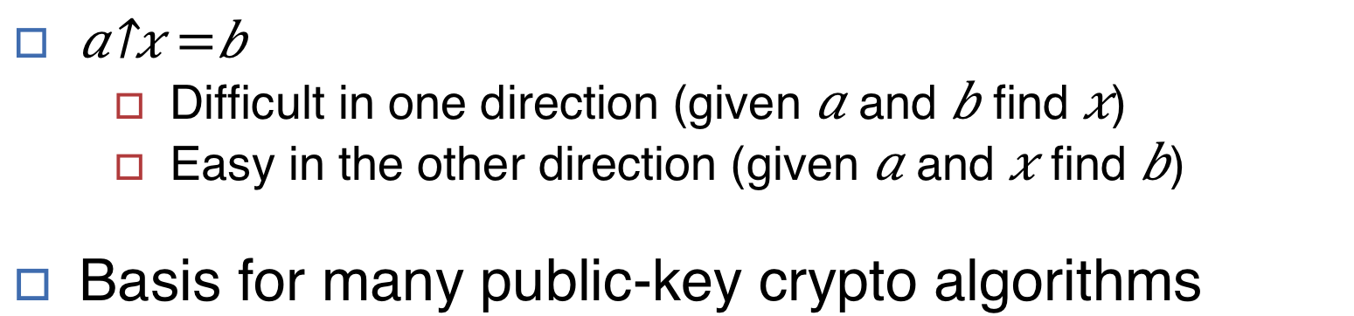
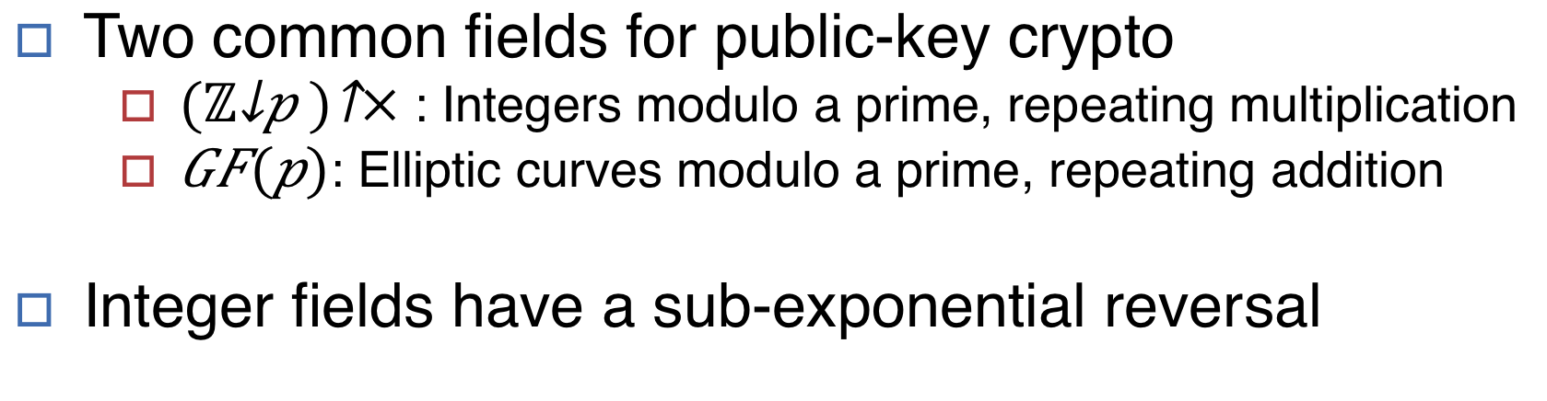
Elliptic Curve Accelerator
Kevin Linger, Palmer Dabbelt
Coprocessor for accelerating elliptic curve cryptography, primarily for embedded devices
Public-Key Cryptography
Why ECDSA?
HW/SW Co-tuning
Two keys, called a keypair
Public: the whole world can know this
Private: only the owner knows this
Four operations
Sign(Message, Private) → Signature
Verify(Message, Signature, Public) → Boolean
Encrypt(Message, Public) → Cyphertext
Decrypt(Cyphertext, Private) → Message
ECDSA is a widely-used signature algorithm
Supports Sign() and Verify()
Two common fields for public-key crypto
${{(ℤ}_{p})}^{×}$: Integers modulo a prime, repeating multiplication
$GF(p)$: Elliptic curves modulo a prime, repeating addition
Integer fields have a sub-exponential reversal
ECDSA consists of many operations
Each can be implemented in HW or SW
Which operations deserve die space?
Configurable C++ ECDSA code
Capable of running all in software
Operations can be selected for hardware
Generate matching C++ and RTL
Easy thanks to Chisel!
Smaller key sizes are great for embedded systems
Elliptic Curves
Accelerator Core
Elliptic curve: the set of points that satisfy
$y^{2}=x^{3}+ax+b$
Some crypto-specific constraints
Finite field -> everything is modular
Difficult -> modulo some large number
Table 1: Comparison of key sizes needed for elliptic curves vs integer fields
Full RTL in Chisel
Primetime for power numbers
Simulation for performance numbers
ECDSA
Figure 4: Block diagram of the coprocessor that connects of the rocket core
Results
Figure 1: Geometric representation of an elliptic curve and a point addition
Figure 2: ECDSA Signing (left) and Verification (right), crux of the operation is the point multiply, denoted with an asterisk
Discrete Logarithm
$a^{x}=b$
Difficult in one direction (given $a$ and $b$ find $x$)
Easy in the other direction (given $a$ and $x$ find $b$)
Basis for many public-key crypto algorithms
ECC equivalent is a point multiply
Figure 3: Point addition operation. When repeated becomes a multiply
Table 2: Results of various hardware configurations using 45 nm educational libraries
Notes:
Please put in notes here to explain poster so that someone else could summarize what your poster is about

