Slide 1
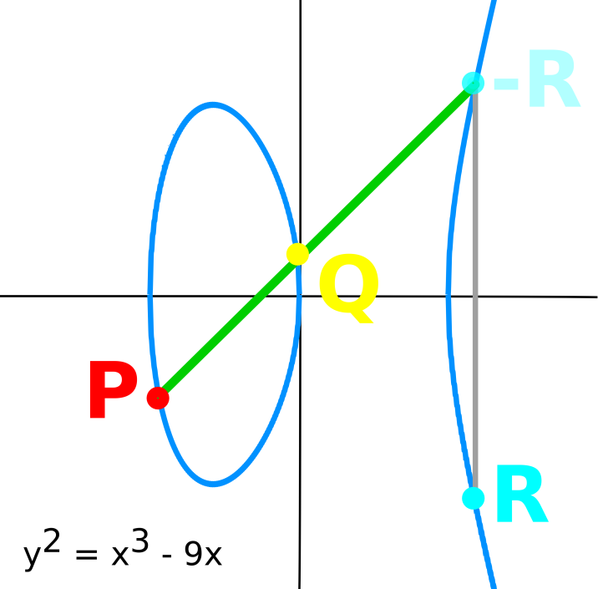


Elliptic Curve Accelerator
Elliptic Curve Cryptography
Public-key cryptosystem
DLP over elliptic curves
[specifically GF(p)]
HW/SW Co-tuning
Energy vs Area tradeoffs
Software Crypto Library
Implements ECDSA
Written in C++
Rocket Coprocessor
Accelerates ECDSA
Written in Chisel
Palmer Dabbelt
Kevin Linger
Notes:
Please put in notes here to explain poster so that someone else could summarize what your poster is about

